Slide 1
The PageRank Citation Ranking:
Bringing Order to the Web
Lawrence Page, Sergey Brin, Rajeev Motwani, Terry Winograd
November, 1999
Stanford University
Technical Report
Presented by Young-Seok Lim

Slide 2
Contents
Introduction
Related Work
Convergence Properties
Searching with PageRank, Personalized PageRank
Applications
Conclusion

Slide 3
Introduction
The World Wide Web
  Very large and extremely diverse
  Inexperienced users
  Pages engineered to manipulate search engine ranking functions
  Hypertext provides link structure
Web search engine Google

Slide 4
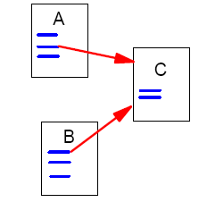
Related Work
Academic citation
  Quality Control
Link Structure of the Web
  Forward link, Back link

Slide 5
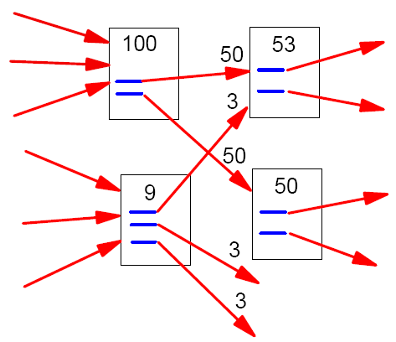
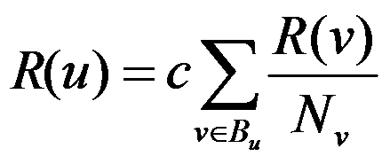
Related Work
Propagation of Ranking through Links
  A page has high rank if the sum of the ranks of its backlinks is high
  Page has many backlinks and page has a few highly ranked backlinks
Definition of PageRank
  r(P_{i}): the PageRank of a page P_{i}
  B_{pi}: the set of pages pointing into P_{i}
  |P_{j}|: the number of outlinks from page P_{j}

Slide 6
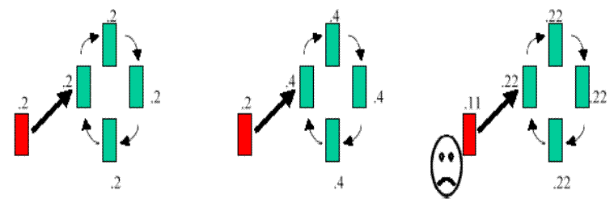
Related Work
Rank Sink
Problem: this loop will accumulate rank but never distribute any rank outside

Slide 7
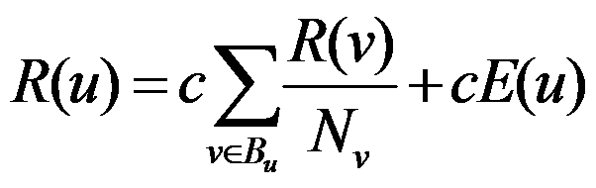
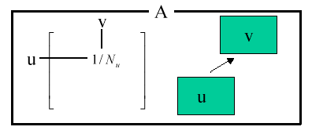
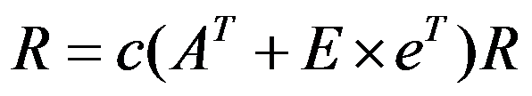
Related Work
Solution: Rank Source
  E(u) is some vector over the web pages that corresponds to a source of rank
Matrix Notaion
  R is the dominant eigenvector and c is the dominant eigenvalue of because c is maximized

Slide 8
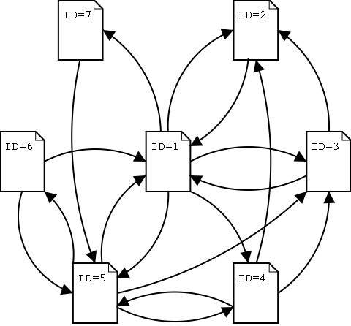
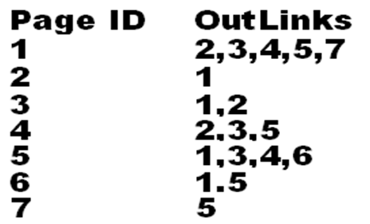
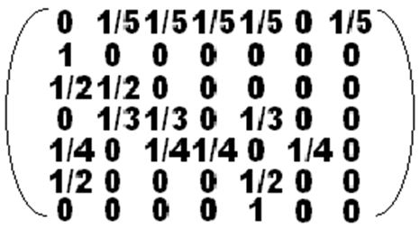
Related Work
A_{T}=

Slide 9
Related Work
Random Surfer Model
  Page Rank corresponds to the probability distribution of a random walk on the web graphs
  E(u) can be re-phrased as the random surfer gets bored periodically and jumps to a different page and not kept in a loop forever

Slide 10






Related Work
Computing PageRank
Loop:
while

Slide 11
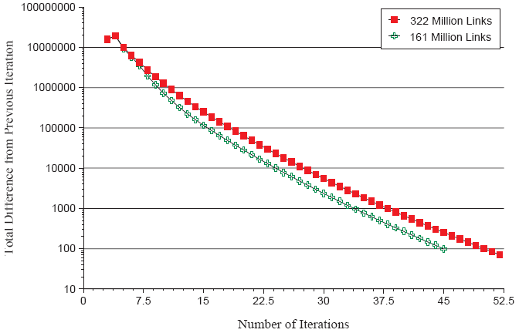
Convergence Properties

Slide 12
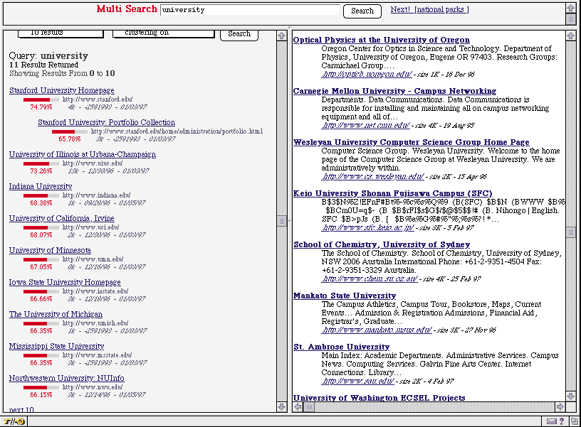
Searching with PageRank

Slide 13
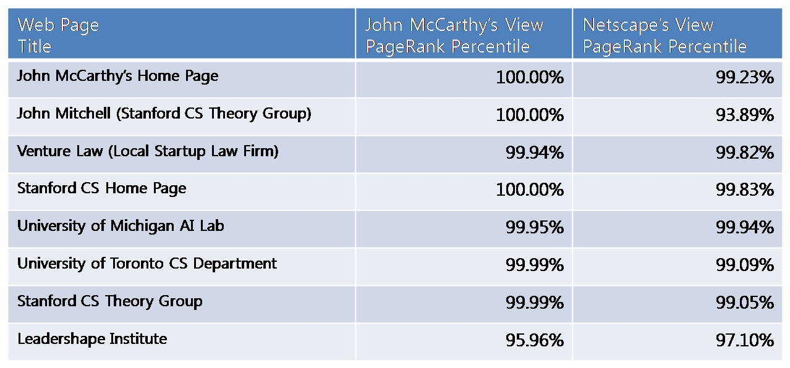
Personalized PageRank
We can generate personalized PageRank by modifying matrix E
Test having E consist entirely of a single web page

Slide 14
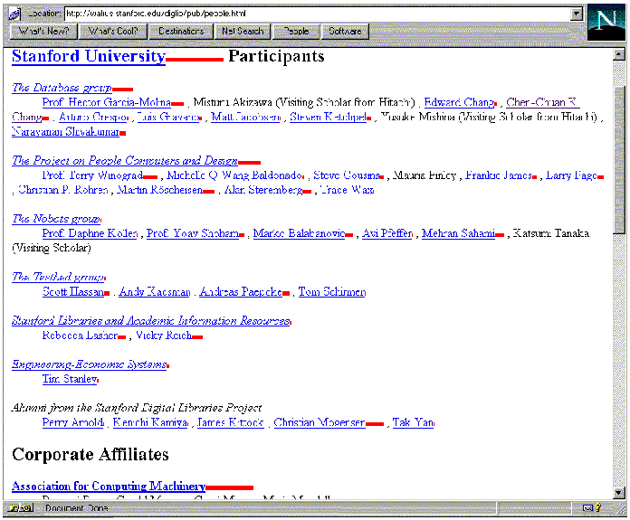
Applications
Estimating Web Traffic
PageRank as Backlink Predictor
User Navigation
  The PageRank Proxy

Slide 15
Conclusion
PageRank is a global ranking of all web pages
  Regardless of their content
  Based solely on their location in the Web’s graph structure
Backlinks from “important” pages are more significant than backlinks from average pages
PageRank can separate out representative pages as cluster center
Personalized PageRanks can be generated

