Slide 1
Overview
Data Mining for Business Intelligence
Shmueli, Patel & Bruce
© Galit Shmueli and Peter Bruce 2008

Slide 2
Core Ideas in Data Mining
Classification
Prediction
Association Rules
Data Reduction
Data Exploration
Visualization

Slide 3
Supervised Learning
Goal: predict a single “target” or “outcome” variable
Training data where target value is known
Score to data where value is not known
Methods: Classification and Prediction

Slide 4
Unsupervised Learning
Goal: segment data into meaningful segments; detect patterns
There is no target (outcome) variable to predict or classify
Methods: Association rules, data reduction & exploration, visualization

Slide 5
Supervised: Classification
Goal: predict categorical target (outcome) variable
Examples: Purchase/no purchase, fraud/no fraud, creditworthy/not creditworthy…
Each row is a case (customer, tax return, applicant)
Each column is a variable
Target variable is often binary (yes/no)

Slide 6
Supervised: Prediction
Goal: predict numerical target (outcome) variable
Examples: sales, revenue, performance
As in classification:
Each row is a case (customer, tax return, applicant)
Each column is a variable
Taken together, classification and prediction constitute “predictive analytics”

Slide 7
Unsupervised: Association Rules
Goal: produce rules that define “what goes with what”
Example: “If X was purchased, Y was also purchased”
Rows are transactions
Used in recommender systems – “Our records show you bought X, you may also like Y”
Also called “affinity analysis”

Slide 8
Unsupervised: Data Reduction
Distillation of complex/large data into simpler/smaller data
Reducing the number of variables/columns (e.g., principal components)
Reducing the number of records/rows (e.g., clustering)

Slide 9
Unsupervised: Data Visualization
Graphs and plots of data
Histograms, boxplots, bar charts, scatterplots
Especially useful to examine relationships between pairs of variables

Slide 10
Data Exploration
Data sets are typically large, complex & messy
Need to review the data to help refine the task
Use techniques of Reduction and Visualization

Slide 11
The Process of Data Mining

Slide 12
Steps in Data Mining
Define/understand purpose
Obtain data (may involve random sampling)
Explore, clean, pre-process data
Reduce the data; if supervised DM, partition it
Specify task (classification, clustering, etc.)
Choose the techniques (regression, CART, neural networks, etc.)
Iterative implementation and “tuning”
Assess results – compare models
Deploy best model

Slide 13
Obtaining Data: Sampling
Data mining typically deals with huge databases
Algorithms and models are typically applied to a sample from a database, to produce statistically-valid results
XLMiner, e.g., limits the “training” partition to 10,000 records
Once you develop and select a final model, you use it to “score” the observations in the larger database

Slide 14
Rare event oversampling
Often the event of interest is rare
Examples: response to mailing, fraud in taxes, …
Sampling may yield too few “interesting” cases to effectively train a model
A popular solution: oversample the rare cases to obtain a more balanced training set
Later, need to adjust results for the oversampling

Slide 15
Pre-processing Data

Slide 16
Types of Variables
Determine the types of pre-processing needed, and algorithms used
Main distinction: Categorical vs. numeric
Numeric
  Continuous
  Integer
Categorical
  Ordered (low, medium, high)
  Unordered (male, female)

Slide 17
Variable handling
Numeric
  Most algorithms in XLMiner can handle numeric data
  May occasionally need to “bin” into categories
Categorical
  Naïve Bayes can use as-is
  In most other algorithms, must create binary dummies (number of dummies = number of categories – 1)

Slide 18
Detecting Outliers
An outlier is an observation that is “extreme”, being distant from the rest of the data (definition of “distant” is deliberately vague)
Outliers can have disproportionate influence on models (a problem if it is spurious)
An important step in data pre-processing is detecting outliers
Once detected, domain knowledge is required to determine if it is an error, or truly extreme.

Slide 19
Detecting Outliers
In some contexts, finding outliers is the purpose of the DM exercise (airport security screening). This is called “anomaly detection”.

Slide 20
Handling Missing Data
Most algorithms will not process records with missing values. Default is to drop those records.
Solution 1: Omission
  If a small number of records have missing values, can omit them
  If many records are missing values on a small set of variables, can drop those variables (or use proxies)
  If many records have missing values, omission is not practical
Solution 2: Imputation
  Replace missing values with reasonable substitutes
  Lets you keep the record and use the rest of its (non-missing) information

Slide 21
Normalizing (Standardizing) Data
Used in some techniques when variables with the largest scales would dominate and skew results
Puts all variables on same scale
Normalizing function: Subtract mean and divide by standard deviation (used in XLMiner)
Alternative function: scale to 0-1 by subtracting minimum and dividing by the range
  Useful when the data contain dummies and numeric

Slide 22
The Problem of Overfitting
Statistical models can produce highly complex explanations of relationships between variables
The “fit” may be excellent
When used with new data, models of great complexity do not do so well.

Slide 23
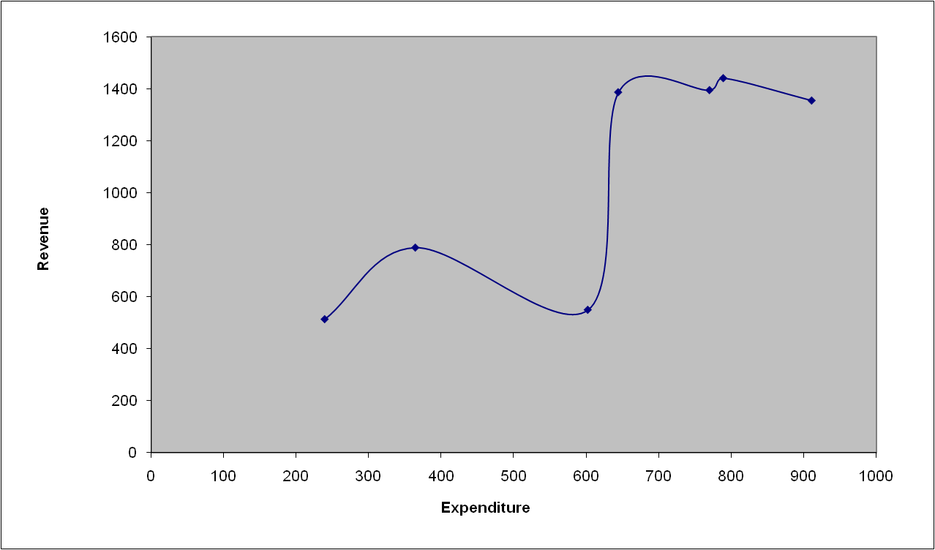
100% fit – not useful for new data

Slide 24
Overfitting (cont.)
Causes:
  Too many predictors
  A model with too many parameters
  Trying many different models
Consequence: Deployed model will not work as well as expected with completely new data.

Slide 25
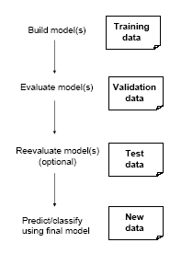
Partitioning the Data
Problem: How well will our model perform with new data?
Solution: Separate data into two parts
  Training partition to develop the model
  Validation partition to implement the model and evaluate its performance on “new” data
Addresses the issue of overfitting

Slide 26
Test Partition
When a model is developed on training data, it can overfit the training data (hence need to assess on validation)
Assessing multiple models on same validation data can overfit validation data
Some methods use the validation data to choose a parameter. This too can lead to overfitting the validation data
Solution: final selected model is applied to a test partition to give unbiased estimate of its performance on new data

Slide 27
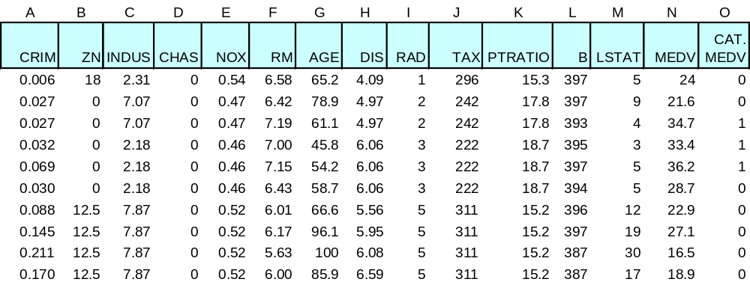
Example – Linear Regression
Boston Housing Data

Slide 28
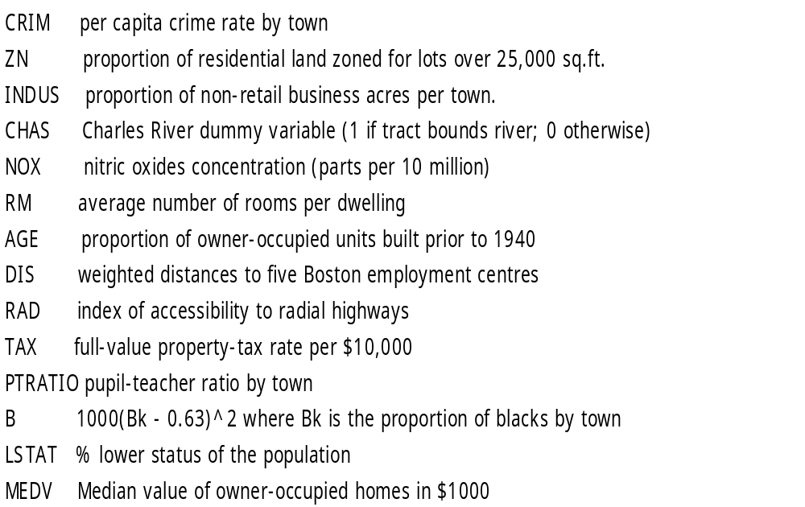

Slide 29
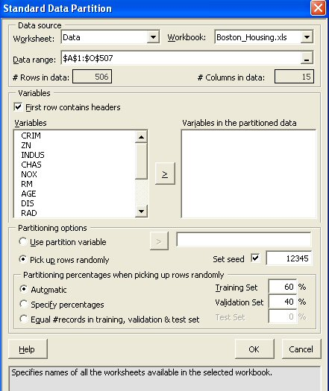
Partitioning the data

Slide 30
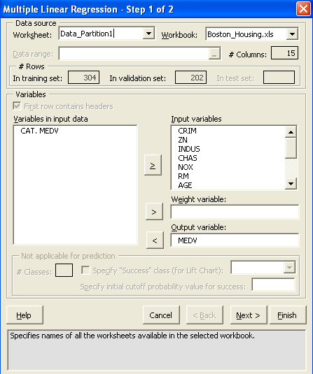
Using XLMiner for Multiple Linear Regression

Slide 31
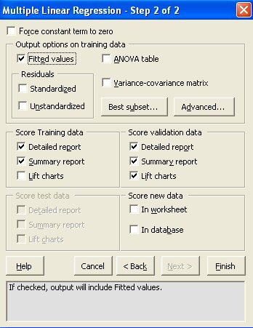
Specifying Output

Slide 32
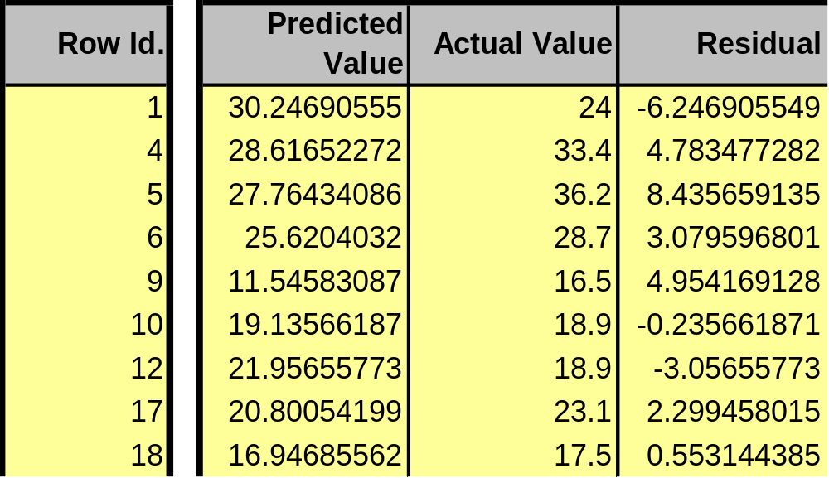
Prediction of Training Data

Slide 33
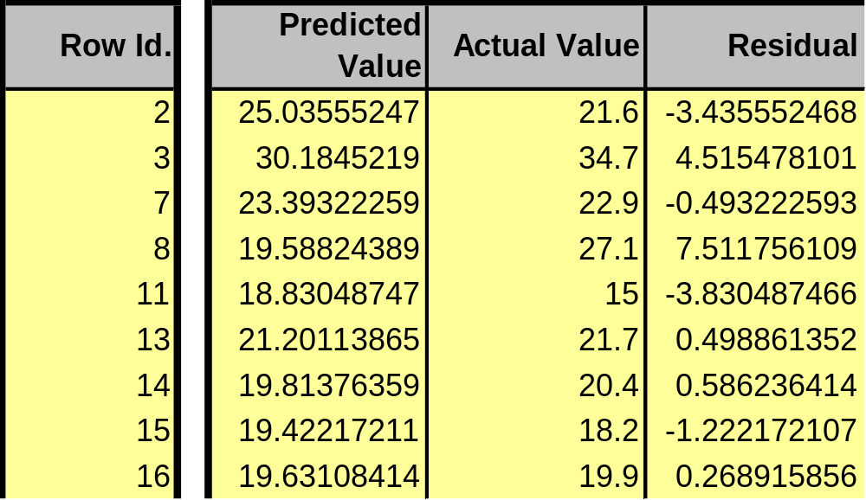
Prediction of Validation Data

Slide 34
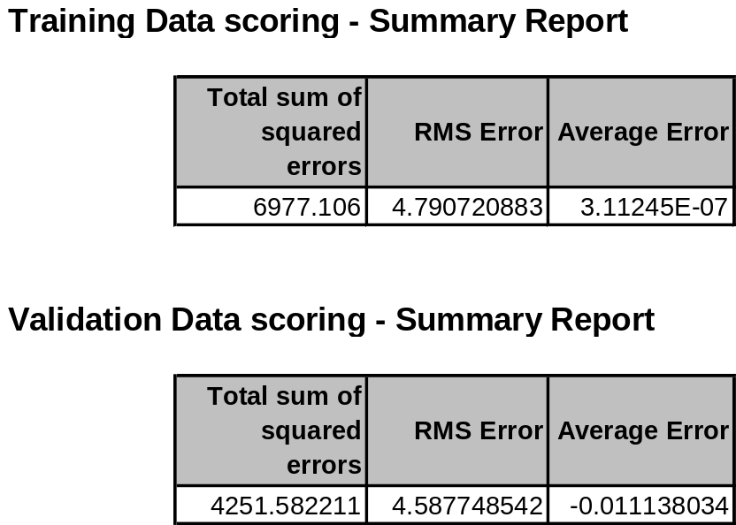
Summary of errors

Slide 35
RMS error
Error = actual - predicted
RMS = Root-mean-squared error
= Square root of average squared error
In previous example, sizes of training and validation sets differ, so only RMS Error and Average Error are comparable

Slide 36
Using Excel and XLMiner for Data Mining
Excel is limited in data capacity
However, the training and validation of DM models can be handled within the modest limits of Excel and XLMiner
Models can then be used to score larger databases
XLMiner has functions for interacting with various databases (taking samples from a database, and scoring a database from a developed model)

Slide 37
Summary
Data Mining consists of supervised methods (Classification & Prediction) and unsupervised methods (Association Rules, Data Reduction, Data Exploration & Visualization)
Before algorithms can be applied, data need to be characterized and pre-processed
To evaluate performance and to avoid overfitting, data partitioning is used
Data mining methods are usually applied to a sample from a large database, and then the best model is used to score the entire database

