Slide 1
Improving Recommendation for Long-tail Queries via Templates
Idan Szpektor, Aristides Gionis, Yoelle Maarek
Yahoo! Research
WWW '11
November 17, 2011
Hye Chan Bae

Slide 2
Contents
Introduction
Preliminaries
Query templates & the Query templates flow graph
Experiment
Conclusion

Slide 3
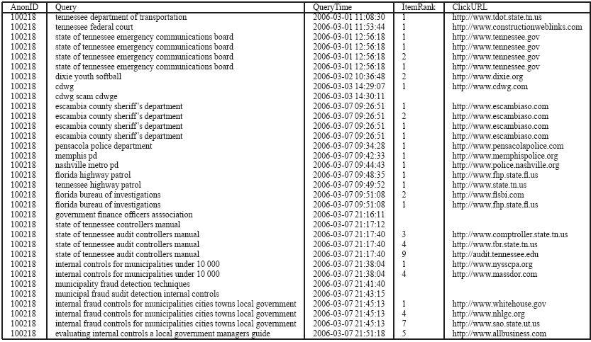
Mining query logs
Tremendously useful for
Web search
Web applications

Slide 4
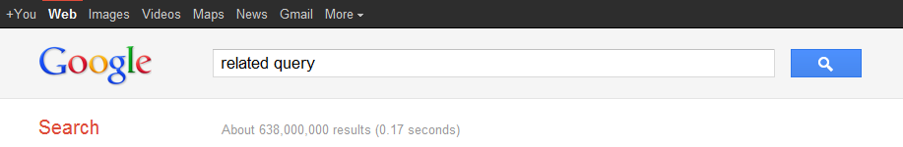

Mining query logs
One of the most direct & visible applications
Query recommendations
Query recommendation!!

Slide 5
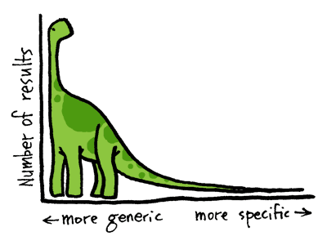
Weakness of query-log based methods
Not useful when reaching the “long tail” queries
One approach simply cuts(ignores) the long tail
i.e. concentrates on best head and torso needs

Slide 6
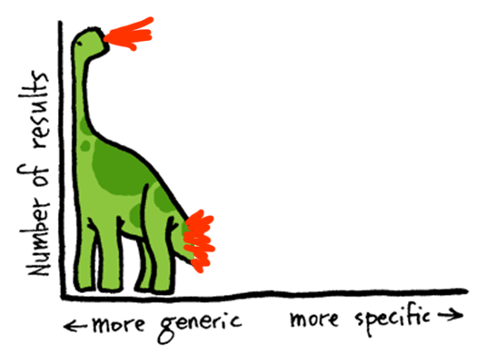

Weakness of query-log based methods
Not useful when reaching the “long tail” queries
One approach simply cuts(ignores) the long tail
i.e. concentrates on best head and torso needs

Slide 7
Importance of handling long-tail queries
anatomy of the long tail [Goel et al.]
“Ordinary people
have
extraordinary tastes!”

Slide 8

Importance of handling long-tail queries
Supporting the tail boosts the head
By providing users a convenient one-stop shop
Mainstream
Niche interests

Slide 9
So, we focus on…
Propose to address the long-tail problem by
Query templates: query constructs
Abstract queries
Generalize queries
Key idea
Identify rules between templates as means for suggesting related queries
Query templates

Slide 10
Contents
Introduction
Preliminaries
Query templates & the Query templates flow graph
Experiment
Conclusion

Slide 11
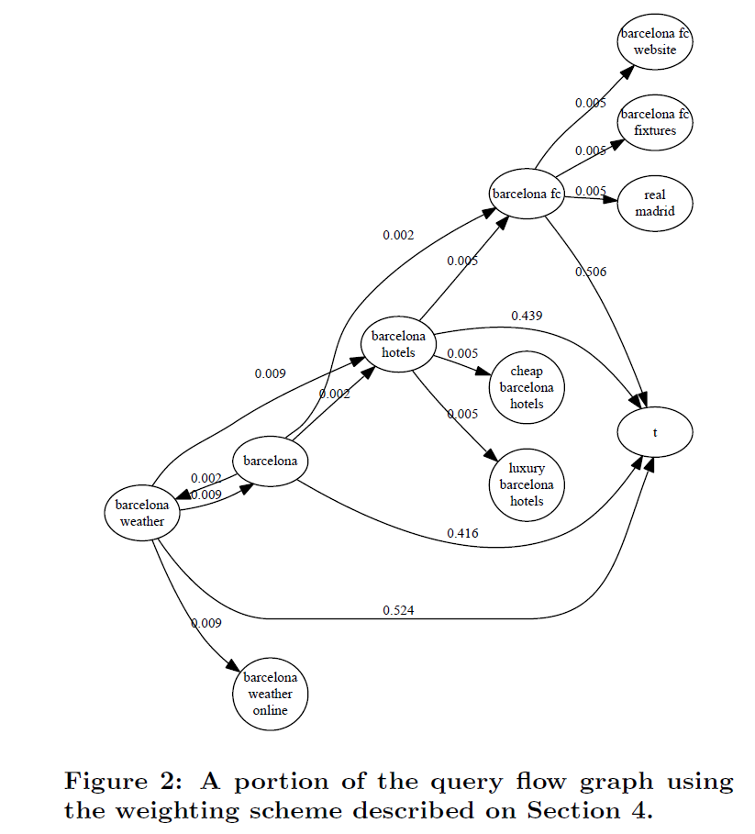
The Query-Flow Graph (QFG)
query transition
query
Notes:
A graph structure
Aggregates information contained in a query log$G_{q}=(Q_{0}, E_{qq}, s_{qq})$
Nodes: queries
Edges $(q_{i}, q_{j})$ with large weights
If there is at least one session in the query log in which $q_{j}$ follows $q_{i}$, two queries $q_{i}$ and $q_{j}$ are connected by an edge.
Methods to decide weights
Simply, frequency of the transition out of all instances
Transition probabilities

Slide 12

An Application of the QFG
Query recommendation
Query $q_{i}$ recommends queries $q_{j}$
The weight of the edge $(q_{i}, q_{j})$ in the QFG is high enough
Limitation
No recommendation can be made for queries that were not seen before
<from query logs>
Los Angeles hotels → Los Angeles restaurants
New York hotels → New York restaurants
<never been observed before>
Yancheng hotels → ?
Notes:
Alternative picking those queries
Based on PageRank & personalized PageRank

Slide 13
Contents
Introduction
Preliminaries
Query templates & the Query Templates Flow Graph
Experiment
Conclusion

Slide 14
The Query-Template Flow Graph (QTFG)
What is the template?
query transition
query
query to template mapping
<city>
<city> weather
template
template transition

Slide 15

Query Templates
A structured pattern for interpreting queries
Based on
Query logs
Additional information source: a generalization hierarchy
Basic notions
$Q=\{q_{1},q_{2}, …\}$ : the set of all queries
$q=w_{1} …{ w}_{r}$ : a sequence of search terms
“Chocolate cookie recipe”

Slide 16

Query Templates (cont.)
Tokenizations
A grouping of the terms of $q$ into consecutive sequences of terms
$q=w_{1} … w_{r}=k_{1} … k_{s}$
“Chocolate cookie recipe”
(chocolate)(cookie)(recipe)
(chocolate)(cookie recipe)
(chocolate cookie)(recipe)
(chocolate cookie recipe)

Slide 17

Query Templates (cont.)
Generalization hierarchy
An additional source of information to use
$H=(E, R)$ on a set of entities $E$
$e_{i} →{ e}_{j}$
Entity $e_{j}$ is a semantic generalization of the entity $e_{i}$
$e_{i}$ is a type of $e_{j}$
“Chocolate cookie recipe”
chocolate → food
chocolate → drink
cookie → dessert
chocolate cookie → dessert
dessert → food
food → substance
recipe → instruction
…
Notes:
Constructed with the help of a generalization hierarchy H over entities
WordNet 3.0 hypernymy hierarchy
Wikipedia category hierarchy via YAGO

Slide 18

Query Templates (cont.)
Template
$t\left(q \right| k_{i} →e_{j})$
Replace the entity $k_{i}$ width a placeholder of type $<e_{j}>$
“Chocolate cookie recipe”
(chocolate)(cookie)(recipe)
(chocolate)(cookie recipe)
(chocolate cookie)(recipe)
(chocolate cookie recipe)
<food> cookie recipe
<drink> cookie recipe
<food> recipe
<substance> recipe
chocolate cookie <instruction>
chocolate → food
chocolate → drink
cookie → dessert
chocolate cookie → dessert
dessert → food
food → substance
recipe → instruction
…

Slide 19
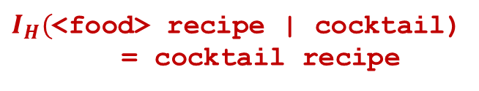
Query Templates (cont.)
Utilizing a template
by matching a token with type of the template placeholder
Could generate queries that were not observed before
“Chocolate cookie recipe”
<food> cookie recipe
<drink> cookie recipe
<food> recipe
<substance> recipe
chocolate cookie <instruction>
$I_{H}($<food> recipe | cocktail)
= cocktail recipe
Notes:
Valid token인지 invalid token인지는 generalization hierarchy H에 의해 판단

Slide 20
The Query-Template Flow Graph (QTFG)
query transition
query
query to template mapping
<city>
<city> weather
template
template transition
Notes:
템플릿이 노드로 추가됐으므로 필연적으로 query-to-template edge와 template transition edge가 생길 수 밖에 없다.
그리고 template edge를 통해서 template rule을 생성할 수 있다.
이 template edge가 이 논문의 핵심이다. 이를 통해서 long-tail query (드물게 나오는 query나 한번도 나오지 않은 query)를 처리할 확률이 높아지기 때문이다.

Slide 21
Template Rules
Rules among templates enable
the inference of recommendations for queries
That have been seen very rarely
Even for the first time
<from query logs>
Los Angeles hotels → Los Angeles restaurants
New York hotels → New York restaurants
<template rule>
<city> hotels → <city> restaurants
<never been observed before>
Yancheng hotels → Yancheng restaurants

Slide 22

Application of the QTFG
Query recommendation
Query $q_{i}$ recommends queries $q_{j}$
Considers weights of the 3 edges
$(q,q′)$ in the QFG
$\left(q, t\right)$ : query-to-template mapping edge
$\left(t, t^{′}\right)$ : template transition edge
How are the weights made?
Let me explain just simply…

Slide 23
Weights of the QTFG
Query-to-template weight
The more we generalize a query, the less confident we are.
Select score to be exponentially decaying with the distance
Between the token and the generalization e in the hierarchy
“Chocolate cookie recipe”
<food> recipe
chocolate cookie → dessert
dessert → food
food → substance
…
<
<substance> recipe

Slide 24
Application of the QTFG (cont.)
Query recommendation
example
<query>
Adele Astaire
<template rule>
Adele Astaire → <artist>
<artist> → <artist> biography
<query recommendation>
Adele Astaire biography

Slide 25
Contents
Introduction
Preliminaries
Query templates & the Query Templates Flow Graph
Experiment
Conclusion
Notes:
실험은 대부분 QFG와 QTFG를 비교

Slide 26
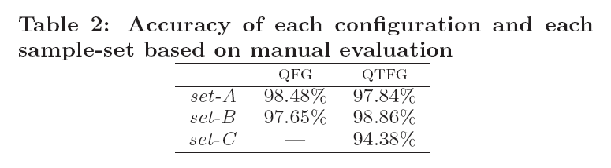
Manual evaluation
It’s not important!!!
Notes:
그냥 QFG나 QTFG나 둘 다 accuracy 결과가 잘 나왔다는 실험결과

Slide 27
Limitation of manual evaluation
The task is hard to define
Which recommendations should be considered as valid related queries
Amount of examples
No more than several hundred examples (of millions)
Slow process
Several rounds of evaluation are needed during the development
So, we propose a novel automatic evaluation!!!

Slide 28

Automatic evaluation
Based on a previously unseen query log
Assumption
$$\{q_{i}, q_{i+1}\}$$
considered more related compared to other possible related queries

Slide 29

Automatic evaluation
Based on a previously unseen query log
Assumption
to test how many of the pairs $\left\{q_{i}, q_{i+1}\right\}$ are also proposed
Should be ranked high
$$\{q_{i}, q_{i+1}\}$$
considered more related compared to other possible related queries

Slide 30
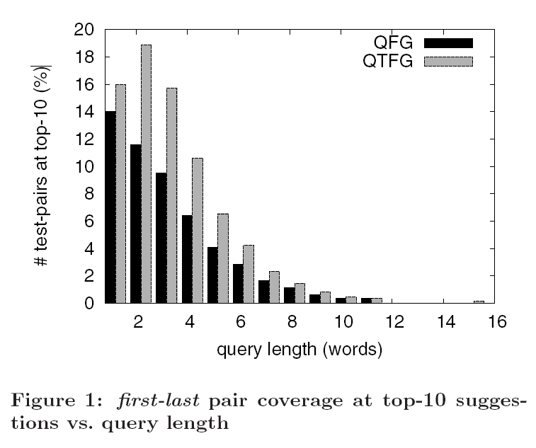
Analysis: query length
First-last pair
Generate just one pair from each session
Consists of the first and the last query in the session
Assume that the last query is the real target query of the user
Notes:
그림1:
QFG는 query length가 많아질수록 결과값이 작아지는 경향을 보임. 왜냐하면 query length가 길어질수록 Frequency가 낮아지기 때문에 추천에 필요한 history가 부족하기 때문이다.
그에 비해 QTFG는 약간의 word가 추가되었을 때 더 좋은 결과를 보인다. 이것은 여러 개의 단어를 통해 context를 일정부분 유추하여 ambiguous 문제를 개선시키기 때문이다.

Slide 31
Ambiguous problem
Jaguar transmission fluid
It is unclear
Which term the focus is
“jaguar” has several meanings
Jaguar transmission fluid → jaguar used parts
Toyota transmission fluid → toyota used parts
<car> transmission fluid → <car> used parts
<feline> transmission fluid → <feline> used parts
feline[|fi:laɪn] 고양이과 동물
Notes:
Jaguar transmission fluid → jaguar used parts indicates that “jaguar” is the focus

Slide 32
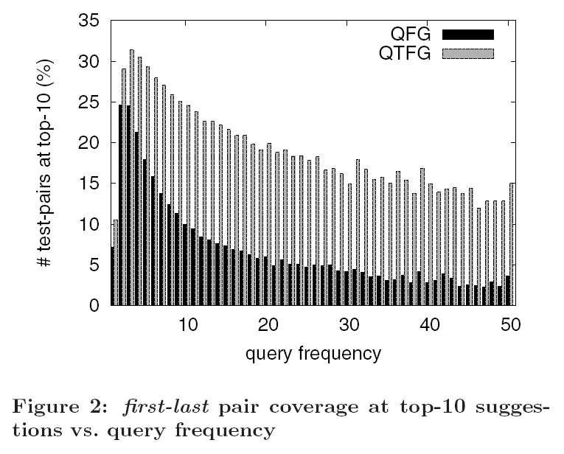
Analysis: query frequency
First-last pair
Generate just one pair from each session
Consists of the first and the last query in the session
Assume that the last query is the real target query of the user
Notes:
그림2:
Frequency가 너무 낮을 때는 test-pair를 찾기 힘들다.
이후로는 좋은 결과값을 보이고 query frequency가 많아질수록 결과값이 감소하는 것을 알 수 있다. 이것은 오히려 frequency가 많음으로 인해 어떠한 suggestion을 하는 것이 best인지 예상하기가 힘들어지기 때문이다.
전반적으로 QTFG가 QFG보다 훨씬 좋은 결과를 보이고 있다.

Slide 33
Analysis: query frequency
First-last pair
Generate just one pair from each session
Consists of the first and the last query in the session
Assume that the last query is the real target query of the user
jack johnson lyrics: 14 times
{ jack johnson lyrics, jack johnson music }
QTFG: 5th
QFG: 43rd
Notes:
그림2:
예를 들어 test-set에서 14번 나온 query인 “jack johnson lyrics”에 대해 test-pair인 {“jack johnson lyrics”, “jack johnson music”}이 QTFG에서는 5위, QFG에서는 43위로 나타났다.

Slide 34
Contents
Introduction
Preliminaries
Query templates & the Query Templates Flow Graph
Experiment
Conclusion
Notes:
실험은 대부분 QFG와 QTFG를 비교

Slide 35
Conclusion
Introduced the concepts of rules
Between query templates & the query-template flow graph
Useful for addressing the long tail of rare or previously unseen queries
Conducted 2 query-recommendation experiments
Manual: both QTFG & QFG are good for query recommendation
Automatic:
QTFG outperforms the QFG
QTFG provides good suggestions for many unseen queries
Future work
Apply the QTFG on other search-related tasks
Improve the quality of rule extraction
Investigate the identification of edges from templates to queries

Slide 36
Thank you!

Slide 37

Query logs
A set of records $<q_{i}, u_{i}, t_{i}, V_{i}, C_{i}>$
$q_{i}$ : a query submitted to the search engine
$u_{i}$ : an anonymized identifier
$t_{i}$ : a timestamp
$V_{i}$ : the set of documents returned as result to the query
$C_{i}$ : the set of clicked documents

Slide 38

The Query-Template Flow Graph (QTFG)
Extents the query-flow graph [Boldi et al]
Representation
$G_{t}=(Q_{0}, T, E_{qq}, E_{qt}, E_{tt}, s_{qq}, s_{qt}, s_{tt})$
Nodes
The set of queries $Q_{0}$
The set of all templates $T$
Edges
Query-to-query transition edges $E_{qq}$
Query-to-template mapping edges $E_{qt}$
Template-to-template transition edges $E_{tt}$

Slide 39
The Query-Template Flow Graph (QTFG) (cont.)
Template construction
Constructed with the help of a generalization hierarchy H over entities
WordNet 3.0 hypernymy hierarchy
Wikipedia category hierarchy via YAGO
For each query q
Normalize q
Every word n-gram up to length 3 in q is considered as a token for replacement
Special cases
Email type
url
Numbers
Noun-phrase
ggg@yahoo.com instant message → <email> instant message
nbc.com login → <URL> login
555-7777 address → <000-0000> address
Luxury cars sale → <?-cars> sale
Notes:
Nomalize : convert to lower case, remove continuous spaces/non-printable characters, etc.
N-gram :
Add to T(q) all the templates formed by replacing k with each of its generalizations in H
note that stop-words are ignored.

