Slide 1
Practical RDF Ch.6
Creating an RDF Vocabulary
DongHyuk Im
SNU OOPSLA Lab.
Shelley Powers, O’Reilly
August 19, 2004

Slide 2
Contents
Introduction
Defining the vocabulary
Prototyping the vocabulary
Adding repeating values, a container, in a value
Formalizing the vocabulary with RDFS
The Dublin Core

Slide 3
How RDF Vocabularies Differ from XML
RDF
  A way of recording information about resources
  Serialized using XML
  Specific business domain
Directly within XML
  Define the concept of “class” and “property”
  Ex) “Source is a property of Term”
    The source element is processed as a property of Term

Slide 4
Defining the Vocabulary
Problem with maturing web site
  “404 Page not found” : missing page
  Site structure doesn’t remain constant
  Forwarding message and link to redirect
    Reason for move aren’t maintained
  FrontPage, Vignette
    Do not help provide information about the context of the resource

Slide 5
Defining the Vocabulary
Meta tags can be attached
  Copyright information, keywords, authorship
  Expectancy of the resource of its move history
  Reasons for move
Provide information
  Useful for humans
  Usable by automated process

Slide 6
The PostCon Domain Elements
RDF-capable
  Describe the major entities and properties
  Describe how these entities are related to one another
PostCon
  What is the content’s bio
  What is the content’s relevancy
  What is the content’s history of movement
  What are the content’s related resources
  If the resource no longer exists, are there replacement
  What are the presentation characteristics of the content

Slide 7
Postcon System domain (Ex.)
Element | Property | Description
Content | Unique Content ID | To identufy content
 | Biography | Content biographical information
 | Relevancy | Relevancy of content
 | History | History of content movement
 | Presentation | Content type and presentation
 | Related | Related content

Slide 8
Prototyping the Vocabulary
When creating a new vocabulary
  Define the URI for the vocabulary
    Ex) http://burningbird.net/postcon/elements/1.0
  Determining what the URI of the web resource is
    Ex) http://burningbird.net/articles/monster1.htm
<?xml version=“1.0”?>
<rdf:RDF
xml:rdf=http://www.w3.org/1999/02/22-rdf-syntax-ns#
xml:pstcn=http:///burningburd.net/postcon/elements/1.0/
xml:base=http://burningbird.net/articles/>
<rdf:Description rdf:about=“monster1.htm”>
<pstcn:bio />
<pstn:relevancy />
<pstcn:presentaion />
<pstcn:history />
<pstcn:related />
</rdf:Description>
</rdf:RDF>
First cut of PostCon vocabulary

Slide 9
The Graph of our PostCon Example
http://www.w3c.org/1999/02/22-rdf-syntax-ns#type
http://www.burningbird.net/postcon/elements/1.0/resource
http://burningbird.net/postcon/elements/_x000b_1.0/bio
http://burningbird.net/postcon/elements/_x000b_1.0/relevancy
http://burningbird.net/articles/monster1.htm
http://burningbird.net/postcon/elements/_x000b_1.0/presentation
http://burningbird.net/postcon/elements/_x000b_1.0/history
http://burningbird.net/postcon/elements/_x000b_1.0/related

Slide 10
Adding Repeating Values
Web resource can move many times
More than one recommended resource
Use the same predicate in multiple statement
    Ex) <pstcn : related rdf:resource=“monster2.htm” />
    <pstcn : related rdf:resource=“monster3.htm” />
    <pstcn : related rdf:resource=“monster4.htm” />
    Three related resource for entity being defined
    No order to resources

Slide 11
Adding a Container
Container
  A group of related items : infinite number of items
  Seq, Bag or Alt
Web site movement are related to one another
  By date and time
  Infinite numbers of movements are possible
  The best fit is Seq
    Ex)
<pstcn : history>
<rdf:Seq>
<rdf:_1 rdf:resource=“http://www.yasd.com/dynaearth/monster1.htm” />
<rdf:_2 rdf:resource=http://www.dynamicearth.com/articles/monster1.htm />
<rdf:_3 rdf:resource=http://burningbird.net/articles/monster1.htm />
<rdf:Seq>
</pstcn:history>

Slide 12
The Graph of model defined
http://www.burningbird.net/postcon/elements/1.0/resource
http://www.w3c.org/1999/02/22-rdf-syntax-ns#type
http://burningbird.net/postcon/elements/_x000b_1.0/bio
http://www.w3.org/1999/02/22-rdf-syntax-ns#type
Genid:6405
http://burningbird.net/postcon/elements/_x000b_1.0/relevancy
http://burningbird.net/articles/monster1.htm
http://burningbird.net/postcon/elements/_x000b_1.0/presentation
http://burningbird.net/postcon/elements/_x000b_1.0/history
http://burningbird.net/postcon/elements/_x000b_1.0/related

Slide 13
Adding in a Value
How the value is treated
  Rdf:value work for pstcn:requires
  References the actual value of the predicate
  Ex)
<pstcn:presentation rdf:parseType=“Resource”>
<pstcn:requires rdf:parseType=“Resource”>
<pstcn:type>stylesheet</pstcn:type>
<rdf:value>http://burningbird.net/de.css<rdf:value>
</pstcn:requires>
<pstcn:requires rdf:parseType=“Resource”>
<pstcn:type>logo</pstcn:type>
<rdf:value>http://burningbird.net/mm/dynamicearth.jpg<rdf:value>
</pstcn:requires>
</pstcn:presentation>

Slide 14
Formalizing the Vocabulary with RDFS
RDFS
  Define which vocabulary elements are classes and properties
  Define the range for each property
  Class
    Equivalent to a relational data model entity
    Any item
      Rdf:Description block with an associated rdf:type
      Ex) Movement, Resource

Slide 15
Formalizing the Vocabulary with RDFS
Defining the vocabulary classes (Ex. Resource)
    Subclass of the RDF Resource type
    Human-readable label is Web Resource
    Comments provide a brief description
<rdfs:Class rdf:about=“http://burningbird.net/postcon/elements/1.0/Resource”>
<rdfs:isDefinedBy rdf:resource=“http://burningbird.net/postcon/elements/1.0/”>
<rdfs:subClass rdf:resource=“http://www.w3.org/2000/01/rdf-schema#Resource/”>
<rdfs:label xml:lang=“en”> Web Resource </rdfs:label>
<rdfs:comment xml:lang=“en”>
Web resource managed with PostCon System
</rdfs:comment>
</rdfs:class>

Slide 16
Formalizing the Vocabulary with RDFS
Defining the Properties (Ex. Type)
    Type element has a range that determines the type of value
    Literal : element contains literal values
<rdfs:Property rdf:about=“http://burningbird.net/postcon/elements/1.0/type”>
<rdfs:isDefinedBy rdf:resource=“http://burningbird.net/postcon/elements/1.0/”>
<rdfs:label xml:lang=“en”>Resource Type</rdfs:label>
<rdfs:comment >Type of Required Resource </rdfs:comment>
<rdfs:range rdf:resource=“http://www.w3.org/2000/01/rdf-schema#Literal/”>
</rdfs:Property>

Slide 17
Intergrating the Dublin Core
Dublin Core
  Open forum engaged in metadata standards
  purpose
    Metadata model : be used intelligently
    More efficient and intelligent resource search
  MetaData Element set
    Ex) title : a name given to the resource
    creator : an entity responsible for making the content of the
    resource
    subject : the topic of the content of the resource

Slide 18
Dublin Core in RDF/XML
Namespace for elements
  http://purl.org/dc/elements/1.1/
  Ex)
<rdfs:Property rdf:about=“http://purl.org/dc/elements/1.1/title”>
<rdfs:label xml:lang=“en-US”> Title </rdfs:label>
<rdfs:comment xml:lang=“en-US”> A name given to the resource. </rdfs:comment>
<dc:description xml:lang=“en-US”> Typically, a title will be a name by which the resource
is formally known. </dc:description>
<rdfs:isDefinedBy rdf:resource=“http://purl.org/dc/elements/1.1/”>
<dcterms:issued> 1999-07-02 </dcterms:issued>
</rdfs:Property>

Slide 19
Mixing Vocabularies
Replace the PostCon attributes with DC elements
Pstcn : title
dc: title
Pstcn : author
dc: creator
Pstcn : owner
dc: publisher

Slide 20
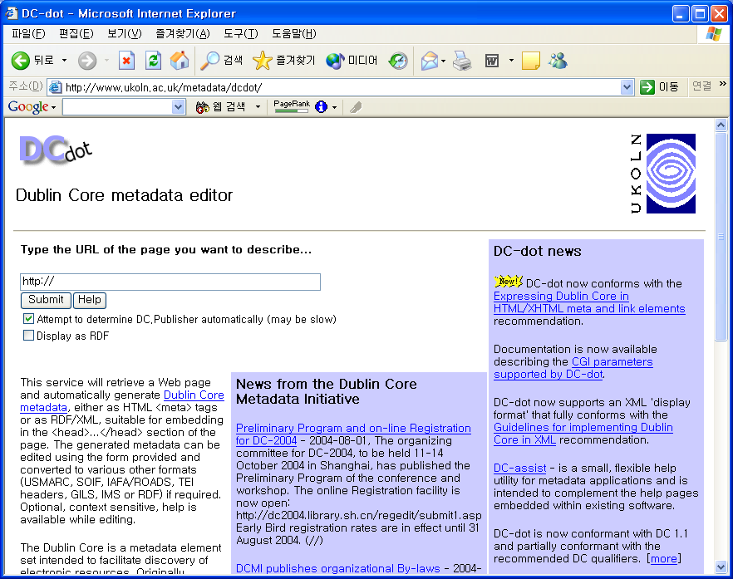
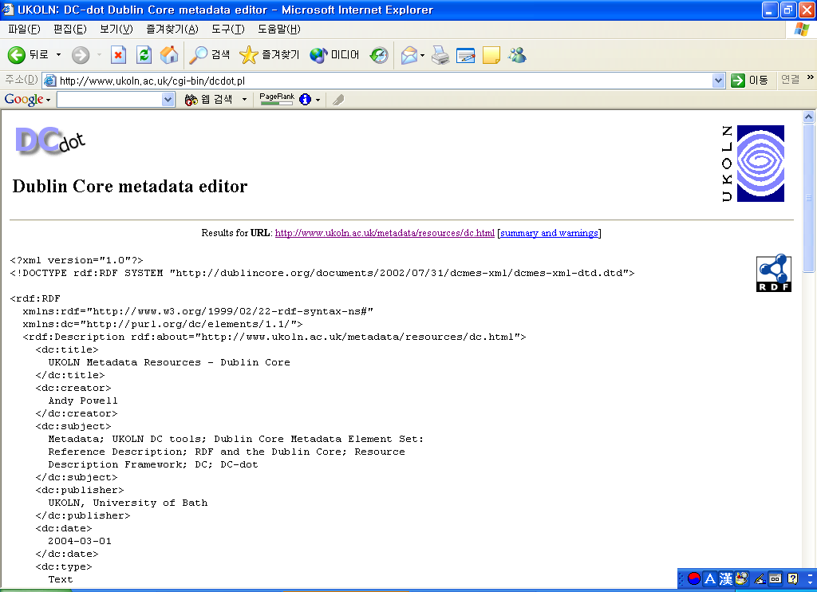
Using DC-dot to Generate DC RDF

