Slide 1
Efficient Identification of Web Communities
Gary W. Flake, Steve Lawrence and C.Lee Giles/ KDD 2000
2014. 4. 7.
Hyun Geun Soo

Slide 2
Introduction
Search engine can not cover the whole web and are out of date
The balance between precision and recall of query results
(high precision and low recall)
=> The concept of web community can help to solve these two problems

Slide 3
Introduction
Community
A community is a set of web pages that link to more web pages in the community than to pages outside of the community

Slide 4
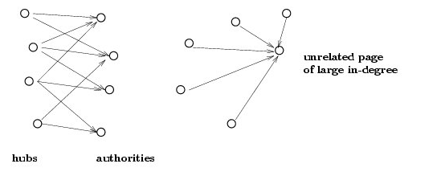
Background : Link Analysis
HITS(Hyperlink Induced Topic Search)
Find hub and authorities in subgraph(query result)
Use Hubs and authorities as seed
Notes:
http://www.google.com/patents/WO2009131386A2?cl=ko
http://webscience.creation.net/3

Slide 5
Background : Graph Cuts and Partitions
Balanced minimum cut graph partitioning
NP complete
Removed constraints on the partion sizes => polynomial
Unrestricted minimal cut
One partition very small

Slide 6
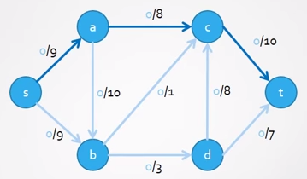
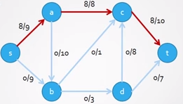
Background : Maximum Flow and Minimal Cuts

Slide 7
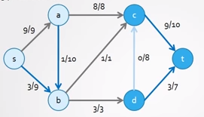
Background : Maximum Flow and Minimal Cuts

Slide 8
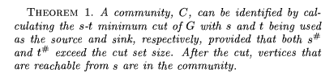

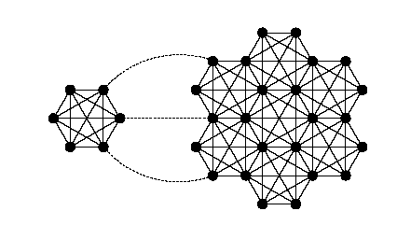
Ideal Communities

Slide 9
Ideal Communities
Single Source have problem
Many link to unrelated page ( ex. Bookmark)
Multiple seeds are used to address the unrelated link problem
Sink(cen ter of web graph)
Top-levels of a small collection of web portals, such as Yahoo

Slide 10
Approximate Communities
Ideal communities require rapid access to the inbound and outbound links
We can’t get whole web graph

Slide 11
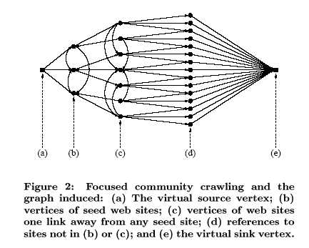
Focused crawler

Slide 12
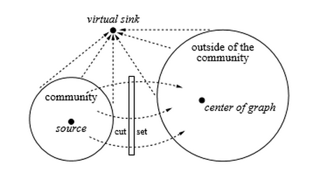
Focused crawler

Slide 13
Expectation Maximization
More seed need
EM-algorithm
E step : iteratively applies estimation
M step : maximization

Slide 14
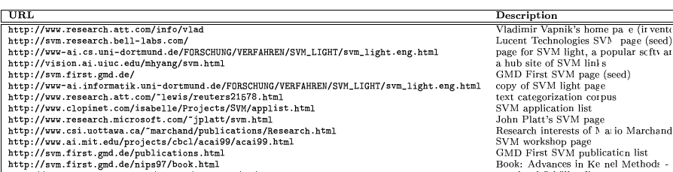

SVM community

Slide 15
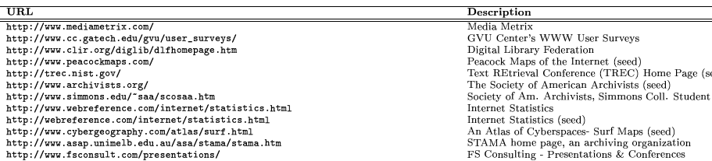
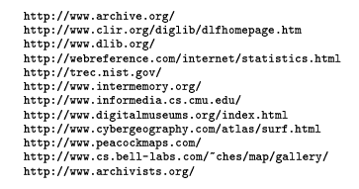
Internet Archive community

Slide 16
Conclusion
Define a new type of web community
Use maximum flow min cut
Focused web crawler to approximate a community

