Slide 1
Class & Object Diagram
© copyright 2001 SNU OOPSLA Lab.

Slide 2
Contents
What is a Class
Class Notation
What is a Object
CRC Cards
Class Modeling Technique
What is a Relationship

Slide 3
What is a class
Class
  The most fundamental concepts of object-oriented design and programming are classes and objects
  State( or data, attribute )
  Behavior( or function, operation )
Shape
origin
move ( )
resize ( )
display ( )
Attribute 명
Class 명
Operation 명
Class notation

Slide 4
What is a class
Class
  defines a collection of similar instances
  defines the interface and implementation of its instances
  It exists at compilation time and serves as a type
  Example 1. Business System
    Customer, Agreement, Invoice, Debt, Asset, Quotation
  Example 2. Technical System
    Sensor, Display, I/O card, Engine, Button, Control class
  Example 3. System Software
    File, Executable Program, Device, Icon, Window, Scrollbar

Slide 5
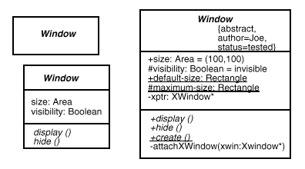
Class Notation
Class
Attribute
Operation

Slide 6
Class Notation
Class Name
  Each Class has a unique name
    Simple Name : Class itself
    Path Name : Class가 소속된 Package명을 포함
  Name should be a noun
  Name should be derived from problem domain and should be as unambiguous as possible
<< Simple Name >>
<< Path Name >>
Temperature
Sensor
Customer
Business Rules :: FraudAgent
Wall
Java :: awt :: Rectangle
UML notation for a class

Slide 7
Class Notation
Attribute
  describe the characteristics of the objects
    property
    type
    Visibility Name : Type = Default Value
Attributes
Wall
+ height : float
+ width : float
+ thickness : float
+ isLoadBearing : Boolean = false
Attribute Default Value
Attribute Type
Signature
Customer
+ name
+ address
+ phone
birthdate
Attribute Name
+ : Public
- : Private
# : Protected
UML notation for attributes

Slide 8
Class Notation
Operation
  Operations are used to manipulate the attributes or to perform other actions
  A operation is described with a return-type, a name, and zero or more parameters ( signature of the operation )
  what class can do, what services it offers
  the interface to the class
    Visibility Name (Parameter-List) : Return-Type-Expression {Property-String}
  Class : Operation
  Object : Method

Slide 9
Class Notation
Operation
FaudeAgent
<<constructor>>
new ( )
new (p : Policy)
<<process>>
process (o : Order)
. . .
<<query>>
isSuspect (o : Order)
isFraudulent (o : Order)
<<helper>>
validateOrder (o : Order)
Operations
Stereotype
Rectangle
+ add ( )
+ grow ( )
- move ( )
+ isEmpty ( )
TemperatureSensor
reset ( )
setAlarm (t : Temperature)
value ( ) : Temperature

Slide 10
What is a Object
Object
  A particular instance of a class
  Created as needed
  Represent several kinds of concepts
    Physical entity : automobile, credit card scanner
    Role : John Smith in the role of a customer
    Organization unit
    Interaction

Slide 11
What is a Object
Object
  An object must have three properties
    Identity : distinguish this object from all others( OID )
    State : an object should maintain data about itself
    Behavior : an object should be able to perform actions
interface
request from other objects
current
Order
:Order
current
Order
:Order
hidden middle
request to other objects
UML notation for Order objects

Slide 12
CRC Cards
Responsibility
  A high-level description of the purpose of the class
  How to do responsibility : Attributes and Operations
  CRC(Class Responsibility Collaboration) Card
FraudAgent
Responsibilities
-- determine the risk of a customer order
-- handle customer - specific criteria for fraud
Class
Order
Check if items in stocks
Order Line
Collaboration
Determine price
“
Responsibility
Check for valid payment
Customer
Dispatch to delivery address

Slide 13
CRC Cards
CRC (Class Responsibility Collaboration) Cards
  The responsibilities of a class are general statements about the operations of the class
  A class should normally have at most three or four responsibilities
  Collaborators are other classes which help a class to carry out its responsibilities
  If an object of one class collaborates with an object of another class, it does so by sending it a message
  CRC cards can be used to walk through use cases

Slide 14
Class Modeling Technique
A "good" class model has the following properties:
  It satisfies the current system requirements and was built quickly
  It enables the software system to be easy to maintain and to adapt to future requirements
Class Naming
  The name of a class is particularly important. It should be meaningful and usually corresponds to a real-world thing or role

Slide 15
Class Modeling Technique
Two Object-Oriented Design Camps :
  Data Driven Design (DDD)
    Use the noun identification technique to identify all the data in the system
    Create classes containing related data
  Responsibility Driven Design (RDD)
    Identify all the responsibilities in the system
    Create classes with related responsibilities
    Uses CRC (Class, Responsibilities, Collaborations) cards

Slide 16
Class Modeling Technique
Finding Classes
  Do we have that should be stored or analyzed ?
  Do we have external system ? external system is modeled as class
  Do we have any patterns, class libraries, components, and so on ?
  Are there devices that the system must handle ?
  Do we have organizational parts ?
  Which roles do the actors in the business play ?

Slide 17
Class Modeling Technique
Noun Identification Technique
  Classes are usually derived from the following real-world items :
    Tangible or "real-world" things: book, copy, course
    Roles: library member, student, director of studies
    Events: arrival, leaving, request (help find associations)
    Interactions: meeting, intersection
Customer
name
address
phone
birthdate
Product
id
name
price
location
Transaction
actions
commit ( )
rollBack ( )
wasSuccessful ( )
Shipment
Responsibilities
-- maintain the information regarding products shipped against an order
-- track the status and location of the shipped product

Slide 18
Class Modeling Technique
Identifying Inappropriate Classes:
  redundant - the same class has different names.
  vague - you do not know what the noun means.
  an event or an operation - Does it have state, behavior and identity?
  meta-language - the noun is part of our language of modeling and not part of the problem domain.
  outside the scope of the system - the noun is relevant to describing how the system works, but does not refer to something in the system.
  an attribute - where a noun refers to something simple with no behavior.

Slide 19
Special Class – Actors as Classes
Actor : external agent
  interact with system, but are not a part of the system itself
  black box to the system : internal implementations are irrelevant
  UML treats actors as special stereotyped classes
  stereotyped class : like a normal class, but it has special semantics
  don’t have to implement it or understand its internal details
<<actor>>
Telephone
Agent
Telephone
Agent
The telephone agent actor class

Slide 20
What is a Relationship
Relationship
  Elements in class and object diagrams are not “islands”
  Relationship Type : Dependency, Generalization, Association
Dependency
Window
open ( )
close ( )
move ( )
display ( )
handleEvent ( )
Event
ConsoleWindow
Generalization
DialogBox
Control
Association

Slide 21
Dependency Relationship
Dependency Relationship
  A semantic connection between two model elements, one independent and one dependent model element
  A change in the independent element will affect the dependent element
  One class takes an object of another class as a parameter
  One class accesses a global object of another class
Transaction
name
playOn (c:Channel)
start ( )
stop ( )
reset ( )
Channel
Dependency Relationship

Slide 22
Generalization Relationship
Generalization Relationship
  A taxonomic relationship between a more general element and a more specific element( In UML, element may be use case, class and package )
  The more specific element is fully consistent with the more general element and contain additional information
  “ is-a” Relationship( a car is a vehicle; a sales-manager is an employee, etc )
  Generalization is only used on types, never on instances( a class can inherit another class, but an object cannot inherit another object )
  The attributes, operations and all associations are inherited from a superclass to a subclass
  Visibility : public(+), private(-), protected(#)

Slide 23
Generalization Relationship
Shape
origin
move ( )
resize ( )
display ( )
Base Class
Generalized Relationship
Rectangle
corner : Point
Circle
radius : Float
Polygon
points : List
display ( )
Square
Leaf Class
A class hierarchy for shape

Slide 24
Association Relationship
Association Relationship
  A connection between classes, a semantic connection(link) between objects of the classes involved in the association
  Bidirectional : both objects are aware of each other
name
name direction
Works for
Person
Company
Association Relationship
1..*
Owns
0..*
Person
Car
Owned by
Represent multiplicity

Slide 25
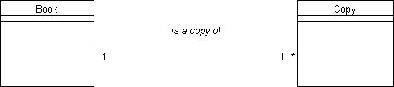
Association Relationship
Association Relationship
  In general, class A and class B are associated if:
    an object of class A sends a message to an object of class B
    an object of class A creates an object of class B
    an object of class A has an attribute whose values are objects of B or collections of objects of class B
    an object of class A receives a message with an object of class B as an argument
Every copy object (of class Copy) is associated by "is a copy of" with just
one book (of class Book).
Each book object may have any number of copies associated with it.

Slide 26
Association Relationship
A
*
*
B
Person
wife
Can be transformed into
husband
A
*
1
B
1
*
B
married to
A bidirectional many-to-many association can be transformed into two
one-to-many association
Both husband and wife are people
Car
drives
Person
*
*
company car
driver
A person plays the role of a driver and a car plays the role of a company car
Roles are the context in which objects act.

Slide 27
Association Relationship
Insurance
company
1
0..*
Insurance
contract
0..*
Insurance
contract
0..*
0..*
{ordered}
{or}
1..*
1..*
1..*
Person
Company
Customer
An or-association shows that only one of the associations is valid at a time
An ordered association

Slide 28
Aggregation Relationship
Aggregation
  A special case of association
  “whole-part” relationship
    A car that consists of four wheels, an engine, a chassis, a gear box, and so on
  “consists of”, “contains”, “is part of”
Navy
*
Warship
The Navy contains many warships. The parts(the
warships) compose the whole(the Navy)
The hollow diamond shows the aggregation

Slide 29
Aggregation Relationship
Shared Aggregation
  The parts may be parts in any wholes
  Shared is shown by its multiplicity
Team
*
*
Person
Members
A team is composed of team members. One person
could be a member of many teams. The people are
shared parts

Slide 30
Aggregation Relationship
Composition Aggregation
  A composition aggregation owns its parts
  Strong ownership
  The parts “live” inside the whole
  The parts will be destroyed
  together with its whole
*
Text
*
Listbox
Window
*
Button
*
Menu
The diamond shows the composition aggregate; the window
contains( is aggregated of ) many menus, buttons, and texts

Slide 31
Relationship Modeling Technique
Simple Dependency Modeling
  특정 Class가 다른 Class를 Operation에서 Parameter로만 사용하는 관계
  Operation에서 Parameter로 상대 Class를 사용하려는 Class쪽에서 의존 관계를 표현
CourseSchedule
add (c : Course)
remove (c : Course)
Course
Iterator

Slide 32
Relationship Modeling Technique
Single Inheritance Modeling
  구조적, 행동적 특성을 파악하여 Generalization Class와 Specialization Class로 구분하여 작성
  Class 집합에서 둘 이상 다수의 Class에 공통으로 존재하는 책임, 속성, Operation을 파악
  파악된 책임, 속성, Operation을 일반화 Class로 작성
  특수화 Class는 일반화 Class로부터 상속되도록
  관계를 설정
Security
presentValue ( )
history ( )
CashAccount
interestRate
presentValue ( )
Stock
presentValue ( )
Bond
presentValue ( )
Property
assesment
presentValue ( )
SmallCapStock
LargeCapStock

Slide 33
Relationship Modeling Technique
Associative Relationship Modeling
  의존/일반화(부분 관계) 관계와 같이 일방적인 관계가 아닌 Class 간에 대등한 관계
  한 쌍의 Class에 대하여 한 객체들로부터 다른 객체로의 왕래가 필요하면 두 Class사이에 연관 관계를 지정
  한 쌍의 Class에 대하여 한 Class 객체가 다른 Class 객체와 Operation Parameter 이외의 방법으로 교류하면 관계 설정(행동 중심적 관점)
  각 연관에 대해 다중성, 역할 명을 표현
  한쪽 Class가 구조적, 조직적으로 전체가 되고 다른 쪽이 부분 관계와 같이 판단되면 집합 연관으로 표현
has
0 .. 1
School
Department
1
1 .. *
1 .. *
1 .. *
1 .. *
member
assignedTo
0 .. 1
*
1 .. *
1 .. *
chairperson
Student
attends
Course
teaches
Instructor
*
*
*
1 .. *

Slide 34
Relationship Modeling Technique
UML에서 관계를 Modeling하려면
  Modeling 대상 관계가 구조적이 아닌 경우에만 의존 사용
  일반화는 “is-a-kind-of” 관계일 때만 사용하며 다중 상속은 집합 연관으로 표현
  순환하는 일반화 관계는 표현하지 않도록 유의
  일반화 관계를 전체적으로 균형 있게 유지(상속 계층이 너무 깊거나, 넓지 않도록)
  연관은 객체간에 구조적 관계가 있을 때 사용

Slide 35
Class Diagram
  Describes the types of objects in the system and various kinds of static relationships that exist among them.
  Shows attributes and operations of a class and constraints that apply to the way objects are connected
  Can be drawn from three different perspectives: conceptual, specification and implementation

Slide 36
Class Diagramming Perspectives
Conceptual Model
  represents the concepts in the domain under study
  describes business architecture rather than software architecture in a programming language-independent way
Specification Model
  represents the interfaces of the software, not the implementation
  describes types rather than classes in OO language
    e.g., Java beans, CORBA, COM, Cool:Gen component interfaces
Implementation Model
  defining classes in OO languages
  most often used perspective to date

Slide 37
Example: Class Diagram

Slide 38
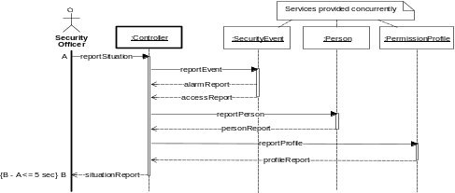
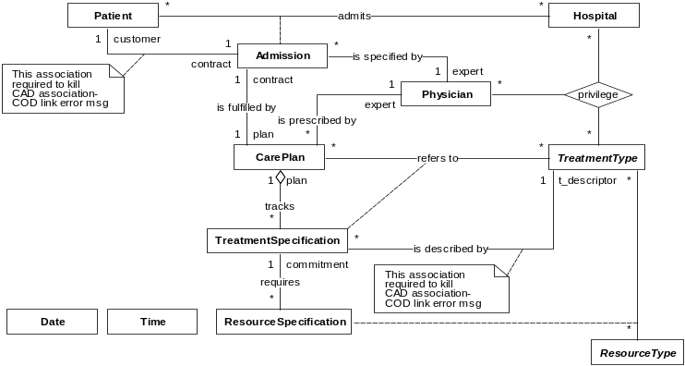
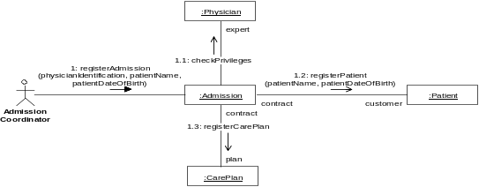
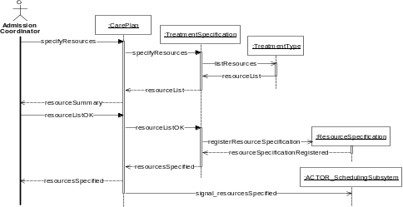
Relationship between Class & Interaction Diagrams
Interaction diagrams coalesce into class diagram(s):
objects into classes, links into associations
Notes:
One approach to object-oriented modeling — the one being presented in this course — is to proceed from the specific to the generic, i.e., from objects to classes. Objects are abstractions of the “real” things being modeled and classes are descriptors of sets of objects that share the same properties. Classes are used for the sake of brevity — typically there are just too many objects to consider drawing all of them.

Slide 39
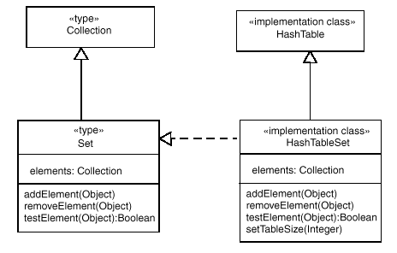
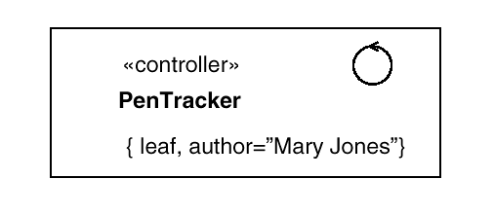
Class with Stereotype / Property
  A persistent class is described by putting {persistent} property in the name compartment.
  Conceptual, spec. and implem. classes are described using «type» and «implementation class» stereotypes.
  Classes can be stereotyped to «entity», «boundary» and «controller» based on the model-view-controller concept (data-UI-logic layers).
Conceptual or
specification class
Implementation
class
Stereotype icon
Entity
Boundary

Slide 40
Interface and Abstract Class
  An interface is a class with no implementation (i.e., no objects)
    has operation declaration but no method bodies and no fields.
  An interface is often declared through abstract class.
    Subclassing provides the implementation, but clients never see the implementation, only the interface.
    Abstract class allows you to add implementation of some of the methods; an interface forces you to defer definition of all methods.
    Abstract classes are described by {abstract} property in the name compartment.
  Refinement is a relationship between two descriptions of the same thing, but at different levels of abstraction (levels of detail).
  A class that uses the interface implemented in another class is connected via a dependency relationship to the interface circle.

Slide 41
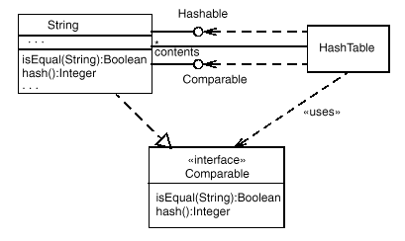
Interface
Refinement
Dependency

Slide 42
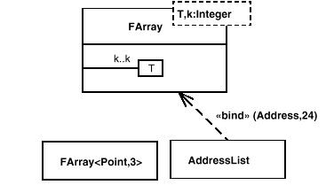
Parameterized Class
  A template is the descriptor for a class with one or more unbound formal parameters.
  Defines a family of classes, each class specified by binding the parameters to actual values.
  Attributes and operations within the template are defined in terms of the formal parameters.

Slide 43
Association
  Conceptual level: semantics as in ERD
    e.g., an Order must come from a single Customer, and a Customer may make several Orders over time
  Specification level: responsibilities (i.e., interface)
    e.g., there are one or more methods assoc. w/ Customer that tell what orders a given Customer has made, and those assoc. w/ Order telling which Customer placed a given Order; further, Customer could be specified in the constructor for Order.
  Implementation level: physical implementation
    e.g., Customer has a field that is a collection of pointers to Orders.
Customer
1
*
Order

Slide 44
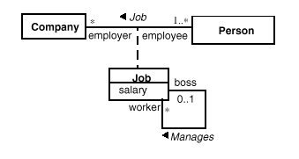

Association
  Each association has two roles, one for each direction.
    Role name: verb phrase or noun (responsibility or operation).
  Multiplicity : 0..1; 1 (default); * (0..∞); 1..*; 2,4; 5.
  Navigability: An arrow at the end of the association line indicates that the assoc. can be used in only that direction.
    Meaningful only in spec. and implem. diagrams.
Association
Association name
Role
Multiplicity
Reflexive
association
Or constraint

Slide 45
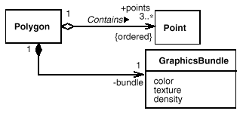
Adornments on Assoc. Roles
  N-side -- {ordered}, {multiset}, {ordered multiset}, {tree}, {directed tree}, etc.
  Visibility -- public (+), private (−), protected (#)

Slide 46
Qualified Association
Unqualified
Hospital
Admission
Name
AdmissionId
Date
Type
NumberOfBeds
1
authorizes
*
AHAClassification
Qualified
Partial key of
the weak entity
Hospital
Admission
Name
Date
Type
NumberOfBeds
1
authorizes
1
AHAClassification
AdmissionId
Weak entity type
“Given a Hospital and an AdmissionId,
there can be only one Admission.”

Slide 47
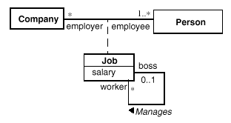
Association Class
  Allows to add attributes and operations to associations
  There can be only one instance of the assoc. class between any pair of participating objects (like the associative entity type in the data model).
  If a person can have more than one job in a company, you need to promote the assoc. class to a full class.
Associative entity type

Slide 48
Example: Association Class
Admission
AdmissionId
Date
Type
ScheduleNew
Reschedule
Hospital
Patient
*
*
Name
Name
NumberOfBeds
serves
AHAClassification
PatientId
Notes:
This shows another way to model hospital admissions.

Slide 49
N-ary Association
  Each instance of the association is an n-tuple of values from the respective classes.
  The multiplicity on a role represents the potential number of instance tuples in the association when the other N-1 values are fixed.
Person
Association class
*
Assignment
startDate
endDate
cancel
1
Role
*
Project

Slide 50
Generalization
  Conceptual level: supertype/subtype relationship as in ERD
  Specification level: Interface of the subtype must include all elements from (or must conform to) the interface of the supertype.
    E.g. a Corporate Customer can substitute a Customer within any code requiring a Customer.
    The Corporate Customer may respond differently from Personal Customer when the same operation, creditRating, is called. -- Polymorphism
  Implementation level: subclassing, i.e., inheritance of all the methods and fields of the superclass in programming language
Customer
Corporate
Customer
Personal
Customer

Slide 51
Example: Generalization
Admission
AdmissionId
Date
Type
ScheduleNew
Reschedule
InPatientAdmission
OutPatientVisitAdmission
RoomType
Reason
PlannedLengthOfStay
TypeOfVisit
ReasonForVisit
RecordNewAdmision
ChangeRoomType
RecordVisit
UpdatePlannedStay
Notes:
This simple model portrays the following:
There are two subclasses of admission:
InPatientAdmission
OutPatientVisitAdmission
All admissions, including the subclasses, have ...
Three attributes: AdmissionId, Date and Type
Two operations: ScheduleNew and Reschedule
InPatientAdmissions are a special type admission, with additional ...
Attributes: RoomType and PlannedLengthOfStay
Operations: RecordNewAdmission, ChangeRoomType, UpdatePlannedStay
Note: Subclasses can have their own connections to the superclass, or they can be joined into a “tree” as shown here; the meaning is the same.

Slide 52
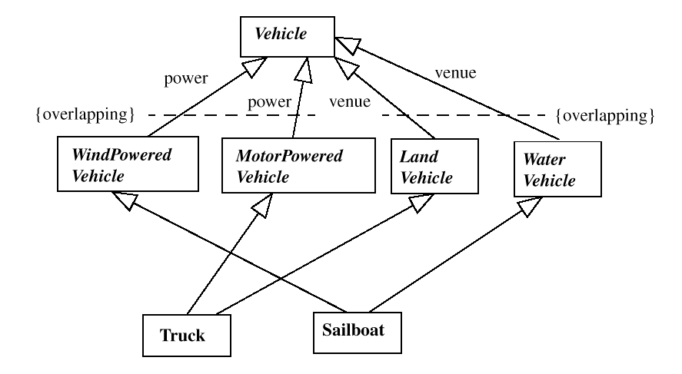
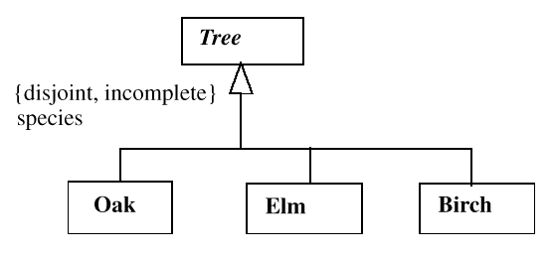
Classification
Discriminator
Multiple classification
(Multiple inheritance)

Slide 53
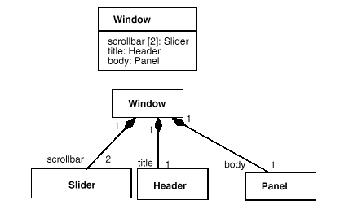
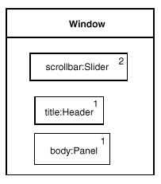
Aggregation
Whole-part relationship
  normal aggregation - 1:N
  shared aggregation - M:N
  composition aggregation - 1:N owner relationship
Navy
*
Warship
Team
*
*
Person

Slide 54
Example: Aggregation
TreatmentHistory
1
CompletedTreatment
record of
*
Status
Name
NextTreatment
Date
Duration
AddTreatment
TreatmentNote
RecordTreatment
CarePlan
LastUpdated
CompletionDate
UpdateCompDate
1
*
*
PrescribedTreatment
NursingOrder
Name
Name
Strength
Instructions
Duration
Note
TreatmentNote
RecordTreatment
RecordNote
Notes:
This simple model portrays the following:
A treatment history is an aggregate record of many completed treatments
A completed treatment is a component (part) of a treatment history

Slide 55
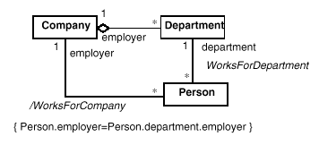

Derived Association / Attributes
  Derived assoc. and attributes can be calculated from other assoc. or attributes, resp.
  {Frozen} constraint can be used to indicate for an attribute or role, that its value may not change during the lifetime of the source object.
  {Read-only} indicates that a value cannot be changed directly, but may change due to a change in some other values.

Slide 56
Object Diagram
  An object is an instance of a class.
  An object diagram shows specific instances of classes in a class diagram and links between the instances at some point in time.
  It can be thus viewed as an example of a class diagram.
  It uses the same notation as the class diagram.
  Object name format: object name: class name
Node 1
Node 2
Node
*
*
Connects
Node 3
Node 4
Class Diagram
Object Diagram

Slide 57
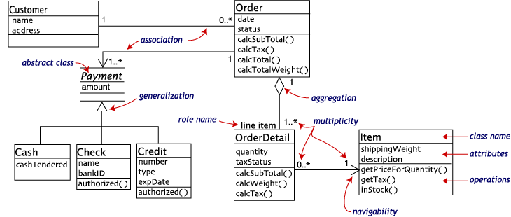
Example : Customer order from a retail catalog

Slide 58
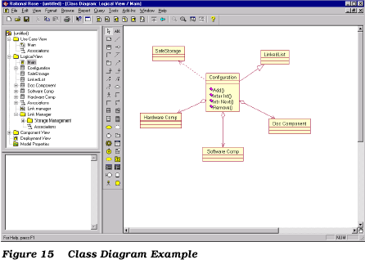
Example : Rational Rose Class Diagram

Slide 59
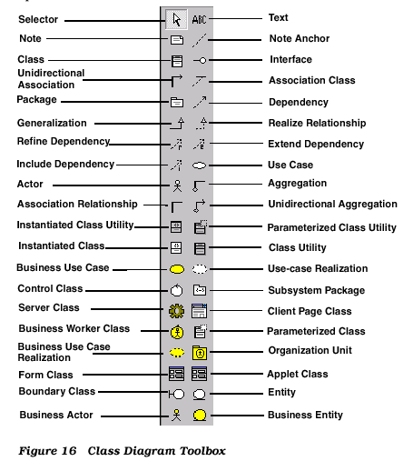
Example : Rational Rose Class Tool

