Slide 1

Session 3
How to Approach the UML
Written by Thomas A. Pender
Published by Wiley Publishing, Inc.
October 5, 2011
Presented by Kang-Pyo Lee

Slide 2
Contents
Views
  Functional View
  Static View
  Dynamic View
  Three Views
Object-Oriented Principles

Slide 3
Views (1/7)
UML includes specifications for nine different diagrams plus Packages
The Component and Deployment diagrams describe an implementation
The remaining seven diagrams are used to model requirements and design
This session presents
  A way to organize these last seven diagrams to make them easier to remember and apply
  An overview of the principles that guide their development

Slide 4
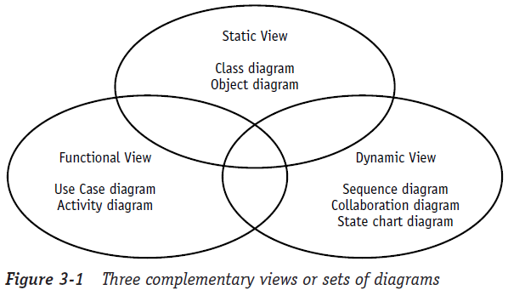
Views (2/7)
A view is a collection of diagrams that describe a similar aspect of the project
Three distinct yet complementary views
  Static View, Dynamic View, and Functional View

Slide 5
Views (3/7)
Consider the process of applying for a job
  The static part of the job description
    You can find out what the job is about through a published description
    A typical job description begins with a title and a brief definition of the job, usually in paragraph form
    It simply states what the job is
  The dynamic part of the job
    The job description is usually followed by a list of duties detailing what is expected of you in the performance of this job
    You could think of the listed items as demands placed on you throughout the course of your job
  The functional details of the job
    After you get the job, there are often specific instructions on how to do your job
    E.g., how to perform the job rather than what to perform

Slide 6
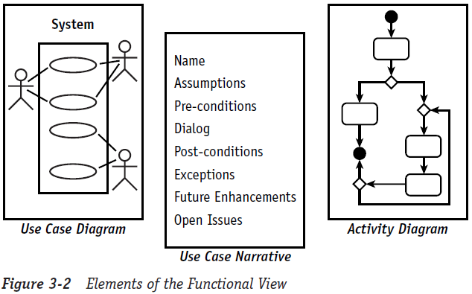
Views (4/7)
- Functional Views
The Use Case diagram describes the features that the users expect the system to provide
The Activity diagram describes processes including sequential tasks, conditional logic, and concurrency
  Like a flowchart, but enhanced for use with object modeling

Slide 7
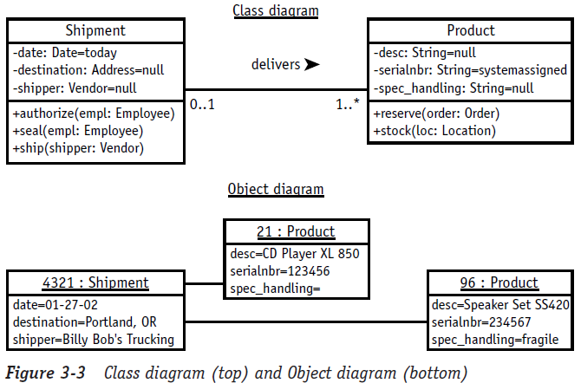
Views (5/7)
- Static Views
The Class diagram is the primary static diagram
  the foundation for modeling the rules about types of objects (classes), the source for code generation, and the target for reverse engineering
The Object diagram illustrates facts in the form of objects to model examples and test data
  can be used to test or simply to understand a Class diagram

Slide 8
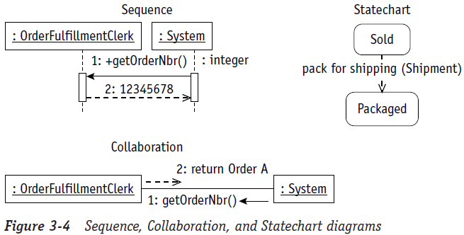
Views (6/7)
- Dynamic Views
For modeling object interactions, the Dynamic View includes the Sequence and Collaboration diagrams
The Statechart diagram provides a look at how an object reacts to external stimuli and manages internal changes

Slide 9
Views (7/7)
- Three Views
"Why do I have to do all of these diagrams? Joe next door has always just drawn Class diagrams.“
The diagrams each look at your problem in a different way
  Like different witnesses to a car accident
The diagrams will overlap
  If they agree where they overlap, you can relax knowing you’ve probably got it right
  When they disagree, you’ve pinpointed where you need to invest your effort
  When everything agrees, you know you’re done

Slide 10
Contents
Views
Object-Oriented Principles
  Abstraction
  What an Object Knows
  Encapsulation

Slide 11
Object-Oriented Principles (1/7)
All the UML diagrams describe some form of object-oriented information
So what is an object?
  An object can be a physical entity, like the things you see
  An object may also be intangible, for example, a concept like an illness, attendance, or a job
  Even though a job is not something you can touch, it is something you can describe, discuss, assign, and complete

Slide 12
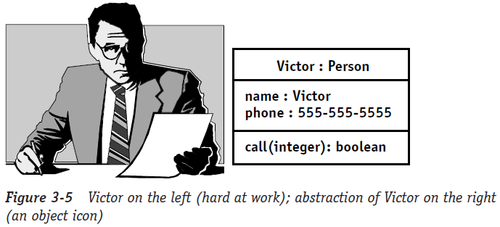
Object-Oriented Principles (2/7)
- Abstraction
A software object is an abstraction, a representation of something in the real world
An abstraction is a way to describe something where you only include the information about it that is important to you
My own working definition for creating an abstraction is: representing something in the real world in a useful manner to solve a specific problem

Slide 13
Object-Oriented Principles (3/7)
- What an Object Knows
To function properly, every object has to know two kinds of information and two types of behavior
Information
  An object can describe itself
  An object knows its current condition (or state)
Behavior
  An object knows what it can do
  An object knows what can be done to it

Slide 14
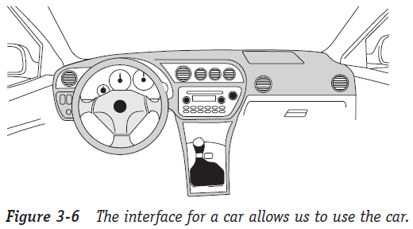
Object-Oriented Principles (4/7)
- Encapsulation
Encapsulation says you need to separate everything you know about the object into two categories:
  What you need to know in order to use the object
  What you need to know in order to make the object work properly
To use the object
  In order to use an object, you need to expose the interface of the object, like the car interface

Slide 15
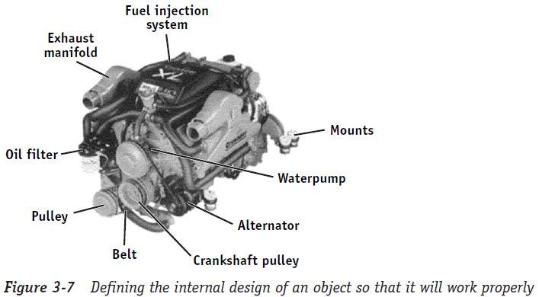
Object-Oriented Principles (5/7)
- Encapsulation
To make the object work properly
  Encapsulation tells you that the information has to be inside the object with the behavior so that you can control access to it and protect its integrity (information hiding)
    The implementations for each interface
    The data that describes the structure of the object
    The data that describes the current state of the object

Slide 16
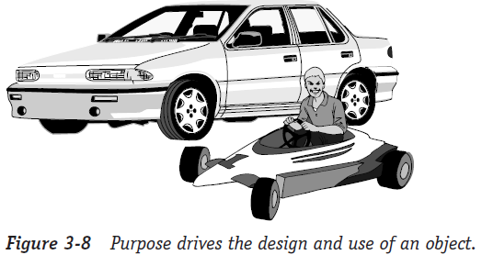
Object-Oriented Principles (6/7)
- Encapsulation
Giving an object purpose
  You need to know why that type of object exists, what it was designed for
  The interface is designed to satisfy the purpose

Slide 17
Object-Oriented Principles (7/7)
- Encapsulation
Encapsulation summary
  Encapsulation of an object requires you to expose:
    Its purpose, so you can select the proper object for the application you have in mind
    Its interface, so you know how to use the object
  Encapsulation of an object requires you to hide:
    The implementation that provides the behavior requested through the interface
    The data within the object that provides the structure that supports its behavior, and tracks the condition of the object, its state, at any given point in time

Slide 18
The End

