Slide 1
O’Reilly – Hadoop: The Definitive Guide Ch.7 MapReduce Types and Formats
29 July 2010
Taikyoung Kim

Slide 2
Outline
MapReduce Types
Input Formats
Output Formats

Slide 3
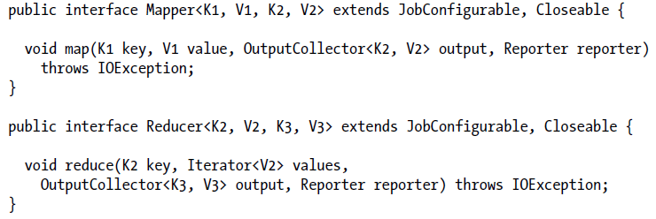
MapReduce Types(1/7)
≠
General form
Java interface
OutputCollector emitts key-value pairs
Reporter updates counters and status
map: (K1, V1) → list(K2, V2)
reduce: (K2, list(V2)) → list(K3, V3)
=

Slide 4


MapReduce Types(2/7)
Combine function
The same form as the reduce function, except its output types
Output type is the same as Map
Often the combine and reduce functions are the same
Partition function
Input intermediate key and value types
Returns the partition index

Slide 5
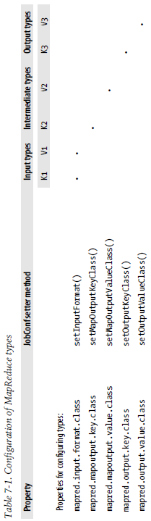

MapReduce Types(3/7)
Input types are set by the input format
Ex) setInputFormat(TextInputFormat.class)
Generate Key type: LongWritable, Value type: Text
Other types are set explicitly by calling the methods on the JobConf
Ex) JobConf conf; conf.setMapOutputKeyClass(Text.class)
Intermediate types are also set as the final output types by default
Just need to call setOutputKeyClass() if K2 and K3 are the same

Slide 6
MapReduce Types(4/7)
Why can’t the types be determined from a combination of the mapper and the reducer?
Type Erasure in JAVA Compiler deletes generic types at compile time
The configuration isn’t checked at compile time
Possible to configure a MapReduce job with incompatible types
Type conflicts are detected at runtime
Give types to Hadoop explicitly
Notes:
Type Erasure: JVM 레벨의 호환성을 위해서 컴파일 시에 제네릭 타입 정보를 삭제해버리는 기능

Slide 7
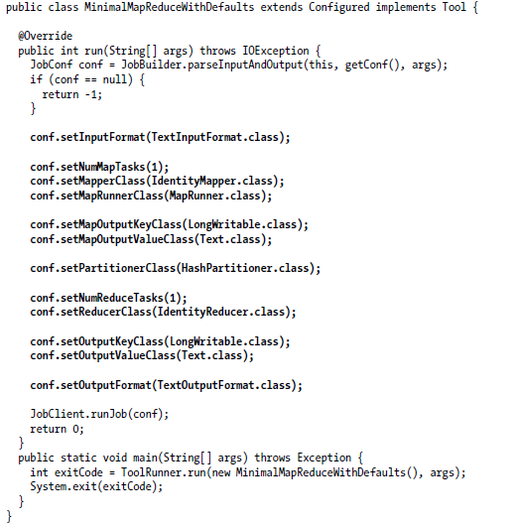
MapReduce Types(5/7) The Default MapReduce Job
Default Input Format
TextInputFormat
LongWritable (Key)
Text (Value)
setNumMapTasks(1)
Does not set the number of map tasks to one
1 is a hint

Slide 8
MapReduce Types(6/7) Choosing the Number of Reducers
The optimal number of reducers is related to the total number of available reducer slots
Total number of available reducers =
Total nodes * mapred.tasktracker.reduce.tasks.maximum
To have slightly fewer reducers than total slots
Tolerate a few failures without extending job execution time

Slide 9
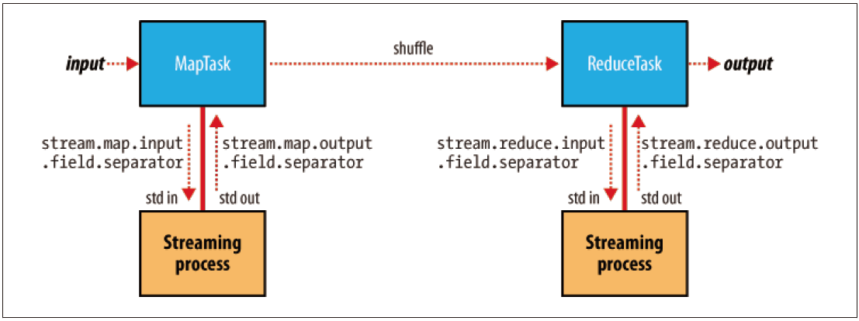
MapReduce Types(7/7) Keys and values in Streaming
A streaming application can control the separator
Default separator: tab character
Separators may be configured independently for maps and reduces
The number of fields separated by itself to treat as the map output key
Set the first n fields in stream.num.map.output.key.fields
Ex) Output was a,b,c (and separator is a comma), n=2
Key: a,b Value:c

Slide 10
Outline
MapReduce Types
Input Formats
Input Splits and Records
Text Input
Binary Input
Multiple Inputs
Database Input(and Output)
Output Formats

Slide 11
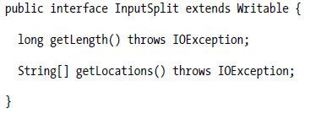
Input Formats Input Splits and Records
InputSplit (org.apache.hadoop.mapred package)
A chunk of the input processed by a single map
Each split is divided into records
Split is just a reference to the data (Doesn’t contain the input data)
Ordering the splits
To process the largest split first (minimize the job runtime)

Slide 12
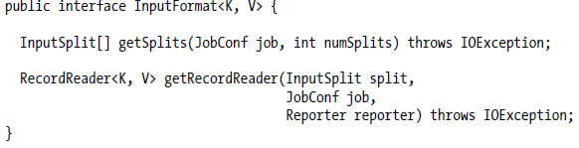
Input Formats Input Splits and Records - InputFormat
Create the input splits, and dividing them into records
numSplits argument of getSplits() method is a hint
InputFormat is free to return a different number of splits
The client sends the calculated splits to the jobtracker
Schedule map tasks to process on the tasktrackers
RecordReader
Iterate over records
Used by the map task to generate record key-value pairs

Slide 13
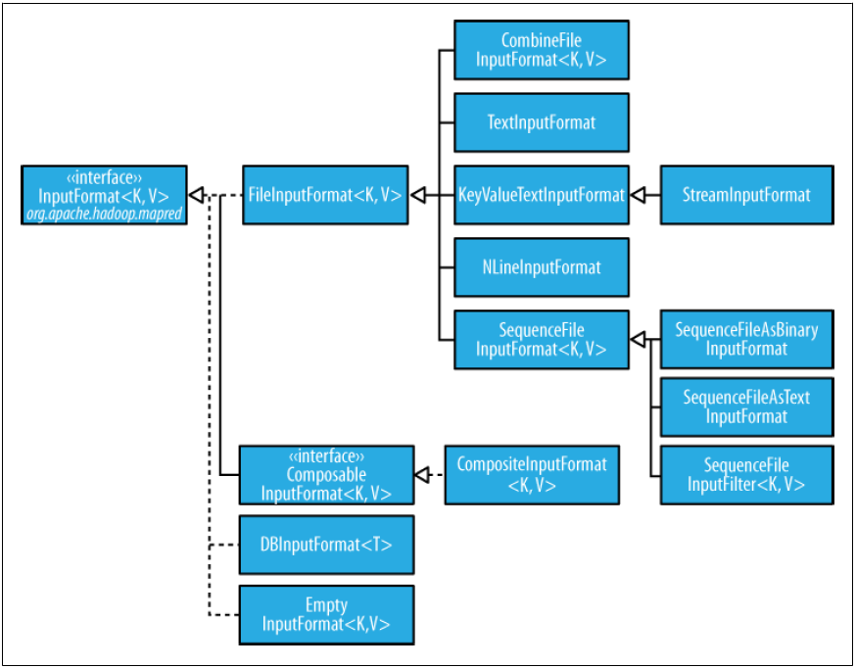
Input Formats Input Splits and Records - FileInputFormat
The base class for all InputFormat that use files as their data source

Slide 14

Input Formats Input Splits and Records - FileInputFormat
FileInputFormat offers 4 static methods for setting a JobConf’s input paths
addInputPath() and addInputPaths()
Add a path or paths to the list of inputs
Can call these methods repeatedly
setInputPaths()
Set entire list of paths in one time (Replacing any paths that were set in previous calls)
A path may represent
A file
A directory (consider all files in the directory as input)
Error when subdirectory exists (solved by glob or filter)
A collection of files and directories by using a glob

Slide 15
Input Formats Input Splits and Records - FileInputFormat
Filters
Use FileInputFormat as a default filter
Exclude hidden files
Use setInputPathFilter() method
Act in addition to the default filter
Refer page 61

Slide 16
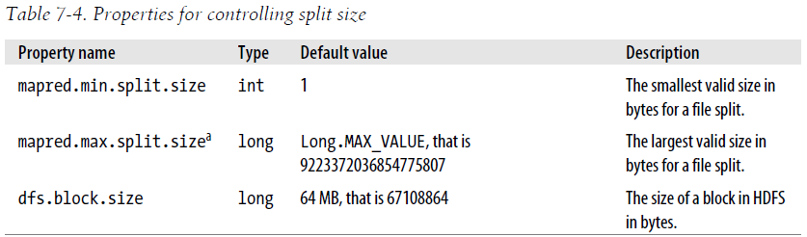
Input Formats Input Splits and Records – FileInputFormat input splits
FileInputFormat splits only large files that larger than an HDFS block
Normally the split size is the size of an HDFS block
Possible to control the split size
Effect maximum split size: The maximum size is less than block size

Slide 17
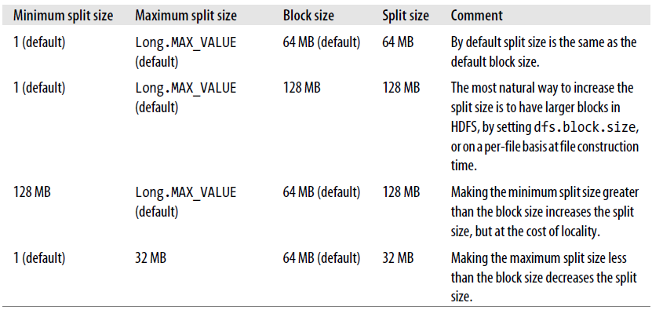
Input Formats Input Splits and Records – FileInputFormat input splits
The split size calculation (computeSplitSize() method)
By default
Split size is blockSize
Control the split size

Slide 18
Input Formats Input Splits and Records – Small files and CombineFileInputFormat
Hadoop works better with a small number of large files than a large number of small files
FileInputFormat generates splits that each split is all or part of a single file
Bookkeeping overhead with a lot of small input data
Use CombineFileInputFormat to pack many files into splits
Designed to work well with small files
Take node and rack locality when packing blocks into split
Worth when already have a large number of small files in HDFS
Avoiding the many small files is a good idea
Reduce the number of seeks
Merge small files into larger files by using a SequenceFile

Slide 19
Input Formats Input Splits and Records – Preventing splitting
Some application don’t want files to be split
Want to process entire data by a single mapper
Two ways of ensuring an existing file is not split
Set the minimum split size larger than the largest file size
Override the isSplitable() method to return false

Slide 20

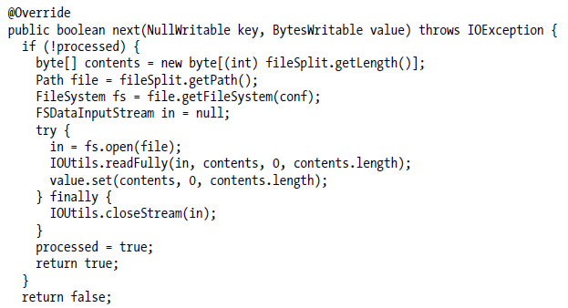
Input Formats Input Splits and Records – Processing a whole file as a record
WholeFileRecordReader
Take a FileSplit and convert it into a single record

Slide 21


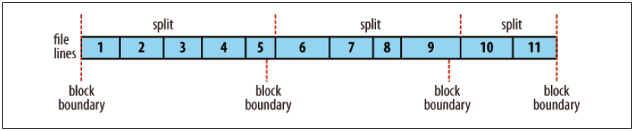
Input Formats Text Input - TextInputFormat
TextInputFormat is the default InputFormat
Key: The byte offset of the beginning of the line (LongWritable) ; Not line number
Value: The contents of the line excluding any line terminators (Text)
Each split knows the size of the preceding splits
A global file offset = The offsets within the split + The size of preceding splits
The logical records do not usually fit into HDFS

Slide 22
Input Formats Text Input - NLineInputFormat
Each mapper receives a variable number of lines of input using:
TextInputFormat, KeyValueTextInputFormat
To receive a fixed number of lines of input, use
NLineInputFormat as InputFormat
N: The number of lines of input
Control N in Mapred.line.input.format.linespermap property
Inefficient if a map task takes a small number of lines of input
Due to task setup overhead

Slide 23
Input Formats Text Input - XML
Use StreamXmlRecordReader class for XML
Org.apache.hadoop.streaming package
Set stream.recordreader.class to org.apache.hadoop.streamin.StreamXmlRecordReader

Slide 24
Input Formats Binary Input
SequenceFileInputFormat
Hadoop’s sequence file format stores sequences of binary key-value pairs
Data is splittable (Data has sync points)
Use SequenceFileInputFormat
SequenceFileAsTextInputFormat
Convert the sequence file’s keys and values to Text objects
Use toString() method
SequenceFileAsBinaryInputFormat
Retrieve the sequence file’s keys and values as opaque binary objects

Slide 25
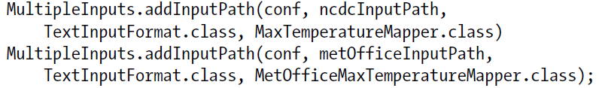
Input Formats Multiple Inputs
Use MultipleInput when
Have data sources that provide the same type of data but in different formats
Need to be parsed differently
Ex) One might be tab-separated plain text, the other a binary sequence file
Use different mappers
The map outputs have the same types
Reducers are not aware of the different mappers

Slide 26
Outline
MapReduce Types
Input Formats
Output Formats
Text Output
Binary Output
Multiple Outputs
Lazy Output
Database Output

Slide 27
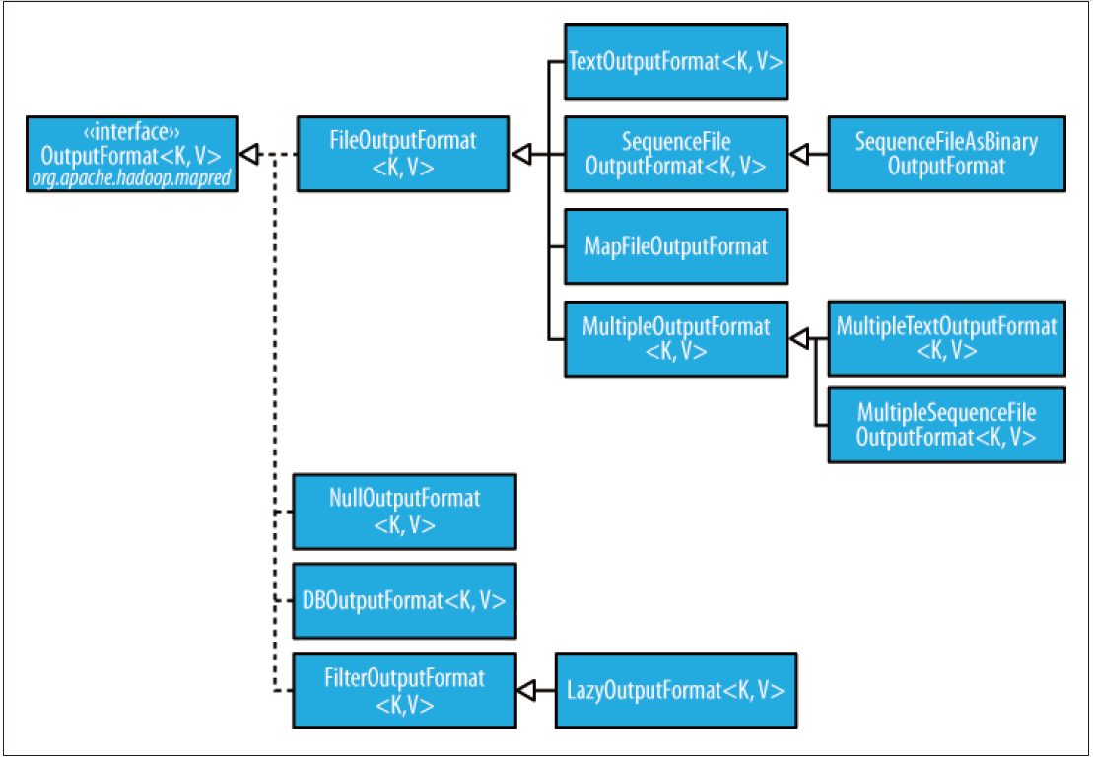
Output Formats
The OutputFormat class hierarchy

Slide 28

Output Formats Text Output
TextOutputFormat (default)
Write records as lines of text
Keys and Values may be of any type
It calls toString() method
Each key-value pair is separated by a tab character
Set the separator in mapred.textoutputformat.separator property

Slide 29
Output Formats Binary Output
SequenceFileOutputFormat
Write sequence files for its output
Compact, readily compressed (Useful for a further MapReduce job)
SequenceFileAsBinaryOutputFormat
Write keys and values in raw binary format into a SequenceFile container
MapFileOutputFormat
Write MapFiles as output
The keys in MapFile must be added in order
Ensure that the reducers emit keys in sorted order (only for this format)

Slide 30
Output Formats Multiple Output
MultipleOutputFormat and MultipleOutputs
Help to produce multiple files per reducer
MultipleOutputFormat
The names of multiple files are derived from the output keys and values
Is an abstract class with
MultipleTextOutputFormat
MultipleSequenceFileOutputFormat
MultipleOutputs
Can emit different types for each output (Differ from MultipleOutputFormat)
Less control over the naming of outputs

Slide 31
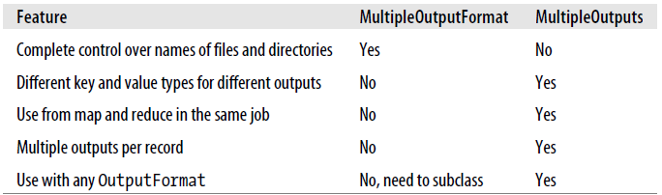
Output Formats Multiple Output
Difference between MultipleOutputFormat and MultiplOutputs
MultipleOutputs is more fully featured
MultipleOutputFormat has more control over the output directory structure and file naming

Slide 32
Output Formats Lazy Output
LazyOutput helps some applications that doesn’t want to create empty files
Since FileOutputFormat subclasses create output files even if they are empty
To use it
Call its setOutputFormatClass() method with the JobConf option

