Slide 1
Clustering Distributed Data Streams in Peer-to-Peer Environments
Sanghamitra Bandyopadhyay, Chris Giannella, Ujjwal Maulik, Hillol Kargupta, Kun Liu, Souptik Datta (University of Maryland)
Information Sciences ‘06
08 January 2016
InYong Lee

Slide 2
Introduction
Problems in centralized data clustering
Not scalable
Sometimes inappropriate
Distributed Clustering Algorithm Categories
One consisting multiple rounds of message passing
The other one consisting local clustering models and transmit to center asynchronously

Slide 3
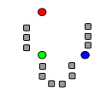
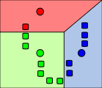
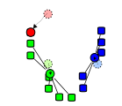
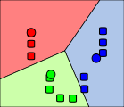
K-means Clustering (1/2)
Make ‘K’ number of Clusters

Slide 4

K-means Clustering (2/2)
Total n Data in d dimension : x₁ ~ x_{n}
Set of data in i^{th} cluster : S_{i}
Centroid of the i^{th} cluster : μ_{i}
Known to minimize

Slide 5
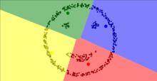
K-means Clustering Limitation
Local optimum
Sometimes infinite loop
Sensitive to outliers
Suitable for spherical clusters

Slide 6
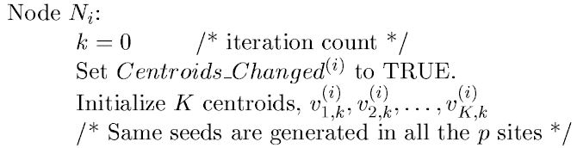
P2P K-Means Clustering (1/4)
K is the number of clusters
k is the number of iteration
i is the node number

Slide 7
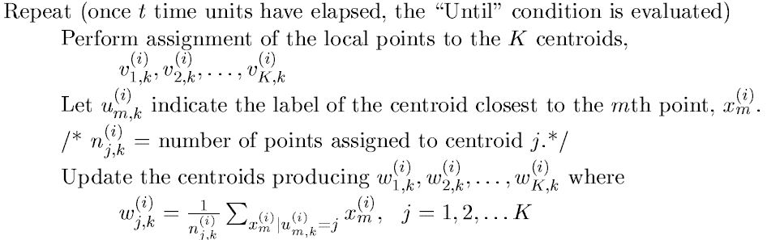

P2P K-Means Clustering (2/4)
has value from 1 to K

Slide 8
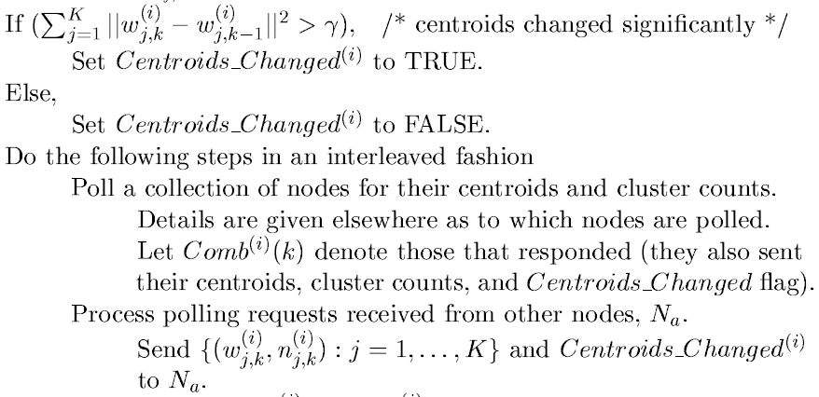

P2P K-Means Clustering (3/4)
Ddd
is the changes of the centroids
Node structure may change during this phase (Dynamic Network)

Slide 9
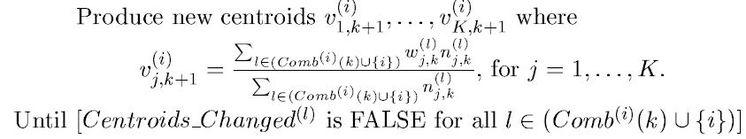
P2P K-Means Clustering (4/4)
Repeat until every returns FALSE
Some nodes may not be in iteration k
Need to synchronize the whole system (wait)

Slide 10
Polling Algorithm
For each node N_{i}
Need to decide which other nodes to poll
Random sampling
More complicated since routing is required
Does not bias the centroids
Immediate neighbors
Much easier to analyze the error

Slide 11
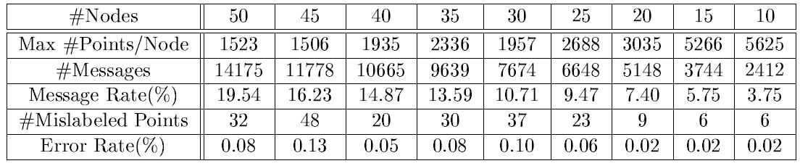
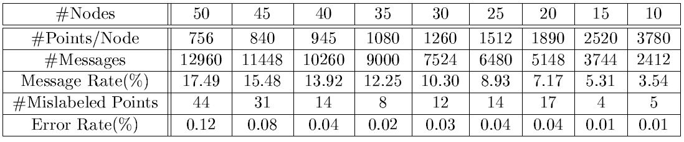
Experiments
Non-uniform
Original data sets : 37,800 data points
Non-uniform distribution vs Uniform Distribution
Sample (polling number) size are from 3 ~ 15
Uniform

Slide 12
Conclusion
P2P K-Means
Need low communication as possible
Synchronization is needed
Non-uniform, Uniform distribution effects the accuracy
Further study
More K-Means algorithms to apply

