Slide 1
Chapter 1: Introduction

Slide 2
Database System Concepts
Chapter 1: Introduction
Part 1: Relational databases
  Chapter 2: Introduction to the Relational Model
  Chapter 3: Introduction to SQL
  Chapter 4: Intermediate SQL
  Chapter 5: Advanced SQL
  Chapter 6: Formal Relational Query Languages
Part 2: Database Design
  Chapter 7: Database Design: The E-R Approach
  Chapter 8: Relational Database Design
  Chapter 9: Application Design
Part 3: Data storage and querying
  Chapter 10: Storage and File Structure
  Chapter 11: Indexing and Hashing
  Chapter 12: Query Processing
  Chapter 13: Query Optimization
Part 4: Transaction management
  Chapter 14: Transactions
  Chapter 15: Concurrency control
  Chapter 16: Recovery System
Part 5: System Architecture
  Chapter 17: Database System Architectures
  Chapter 18: Parallel Databases
  Chapter 19: Distributed Databases
Part 6: Data Warehousing, Mining, and IR
  Chapter 20: Data Mining
  Chapter 21: Information Retrieval
Part 7: Specialty Databases
  Chapter 22: Object-Based Databases
  Chapter 23: XML
Part 8: Advanced Topics
  Chapter 24: Advanced Application Development
  Chapter 25: Advanced Data Types
  Chapter 26: Advanced Transaction Processing
Part 9: Case studies
  Chapter 27: PostgreSQL
  Chapter 28: Oracle
  Chapter 29: IBM DB2 Universal Database
  Chapter 30: Microsoft SQL Server
Online Appendices
  Appendix A: Detailed University Schema
  Appendix B: Advanced Relational Database Model
  Appendix C: Other Relational Query Languages
  Appendix D: Network Model
  Appendix E: Hierarchical Model

Slide 3
Chapter 1: Introduction
1.1 Database-System Applications
1.2 Purpose of Database Systems
1.3 View of Data
1.4 Database Languages
1.5 Relational Databases
1.6 Database Design
1.7 Object-based and Semistructured databases
1.8 Data Storage and Querying
1.9 Transaction Management
1.10 Data Mining and Analysis
1.11 Database Architecture
1.12 Database Users and Administrators
1.13 History of Database Systems

Slide 4
1.1. Database System Applications
Database Management System (DBMS)
DBMS contains information about a particular enterprise
  Collection of interrelated data
  Set of programs to access the data
  An environment that is both convenient and efficient to use
Database Applications:
  Banking: transactions
  Airlines: reservations, schedules
  Universities: registration, grades
  Sales: customers, products, purchases
  Online retailers: order tracking, customized recommendations
  Manufacturing: production, inventory, orders, supply chain
  Human resources: employee records, salaries, tax deductions
Databases can be very large.
Databases touch all aspects of our lives

Slide 5
University Database Example
Application program examples
  Add new students, instructors, and courses
  Register students for courses, and generate class rosters
  Assign grades to students, compute grade point averages (GPA) and generate transcripts
  Deposit money into a bank account
  Assign seats in a flight of an airplane
  Buy and sell stocks in an home trading system
  Run an internet portal system based on keyword queries
In the early days, database applications were built directly on top of OS file systems

Slide 6
1.2 Purpose of Database Systems
Drawbacks of Using File Systems to Store Data
Data redundancy and inconsistency
  Multiple file formats, duplication of information in different files
  Ex. Customer file has records (name, phone_no, address)
  Customer_Auto file has records (name, job, auto_info, address)
Difficulty in accessing and manipulating data
  Need to write a new program to carry out each new task
  Application programming with data scattered in multiple files and formats is difficult
Integrity problems
  Semantics (integrity) of data
  Integrity constraints (e.g., account balance > 0) become “buried” in program code rather than being stated explicitly
  Hard to add new constraints or change existing ones

Slide 7
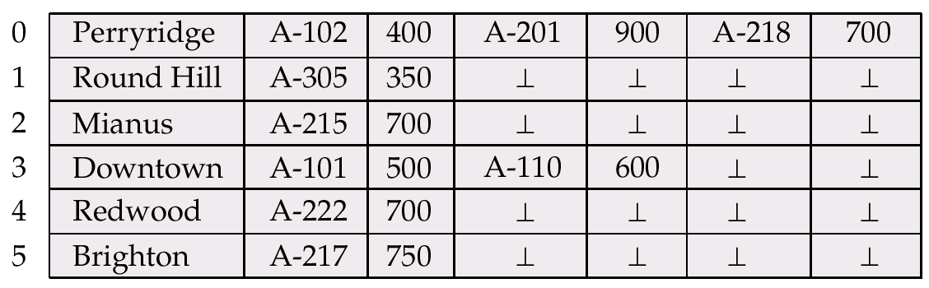

Files supported by OS
Branch name
account
account
account
Branch File having
Variable-length records
Customer File having
fixed-length records
customer
Account number

Slide 8
Drawbacks of Using File Systems to Store Data (Cont.)
Atomicity of updates
  Failures may leave database in an inconsistent state with partial updates carried out
  Example: Transfer of funds from one account to another should either complete or not happen at all
Concurrent access by multiple users
  Concurrent access needed for performance
  Uncontrolled concurrent accesses can lead to inconsistencies
    Example: Two people reading a balance (say 100) and updating it by withdrawing money (say 50 each) at the same time
Security problems
  Hard to provide user access to some, but not all, data
Database systems offer solutions to all the above problems

Slide 9
1.3 View of Data
Levels of Abstraction
Physical level: describes how a record (e.g., customer) is stored.
  File level
Logical level: describes data stored in database, and the relationships among the data.
  Relation level (= schema level)
  type instructor = record
  ID : string;
  name : string;
  dept_name : string;
  salary : integer;
        end;
View level: application programs hide details of data types.
  Application level
  Views can also hide information (such as an employee’s salary) for security purposes.

Slide 10

View of Data
An architecture for a database system

Slide 11
Instances and Schemas
Schema = Similar to types and variables in programming languages
Schema – the logical structure of the database
  Example: The database consists of information about a set of customers and accounts and the relationship between them
  Analogous to type information of a variable in a program
  Physical schema: database design at the physical level
  Logical schema: database design at the logical level
Instance – the actual content of the database at a particular point in time
  Analogous to the value of a variable
Physical Data Independence – the ability to modify the physical schema without changing the logical schema
  Applications depend on the logical schema
  In general, the interfaces between the various levels and components should be well defined so that changes in some parts do not seriously influence others.

Slide 12
Data Models
Data Model: A collection of tools for describing
  Data
  Data relationships
  Data semantics
  Data constraints
Relational model
Entity-Relationship data model (mainly for database design)
Object-based data models (Object-oriented and Object-relational)
Semistructured data model (XML)
Other older models:
  Network model
  Hierarchical model

Slide 13

Relational Data Model

Slide 14

E-R Data Model
Entity
Relationship
Entity

Slide 15

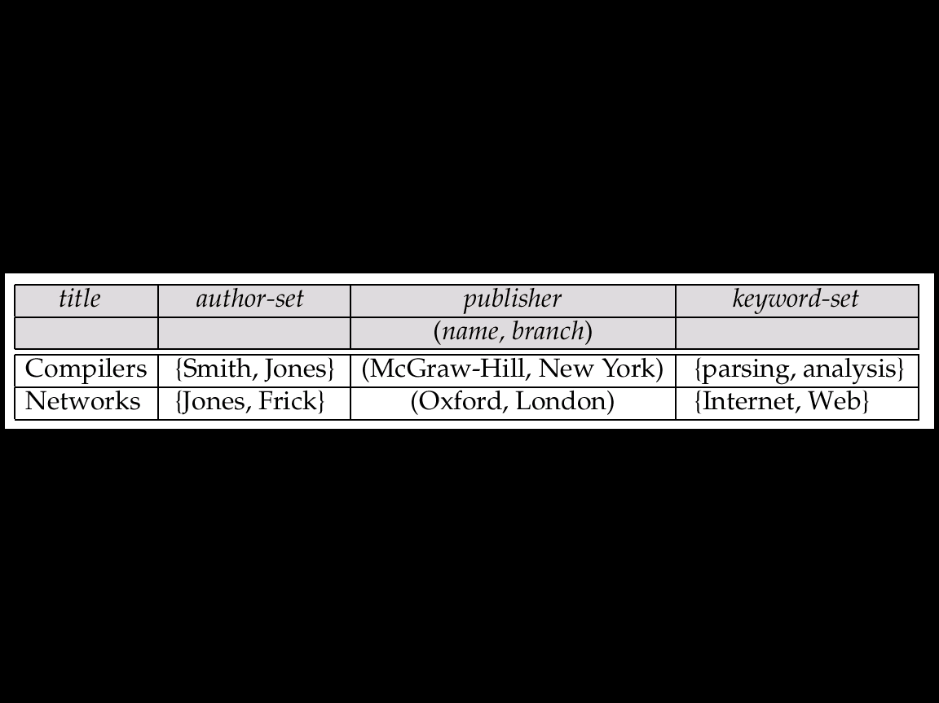
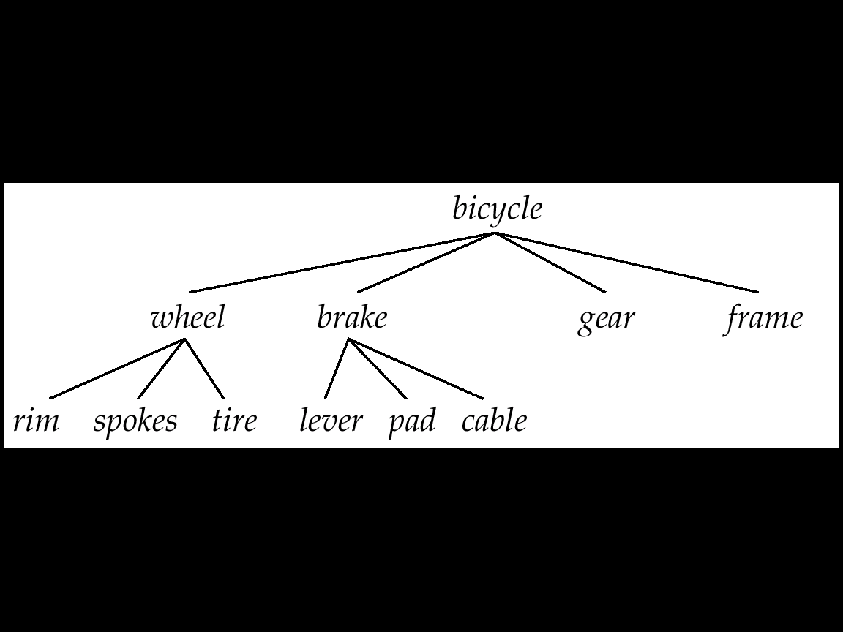
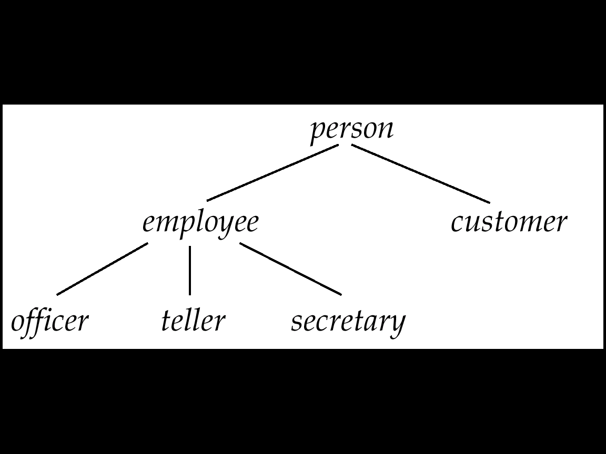
OR (Object-Relational) Data Model
name | street | city | amount
Lowerly | Maple | Queens | 900
Shiver | North | Bronx | 556
Shiver | North | Bronx | 647
Hodges | SideHill | Brooklyn | 801
Hodges | SideHill | Brooklyn | 647
Set valued attributes
Relation valued attributes
Is-part-of relationship
ISA relationship

Slide 16
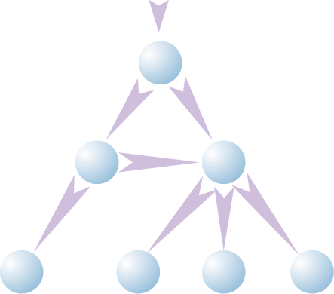

XML Data Model
<Bib>
<paper id=“o2” references=“o3”>
<author>Abiteboul </author>
</paper>
<book id=“o3”>
<author> Hull </author>
<title> Foundations of Data Bases </title>
<publisher> Addison Wesley </publisher>
</book>
</Bib>
Bib
1
paper
book
reference
2
3
XML data
author
author
publisher
title
4
5
6
7
Abiteboul
Hull
Foundations
Of Databases
Addison
Wesley
DOM Model

Slide 17
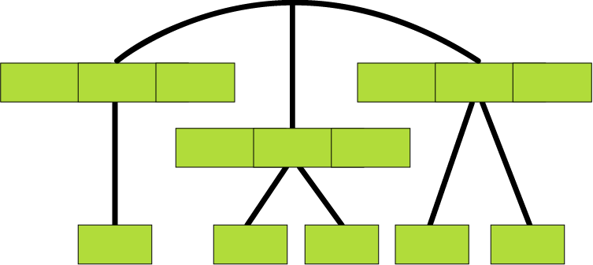
Hierarchical Data Model (Files and Pointers)
Root Record
Customer records
Lowery
Maple
Queens
Hodges
SideHill
Brooklyn
Shiver
North
Bronx
Amount records
900
556
647
647
801

Slide 18
1.4 Database Language
Data Manipulation Language (DML)
Language for accessing and manipulating the data organized by the appropriate data model
  DML also known as query language
Two classes of languages
  Procedural – user specifies what data is required and how to get those data
  Declarative (nonprocedural) – user specifies what data is required without specifying how to get those data
SQL is the most widely used query language
  1980년, IBM Researcher, Don Chamberlain

Slide 19
Data Definition Language (DDL)
Specification notation for defining the database schema
  Example: create table instructor (
  ID char(5),
  name varchar(20),
  dept_name varchar(20),
  salary numeric(8,2))
DDL compiler generates a set of table templates stored in a data dictionary
Data dictionary contains metadata (i.e., data about data)
  Database schema
  Integrity constraints
    Primary key (ID uniquely identifies instructors)
    Referential integrity (references constraint in SQL)
      e.g. dept_name value in any instructor tuple must appear in department relation
  Authorization

Slide 20
1.5 Relational Databases
Relational Model
Relational model (Chapter 2)
Example of tabular data in the relational model
Columns
Rows

Slide 21
A Sample Relational Database and SQL
SQL: widely used non-procedural language
  Example: Find the name of the instructor with ID 22222
  select name
  from instructor
  where instructor.ID = ‘22222’
  Example: Find the ID and building of instructors in the Physics dept.
  select instructor.ID, department.building
  from instructor, department
  where instructor.dept name = “physics”
Application programs generally access databases through one of
  Language extensions to allow embedded SQL
  Application program interface (e.g., ODBC/JDBC) which allow SQL queries to be sent to a database
Chapters 3, 4 and 5

Slide 22
1.6 Database Design
The process of designing the general structure of the database:
Logical Design – Deciding on the database schema.
  Database design requires that we find a “good” collection of relation schemas.
  Business decision – What attributes should we record in the database?
  Computer Science decision – What relation schemas should we have and how should the attributes be distributed among the various relation schemas?
Physical Design – Deciding on the physical layout of the database
  Deciding types of attributes
  Partition the relation into several small pieces vertically or horizontally
  Index assignment on attributes: B-tree index or Hashing or something else..

Slide 23


Database Design?
Is there any problem with this design?

Slide 24
Design Approaches
Normalization Theory (Chapter 8)
  Formalize what designs are bad, and test for them
Entity Relationship Model (Chapter 7)
  Models an enterprise as a collection of entities and relationships
    Entity: a “thing” or “object” in the enterprise that is distinguishable from other objects
      Described by a set of attributes
    Relationship: an association among several entities
  Represented diagrammatically by an entity-relationship diagram

Slide 25
The Entity-Relationship Model
Models an enterprise as a collection of entities and relationships
  Entity: a “thing” or “object” in the enterprise that is distinguishable from other objects
    Described by a set of attributes
  Relationship: an association among several entities
Represented diagrammatically by an entity-relationship diagram:
What happened to dept_name of instructor and student?

Slide 26
1.7 Object-Based and Semistructured Databases
Object-Relational Data Models
Relational model: flat, “atomic” values
Object Relational Data Models
  Extend the relational data model by including object orientation and constructs to deal with added data types.
  Allow attributes of tuples to have complex types, including non-atomic values such as nested relations.
  Preserve relational foundations, in particular the declarative access to data, while extending modeling power.
  Provide upward compatibility with existing relational languages.

Slide 27
XML: Extensible Markup Language
Defined by the WWW Consortium (W3C)
Originally intended as a document markup language not a database language
The ability to specify new tags, and to create nested tag structures made XML a great way to exchange data, not just documents
XML has become the basis for all new generation data interchange formats.
A wide variety of tools is available for parsing, browsing and querying XML documents/data

Slide 28
1.8 Data Storage and Querying
Storage Management
Storage manager is lower-half of DBMS engine
  a program module that provides the interface between the low-level data stored in the database and the application programs and queries submitted to the system.
The storage manager is responsible to the following tasks:
  Interaction with the file manager
  Efficient storing, retrieving and updating of data
Issues:
  Storage access
  File organization
  Indexing and hashing

Slide 29

Query Processing
Query Processor is a higher half of DBMS engine
Parsing and translation
2. Optimization
3. Evaluation

Slide 30
Query Processing (Cont.)
Alternative ways of evaluating a given query
  Equivalent expressions
  Different algorithms for each operation
Cost difference between a good and a bad way of evaluating a query can be enormous
Need to estimate the cost of operations
  Depends critically on statistical information about relations which the database must maintain
  Need to estimate statistics for intermediate results to compute cost of complex expressions

Slide 31
1.9 Transaction Management
What if the system fails?
What if more than one user is concurrently updating the same data?
A transaction is a collection of operations that performs a single logical function in a database application
Transaction-management component ensures that the database remains in a consistent (correct) state despite system failures (e.g., power failures and operating system crashes) and transaction failures.
Concurrency-control manager controls the interaction among the concurrent transactions, to ensure the consistency of the database.
  On-Line Transaction Processsing (OLTP)

Slide 32
Example of Transactions and Concurrent Access
Transaction to transfer $50 from account A to account B:
  1. read(A)
  2. A := A – 50
  3. write(A)
  4. read(B)
  5. B := B + 50
  write(B)
Two people P1 and P2 are using two company debit cards for business
  There is $1000 in the company account
  P1 is trying to retrieve $500
  P2 is trying to retrieve $300

Slide 33
1.10 Data Mining and Analysis
The process of semiautomatically analyzing large databases to find useful patterns and rules
Similar to Knowledge Discovery in AI (also called Machine Learning), but dealing with very large database
Decision Support System for Business
  Data-Warehouse (DW)
  On-Line Analytical Processsing (OLAP)
Information Retrieval from unstructured textual data

Slide 34

1.11 Database Architecture
Overall Database System Structure

Slide 35
Database Architecture
The architecture of a database systems is greatly influenced by the underlying computer system on which the database is running:
  Centralized
  Client-server
  Parallel (multi-processor)
  Distributed

Slide 36

Figure 1.06: Client-Server DBMS Architecture

Slide 37
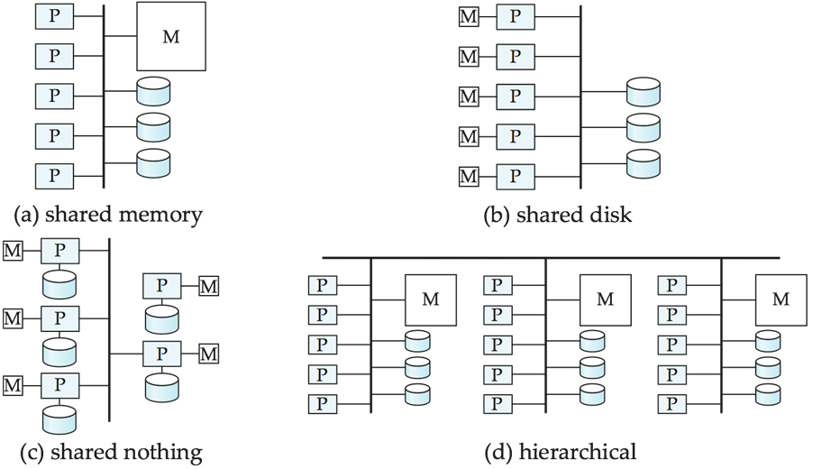
Parallel Database Architectures
Fig 17.08

Slide 38
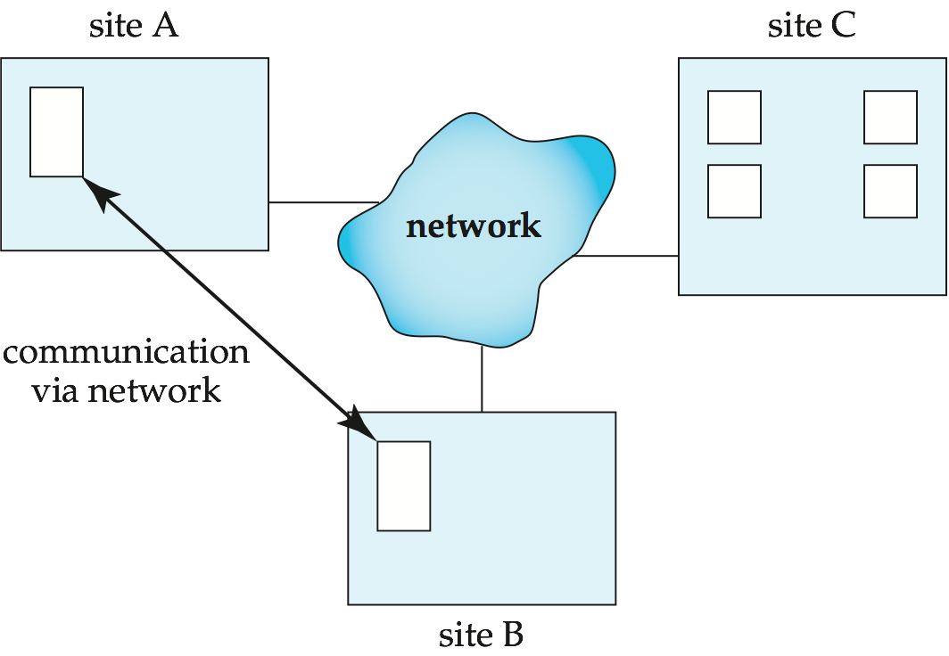
Distributed Database Systems
Fig 17.09

Slide 39

1.12 Database Users and Administrators
DataBase Management System
Users are differentiated by the way they expect to interact with the system
Application programmers – interact with system through DML calls
Sophisticated users – form requests in a database query language
Specialized users – write specialized database applications that do not fit into the traditional data processing framework
Naïve users – invoke one of the permanent application programs that have been written previously
  Examples, people accessing database over the web, bank tellers, clerical staff

Slide 40
Database Administrator (DBA)
Coordinates all the activities of the database system; the database administrator has a good understanding of the enterprise’s information resources and needs.
Database administrator's duties include:
  Schema definition
  Storage structure and access method definition
  Schema and physical organization modification
  Granting user authority to access the database
  Specifying integrity constraints
  Acting as liaison with users
  Monitoring performance and responding to changes in requirements

Slide 41
1.13 History of Database Systems
1950s and early 1960s:
  Data processing using magnetic tapes for storage
    Tapes provided only sequential access
  Punched cards for input
Late 1960s and 1970s:
  Hard disks allowed direct access to data
  Network and hierarchical data models in widespread use
  1970: Ted Codd defines the relational data model
    Would win the ACM Turing Award for this work
    1974: IBM Research begins System R prototype
    1974: UC Berkeley begins Ingres prototype
  High-performance (for the era) transaction processing
1980s:
  Research relational prototypes evolve into commercial systems
    SQL becomes industrial standard
  Parallel and distributed database systems
  Object-oriented database systems

Slide 42
History of Database Systems (Cont.)
1990s:
  Large decision support and data-mining applications
  Large multi-terabyte data warehouses
  1994: Emergence of Web!
  XML and XQuery standards
2000s:
  Automated database administration
  Semantic Web (Ontology, RDF)
  Giant data storage systems
    Google BigTable, Yahoo PNuts, Amazon, ..
2010s ~~
  Big Data Analytics (convergence with Statistics)
  Machine Learning
  Data Mining
  Internet of Things

