Slide 1
Discovering Simple Mappings Between Relational Database Schemas and Ontologies
Wei Hu, Yuzhong Qu
Southeast University, Nanjing, China
ISWC 2007
16 March 2012
SNU IDB Lab.
Hye Chan, Bae

Slide 2
Outline
Introduction
Approach
Evaluation
Conclusion
Discussion

Slide 3
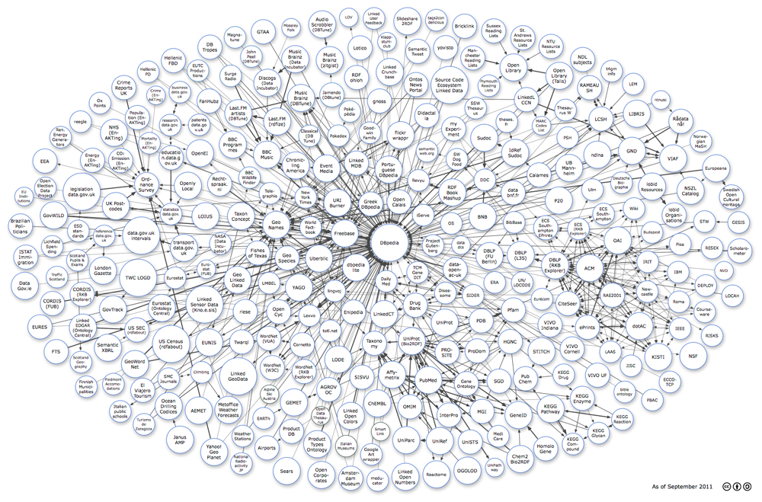
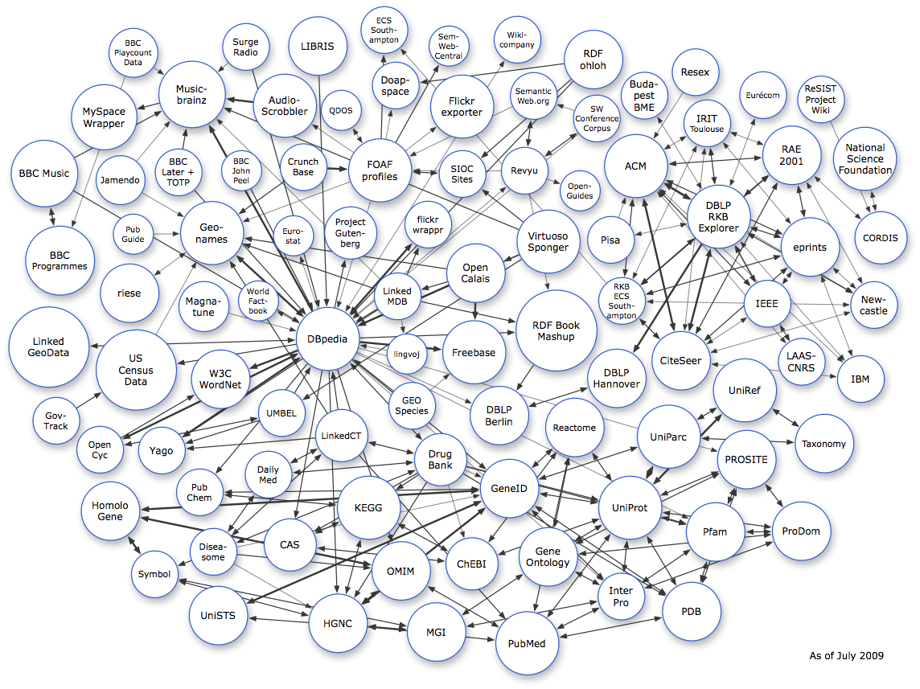

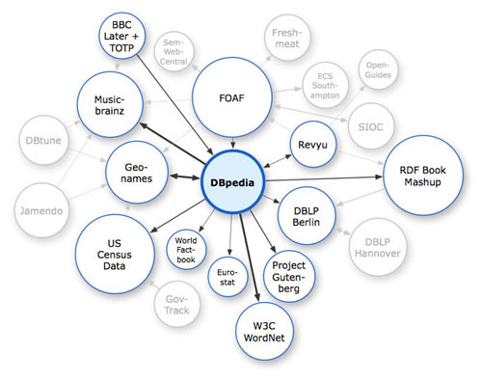
Introduction
The popularity of ontologies is rapidly growing
Since the emergence of the semantic web

Slide 4
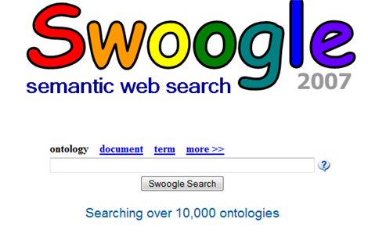
Introduction
The popularity of ontologies is rapidly growing
Swoogle collected more than 10,000 ontologies so far (2007)

Slide 5

Introduction
Still, most of the world's data are locked in data stores
Not published as an open Web resources
About 77.3% data on the current Web are stored in relational databases

Slide 6
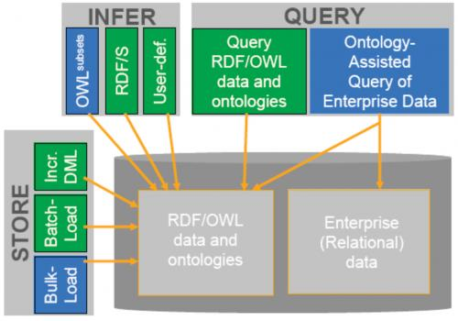
Introduction
It is necessary to establish interoperability between Semantic Web applications using
Relational databases
Ontologies

Slide 7





Introduction
Manually discovering simple mappings is tedious and improbable at the Web scale

Slide 8
Introduction
Automatic approaches have been proposed
Accuracy
Missed Semantic mappings
We propose a new approach
to discover simple mappings!!

Slide 9
Overview of the approach
Phase 1: Classifying entity types
Phase 2: Discovering simple mappings
Phase 3: Validating mapping consistency
Phase 4: Constructing contextual mappings
Constructs virtual documents for entities
Calculates confidence measure via TF/IDF model
Use <relation, class> mappings to validate the consistency of <attribute, property>
<relation, class> + sample instances → contextual mappings

Slide 10
An example
Left part: relations, attributes, primary keys, foreign keys
Right part: classes, properties (object / data)
A mapping m = <id, u, v, t, f>
u : an entity in relational schema
v : an entity in ontology
t : a relationship (equivalence / subsumption)
f : a confidence measure [0, 1]

Slide 11
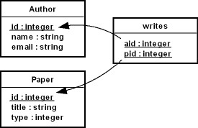
Phase1: Classifying entity types
Relation types
Strong entity relation (SER)
Weak entity relation (WER)
Regular relationship relation (RRR)
Specific relationship relation (SRR)
Attribute types
Foreign key attribute (FKA)
Non-foreign key attribute (NFKA)
Entity types
Group 1: {{SER} U {WER}} X {C}
Group 2: {{RRR} U {SRR}} X {P_{O}}
Group 3: {FKA} X {P_{O}}
Group 4: {NFKA} X {{P_{D}} U {P_{O}}}
Notes:
e.g. the relation Author is a strong entity relation, and matches the class Author;
The relation writes is a regular relationship relation, and matches the object property hasAuthor.
* If a relation is a regular(or specific) relationship relation, all its attributes appeared as primary keys as well as foreign keys are unnecessary to participate in the process of discovering mappings.
- The relation writes is a regular relationship relation, so the attributes aid and pid should not be considered anymore.

Slide 12
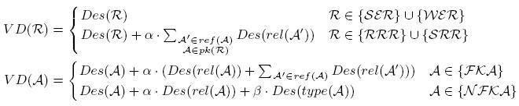
Phase 2: Discovering simple mappings
Construct Virtual Documents(VD) for the entities in both the relational schema and the ontology
To capture their structural information
VD represents a collection of weighted tokens
derived not only from the description of the entity itself, but also from the descriptions of its neighbors
The weights of the tokens indicate their importance
VD(writes) = {"write", α ∙ "paper", α ∙ "author"}

Slide 13

Phase 2: Discovering simple mappings
Relations and attributes
Classes and properties
Notes:
알파와 베타는 케이스에 따라 적절한 값을 정해야 한다.
실험 경험으로 볼 때 알파는 베타보다 약간 더 큰 값이어야 한다.

Slide 14

Phase 2: Discovering simple mappings
Confidence measures
Calculated by the cosine value between 2 vectors corresponding to 2 VD in the TF/IDF model

Slide 15
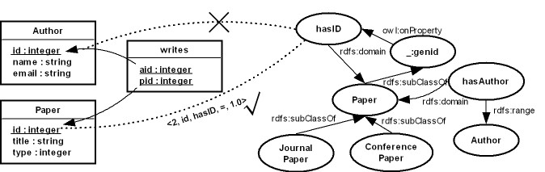
Phase 3: Validating mapping consistency
Uses mappings between <relations, classes> to validate the consistency of <attributes, properties> mappings
We assumed that the mappings between relations and classes are correct
Notes:
Some inference rules should be considered as well. For example, the domains of the datatype property hasID should include the classes JounalPaper and ConferencePaper. Besides, we also check the compatibility of data types between non foreign key attributes and datatype properties.
e.g. we assume that the mapping between the relation Paper and the class Paper has been discovered, we validate 2 candidate mappings:
The mapping between the attribute id in Paper and the property hasID, and
The mapping between the attribute id in Author and the property hasID.
Latter one is inconsistent with the mapping between the relation Paper and the class Paper.

Slide 16
Phase 4: Constructing contextual mappings
Focus on a special type of mappings
Contextual mappings
Directly translated to conditional mappings or view-based mappings
<id₁, Paper, Journal Paper, type=“1”, c₁>
<id₂, Paper, Conference Paper, type=“2”, c₂>
Notes:
Contextual mapping을 구하기 위해서는 미리 구한 input mapping과
Relational schema와 ontology 양쪽 모두 해당하는 sample instance가 필요하다.

Slide 17
Phase 4: Constructing contextual mappings

Slide 18
Evaluation
Data sets
Implemented in JAVA
Called MARSON (Mapping between relational schemas and ontologies)
Notes:
같은 주제에 대해서라도 relational schema와 ontology는 독립적으로 만들어진 것이다.

Slide 19
Evalution
Discovering simple mappings:
Marson vs. Simple, VDoc, Valid
Simple: not constructing virtual documents, not checking mapping consistency;
VDoc: constructing virtual documents, not validating mapping consistency;
Valid: not constructing virtual documents, validating mapping consistency;
F1-Measure: a combination of precision and recall.
Notes:
1, 2, 5에서 Vdoc가 Simple보다 좋게 나왔다. 이것은 local description 만으로 보았을 때에는 공통점이 별로 없는 entity들이 많았기 때문이다.
Valid는 Simple보다 전반적으로 좋다. 이것은 다른 relation안에 있는 이름이 같은 attribute(id or name 등)가 존재하기 때문에 Valid에서 inconsistency한 것들이 제거되기 때문이다.
Vdoc와 Valid를 함께 사용한 Marson이 가장 좋은 결과를 보이고 있다. (data set 4가 조금 떨어지는 수치를 보이지만 특별한 언급은 없었다)

Slide 20
Conclusion
Presented a new approach to discovering simple mappings
Proposed an algorithm to build contextual mappings
Evaluated on several data sets from real world domains
Future work
Compare with some intermediate approaches
Consider some machine learning techniques
Integrate our approach into some existing data integration tools

Slide 21
Discussion
Strong point
Similar, but different from ontology generation from the relational database
Weak point
Cannot realize how it operates exactly
Broken MARSON download link
Lacking examples
Data integration tools
Need to understand more about ontology languages
OWL

Slide 22
Thank you!!!

