Slide 1
Effective Phrase Prediction
Arnab Nandi, H. V. Jagadish
Dept. of EECS, University of Michigan, Ann Arbor
VLDB 2007
15 Sep 2011
Presentation @ IDB Lab Seminar
Presented by Jee-bum Park

Slide 2
Outline
Introduction
Autocompletion
Issues of Autocompletion
Multi-word Autocompletion Problem
Trie and Suffix Tree
Data Model
Experiments
Conclusion

Slide 3
Introduction - Autocompletion
Autocompletion is a feature that suggests possible matches based on queries which users have typed before
Provided by
Web browsers
E-mail programs
Search engine interfaces
Source code editors
Database query tools
Word processors
Command line interpreters
…

Slide 4
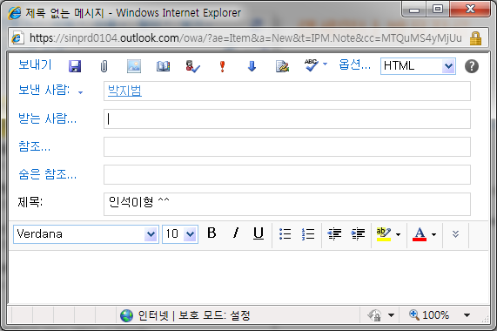
Introduction - Autocompletion
Autocompletion speeds up human-computer interactions

Slide 5
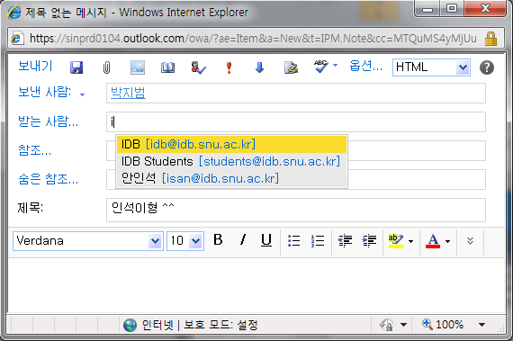
Introduction - Autocompletion
Autocompletion speeds up human-computer interactions

Slide 6
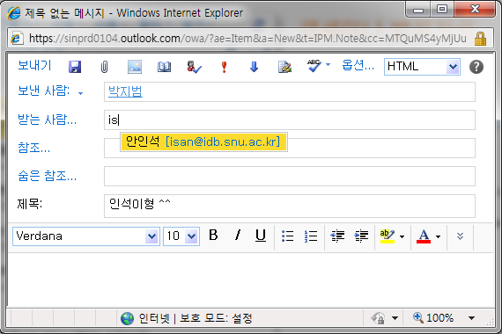
Introduction - Autocompletion
Autocompletion speeds up human-computer interactions

Slide 7

Introduction - Autocompletion
Autocompletion suggests suitable queries

Slide 8
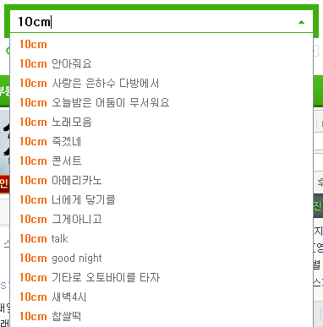
Introduction - Autocompletion
Autocompletion suggests suitable queries

Slide 9
Introduction - Issues of Autocompletion
Precision
It is useful only when offered suggestions are correct
Ranking
Results are limited to top-k ranked suggestions
Speed
In the human timescale, 100 ms is a time upper bound of “instantaneous”
Size
Preprocessing

Slide 10
Introduction - Multi-word Autocompletion Problem
The number of multi-words (phrases) is larger than the number of single-words
If there are n words, number of phrases is _{n}C₂ = n(n - 1) / 2 = O(n²)
A phrase does not have a well-defined boundary
The system has to decide not just what to predict, but also how far

Slide 11
Introduction - Trie and Suffix Tree
For single word autocompletion,
Building a dictionary index of all words with balanced binary search tree
Building: O(n log n)
Searching: O(log n)
9: i
12: in
13: inn
52: tea
54: ten
59: test
72: to
...

Slide 12
Introduction - Trie and Suffix Tree
For single word autocompletion,
Building a dictionary index of all words with trie
Building: O(n)
Searching: O(m), n >> m

Slide 13
Introduction - Trie and Suffix Tree
i
t
9
9: i
12: in
13: inn
52: tea
54: ten
59: test
72: to
...
n
e
o
12
72
a
s
n
n
13
52
54
t
59

Slide 14
Outline
Introduction
Data Model
Significance
FussyTree
PCST
Simple FussyTree
Telescoped (Significance) FussyTree
Experiments
Conclusion

Slide 15
Data Model - Significance
Let a document be represented as a sequence of words,
(w₁, w₂, ..., w_{N})
A phrase r in the document is an occurrence of consecutive words,
(w_{i}, w_{i+1}, ..., w_{i+x–1})
for any starting position i in [1, N]
We call x the length of phrase r, and write it as len(r) = x
There are no explicit phrase boundaries x
We have to decide how many words ahead we wish to predict
The suggestions maybe too conservative, losing an opportunity to autocomplete a longer phrase

Slide 16
Data Model - Significance
To balance these requirements, we use the following definition
A phrase “AB” is said to be significant if it satisfies the following four conditions:
Frequency: The phrase “AB” occurs with a threshold frequency of at least τ in the corpus
Co-occurrence: “AB” provides additional information over “A”, its observed joint probability is higher than that of independent occurrence
P(“AB”) > P(“A”) ∙ P(“B”)
Comparability: “AB” has likelihood of occurrence that is comparable to “A”
P(“AB”) ≥ zP(“A”) , 0 < z < 1
Uniqueness: For every choice of “C”, “AB” is much more likely than “ABC”
P(“AB”) ≥ yP(“ABC”) , y ≥ 1

Slide 17
Data Model - Significance
n_{n-gram} = 2, τ = 2, z = 0.5, y = 3
Document ID | Corpus
1 | please call me asap
2 | please call if you
3 | please call asap
4 | if you call me asap
Phrase | Freq. | Phrase | Freq.
please | 3 | please call* | 3
call | 4 | call me | 2
me | 2 | if you | 2
if | 2 | me asap | 2
you | 2 | call if | 1
asap | 3 | call asap | 1
 |  | you call | 1

Slide 18
Data Model - FussyTree - PCST
Since suffix trees can grow very large, a pruned count suffix tree (PCST) is often suggested
In such a tree, a count is maintained with each node
Only nodes with sufficiently high counts (τ) are retained

Slide 19
Data Model - FussyTree - PCST
Simple suffix tree
root
please
call
me
asap
if
you
call
me
asap
you
call
me
if
asap
if
call
me
asap
you
asap
you
me
asap
asap
asap

Slide 20
Data Model - FussyTree - PCST
PCST (τ = 2)
root
please
call
me
asap
if
you
call
me
asap
you
call
me
if
asap
if
call
me
asap
you
asap
you
me
asap
asap
asap

Slide 21
Data Model - FussyTree - PCST
PCST (τ = 2)
root
please
call
me
asap
if
you
call
me
asap
you
me
if
asap
asap
you

Slide 22
Data Model - FussyTree - Simple FussyTree
Since we are only interested in significant phrases,
We can prune any leaf nodes of the ordinary PCST that are not significant
We additionally add a marker to denote that the node is significant

Slide 23
Data Model - FussyTree - Simple FussyTree
Simple FussyTree (τ = 2, z = 0.5, y = 3)
root
please
call
me
asap
if
you
call
me
asap
you
me
if
asap
asap
you

Slide 24
Data Model - FussyTree - Simple FussyTree
Simple FussyTree (τ = 2, z = 0.5, y = 3)
root
please
call
me
asap*
if
you*
call*
me
asap*
you*
me
if
asap*
asap*
you*

Slide 25
Data Model - FussyTree - Telescoped (Significance) FussyTree
Telescoping is a very effective space compression method in suffix trees (and tries)
It involves collapsing any single-child node into its parent node
In our case, since each node possesses a unique count and marker, telescoping would result in a loss of information

Slide 26
Data Model - FussyTree - Telescoped (Significance) FussyTree
Significance FussyTree (τ = 2, z = 0.5, y = 3)
root
please
call
me
asap*
if
you*
call*
me
asap*
you*
me
if
asap*
asap*
you*

Slide 27
Data Model - FussyTree - Telescoped (Significance) FussyTree
Significance FussyTree (τ = 2, z = 0.5, y = 3)
root
please call*
call me asap*
me asap*
asap*
if you*
you*
me asap*
if you*

Slide 28
Outline
Introduction
Data Model
Experiments
Evaluation Metrics
Method
Tree Construction
Prediction Quality
Response Time
Conclusion

Slide 29
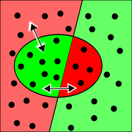
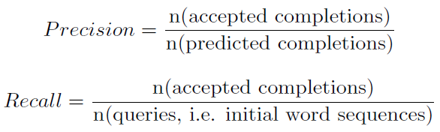
Experiments - Evaluation Metrics
In the light of multiple suggestions per query, the idea of an accepted completion is not boolean anymore

Slide 30
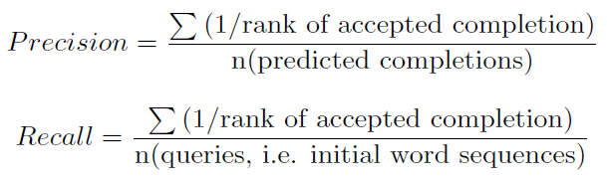
Experiments - Evaluation Metrics
Since our results are a ranked list, we use a scoring metric based on the inverse rank of the results

Slide 31

Experiments - Evaluation Metrics
Total Profit Metric (TPM)
isCorrect: a boolean value in our sliding window test
d: the value of the distraction parameter
TPM(0) corresponds to a user who does not mind the distraction
TPM(1) is an extreme case where we consider every suggestion to be a blocking factor
Real-world user distraction value would be closer to 0 than 1

Slide 32

Experiments - Method
A sliding window based test-train strategy using a partitioned dataset
We retrieve a ranked list of suggestions, and compare the predicted phrases against the remaining words in the window

Slide 33
Experiments - Method
Datasets
Environment
Dataset | # of Documents | # of Characters
Small Enron | 366 | 250 K
Large Enron | 20,842 | 16 M
Wikipedia | 40,000 | 53 M
Language | CPU | RAM | OS
Java | 3.0 GHz, x86 | 2.0 GB | Ubuntu Linux

Slide 34
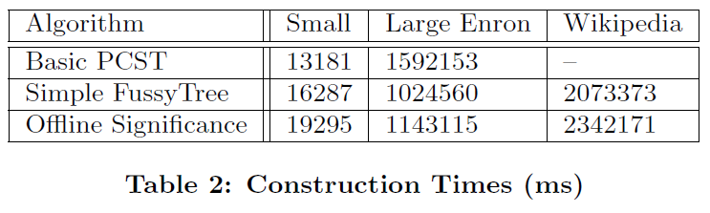
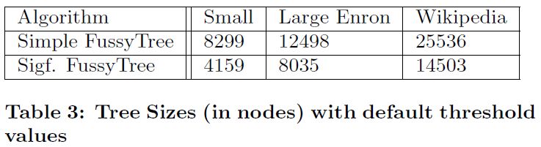
Experiments - Tree Construction

Slide 35
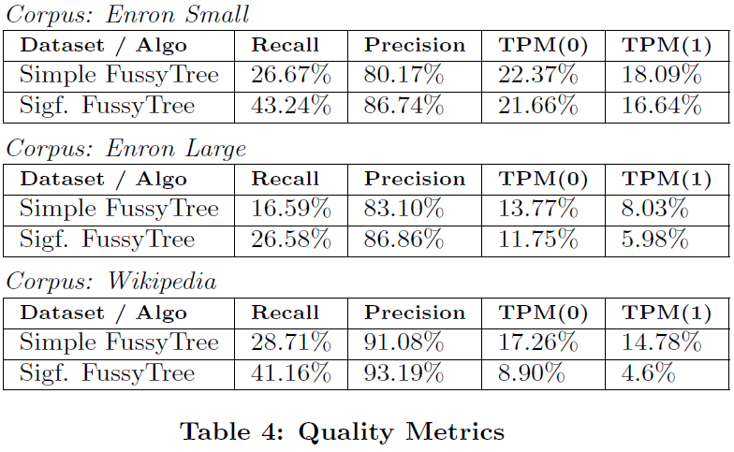
Experiments - Prediction Quality

Slide 36
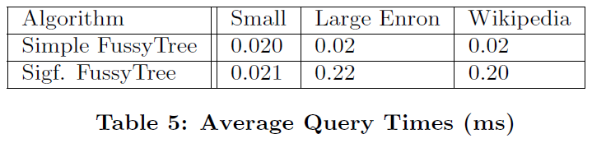
Experiments - Response Time

Slide 37
Outline
Introduction
Data Model
Experiments
Conclusion

Slide 38
Conclusion
Introduced the notion of significance
Devised a novel FussyTree data structure
Introduced a new evaluation metric, TPM, which measures the net benefit provided by an autocompletion system
We have shown that phrase completion can save at least as many keystrokes as word completion

Slide 39
Thank You!
Any Questions or Comments?

