Slide 1
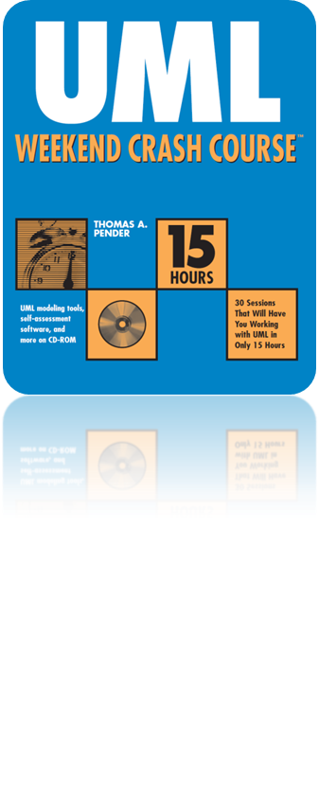
Session 29
Design of a Web Application
Written by Thomas A. Pender
Published by Wiley Publishing, Inc.
November 2, 2011
Presented by Hyewon Kim

Slide 2
Contents
Model 2 Architecture
Detailed Design
Web Application Extension

Slide 3
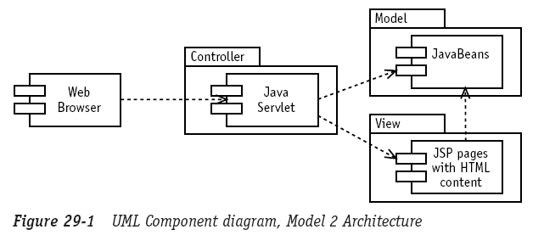
Model 2 Architecture (1/3)
The Model 2 Architecture was presented by Sun Microsystems in the early versions of the servlet specification
  It will separate out the controller elements
All requests for the Web application come through one servlet,
the developer can place generic security checks and audit logging code in the servlet and that code will be run for any request for any part of the Web application

Slide 4
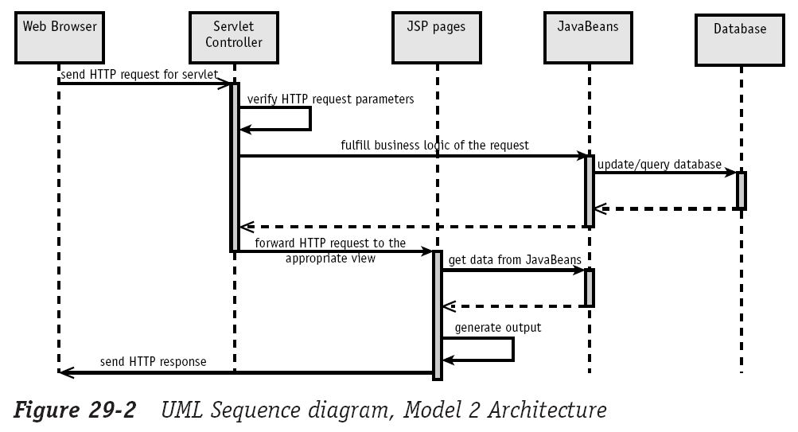
Model 2 Architecture (2/3)
The Model 2 Architecture was presented by Sun Microsystems in the early versions of the servlet specification
  It will separate out the controller elements

Slide 5
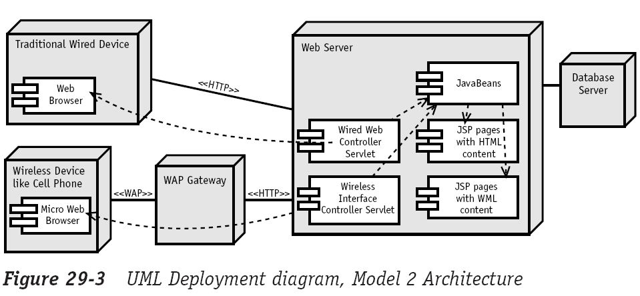
Model 2 Architecture (3/3)
Adds a single servlet that will receive all requests that are sent by the Web browser for any part of the Web application

Slide 6
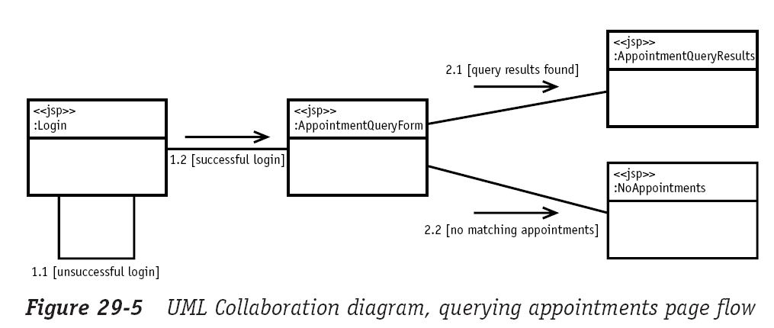
Detailed Design (1/5)
Querying appointments and contacts
In detailed design, Class, Object, Sequence, and Collaboration diagrams will tend to be used more
  It shows how the user will move from one Web page to another

Slide 7
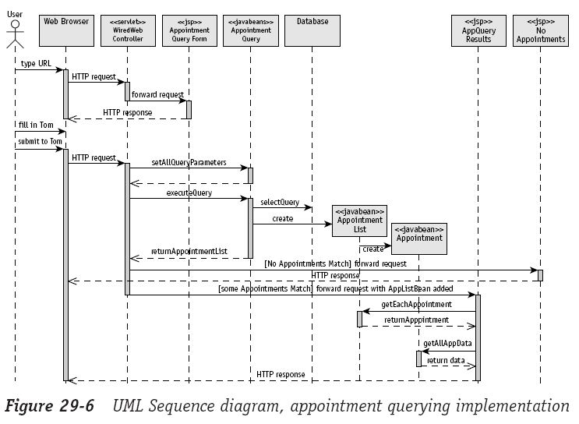
Detailed Design (2/5)
Querying appointments and contacts
In detailed design, Class, Object, Sequence, and Collaboration diagrams will ten to be used more
  It shows the components involved for the purpose of implementation

Slide 8
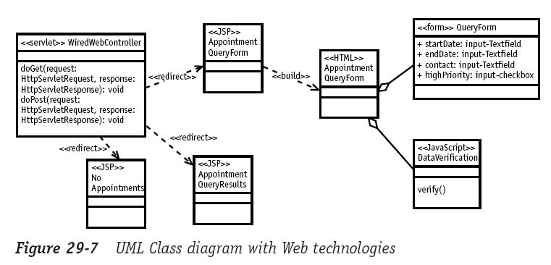
Detailed Design (3/5)
Web technologies on an implementation Class diagram
Sometimes you may wish to show JSP pages, servlets, HTML content, JavaScript, and other Web technologies on a Class diagram.

Slide 9
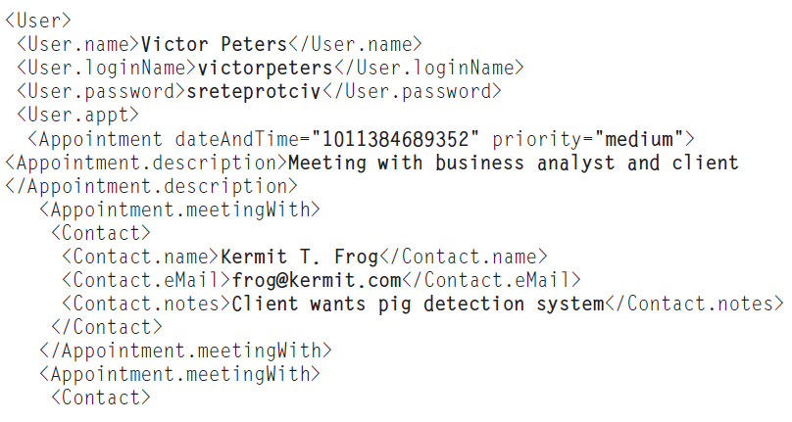
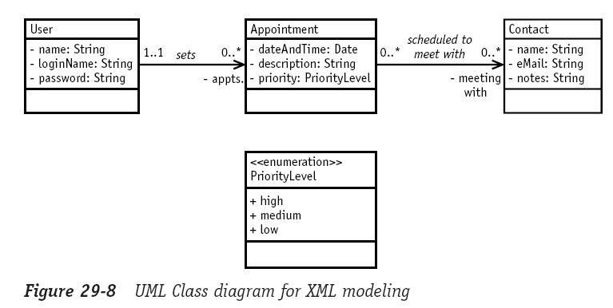
Detailed Design (4/5)
XML
XML has a hierarchical structure that can be modeled as an object hierarchy in the UML using generalization in a Class diagram

Slide 10
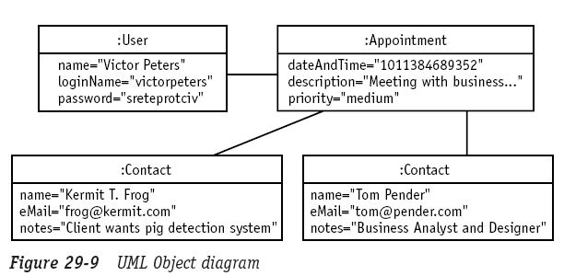
Detailed Design (5/5)
XML
The UML Object-diagram is a valid instantiation of the Class diagram

Slide 11
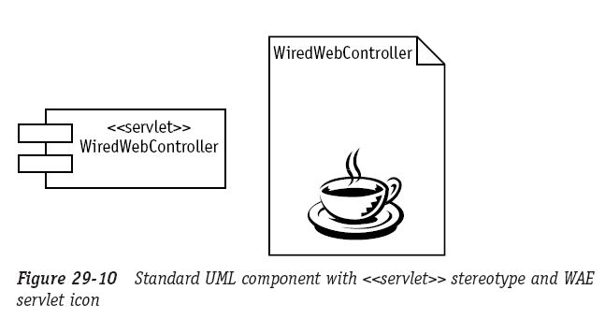
Web Application Extension
An extension to the UML to facilitate Web modeling in UML
  A set of strategies, stereotypes, and icons for UML Web modeling

Slide 12
The End

