Slide 1
Exploring Social Influence via Posterior Effect of Word-of-Mouth Recommendations
Junming Huang, Xue-Qi Cheng, Hua-Wei Shen, Tao Zhou, Xiaolong Jin
WSDM 2012
22 November 2012
Hyewon Lim

Slide 2
Outline
Introduction
Preliminary Study
Posterior Evaluation Models
Model Verification
Identifying Influence Friends
Conclusions

Slide 3
Introduction
Integration of SNS and online sharing communities
Rate books, music and movies
Share their ratings and reviews with friends or followers
Phenomenon that users recommend favorites to others
An important role in shaping users’ behaviors and their collections
Word-of-mouth recommendations
A key to designing a successful marketing strategy in online sharing communities

Slide 4

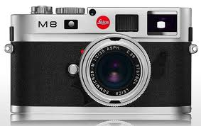
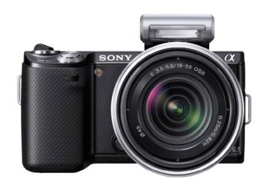

Introduction
Word-of-mouth
recommendation
I have it.
Prior expectation
Posterior effect

Slide 5
Introduction
Posterior effect of WOM recommendations
Estimate user satisfaction
Satisfaction is strongly related to user loyalty
Does it depends only on how a product matches users’ need?
Is it unlikely related to whether or not a friend has recommended it before?

Slide 6
Outline
Introduction
Preliminary Study
Posterior Evaluation Models
Model Verification
Identifying Influence Friends
Conclusions

Slide 7
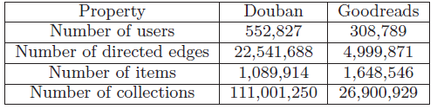
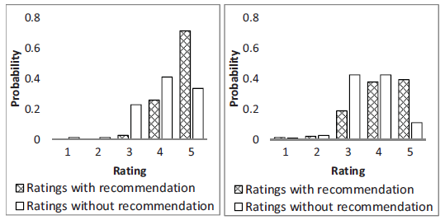
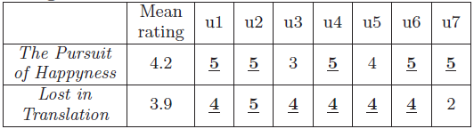
Preliminary Study
Data collection
Higher ratings on items with recommendations

Slide 8
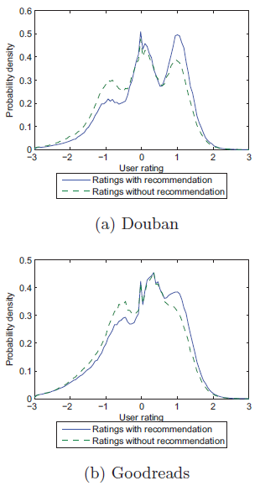
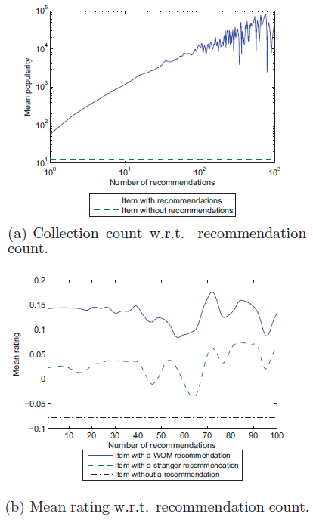
Preliminary Study
Higher ratings on items with recommendations (cont.)
A word-of-mouth recommendation is correlated to
a raise in user posterior evaluation
Notes:
오른쪽 그림
한번이라도 추천을 받은 item의 popularity가 더 높다(실선(w/) vs. 점선(w/o))
누구에게 추천을 받느냐도 중요한 요소

Slide 9
Outline
Introduction
Preliminary Study
Posterior Evaluation Models
Model Verification
Identifying Influence Friends
Conclusions

Slide 10
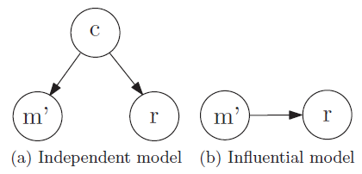

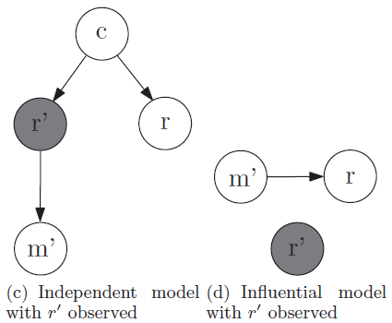


Posterior Evaluation Models
Recommendation
★★★★★
★★★★☆
Notes:
Variable c -> item quality, shared interests, etc.
최초 모델에서 c는 hidden variable로 unobservable하기 때문에 모델 평가를 위해 r’을 도입.

Slide 11
Model Verification
Statistical hypothesis test
Test the independence between p(m’|r’) and p(r|r’)
Whether p(r|m’ = 0, r’) is identical to p(r|m’= 1, r’) for any given r’
t-test and Kolmogorov-Smirnov test
<m’, r, r’>
<m’, r, r’>
<m’, r, r’>
.
.
.
partitioning
r’
Equal-interval
Equal-frequency
r’
Notes:
T-test: 두 집단(예를 들어 남/여)간에 평균의 차이가 있는가를 검증
스미르노프 검정: 연속변수의 정규분포 여부 검정

Slide 12
Model Verification
Null hypothesis
There exists no statistically significant difference between p(r|m’ = 1, r’) and p(r|m’ = 0, r’) for any given r’
Alternative hypothesis: two samples are significantly different
Disproves the conditional independence and supports the influential model
Results of statistical hypothesis tests
Douban: 186,054 data points with m’=1 & 2,278,023 with m’=0
Goodreads: 6,759,850 with m’=1 & 2,899,793 with m’=0

Slide 13
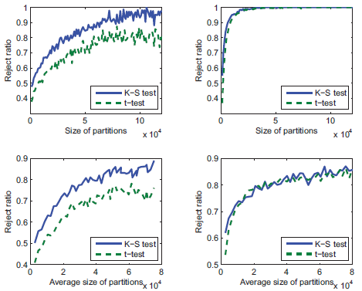
Model Verification
Results of statistical hypothesis tests (cont.)
Almost all partitions consistently reject the null hypothesis
➔ strongly supporting the influential model
Douban
Goodreads
Equal-frequency
Equal-interval
The posterior evaluation of a user directly depends on
whether or not a friend has previously recommended

Slide 14
Outline
Introduction
Preliminary Study
Posterior Evaluation Models
Model Verification
Identifying Influence Friends
Conclusions

Slide 15



Identifying Influential Friends
Social influence measurement
Raise in posterior evaluation caused by WOM recommendation
Social influence of u on v
Influence among two friends often acts in an one-way manner
In 83% Douban pairs and 77% Goodreads pairs, there exists an individual whose social influence on the other is at least as twice
u
v
u
v
Notes:
Expected value -> probabilistic matrix factorization algorithm을 이용해서 트레이닝하여 얻음

Slide 16
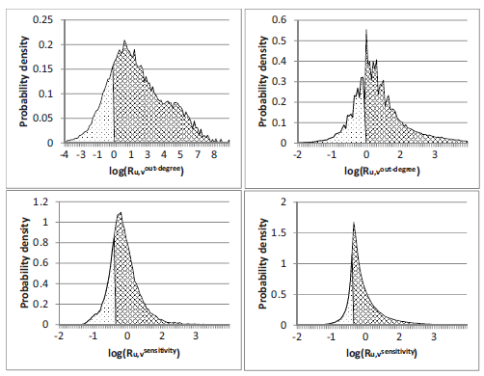
Identifying Influential Friends
Two factors
Social positions of users in the friendship network
Out-degree, PageRank, and LeaderRank
Their personal characteristics independent on other individuals
Collection size, collection frequency, and sensitivity
Examine the influential-side-to-influenced-side ratio
Out-degree
Douban
Goodreads
Sensitivity

Slide 17

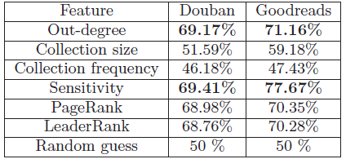
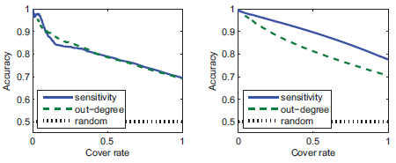
Identifying Influential Friends
Accuracy in predicting the influential side
Gap between u and v as > threshold δ
Accuracy vs. cover rate of prediction
Douban
Goodreads

Slide 18
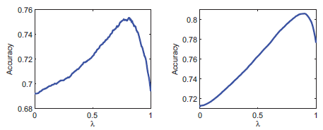
Identifying Influential Friends
Combine two features
Douban
Goodreads
It is necessary to combine the social position of individuals and their personal characteristics when identifying the influential friends for social recommendations

Slide 19
Outline
Introduction
Preliminary Study
Posterior Evaluation Models
Model Verification
Identifying Influence Friends
Conclusions

Slide 20
Conclusions
Contributions
Studies the relationship between WOM recommendations and users’ posterior evaluation
Prove that WOM recommendations can significantly prompt users’ posterior evaluation
Propose a framework to quantitatively measure individuals’ social influence
Develop a method for identifying influential friends with strong social influence
Future work
How social influence propagates in SNs
How multiple WOM recommendations accumulate
Whether or not social influence changes across different topics

Slide 21
Discussion
A new research perspective
Low accuracy rate in predicting the influential side
Why can they not observe the rating with recommendation?

