Slide 1
Storing and Querying Tree-Structured Records in Dremel
Foto N. Afrati^, Dan Delorey*, Mosha Pasumansky*, Jeffrey D. Ullman+
*Google, Inc. +Stanford University ^National Technical University of Athens
VLDB 2014
January 23, 2015
Heymo Kou

Slide 2
Outline
Introduction
Trees as Data and as Data Types
Querying Tree-Structured Data
Filter Queries
The Dominance Relation
Semi-flattening and Repetition Context
Efficient Data Storage and Retrieval
Conclusion

Slide 3

Introduction Dremel [Melnik et al., VLDB ‘10]
Distributed system for interactively querying large datasets
Developed at Google
Column-Store Oriented
Google BigQuery is powered by Dremel
Data is stored as nested relations

Slide 4
Introduction Nested Relations [1/3]
Remember 1NF?
Nested Relations are non-first-normal-form relations
Simply, a cell may have more than one value
1NF requires that all attributes have atomic (indivisible) domains.
A | B
1 | 10
2 | 5
2 | 7
A | B
1 | 10
2 | 5
 | 7
1NF relation
Non 1NF relation

Slide 5
Introduction Nested Relations [2/3]
1NF & 4NF & Nested Relation comparison
Space efficient than 1NF
Lesser join than 4NF
Querying and storing data gets lot more complicated
Title | Author
Compilers | Smith
Compilers | Jones
Networks | Jones
Networks | Frick
Title | Author | Pub-name | Pub-branch | Keyword
Compilers | Smith | McGraw-Hill | New York | Parsing
Compilers | Jones | McGraw-Hill | New York | Parsing
Compilers | Smith | McGraw-Hill | New York | Analysis
Compilers | Jones | McGraw-Hill | New York | Analysis
Networks | Jones | Oxford | London | Internet
Networks | Frick | Oxford | London | Internet
Networks | Jones | Oxford | London | Web
Networks | Frick | Oxford | London | Web
Title | Keyword
Compilers | Parsing
Compilers | Analysis
Networks | Internet
Networks | Web
Title | Author-set | Publisher | Keyword-set
 |  | (name, branch)
Compilers | {Smith, Jones} | (McGraw-Hill, New York) | {Parsing, Analysis}
Networks | {Jones, Frick} | (Oxford, London) | {Internet, Web}
Title | Pub-name | Pub-branch
Compilers | McGraw-Hill | New York
Networks | Oxford | London
Non 1NF version
1NF version
4NF version

Slide 6
Trees as Data and as Data Types
tuple type
a list of attribute names and a type for each attribute
type of an attribute
Basic type – integer, real number, string, etc.
Tuple type
Required – 1 occurrence
Optional – 0 or 1 occurrence
Repeated – 0 or 1, or more occurrence
Required and repeated – 1 or more occurrence
Relation type (schema)
Repeated tuple type

Slide 7
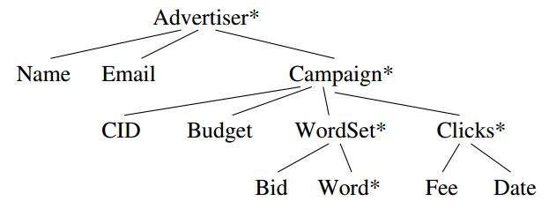
Trees as Data and as Data Types Representing Schemas
Denote as
T = { A₁ : T₁, ….. , A_{n} : T_{n}}
Repeated type : T*
Optional type : T?
One or more occurrences : T⁺

Slide 8
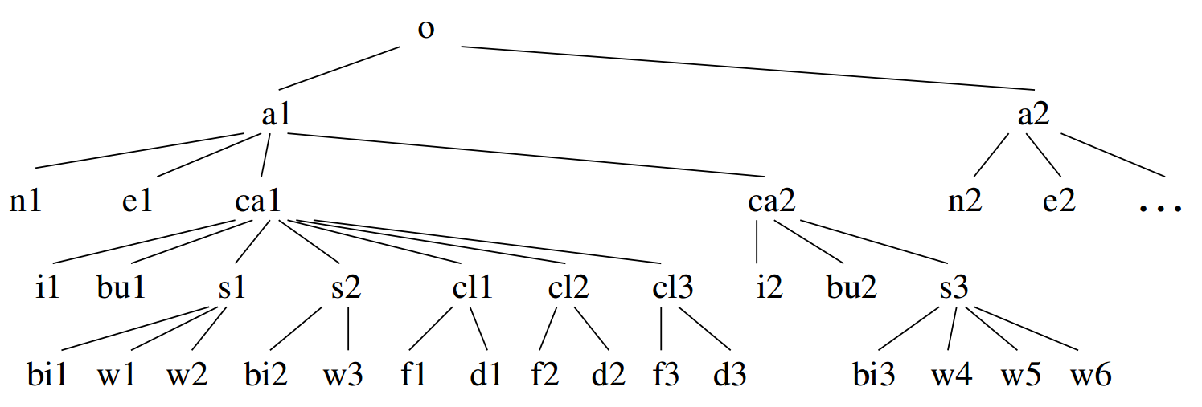
Trees as Data and as Data Types Instances of a Schema
An example data for the same schema below

Slide 9
Querying Tree-Structured Data
Query languages in Dremel
Fundamentally navigation languages on trees
Flattening (Unnesting)
Ordinary SQL cannot be applied
Tree should be flatten in order to apply SQL

Slide 10
Flatten
R = {Name, Email, {Campaign}}
Flatten(R) = {Name, Email, CID, Budget, Bid, Word, Fee, Date}

Slide 11
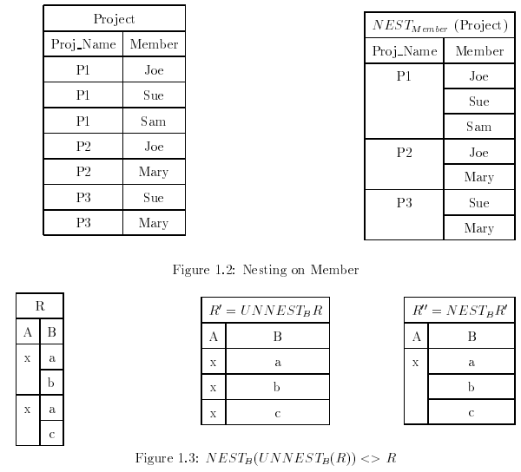
Querying Tree-Structured Data Flattening [1/2]
Flattening nested relation
NEST_{Attribute}(FLATTEN_{Attribute}(Relation)) ≠ Relation

Slide 12
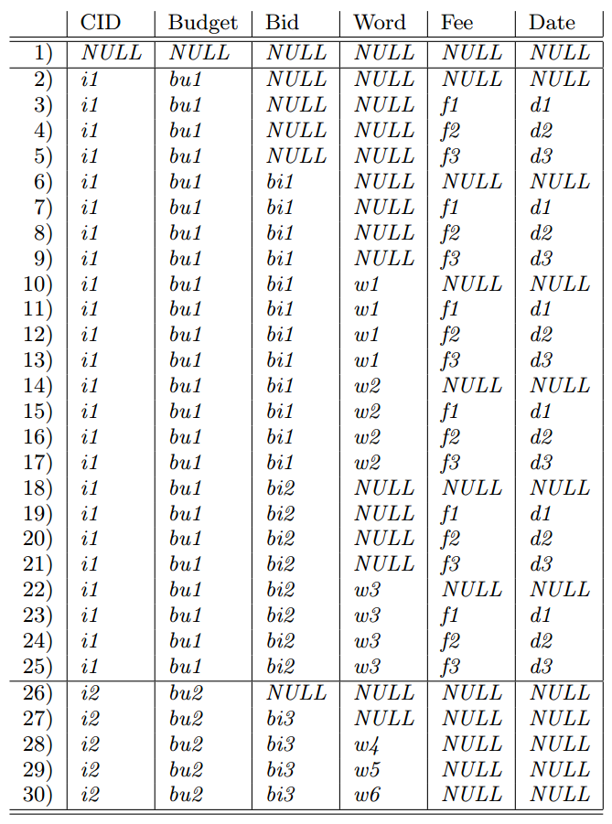
Querying Tree-Structured Data Flattening [2/2]
Flatten

Slide 13
Filter Queries
Filter – Conjunction of comparisons AƟB
A : any attribute
B : an attribute or a constant value
Ɵ : any comparison of two values which results Boolean
{=, ≠, ≤, <, ≥, >}
Ordinary SQL may be used to flattened relation
However, 2 problems rise

Slide 14
Filter Queries 2 problems applying SQL
Flattening expand great amount of space needed to hold tuple
Flattening a relation and then applying filter
No way to prune unnecessary nodes
Purpose of this paper is to resolve problems by
Investigating when the result of filtering a flattened relation is equal to flattening a filtered(pruned) relation
Giving an algorithm to perform the filtering on the tree itself

Slide 15
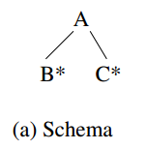
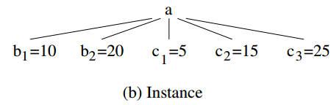
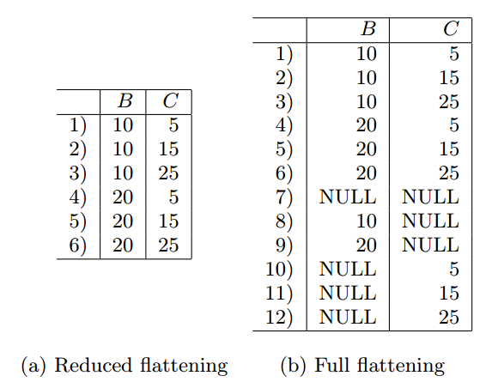
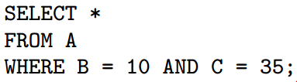
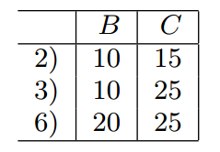

Filter Queries Reduced and full flattening

Slide 16
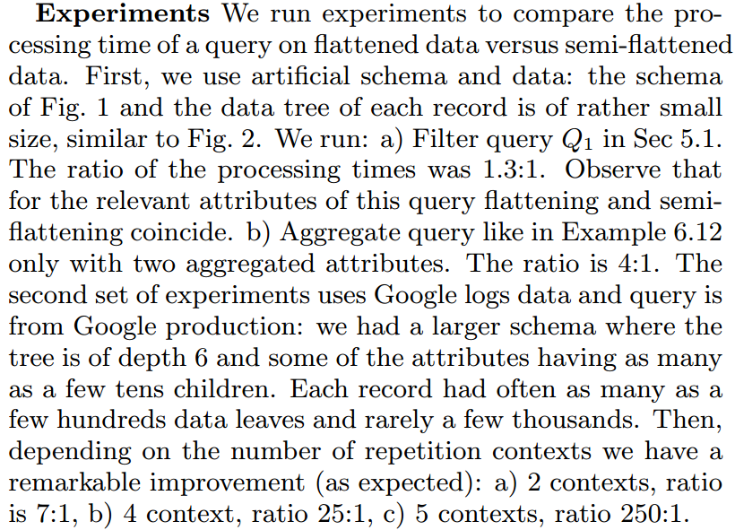
Experiments
No graphs, no environment, Google Style

Slide 17
Conclusion
Dremel is used in BigQuery
Columnar storage is not enough for Google’s service
Tree-structured model for reducing redundancy
Evaluating and Processing Query is tougher
Still, outperforms the ordinary columnar storage

