Slide 1
Data mining for credit card fraud: A comparative study
Siddhartha Bhattacharyya et al.
Decision Support Systems, 2011
2016. 12. 28
임유빈

Slide 2
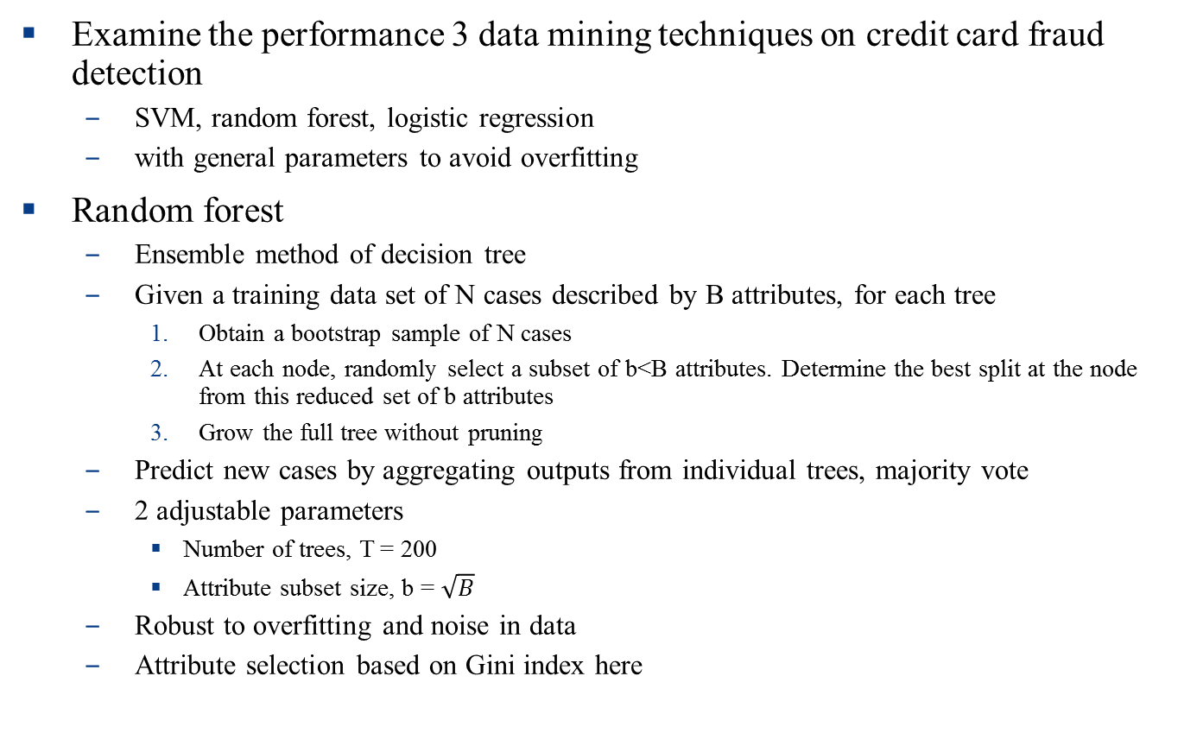
Introduction
Examine the performance 3 data mining techniques on credit card fraud detection
SVM, random forest, logistic regression
with general parameters to avoid overfitting
Random forest
Ensemble method of decision tree
Given a training data set of N cases described by B attributes, for each tree
Obtain a bootstrap sample of N cases
At each node, randomly select a subset of b<B attributes. Determine the best split at the node from this reduced set of b attributes
Grow the full tree without pruning
Predict new cases by aggregating outputs from individual trees, majority vote
2 adjustable parameters
Number of trees, T = 200
Attribute subset size, b = $\sqrt{B}$
Robust to overfitting and noise in data
Attribute selection based on Gini index here

Slide 3
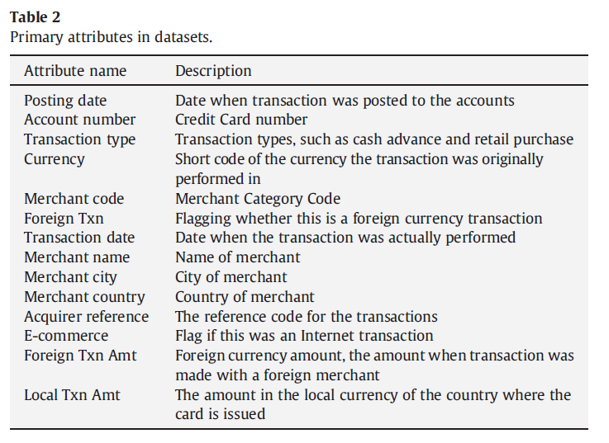
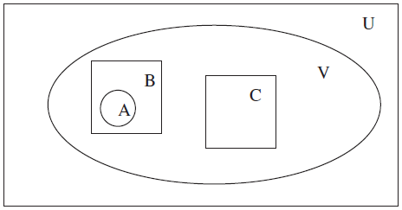

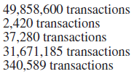
Dataset
Real credit card transactions from an international credit card operation
50m credit card transactions on 1m credit cards from Jan 2006 ~ Jan 2007
2420 known frauds on 506 credit cards

Slide 4
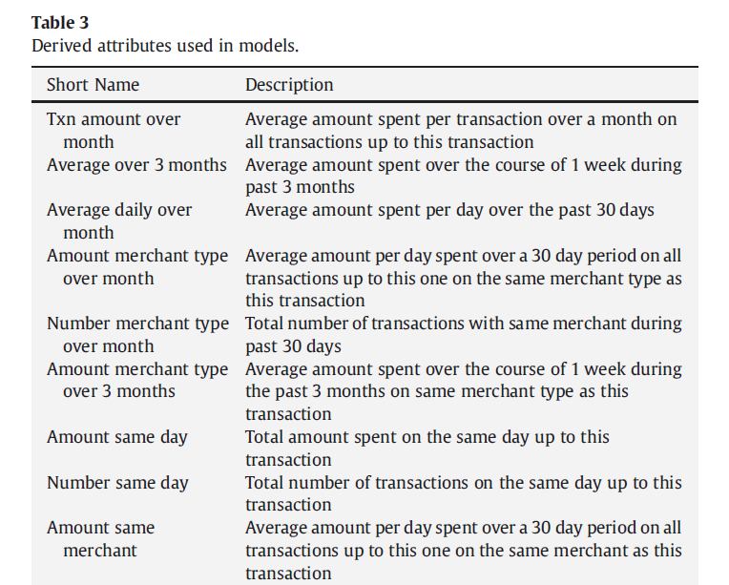
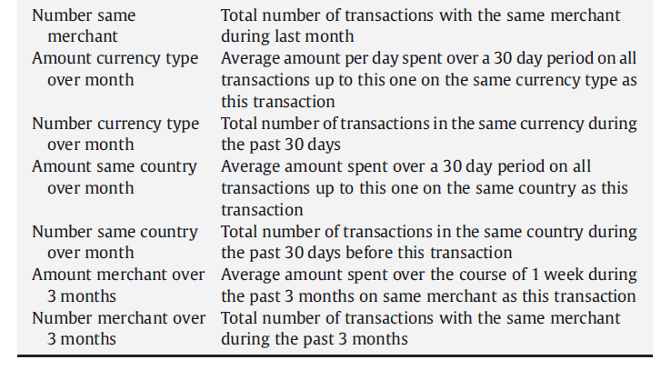
Dataset
Derived attribute
Consider historical context of consumer behaviors

Slide 5
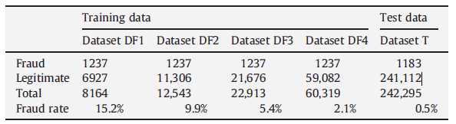
Dataset
Need to sample training & test data
Highly imbalanced data
Create 4 datasets with varying proportions of fraud cases with random undersampling
Divide into 2 subset
each for training & test
Sample legitimate
transactions for datasets

Slide 6
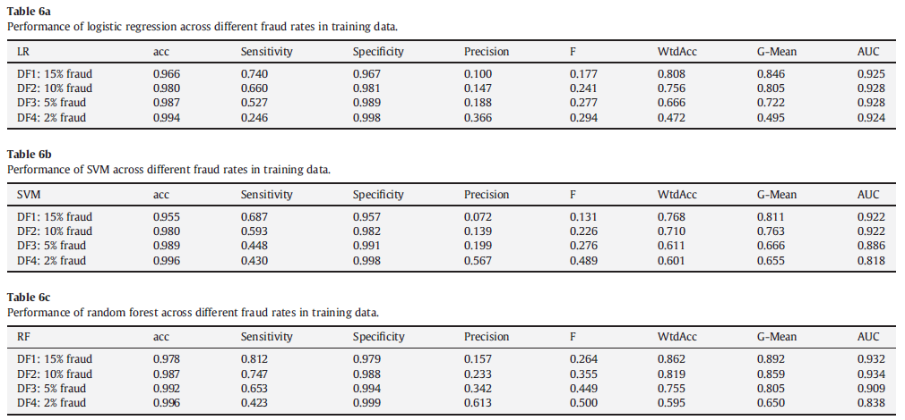
Results
Accuracy: (TP+TN)/(TP+FP+TN+FN) Sensitivity (or recall): TP/(TP+FN)
gives the accuracy on the fraud cases.
Specificity: TN/(FP+TN) Precision: TP/(TP+FP)
gives the accuracy on the non-fraud cases. gives the accuracy on cases predicted as fraud.
F-measure: (2*Precision*Recall)/(Precision+Recall) G-mean: (Sensitivity * Specificity)^{0.5}
wtdAcc: w * Sensitivity+(1−w) * Specificity cutoff value: 0.5
we use w=0.7 to indicate higher weights for accuracy on the fraud cases.

Slide 7
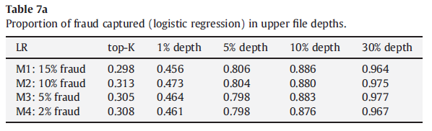
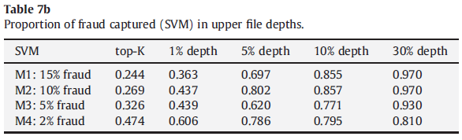
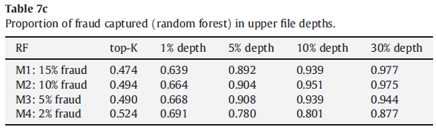
Results
Performance with respect to the proportion of frauds captured at different data depth
Sorted by model score in descending order
K = total number of fraud in test set = 1183

Slide 8
FraudMiner: A Novel Credit Card Fraud Detection Model Based on Frequent Itemset Mining
K. R. Seeja, Masoumeh Zareapoor
The Scientific World Journal, 2014
2016. 12. 28
임유빈

Slide 9
Introduction
Classify fraud from anonymous credit card transaction datasets using frequent itemset mining
Compare the performance with other techniques
SVM, K-NN, Naïve Bayes, Random Forest
FraudMiner
Create legal pattern and fraud pattern of each customer by using frequent itemset mining
Matching algorithm detects which pattern the new case matches more
Training – pattern database construction
Apply A priori algorithm to set of legal and fraud transactions, respectively, for each customer
Store the largest frequent itemset
Testing – matching algorithm
Count number of attributes in new transaction matching with that of legal(fraud) pattern of corresponding customer. Let it be lc(fc)
If fc(lc) = 0 and lc(fc) is larger than threshold, new transaction is legal(fraud)
If fc, lc > 0 and fc >= lc, new transaction is fraud, else legal

Slide 10
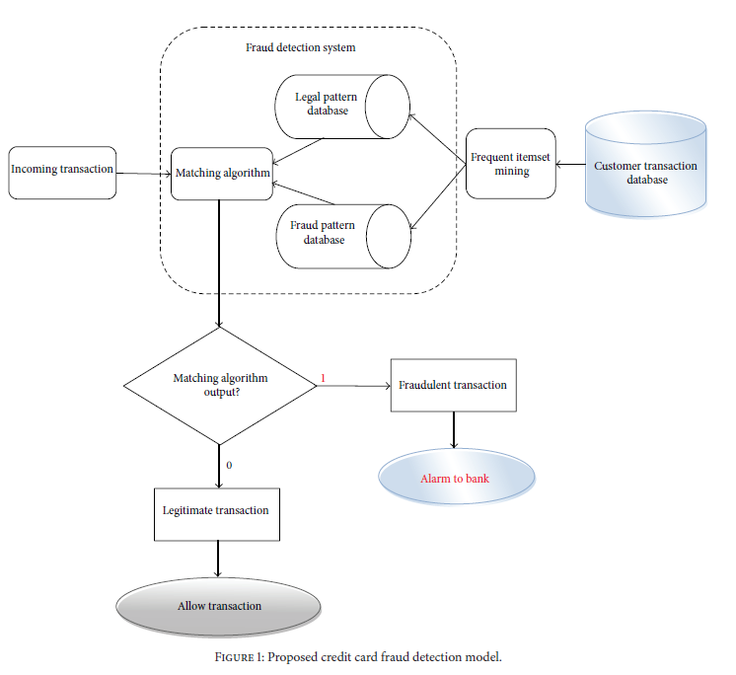
Model Description

Slide 11



Dataset
UCSD-FICO data mining contest 2009
Real dataset of e-commerce transactions
Training data: 100,000 credit card transactions of 73,729 customers for 98 days with 2654 frauds
Test data: 50,000 transactions with no label
Every field is anonymized

Slide 12
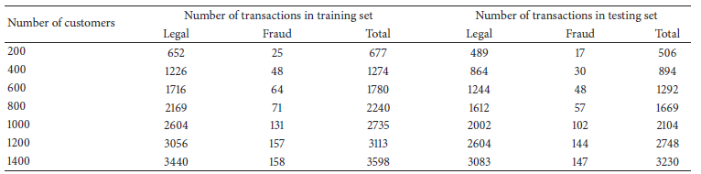
Experiment Setup
Intel Core i5 processor with 4GB RAM
MATLAB R2013a
Data preprocessing
Remove csutAttr2, total, hour2, state1 as there are duplicate columns
Final dataset contains 16 fields
Dataset creation
Remove customers who have only one transaction – 40,918 transactions remain
Divide into two subset. training set: 21,000, test set: 19,918
Remove customers who have only one transaction from the training set as it’s hard to find pattern with single transaction – 19,165 transactions remain in training set
Randomly select different number of people as a group

Slide 13
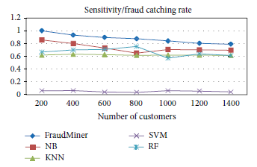
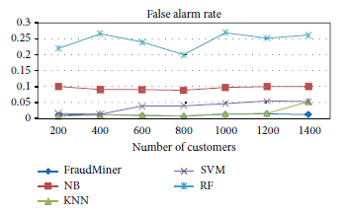
Result

