Slide 1
Chapter 11: Indexing and Hashing

Slide 2
Basic Concepts
Indexing mechanisms used to speed up access to desired data
  e.g., author catalog in library, term index at the end of a book
Search key - attribute to set of attributes used to look up records in a file
An index file consists of records (called index entries) of the form
Index files are typically much smaller than the original file
Two basic kinds of indices:
  Ordered indices: search keys are stored in sorted order
  Hash indices: search keys are distributed uniformly across “buckets” using a “hash function”
search-key
pointer

Slide 3
Index Evaluation Metrics
Access types supported efficiently
  Point query: records with a specified value in the attribute
  Range query: records with an attribute value falling in a specified range of values
Access time
Insertion time
Deletion time
Space overhead

Slide 4
Ordered Indices
Ordered index: index entries are stored sorted on the search key value
  e.g., author catalog in library
Primary index: an index whose search key specifies the sequential order of the file
  Also called clustering index
  The search key of a primary index is usually (but not necessarily) the primary key
Secondary index: an index whose search key specifies an order different from the sequential order of the file
  Also called non-clustering index
Index-sequential file: ordered sequential file with a primary index

Slide 5

Dense Index Files
Dense index
  Index record appears for every search-key value in the file

Slide 6

Primary Indices Example
Example: dense index on dept_name, with instructor file sorted on dept_name

Slide 7
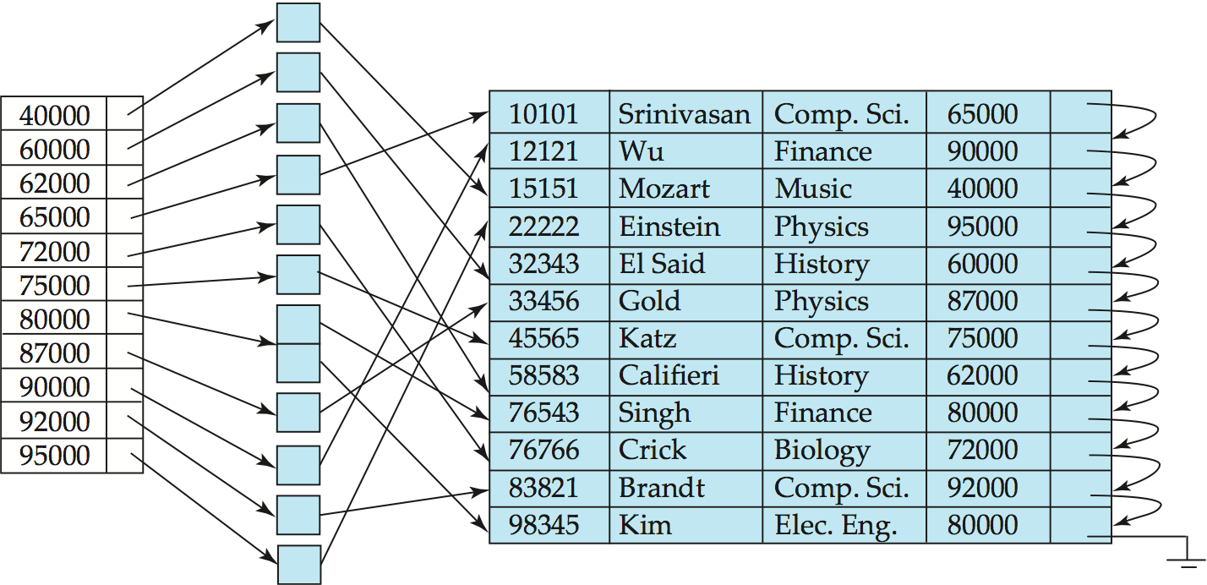
Secondary Indices Example
Index record points to a bucket that contains pointers to all the actual records with that particular search-key value.
Secondary indices have to be dense
Secondary index on salary field of instructor

Slide 8

Sparse Index Files
Sparse Index: contains index records for only some search-key values.
  Applicable when records are sequentially ordered on search-key
Compared to dense indices:
  Less space and less maintenance overhead for insertions and deletions
  Generally slower than dense index for locating records

Slide 9
Index Update: Deletion
If deleted record was the only record in the file with its particular search-key value, the search-key is deleted from the index also.
Dense indices – deletion of search-key is similar to file record deletion
Sparse indices
  If an entry for the search key exists in the index,
    Replace the entry in the index with the next search-key value
    in the file (in search-key order)
  If the next search-key value already has an index entry
    Delete the entry

Slide 10
Index Update: Insertion
Perform a lookup using the search-key value appearing in the record to be inserted
Dense indices
  If the search-key value does not appear in the index, insert it.
Sparse indices
  If index stores an entry for each block of the file
    No change needs to be made to the index, unless a new block is created
    If a new block is created, the first search-key value appearing in the new block is inserted into the index

Slide 11
Primary and Secondary Indices
Indices offer substantial benefits when searching for records
When a file is modified, every index on the file must be updated
  Updating indices imposes overhead on database modification
Sequential scan using primary index is efficient, but a sequential scan using a secondary index is expensive
  Each record access may fetch a new block from disk
  Block fetch requires about 5 to 10 milliseconds, versus about 100 nanoseconds for memory access

Slide 12

Multilevel Index
If primary index does not fit in memory,
access becomes expensive
Solution: treat primary index
kept on disk as a sequential file
and construct a sparse index on it
  outer index – a sparse index of
  primary index
  inner index – the primary index file
If even outer index is too large to fit in
main memory, yet another level of index
can be created, and so on
Indices at all levels must be updated
on insertion or deletion from the file

Slide 13
B⁺-Tree Index Files
Advantage of B⁺-tree index files:
  Automatically reorganizes itself with small local changes, in the face of insertions and deletions
  Reorganization of entire file is not required to maintain performance
(Minor) disadvantage of B⁺-trees:
  Extra insertion and deletion overhead, space overhead
  B⁺-trees are used extensively
  Advantages of B⁺-trees outweigh disadvantages

Slide 14
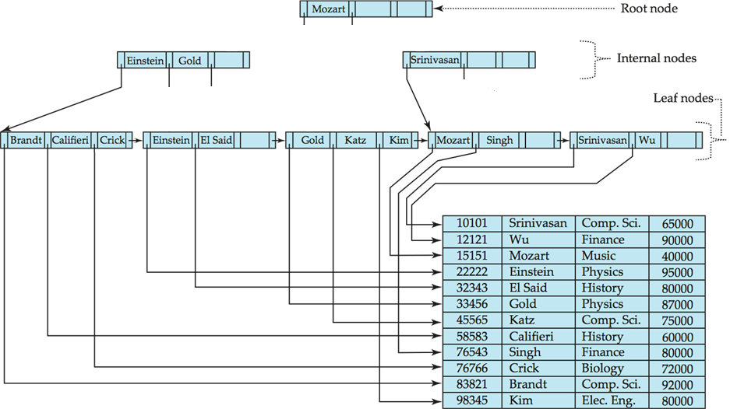
Example of B⁺-Tree

Slide 15
B⁺-Tree Index Files (Cont.)
A B⁺-tree is a rooted tree satisfying the following properties:
All paths from root to leaf are of the same length
Each node that is not a root or a leaf has between ⎡n/2⎤ and n children
A leaf node has between ⎡(n–1)/2⎤ and n–1 values
Special cases: root node
  If the root is not a leaf, it has at least 2 children
  If the root is a leaf (that is, there are no other nodes in the tree), it can have between 0 and (n–1) values

Slide 16
B⁺-Tree Node Structure
Typical node (non-leaf node)
  K_{i} are the search-key values
  P_{i} are pointers to children (for non-leaf nodes)
  or pointers to records (for leaf nodes)
The search-keys in a node are ordered
K₁ < K₂ < K₃ < . . . < K_{n–1}
  We assume no duplicate keys

Slide 17

Leaf Nodes in B⁺-Trees
For i = 1, 2, . . ., n–1, pointer P_{i} points to a file record with search-key value K_{i}
P_{n} points to next leaf node in search-key order
If L_{i}, L_{j} are leaf nodes and i < j, L_{i}’s search-key values are less than or equal to L_{j}’s search-key values

Slide 18
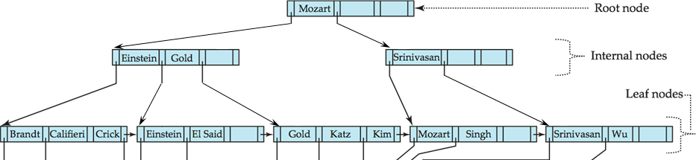
Non-Leaf Nodes in B⁺-Trees
Non leaf nodes form a multi-level sparse index on the leaf nodes
For a non-leaf node with m pointers (m ≤ n):
  All the search-keys in the subtree to which P₁ points are less than K₁
  For 2 ≤ i ≤ m – 1, all the search-keys in the subtree to which P_{i} points have values greater than or equal to K_{i–1} and less than K_{i}
  All the search-keys in the subtree to which P_{m} points have values greater than or equal to K_{m–1}

Slide 19

Example of B⁺-tree
Leaf nodes must have between 3 and 5 values
  ⎡(n–1)/2⎤ and n –1, with n = 6
Non-leaf nodes other than root must have between 3 and 6 children
  ⎡(n/2)⎤ and n, with n = 6
Root must have at least 2 children
B⁺-tree for instructor file (n = 6)

Slide 20
Observations about B⁺-trees
Since the inter-node connections are done by pointers,
“logically” close blocks need not be “physically” close
The non-leaf levels of the B⁺-tree form a hierarchy of sparse indices
The B⁺-tree contains a relatively small number of levels
    Level below root has at least 2 * ⎡n/2⎤ values
    Next level has at least 2 * ⎡n/2⎤ * ⎡n/2⎤ values
    .. etc.
  If there are K search-key values in the file, the tree height is no more than
  ⎡ log_{⎡n/2⎤}(K) ⎤
  Thus searches can be conducted efficiently
Insertions and deletions to the main file can be handled efficiently, as the index can be restructured in logarithmic time (as we shall see).

Slide 21

Queries on B⁺-Trees
Find record with search-key value V
  C = root
  While C is not a leaf node {
    Let i be least value s.t. V ≤ K_{i}.
    If no such exists, set C = last non-null pointer in C
    Else { if (V= K_{i} ) set C = P_{i +1}
    else set C = P_{i} }
    }
  Let i be least value s.t. K_{i} = V
  If there is such a value i, follow pointer P_{i} to the desired record
  Else no record with search-key value k exists

Slide 22
Queries on B⁺⁻Trees (Cont.)
If there are K search-key values in the file, the height of the tree is no more than ⎡log_{⎡n/2⎤}(K)⎤
A node is generally the same size as a disk block, typically 4 kilobytes
  n is typically around 100 (40 bytes per index entry)
With 1 million search key values and n = 100
  At most log₅₀(1,000,000) = 4 nodes are accessed in a lookup
Contrast this with a balanced binary tree with 1 million search key values
  Around 20 nodes are accessed in a lookup
  Difference is significant since every node access may need a disk I/O, costing around 20 milliseconds

Slide 23
Updates on B⁺-Trees: Insertion
Find the leaf node in which the search-key value would appear
Add the record to the file
If there is room in the leaf node, insert (key-value, pointer) pair in the leaf node
Otherwise, split the node (along with the new (key-value, pointer) entry)

Slide 24
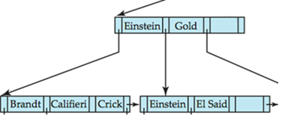
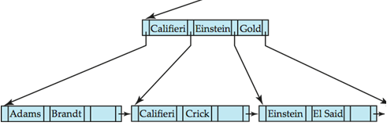
Leaf Node Split in B⁺-Trees
Splitting a leaf node:
  Take the n (search-key value, pointer) pairs (including the one being inserted) in sorted order
    Place the first ⎡n/2⎤ in the original node, and the rest in a new node
    Make the original node point to the new node
  Let the new node be p, and let k be the least key value in p
    Insert (k, p) in the parent of the node being split
  If the parent is full, split it and propagate the split further up
Splitting of nodes proceeds upwards till a node that is not full is found
Insert
“Adams”

Slide 25
Non-Leaf Node Split in B⁺-Trees
Splitting a non-leaf node: when inserting (k,p) into an already full internal node N
  Copy N to an in-memory area M that can hold N and (k,p)
  Insert (k,p) into M
  Copy P₁,K₁, …, K _{⎡n/2⎤-1},P _{⎡n/2⎤} from M back into node N
  Copy P_{⎡n/2⎤+1},K _{⎡n/2⎤+1},…,K_{n-1},P_{n} from M into newly allocated node N’
  Insert (K _{⎡n/2⎤},N’) into parent N

Slide 26
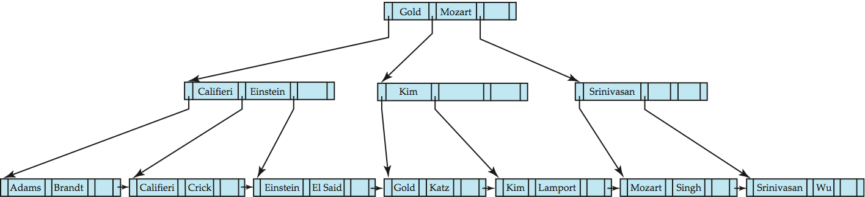
B⁺-Tree Non-Leaf Node Split Example
After insertion of “Lamport”

Slide 27
Updates on B⁺-Trees: Deletion
Find the record to be deleted, and remove it from the main file
Remove (search-key value, pointer) from the leaf node
If the node has too few entries due to the removal,
merge siblings or redistributed pointers (next slide)
The node deletions may cascade upwards till a node which has ⎡n/2⎤ or more pointers is found
If the root node has only one pointer after deletion, it is deleted and the sole child becomes the root

Slide 28
Updates on B⁺-Trees: Deletion (Cont.)
If the node has too few entries due to the removal,
  The entries in the node and a sibling fit into a single node – merge siblings:
    Insert all the search-key values in the two nodes into a single node (the one on the left), and delete the other node
    Delete the pair (K_{i–1}, P_{i}), where P_{i} is the pointer to the deleted node, from its parent, recursively using the above procedure
  The entries in the node and a sibling do not fit into a single node – redistribute pointers:
    Redistribute the pointers between the node and a sibling such that both have more than the minimum number of entries
    Update the corresponding search-key value in the parent of the node
Order to check an adjacent sibling
  Right sibling first
  If not possible, then, left sibling

Slide 29
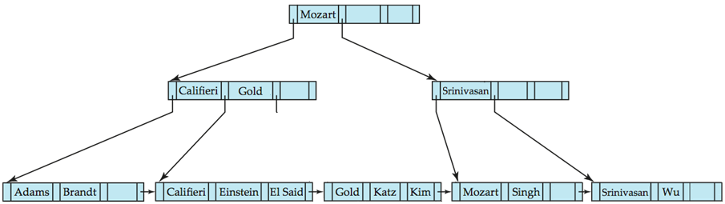
Example: B⁺-Tree Deletion – Merge Siblings
After deletion of “Crick”
Deleting “Crick” causes merging of under-full leaves

Slide 30
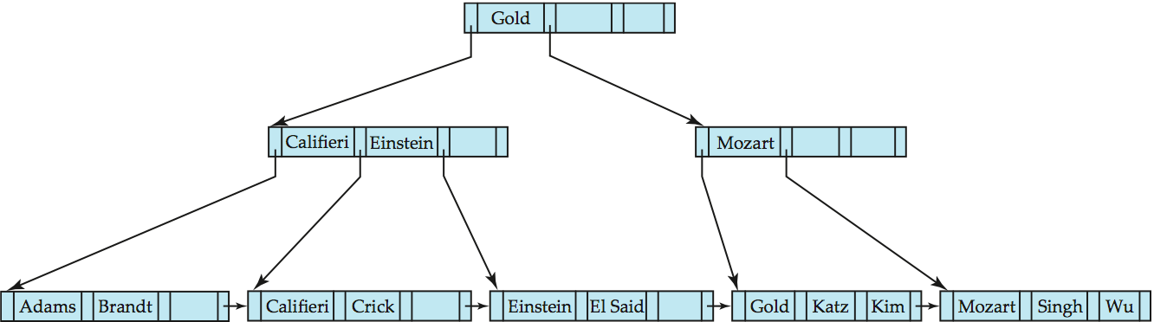
Example: B⁺-Tree Deletion – Merge Siblings (*)
After deletion of “Srinivasan”
Deleting “Srinivasan” causes merging of under-full leaves
Parent node becomes underfull, and is merged with its sibling
  Value separating two nodes (at the parent) is pulled down when merging
Root node then has only one child, and is deleted, but re-created after merging

Slide 31
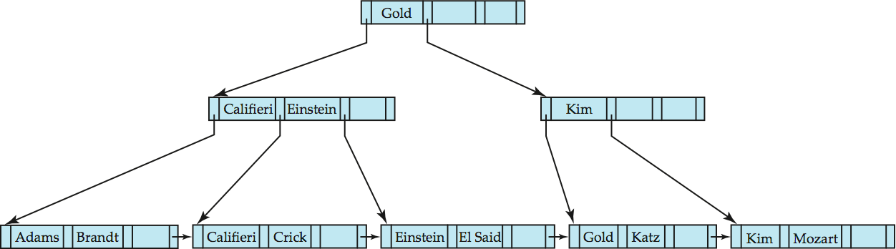
Example: B⁺-tree Deletion – Redistribute Pointers
After deletion of “Singh” and “Wu”
Leaf containing Singh and Wu became underfull, and borrowed a value Kim from its left sibling
Search-key value in the parent changes as a result

Slide 32
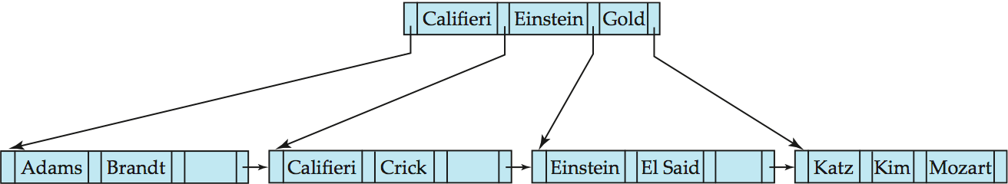
Example: B⁺-tree Deletion – Root Node Deletion
After deletion of “Gold”
Node with Gold and Katz became underfull, and was merged with its sibling
Parent node becomes underfull, and is merged with its sibling
  Value separating two nodes (at the parent) is pulled down when merging
Root node then has only one child, and is deleted

Slide 33
Handling Non-Unique Search Keys
Buckets on separate block (bad idea)
List of tuple pointers with each key
  Extra code to handle long lists
  Deletion of a tuple can be expensive if there are many duplicates on search key
  Low space overhead, no extra cost for queries
Make search key unique by adding a record-identifier
  Extra storage overhead for keys
  Simpler code for insertion/deletion
  Widely used

Slide 34
Bulk Loading and Bottom-Up Build
Inserting entries one-at-a-time into a B⁺-tree requires ≥ 1 IO per entry
  assuming leaf level does not fit in memory
  can be very inefficient for loading a large number of entries at a time (bulk loading)
Efficient alternative 1:
  Sort entries first (using efficient external-memory sort algorithms discussed later in Section 12.4)
  Insert in sorted order
    insertion will go to existing page (or cause a split)
    much improved IO performance, but most leaf nodes half full
Efficient alternative 2: Bottom-up B⁺-tree construction
  As before sort entries
  And then create tree layer-by-layer, starting with leaf level
    details as an exercise
  Implemented as part of bulk-load utility by most database systems

Slide 35
Multiple-Key Access
Use multiple indices for certain types of queries.
Example:
  select ID
  from instructor
  where dept_name = “Finance” and salary = 80000
Possible strategies for processing query using indices on single attributes:
  1. Use index on dept_name to find instructors with department name Finance; test salary = 80000
  2. Use index on salary to find instructors with a salary of $80000; test dept_name = “Finance”.
  3. Use dept_name index to find pointers to all records pertaining to the “Finance” department. Similarly use index on salary. Take intersection of both sets of pointers obtained.

Slide 36
Indices on Multiple Keys
Composite search keys are search keys containing more than one attribute
  E.g. (dept_name, salary)
Lexicographic ordering: (a₁, a₂) < (b₁, b₂) if either
  a₁ < b₁, or
  a₁=b₁ and a₂ < b₂
Suppose we have an index on combined search-key (dept_name, salary).
Can efficiently handle
where dept_name = “Finance” and salary = 80000
  Fetch only records that satisfy both conditions
Can also efficiently handle
where dept_name = “Finance” and salary < 80000
But cannot efficiently handle
where dept_name < “Finance” and balance = 80000
  May fetch many records that satisfy the first but not the second condition

Slide 37
Static Hashing
Bucket
  A unit of storage containing one or more records
  Typically a disk block
Hash file organization
  The bucket of a record is directly obtained from its search-key value using a hash function
Hash function h
  A function from the set of all search-key values K to the set of all bucket addresses B
  is used to locate records for access, insertion as well as deletion.
Records with different search-key values may be mapped to the same bucket
  Thus entire bucket has to be searched sequentially to locate a record

Slide 38

Example of Hash File Organization
# of buckets = 8
The binary representation
of the ith character is
assumed to be the integer i
The hash function returns
the sum of the binary
representations of the
characters modulo 8
  E.g. h(Music) = 1
  h(History) = 2
  h(Physics) = 3
  h(Elec. Eng.) = 3
Hash file organization of instructor file, using dept_name as key

Slide 39
Hash Functions
Worst hash function
  All search-key values are mapped to the same bucket
  Access time is proportional to the number of search-key values in the file
Ideal hash function
  Uniform: each bucket is assigned the same number of search-key values from the set of all possible values
  Random: each bucket will have the same number of records assigned to it irrespective of the actual distribution of search-key values in the file
Typical hash functions perform computation on the internal binary representation of the search-key

Slide 40
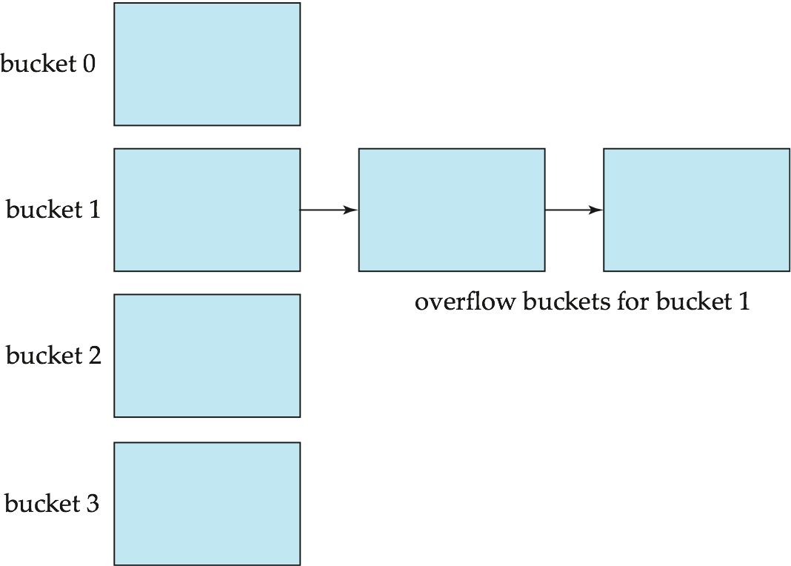
Handling of Bucket Overflows
Bucket overflow can occur because of
  Insufficient buckets
  Skew in distribution of records. This can occur due to two reasons:
    multiple records have same search-key value
    chosen hash function produces non-uniform distribution of key values
Although the probability of bucket overflow can be reduced, it cannot be eliminated; it is handled by using overflow buckets.
Overflow chaining
  The overflow buckets of
  a given bucket are chained
  together in a linked list

Slide 41
Hash Indices
A hash index organizes the search keys, with their associated record pointers, into a hash file structure.
Strictly speaking, hash indices are always secondary indices
  If the file itself is organized using hashing, a separate primary hash index on it using the same search-key is unnecessary
  However, we use the term hash index to refer to both secondary index structures and hash organized files

Slide 42
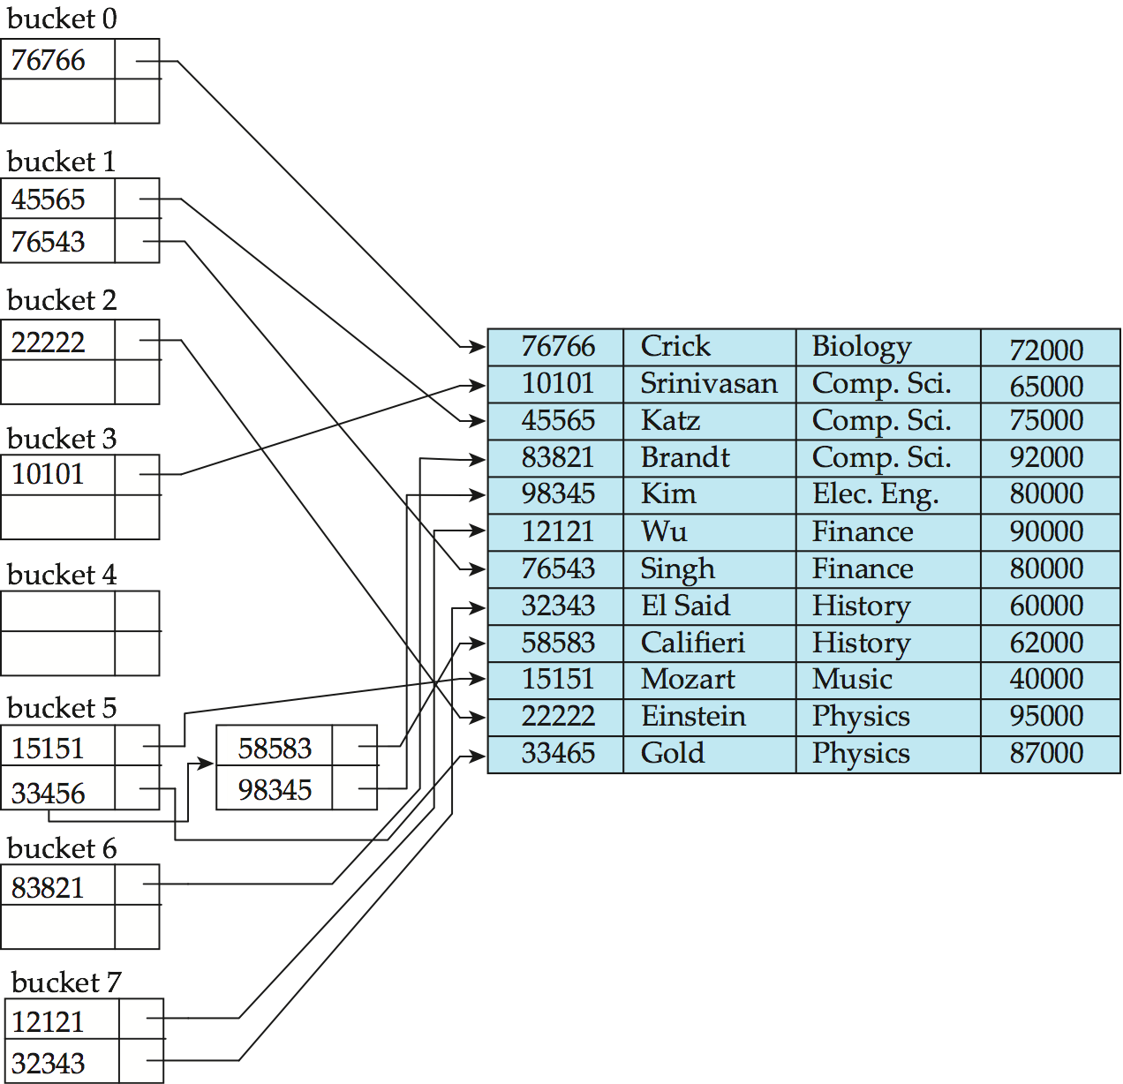
Example of Hash Index
hash index on instructor, on attribute ID

Slide 43
Deficiencies of Static Hashing
In static hashing, function h maps search-key values to a fixed set of B of bucket addresses
  Databases grow or shrink with time
  If initial number of buckets is too small, and file grows, performance will degrade due to too much overflows
  If space is allocated for anticipated growth, a significant amount of space will be wasted initially (and buckets will be underfull)
  If database shrinks, again space will be wasted
One solution: periodic re-organization of the file with a new hash function
  Expensive, disrupts normal operations
Better solution: allow the number of buckets to be modified dynamically
  Dynamic hashing is not covered in this class

Slide 44
Comparison of Ordered Indexing and Hashing
Cost of periodic re-organization
Relative frequency of insertions and deletions
Is it desirable to optimize average access time at the expense of worst-case access time?
Expected type of queries:
  Hashing is generally better at retrieving records having a specified value of the key (point query)
  If range queries are common, ordered indices are to be preferred
In practice:
  PostgreSQL supports hash indices, but discourages use due to poor performance
  Oracle supports static hash organization, but not hash indices
  SQLServer supports only B⁺-trees

Slide 45
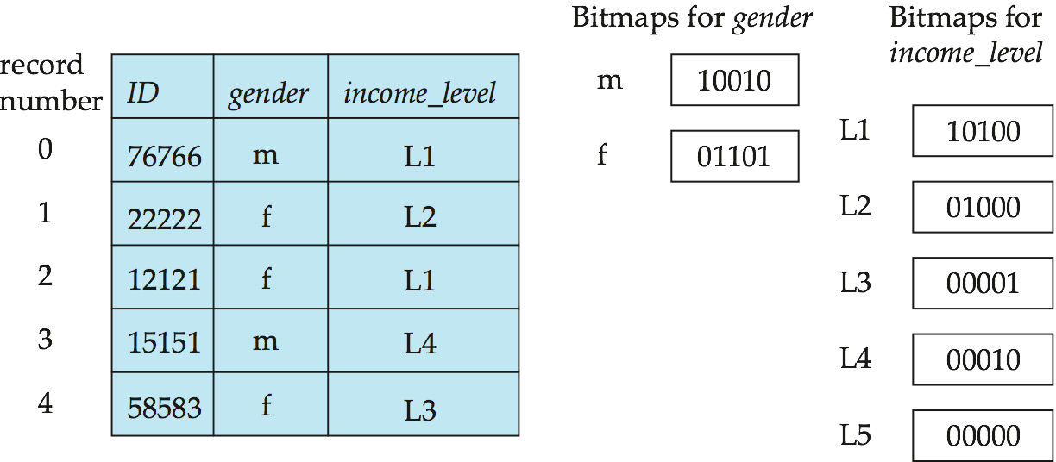
Bitmap Indices
Bitmap: simply an array of bits
Bitmap index: a specialized type of index designed for efficient querying on multiple keys
In the simplest form, a bitmap index on an attribute has a bitmap for each value of the attribute
  Bitmap has as many bits as records
  In a bitmap for value v, the bit for a record is 1 if the record has the value v for the attribute, and is 0 otherwise

Slide 46
Bitmap Indices (Cont.)
Applicable on attributes that take on a relatively small number of distinct values
  E.g. gender, country, state, …
  E.g. income-level (income broken up into a small number of levels such as 0-9999, 10000-19999, 20000-50000, 50000- infinity)
Bitmap indices generally very small compared with relation size
  E.g. if record is 100 bytes, space for a single bitmap is 1/800 of space used by relation
    If # of distinct attribute values is 8, bitmap is only 1% of relation size

Slide 47
Bitmap Indices (Cont.)
Bitmap indices are useful for queries on multiple attributes
  not particularly useful for single attribute queries
Queries are answered using bitmap operations
  Intersection (and): e.g., 100110 AND 110011 = 100010
  Union (or): e.g., 100110 OR 110011 = 110111
  Complementation (not): e.g., 100110 NOT 100110 = 011001
Each operation takes two bitmaps of the same size and applies the operation on corresponding bits to get the result bitmap
  E.g. males with income level L1: 10010 AND 10100 = 10000
    Can then retrieve required tuples
    Counting number of matching tuples is even faster

Slide 48
Index Definition in SQL
Create an index
  create index <index-name> on <relation-name>
  (<attribute-list>)
  E.g.: create index dept_index on instructor (dept_name)
Use create unique index to indirectly specify and enforce the condition that the search key is a candidate key
  Not really required if SQL unique integrity constraint is supported
To drop an index
  drop index <index-name>
Most database systems allow specification of type of index, and clustering

Slide 49
End of Chapter 11

