Slide 1
Chapter 8 – Logistic Regression
Data Mining for Business Intelligence
Shmueli, Patel & Bruce
© Galit Shmueli and Peter Bruce 2008

Slide 2
Logistic Regression
Extends idea of linear regression to situation where outcome variable is categorical
Widely used, particularly where a structured model is useful to explain (=profiling) or to predict
We focus on binary classification
  i.e. Y=0 or Y=1

Slide 3
Why Not Linear Regression?
Technically, you can run linear regression with a 0/1 response variable and obtain an output
But the resulting model will not make sense
For instance:
Predictions will mostly not be 0 or 1
Coefficient interpretation will not make sense

Slide 4
The Logit
Goal: Find a function of the predictor variables that relates them to a 0/1 outcome
Instead of Y as outcome variable (like in linear regression), we use a function of Y called the logit
Logit can be modeled as a linear function of the predictors
The logit can be mapped back to a probability, which, in turn, can be mapped to a class

Slide 5
Step 1: Logistic Response Function
p = probability of belonging to class 1
Need to relate p to predictors with a function that guarantees 0 ≤ p ≤ 1
Standard linear function (as shown below) does not:
q = number of predictors

Slide 6

The Fix: use logistic response function
  Equation 8.2 in textbook

Slide 7
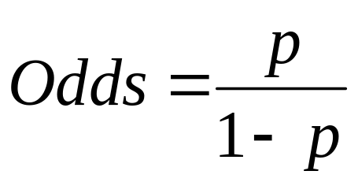
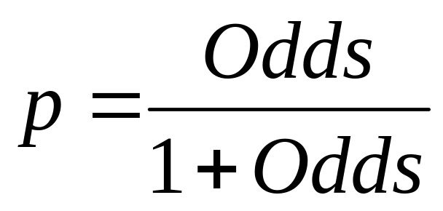
Step 2: The Odds
The odds of an event are defined as:
eq. 8.3
p = probability of event
Or, given the odds of an event, the probability of the event can be computed by:
eq. 8.4

Slide 8
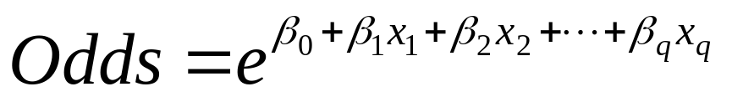
We can also relate the Odds to the predictors:
eq. 8.5
To get this result, substitute 8.2 into 8.4

Slide 9
Step 3: Take log on both sides
This gives us the logit:
log(Odds) = logit (eq. 8.6)

Slide 10
Logit, cont.
So, the logit is a linear function of predictors x₁, x₂, …
Takes values from -infinity to +infinity
Review the relationship between logit, odds and probability

Slide 11
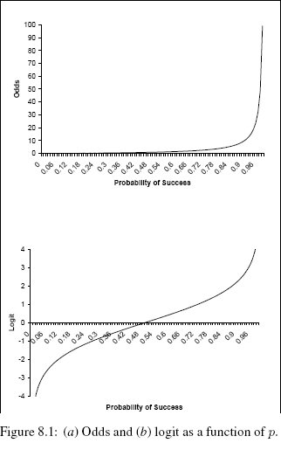

Slide 12
Example

Slide 13
Personal Loan Offer
Outcome variable: accept bank loan (0/1)
Predictors: Demographic info, and info about their bank relationship

Slide 14
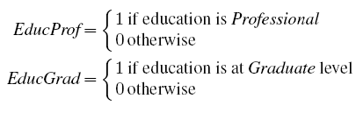
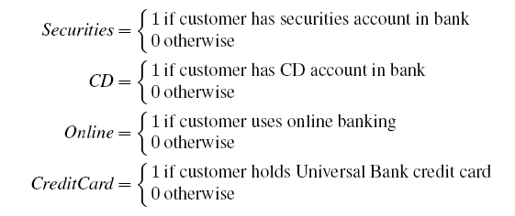
Data Preprocessing
Partition 60% training, 40% validation
Create 0/1 dummy variables for categorical predictors

Slide 15

Single Predictor Model
Modeling loan acceptance on income (x)
Fitted coefficients (more later): b₀ = -6.3525, b₁ = -0.0392

Slide 16
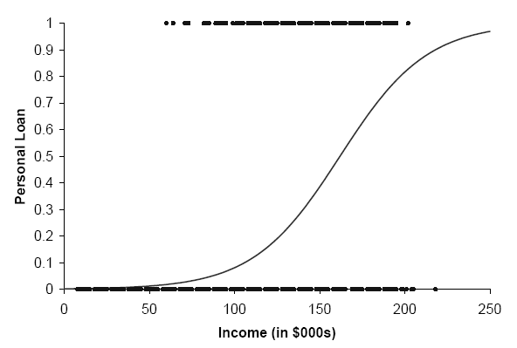
Seeing the Relationship

Slide 17
Last Step: Classify
Model produces an estimated probability of being a “1”
Convert to a classification by establishing cutoff level
If estimated prob. > cutoff, classify as “1”

Slide 18
Ways to Determine Cutoff
0.50 is popular initial choice
Additional considerations (see Chapter 4)
  Maximize classification accuracy
  Maximize sensitivity (subject to min. level of specificity)
  Minimize false positives (subject to max. false negative rate)
  Minimize expected cost of misclassification (need to specify costs)

Slide 19
Example, Cont.
Estimates of β’s are derived through an iterative process called maximum likelihood estimation
Let’s include all 12 predictors in the model now
XLMiner’s output gives coefficients for the logit, as well as odds for the individual terms

Slide 20
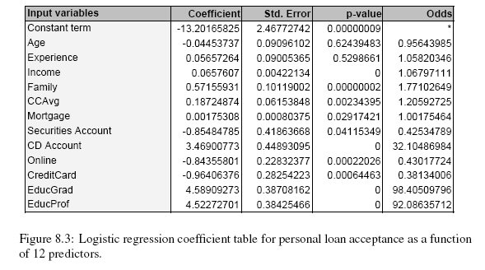

Slide 21
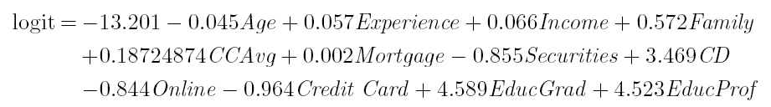
Estimated Equation for Logit
(Equation 8.10)

Slide 22
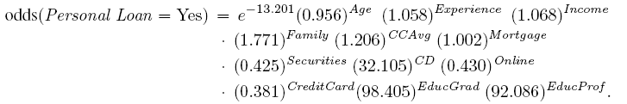
Equation for Odds (Equation 8.11)

Slide 23
Converting to Probability

Slide 24
Interpreting Odds, Probability
For predictive classification, we typically use probability with a cutoff value
For explanatory purposes, odds have a useful interpretation:
  If we increase x₁ by one unit, holding x₂, x₃ … x_{q} constant, then
  b₁ is the factor by which the odds of belonging to class 1 increase

Slide 25
Loan Example:
Evaluating Classification Performance
Performance measures: Confusion matrix and % of misclassifications
More useful in this example: lift

Slide 26
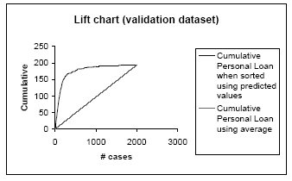

Slide 27
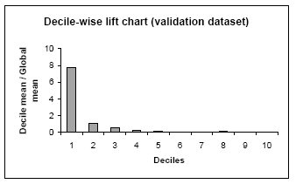

Slide 28
Multicollinearity
Problem: As in linear regression, if one predictor is a linear combination of other predictor(s), model estimation will fail
  Note that in such a case, we have at least one redundant predictor
Solution: Remove extreme redundancies (by dropping predictors via variable selection – see next, or by data reduction methods such as PCA)

Slide 29
Variable Selection
This is the same issue as in linear regression
The number of correlated predictors can grow when we create derived variables such as interaction terms (e.g. Income x Family), to capture more complex relationships
Problem: Overly complex models have the danger of overfitting
Solution: Reduce variables via automated selection of variable subsets (as with linear regression)

Slide 30
Goodness-of-Fit
How well does model fit the data?
Popular measures:
  Deviance ( = std. dev. estimate in XLMiner)
  Multiple R²
Goodness of fit measures are used in explanatory data analysis (profiling), not much in classification (where we look at classification accuracy with validation data)

Slide 31
P-values for Predictors
Test null hypothesis that coefficient = 0
Useful for review to determine whether to include variable in model
Key in profiling tasks, but less important in predictive classification

Slide 32
Complete Example:
Predicting Delayed Flights DC to NY

Slide 33
Variables
Outcome: delayed or not-delayed
Predictors:
  Day of week
  Departure time
  Origin (DCA, IAD, BWI)
  Destination (LGA, JFK, EWR)
  Carrier
  Weather (1 = bad weather)

Slide 34
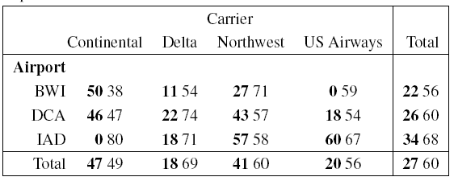
Delayed Flights: Summary
Bold numbers are delayed flights on Mon – Wed
Regular numbers Thurs - Sun

Slide 35
Data Preprocessing
Create binary dummies for the categorical variables
Partition 60%/40% into training/validation

Slide 36
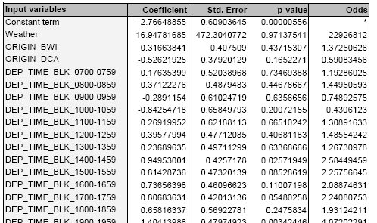
The Fitted Model (not all 28 variables shown)

Slide 37
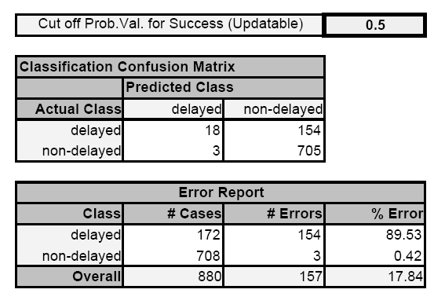
Model Output (Validation Data)

Slide 38
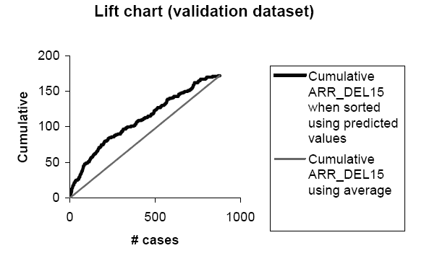
Lift Chart

Slide 39
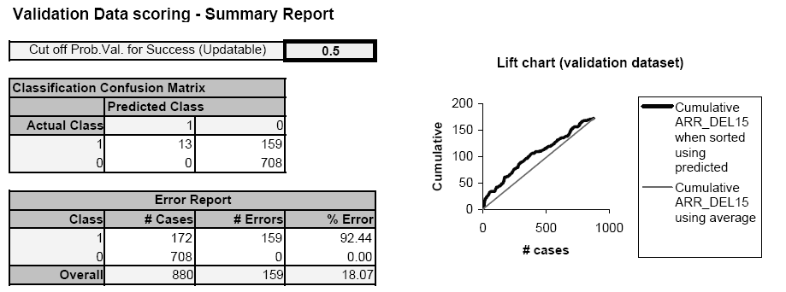
After Variable Selection
(Model with 7 Predictors)

Slide 40
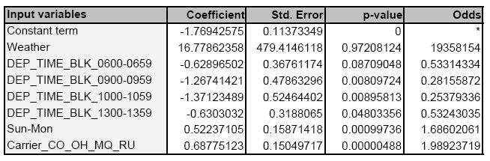
7-Predictor Model
Note that Weather is unknown at time of prediction (requires weather forecast or dropping that predictor)

Slide 41
Summary
Logistic regression is similar to linear regression, except that it is used with a categorical response
It can be used for explanatory tasks (=profiling) or predictive tasks (=classification)
The predictors are related to the response Y via a nonlinear function called the logit
As in linear regression, reducing predictors can be done via variable selection
Logistic regression can be generalized to more than two classes (not in XLMiner)

