Slide 1
Freshness Matters: In Flowers, Food, and Web Authority
Na Dai and Brian D. Davison
Lehigh University, USA
SIGIR 2010, link analysis and advertising
20 July, 2011
SNU IDB Lab.
Hyunwoo Kim

Slide 2
Outline
Introduction
Methodology
Experiment
Conclusion

Slide 3

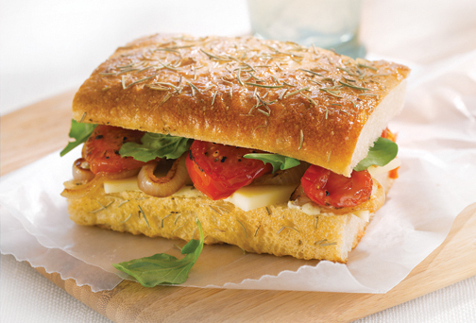
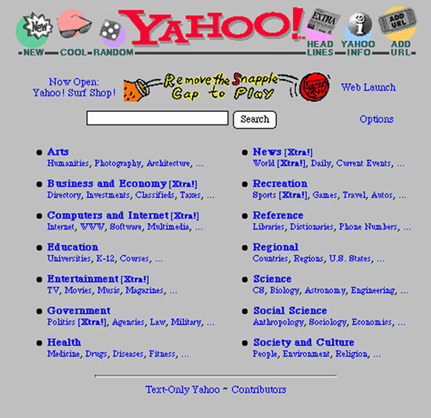
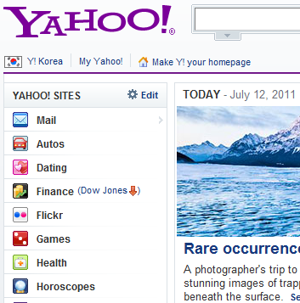

Introduction
Freshness matters
Flowers
Food
1995
2011
Web Authority?

Slide 4
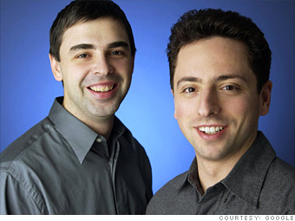
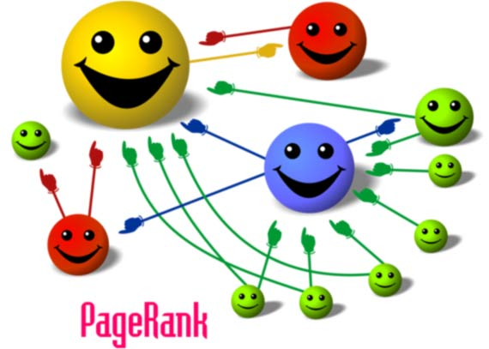

Introduction
Web page authority
Sergey Brin
Larry Page
PageRank

Slide 5
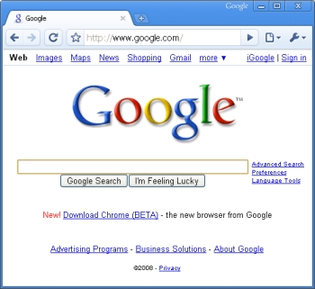
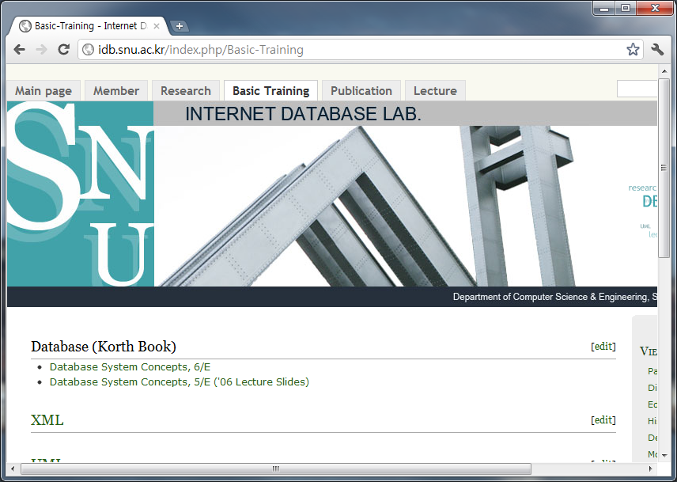
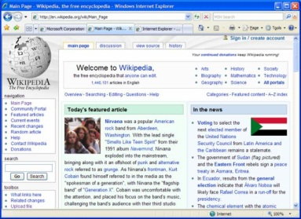
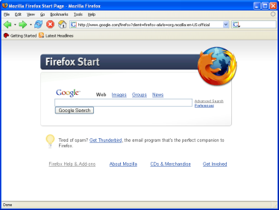
Introduction
Web page freshness and in-link freshness
Freshness of Web page itself
Freshness of in-link

Slide 6
Methodology
Temporal ranking model (T-Fresh)
To incorporate Web freshness and link structures at different time points
Web page authority estimation
To utilize authors’ maintenance activities on Web page and links
T-Fresh outputs an authority score for each page at every predefined time point
The authority is estimated in an approximated way
Partly depending on the link structure and Web freshness of nearby snapshots
Farther time points having smaller influence

Slide 7
Methodology
Representing Web freshness over time
Web freshness reflects how fresh a Web page is at a given time point
In-link freshness (InF) and page freshness (PF)
InF and PF depict Web freshness from the perspectives of information recommenders (InF) and information providers (PF)
Preventing on type of Web freshness from dominating a single freshness score

Slide 8
Methodology
Building temporal page and link profiles
Temporal page profiles (TPP)
Temporal link profiles (TLP)
Activities on pages and links
TPP: <page ID, activity type, timestamp>, activity type= {creation, update, removal}
TLP: <link ID, activity type, timestamp>,
activity type= {creation, update with unchanged anchor, update with changed anchor, removal}
Page activity | PF
Creation
Update
Removal
Link activity | InF
Creation
Update with changed anchor
Update with unchanged anchor
Removal

Slide 9
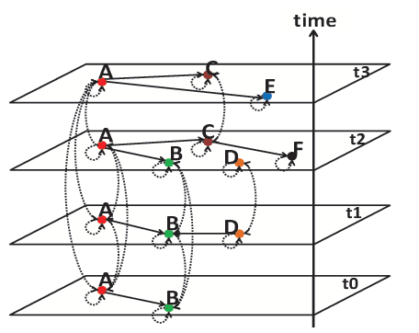


Methodology
Quantifying Web freshness
Temporal random surfer model
Temporal intent
Fresh Web resource
Δt
t_{i-1}
t_{i}
$${InF}_{t_{i}}={InF}_{t_{i−1}}+∆InF\left|\begin{matrix}t_{i} \\ t_{i−1}\end{matrix}\right.$$
$${PF}_{t_{i}}={PF}_{t_{i−1}}+∆PF\left|\begin{matrix}t_{i} \\ t_{i−1}\end{matrix}\right.$$

Slide 10





Methodology
Temporal random surfer model (cont’d)
Surfer movement
Step 1. Either to follow one of the out-linked pages or to randomly jump to any page at the same time point
Step 2. Select the specific snapshot of the page
Step 3. Browse the page with the mean stay time
move
stationary probability
$$π_{i}$$
$$PF$$
stay
$$μ_{i}$$
staying time
$$InF$$

Slide 11
Experiment
Standard data sets
Only contain one snapshot of a Web corpus
ex) TREC
Not suitable to show the effectiveness of ranking models utilizing temporal information
Corpus of archival Web pages
Collected by Internet Archive from January 2000 to December 2007
Web activity detection
Update of page: difference and metadata
Update of link: once a page has an update, all its out-links are updated

Slide 12
Experiment
Human editors judge each pair of <query, URL>
1. How relevant the page is to the query
2. How fresh the page would be as a result for the requested time period
Comparison
T-Fresh vs. PageRank, TimedPageRank, T-Rank, BuzzRank, TemporalRank, and T-random

Slide 13
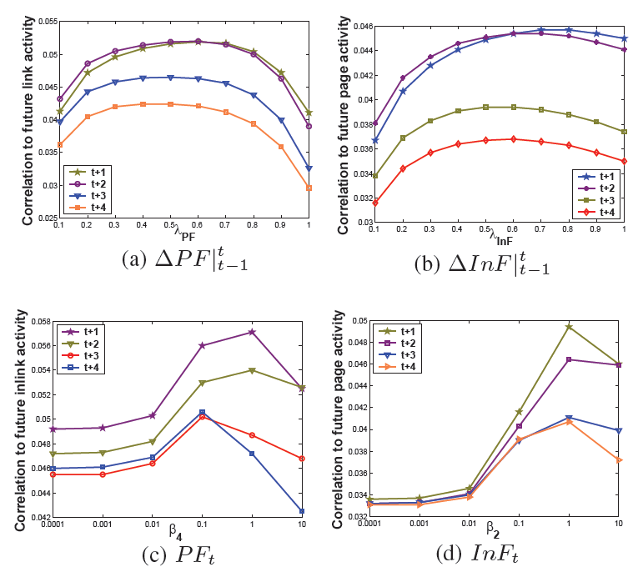
Experiment
Correlation of InF and PF
Correlation between Web freshness and future Web activities
- Parameter setting
- Interpretation

Slide 14
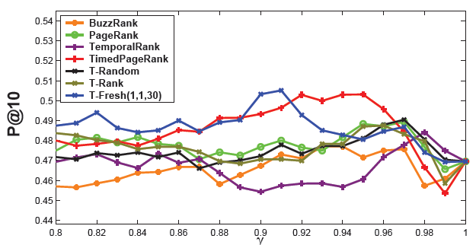
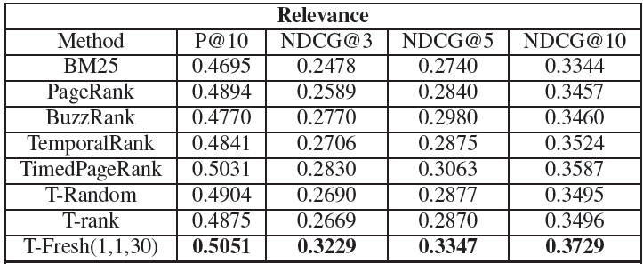
Experiment
Ranking performance
Relevance

Slide 15
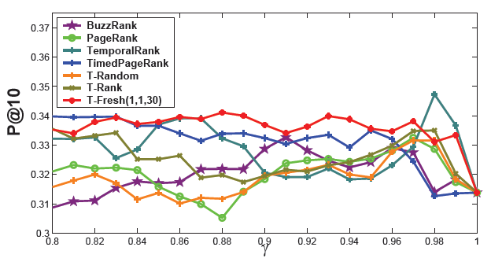
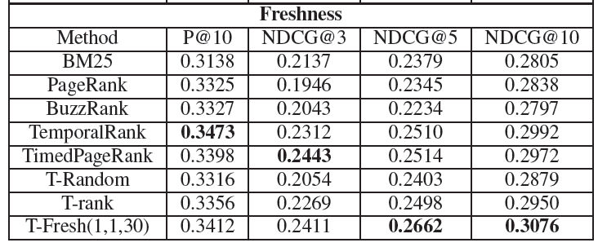
Experiment
Ranking performance
Freshness
- PageRank

Slide 16
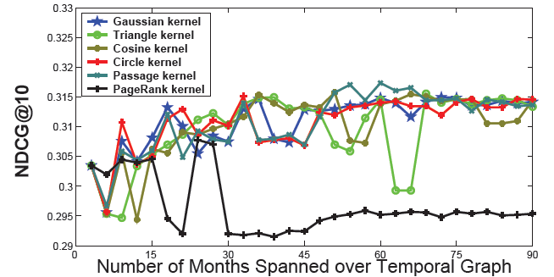
Experiment
Deeper analysis
Effects of propagation kernels in freshness performance
In PageRank, authority propagation become very weak when the graph time span is large enough

Slide 17
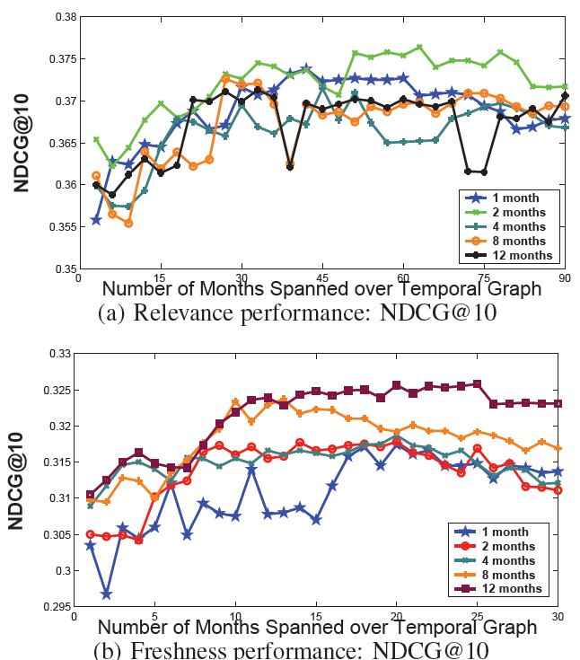
Experiment
Best ranking performance
Windows size used in the stay time estimation
To use in-link freshness on several adjacent time points
It does harm when windows size is too large
Large window size result in large variance of performance
Performance improves with the increase of graph time span

Slide 18
Conclusion
Web freshness form Web creators’ activities
Web freshness is an important attribute of Web resources
Temporal Web link-based ranking algorithm to estimate time-dependent Web page authority

Slide 19
THANK YOU

