Slide 1
Scalable SPARQL Querying of Large RDF Graphs
IDB Lab.
11. 25.
현근수
In VLDB 11.
Jiewen Huang, Daniel J. Abadi, Kun Ren

Slide 2
Outline
Introduction
Background
System Architecture
Data Partitioning
Vertex Partitioning
Triple Placement
Query Processing
Experiments
Conclusion and Future work

Slide 3
Introduction
Problem
Increased amount of RDF available
the increased amount of RDF available is causing performance bottlenecks

Slide 4
Introduction
Single machine RDF data management systems
Sesame, Jena, 3store, RDFSuite, RDF-3X
Clustered RDF database system
Hash partition triples and parallelize access
SHARD, YARS2, Virtuoso
Work well for simple index lookup queries
Far from optimal in complex query
Limitation
data communication
These systems were not originally designed for RDF data

Slide 5
Introduction
Our Approach
Horizontally scalable RDF database system
Use RDF3X
Use graph partitioning algorithm instead of hash partitioning
Close to each other in the RDF graph to be stored on the same machine
Allow some overlap of data across partitions
Automatic decomposition of queries into chunk
Reconstructed using the Hadoop
Achieve up to 1000 times shorter query latencies relative to alternative solutions

Slide 6
Introduction
Summary
We introduce the architecture of a scalable RDF datab-ase system that leverages best-of-breed single node RDF-stores and parallelizes execution across them using the Hadoop framework.
We describe date partitioning and placement techniques that can dramatically reduce the amount of networkcommunication at query time.
We provide an algorithm for automatically decomposing queries into parallelizable chunks.
We experimentally evaluate our system to understand the eect of various system parameters and compare against other currently available RDF stores.

Slide 7
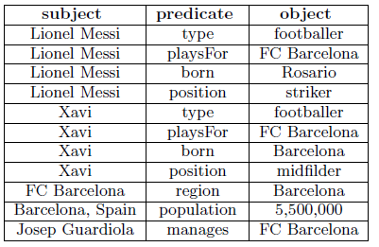
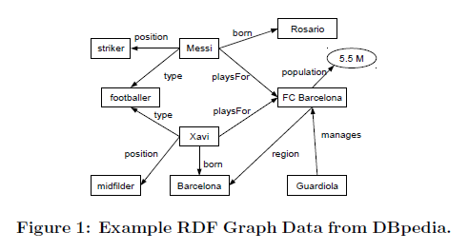
Background
RDF
RDF uses a graph data model
Most RDF-stores represent RDF graphs as a table of triple
<subject, predicate, object>
Many RDF-stores store the triples in a relational database
Single relational table containing three columns.

Slide 8
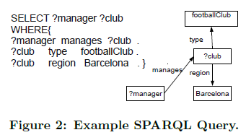
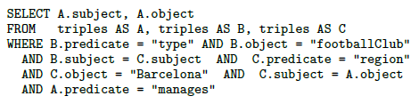
Background
SPARQL
Graph pattern matching
Convert to SQL

Slide 9
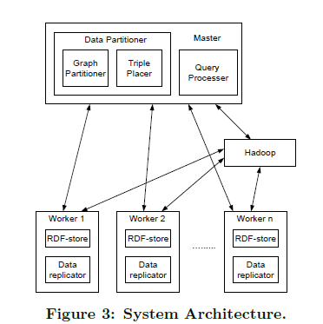
System Architecture

Slide 10
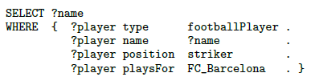
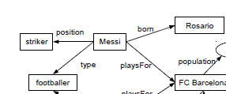
Data partitioning
If data was hash partitioned by RDF subject?
It guaranteed that all triples related to a particular player are stored on the same machine

Slide 11
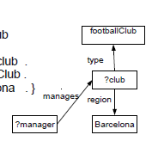
Data partitioning
Do not share common thing
Graph partition RDF data
Vertex partitioning vs edge partitioning
Edge partitioning is bad in star query
Two step
Vertex partitioning
Triple placement

Slide 12
Vertex partitioning
Remove triple predicate is rdf:type
Rdf:type make same type in two hops
Graph more complex
METIS partitioner

Slide 13
Triple Placement
Simply way, check subject and place the triple in corresponding vertex
Trade-off between storage overhead and communication overhead
Minimizing data shuffling/exchange
Allow data overlap
n-hop guarantee
The extent of data overlap
If a vertex is assigned to a machine, any vertex that is within n-hop of this vertex is also stored in this machine

Slide 14
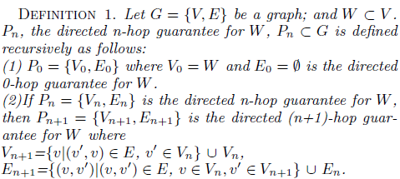
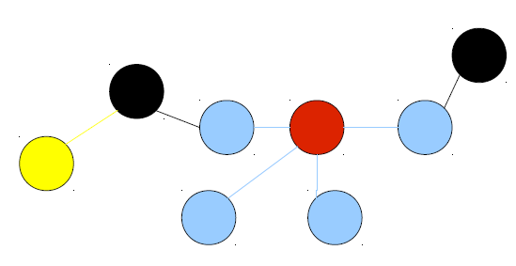
Triple Placement
Direct n-hop guarantee

Slide 15
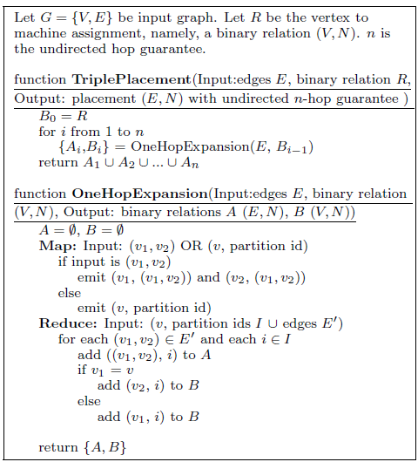
Triple Placement
Algorithm

Slide 16
Query processing
Queries are executed in RDF-stores and/or Hadoop
Query execution is more efficient in RDF-stores than in Hadoop
Pushing as much of the processing as possible into RDF-stores
Minimizing the number of Hadoop jobs
The larger the hop guarantee, the more work is done in RDF-stores

Slide 17
Query processing
To Communicate, or not to Communicate
Given a query and n-hop guarantee, is communication (Hadoop job) between nodes needed?
Choose the “center” of the query graph
Calculate the distance from the “center” to the furthest edge
If distance > n, communication is needed; not needed otherwise

Slide 18
Query processing
Determining whether a Query is PWOC
PWOC(parallelizable without communication) Query
parallelizable without communication
DoFE(distance of farthest edge)
distance of farthest edge
the vertex in a graph with the smallest DoFE will be the most central in a graph

Slide 19
Query processing
A query is not PWOC
decompose the query into PWOC subqueries
use Hadoop jobs to join the results of the PWOC subqueries
The number of Hadoop jobs required to complete the query increases as the number of subqueries increases

Slide 20
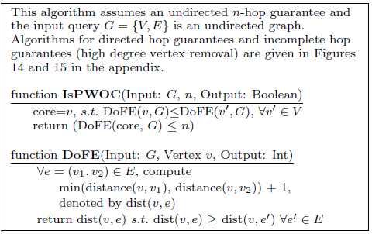
Query processing

Slide 21
Query processing
the issue of duplicate results
naive approach
remove duplicates after the query has completed
owner-computes model
add triples (v, ‘<isOwned>’, ‘Yes’) to a partition
For each query issued to the RDF-stores, add an additional pattern (core, ‘<isOwned>’, ‘Yes’)

Slide 22
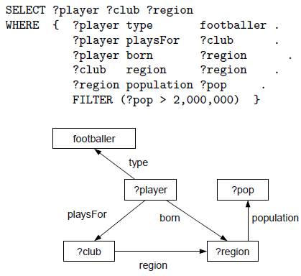
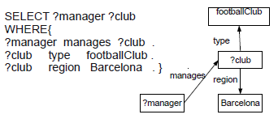
Query processing
example
DoFEs for manager, footballClub, Barcelona and club are 2, 2, 2 and 1
the DoFEs for footballer, pop, region, player and club are 3, 3, 2, 2 and 2,

Slide 23
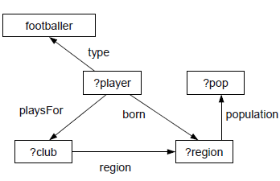
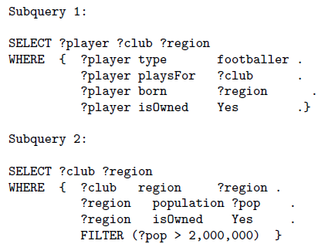
Query processing
Decompose example

Slide 24
Experiments
20-machine cluster
Leigh University Benchmark (LUBM): 270 million triples
Competitors:
Single-node RDF-3X
SHARD: triple-store system in Hadoop
Graph partitioning (the proposed system)
Hash partitioning on subjects

Slide 25
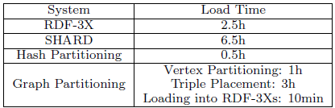
Experiments
Data load time

Slide 26
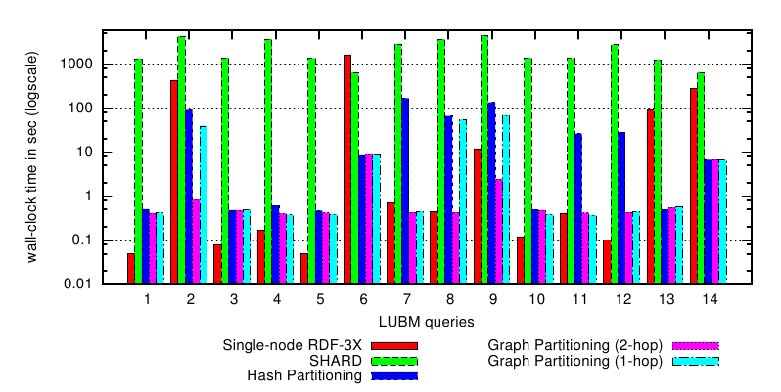
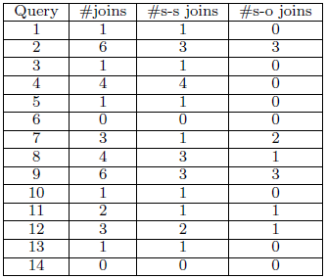
Experiments
Performance Comparison

Slide 27
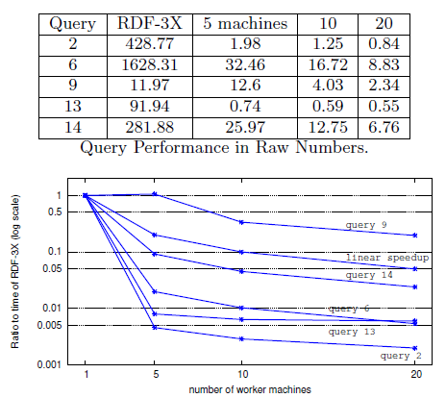
Experiments
Varying Number of Machines

Slide 29
minimal number of subqueries
reduces to the problem of finding minimal edge partitioning of a graph into subgraphs of bounded diameter
brute-force

