Slide 1

Session 27
Introduction to Web
Development with Java
Written by Thomas A. Pender
Published by Wiley Publishing, Inc.
November 2, 2011
Presented by Hyewon Kim

Slide 2
Contents
Issues in Using the UML in Web Development
Basic Web Architecture and Static Web Content
Dynamic Web Content

Slide 3
Issues in Using the UML in Web Deployment (1/2)
The UML was developed primarily for traditional object-oriented application development
???
Object-oriented application
Web architecture model
UML
Web applications have several differences from traditional object-oriented applications
that require adapting the UML
to work with the Web architecture model

Slide 4

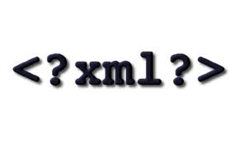
Issues in Using the UML in Web Deployment (2/2)
Some of the key aspects of Web development that affect that use of the UML models include
  An object representation of markup language documents using a class diagram
  Web applications are inherently very network-dependent architectures
  Web applications frequently involve a wide variety of different technologies integrated together
  The others modeling techniques can support the development of highly modular designs that are more easily developed and maintained
Class diagram
Modeling Web application
Deployment diagram
Relationships between architectures
Component diagram

Slide 5
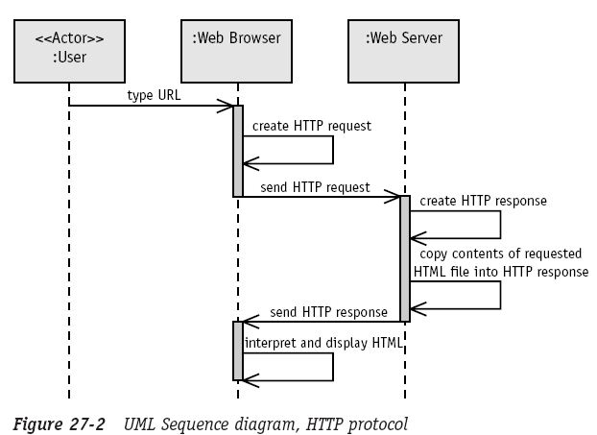
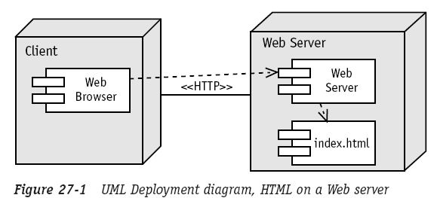
Basic Web Architecture and Static Web Content
Consider the static Web content, which is the Web content that never or infrequently changes
  You would write an HTML page with this content and place it on your Web server

Slide 6
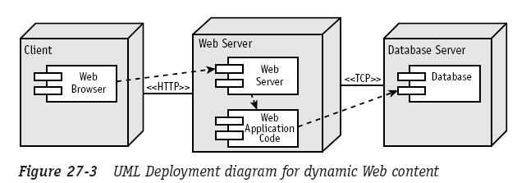
Dynamic Web Content
Most Web applications require dynamically generated content
  All those activities require some code on the Web server that reacts to the HTTP request by completing some processing and then returning Web content such as HTML or XML
CGI, Java Servlets, Template pages, JavaServer pages …

Slide 7
The End

