Slide 1
Dynamic Data Structures and Generics
Chapter 12

Slide 2
Objectives
Define and use an instance of ArrayList
Describe general idea of linked list data structures and implementation
Manipulate linked lists
Use inner classes in defining linked data structures
Describe, create, use iterators
Define, us classes with generic types

Slide 3
Array-Based Data Structures: Outline
The Class ArrayList
Creating an Instance of ArrayList
Using Methods of ArrayList
Programming Example: A To-Do List
Parameterized Classes and Generic Data Types

Slide 4
Class ArrayList
Consider limitations of Java arrays
  Array length is not dynamically changeable
  Possible to create a new, larger array and copy elements – but this is awkward, contrived
More elegant solution is use instance of ArrayList
  Length is changeable at run time

Slide 5
Class ArrayList
Drawbacks of using ArrayList
  Less efficient than using an array
  Can only store objects
  Cannot store primitive types
Implementation
  Actually does use arrays
  Expands capacity in manner previously suggested

Slide 6
Class ArrayList
Class ArrayList is an implementation of an Abstract Data Type (ADT) called a list
Elements can be added
  At end
  At beginning
  In between items
Possible to edit, delete, access, and count entries in the list

Slide 7
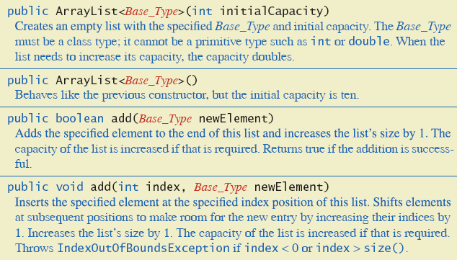
Class ArrayList
Figure 12.1a Methods of class ArrayList

Slide 8
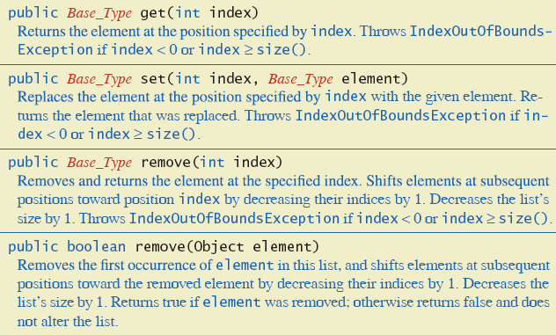
Class ArrayList
Figure 12.1b Methods of class ArrayList

Slide 9
Creating Instance of ArrayList
Necessary to
import java.util.ArrayList;
Create and name instance
ArrayList<String> list =
new ArrayList<String>(20);
This list will
  Hold String objects
  Initially hold up to 20 elements

Slide 10
Using Methods of ArrayList
Object of an ArrayList used like an array
  But methods must be used
  Not square bracket notation
Given
ArrayList<String> aList =
new ArrayList<String> (20);
  Assign a value with
  aList.add(index, "Hi Mom");
  aList.set(index, "Yo Dad");

Slide 11
Programming Example
A To-Do List
  Maintains a list of everyday tasks
  User enters as many as desired
  Program displays the list
View source code, listing 12.1
class ArrayListDemo

Slide 12
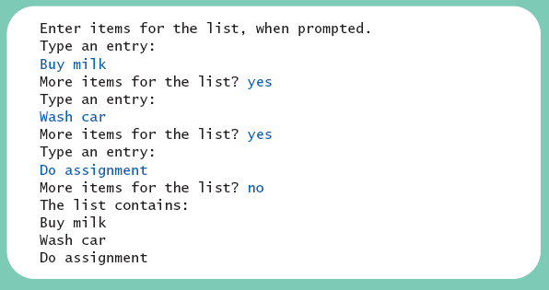
Programming Example
Sample
screen output

Slide 13
Programming Example
When accessing all elements of an ArrayList object
  Use a For-Each loop
Use the trimToSize method to save memory
To copy an ArrayList
  Do not use just an assignment statement
  Use the clone method

Slide 14
Parameterized Classes, Generic Data Types
Class ArrayList is a parameterized class
  It has a parameter which is a type
Possible to declare our own classes which use types as parameters
Note earlier versions of Java had a type of ArrayList that was not parameterized

Slide 15
Linked Data Structures:Outline
The Class LinkedList
Linked Lists
Implementing Operations of a Linked List
A Privacy Leak
Inner Classes

Slide 16
Linked Data Structures:Outline
Node Inner Classes
Iterators
The Java Iterator Interface
Exception Handling with Linked Lists
Variations on a Linked List
Other Linked Data Structures

Slide 17
Class LinkedList
Linked data structure
  Collection of objects
  Each object contains data and a reference to another object in the collection
Java provides a class to do this, LinkedList
  More efficient memory use than ArrayList
We will write our own version to learn the concepts of a linked list

Slide 18
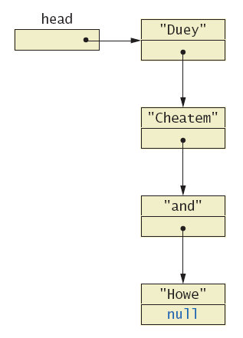
Linked Lists
A dynamic data structure
Links items
in a list to one
another
Figure 12.2,
a linked list

Slide 19
Linked Lists
Node of a linked list object requires two instance variables
  Data
  Link
View sample class, listing 12.2
class ListNode
  This example has String data
  Note the link, a reference to the type which is the class

Slide 20
Implementing Operations of Linked Lists
Now we create a linked list class which uses the node class
View class, listing 12.3
class StringLinkedList
Note the single instance variable of type ListNode
Note method to traverse and print the contents of the list

Slide 21
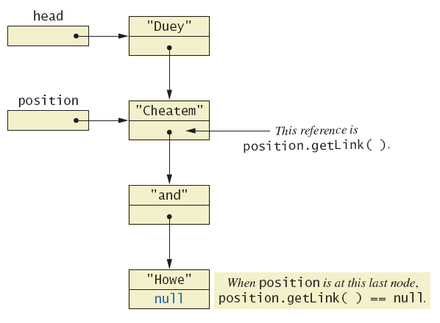
Implementing Operations of Linked Lists
Figure 12.3 Moving down a linked list

Slide 22
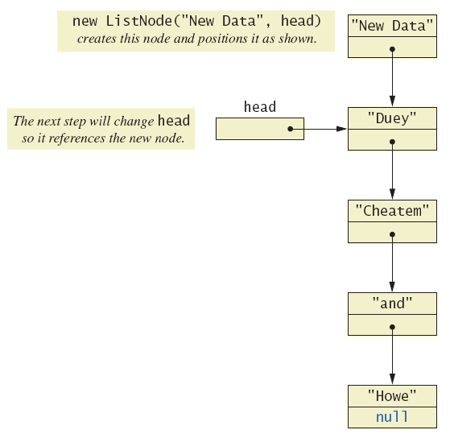
Implementing Operations of Linked Lists
Figure 12.4
Adding a node
at the start of
a linked list

Slide 23
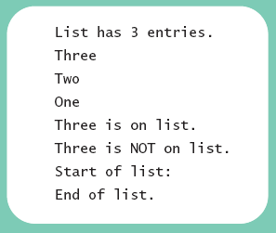
Implementing Operations of Linked Lists
View linked-list demonstration, listing 12.4
class StringLinkedListDemo
Sample
screen output

Slide 24
Implementing Operations of Linked Lists
Java automatically returns memory used by deleted node to the operating system.
  Called automatic garbage collecting
In this context, note the significance of NullPointerException messages
Consider the fact that our program has a reference (name) to only the head node

Slide 25
A Privacy Leak
Note results of getLink in class ListNode
  Returns reference to ListNode
  This is a reference to an instance variable of a class type … which is supposed to be private
Typical solution is to make ListNode a private inner class of StringLinkedList

Slide 26
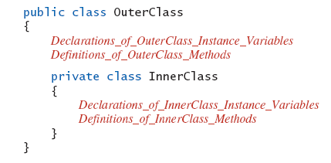
Inner Classes
Defined within other classes
Example

Slide 27
Inner Classes
Inner class definition local to the outer-class definition
  Inner-class definition usable anywhere within definition of outer class
Methods of inner and outer classes have access to each other's methods, instance variables

Slide 28
Node Inner Classes
We show ListNode as a private inner class
  This is safer design
  Hides method getLink from world outside StringLinkedList definition
View new version, listing 12.5
class StringLinkedListSelfContained

Slide 29
Iterators
A variable that allows you to step through a collection of nodes in a linked list
  For arrays, we use an integer
Common to place elements of a linked list into an array
  For display purposes, array is easily traversed
View method to do this, listing 12.6
method toArray

Slide 30
Iterators
Consider an iterator that will move through a linked list
  Allow manipulation of the data at the nodes
  Allow insertion, deletion of nodes
View sample code, listing 12.7
class StringLinkedListWithIterator

Slide 31
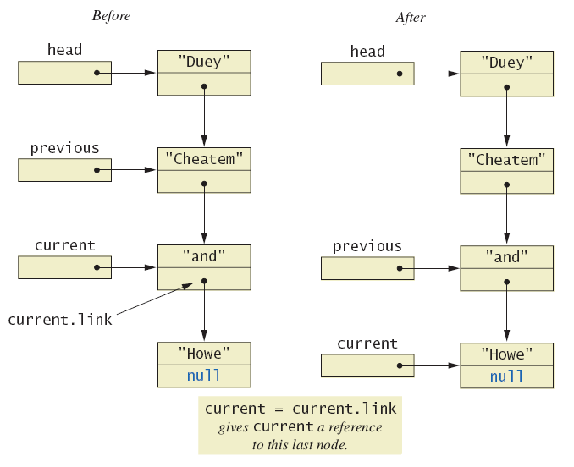
Iterators
Figure 12.5 The effect of goToNext on a linked list

Slide 32
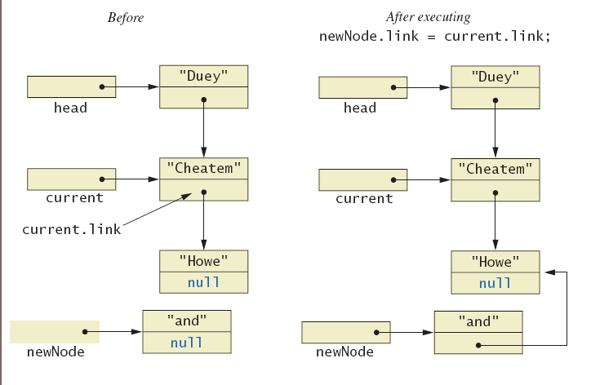
Iterators
Figure 12.6a Adding node to linked list using insertAfterIterator

Slide 33
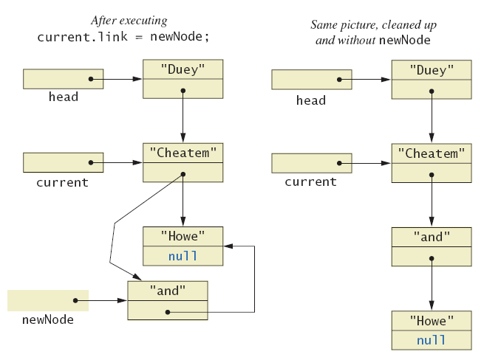
Iterators
Figure 12.6b Adding node to linked list using insertAfterIterator

Slide 34
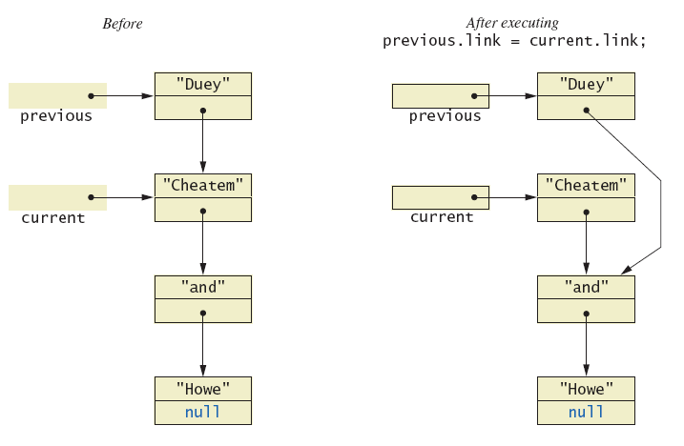
Iterators
Figure 12.7a Deleting a node

Slide 35
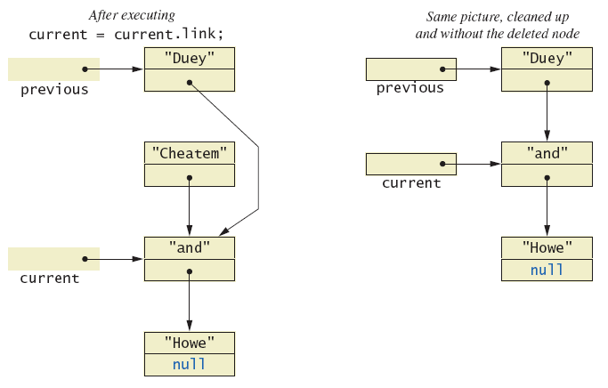
Iterators
Figure 12.7b Deleting a node

Slide 36
Java Iterator Interface
Java formally considers an iterator to be an object
Note interface named Iterator with methods
  hasNext – returns boolean value
  next – returns next element in iteration
  remove – removes element most recently returned by next method

Slide 37
Exception Handling with Linked Lists
Recall class StringLinkedListWithIterator
  Methods written so that errors caused screen message and program end
More elegant solution is to have them throw exceptions
  Programmer decides how to handle
Note class which does this, listing 12.8
class LinkedListException

Slide 38
Variations on a Linked List
Possible to make a linked where data element is of any type
  Replace type String in definition of node class with desired data type
Consider keeping a reference to last node in list
  Called the tail of the list
  Constructors, methods modified to accommodate new reference

Slide 39
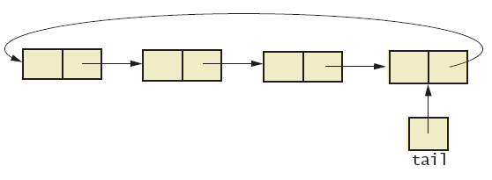
Variations on a Linked List
Consider having last link point back to head
  Creates a circular linked list
Figure 12.8 Circular linked list

Slide 40
Variations on a Linked List
Also possible to have backward as well as forward links in the list
  Doubly linked list
  Possible to traverse in either direction
Figure 12.9 Doubly linked list

Slide 41
Other Linked Data Structures
Stack
  Elements removed from ADT in reverse order of initial insertion
  Can be implemented with linked list
Tree
  Each node leads to multiple other nodes
  Binary tree leads to at most two other nodes

Slide 42
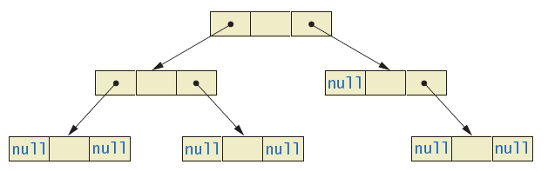
Other Linked Data Structures
Figure 12.10 Binary tree

Slide 43
Generics: Outline
The Basics
Programming Example: A Generic Linked List

Slide 44
Basics of Generics
Beginning with Java 5.0, class definitions may include parameters for types
  Called generics
Programmer now can specify any class type for the type parameter
View class definition, listing 12.9
class Sample<T>
Note use of <T> for the type parameter

Slide 45
Basics of Generics
Legal to use parameter T almost anywhere you can use class type
  Cannot use type parameter when allocating memory such as anArray = new T[20];
Example declaration
Sample <String> sample1 =
new Sample<String>();
  Cannot specify a primitive type for the type parameter

Slide 46
Programming Example
Generic linked list
  Revision of listing 12.5
  Use type parameter E instead of String
Note similarities and differences of parameterized class with non-paramaterized classes
View generic class, listing 12.10
class LinkedList <E>

Slide 47

Programming Example
View demo program, listing 12.11
class LinkedListDemo
Sample
screen output

Slide 48
Summary
Java Class Library includes ArrayList
  Like an array that can grow in length
  Includes methods to manipulate the list
Linked list data structure contains nodes (objects)
Linked data structure is self-contained by making the node class an inner class

Slide 49
Summary
Variable or object which allows stepping through linked list called an iterator
Class can be declared with type parameter
Object of a parameterized class replaces type parameter with an actual class type
Classes ArrayList and LinkedList are parameterized classes

