Slide 1
Adapting Prime Number Labeling Scheme for Directed Acyclic Graphs
Gang Wu, Kuo Zhang, Can Liu and Juanzi Li
Tsinghua University, China
DASFAA, 2006
Presented by Dong-Hyuk Im

Slide 2
Contents
Introduction
Prime Number Labeling Scheme for DAG
  Lite
  Full
Optimization Techniques
Performance Study
Conclusion

Slide 3
Introduction
DAG (Ditected Acyclic Graph)
  Effective data structure for representing subsumption hierarchies in application (ex. OO programming, soft engineering, knowledge management)
  The growing number and volume of DAG -> demands for appropriate index structure for DAG
Labeling schemes
  Widely used in indexing tree or graph
  Determinacy, compaction, dynamicity and flexibility
  Labeling schemes for DAG could not satisfy above requirements simulataneously

Slide 4
Labeling Schemes for DAG
Spanning tree based
  First find a spanning tree and assign label for vertices following the tree’s edge
  Propagate additional labels to record relationships of the non-tree edges
  Ex) interval-based, prefix-based
No concern with spanning tree
  Ex) bit vector, 2-hops

Slide 5
Prime Number Labeling Scheme
A novel labeling scheme for XML tree
  Associate each vertex with a unique prime number
  Label each vertex by multiplying parents’s label and the prime number owned by the vertex
Compared with prefix-based scheme
  The effect of updating is almost the same
  The query response time and the size requirements are even smaller

Slide 6
Ex) Prime Number Labeling Scheme in XML
1155
1
(1*1)
15
77
2
(1*2)
3
(1*3)
3
5
7
11
10
(2*5)
14
(2*7)
33
(3*11)
39
(3*13)
Bottom-up labeling scheme
Top-down labeling scheme
<from “A Prime Number Labeling Scheme for dynamic ordered XML Trees,
In ICDE 2004>

Slide 7
Major Contribution
Extend original prime number scheme for labeling DAG and supporting the processing of typical operations on DAG
Optimize the scheme on space and time requirements in terms of the characteristics of DAG and prime number
Space requirement, construction time, scalability, and the impact of selectivity and update are all studied in the experiment

Slide 8

PLSD-Lite
Definition
  Let G = (V,E) be a DAG. A Prime Number Labeling Scheme for DAG – Lite (PLSD-Lite) associates each vertex v ∈ V with an exclusive prime number p[v], and assigns to v a label L_{lite} (v) = (c[v]), where
  For any two vertices v, w ∈ V where L_{lite} (v) = (c[v]) and L_{lite} (w) = (c[w]), v -> w (c[v]c[w])

Slide 9
Ex) PLSD-Lite
(2 * 1 = 2)
A
C
(17 * 2 = 34)
(3 * 2 * 34 = 204)
(19 * 34 = 646)
B
E
F
(23 * 34 = 782)
(5 * 204 = 1020)
D
G
(11 * 204 * 646 * 782= 1133605968)
(13 * 1133605968 = 14736877584)
H
I
(7 * 1020 * 1133605968 = 8093946611520)

Slide 10
Update in PLSD-Lite
(2 * 1 = 2)
A
C
(17 * 2 = 34)
(3 * 2 * 34 = 204)
(19 * 34 = 646)
(23 * 34 = 782)
B
E
F
J
(29 * 782 = 22678)
J
D
G
(11 * 204 * 646 * 22678= 32874573072)
(31 * 204 = 6324)
(5 * 204 = 1020)
(13 * 32874573072 = 427369449936)
H
I
(7 * 32874573072 = 230122011504)

Slide 11
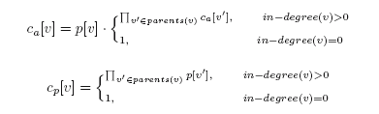
PLSD-Full
Definition
  Let G = (V,E) be a DAG. A Prime Number Labeling Scheme for DAG – Full (PLSD-Full) associates each vertex v ∈ V with an exclusive prime number p[v], and assigns to v a label L_{full} (v) = (p[v] , c_{a}[v], c_{p}[v]), where
  We term p[v] as “self-label, c_{a}[v] as “ancestors-label”, c_{p}[v] as “parent-label”

Slide 12
Ex) PLSD-Full
(2, 2, 1)
A
C
(17, 34, 2)
(19, 646, 17)
(3, 204, 2 * 17 = 34)
B
E
F
(23, 782, 17)
(5, 1020, 3)
D
G
(11, 1133605968, 3 * 19 * 23 = 1311)
(13, 14736877584, 11)
H
I
(7, 8093946611520, 5 * 11 = 55)

Slide 13
Optimization Techniques
Elementary arithmetic operations employed by PLSD
  Time-consuming when their inputs are large numbers
  Some optimizations are introduced
  Least Common Multiple
  Topological Sort
  Leaves Marking
  Descendants-Label

Slide 14

Least Common Multiple
There is apparent redundancy in previous construction of ancestor-label
  Ancestor-label can be simply constructed by multiplying self-label by the least common multiple of all the parents’ ancestors-labels

Slide 15
Ex) Least Common Multiple
(2, 2*1 = 2, 1)
A
C
(17, 17*lcm(2) = 34, 2)
(3, 3*lcm(2,34) = 102, 34)
(19, 19*lcm(34)=646, 17)
B
E
F
(23, 23*lcm(34)=782, 17)
(5, 5*lcm(102)=510, 3)
D
G
(11, 11*lcm(102,646,782)=490314, 1311)
(13, 13*lcm(490314)=6374082, 11)
H
I
(7,7*lcm(510,490314)=17160990, 55)

Slide 16
Topological Sort
Vertices on the top of the hierarchy should be assigned small prime numbers as early as possible
  Topological sort of a DAG provides the character we need
  Ex)
A
C
“A, C, E, F, B, D, G, H, I”
“2, 3, 5, 7, 11, 13, 17, 19, 23”
B
E
F
D
G
H
I

Slide 17
Ex) Topological Sort
(2, 2, 1)
A
C
(3, 3*lcm(2)=6, 2)
(11, 11*lcm(2,6)=66,2*3=6)
(5,5*lcm(6)=30, 3)
B
E
F
(7, 7*lcm(6)=42, 3)
D
G
(17, 17*lcm(66,30,42)=39270, 165)
(13, 13*lcm(66)=858, 11)
(23, 23*lcm(39270)=903210, 17)
H
I
(19, 19*lcm(39270,858)=9699690, 221)

Slide 18
Leaves Marking
As an optimization for reducing label size,
  Even number eg. 2¹, 2², …, 2^{n} are used as self-labels for leaf vertices in XML tree
  The growth of prime number is slower than that of power of 2, so self-labels of even number leaves increase dramatically
An alternative
  Follow the rule of PLSD-FULL and simply set leaf’s ancestors-label to be negative
  Whether a vertex is a leaf could be determined by the sign of its ancestors-label

Slide 19

Descendants-Label
In the same idea of ancestor-label, we can extended LUDP-Full by adding the following so-called “descendants-label”

Slide 20
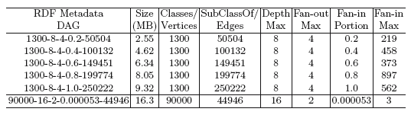
Performance Study
Experimental settings
  PC with 2.66GHz Intel Pentium 4, 1GB Memory, JAVA
  PostgreSQL data type text instead of bigint
  Interval-based, Dewey prefix, PLSDF, PLSDF-D
Data Sets
  RDF metadata generator with arbitrary complexity and scale of RDF class hierarchy

Slide 21
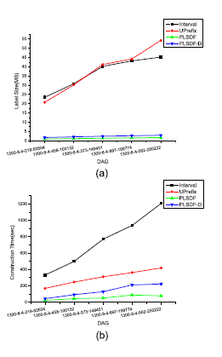
Space Requirement and Construction Time
PLSDF and PLSDF-D
  Have much smaller space requirement and mild trend of increase
PLSDF and PLSDF-D
  Have the same gentle tendancy but less construction time to Uprefix
It is obvious that
  The count of non-spanning tree edges impacts the space requirement and label construction time

Slide 22
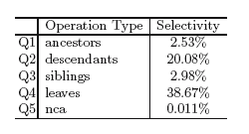
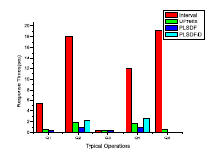
Overall Performance
DAG “9000-8-4-0.004-45182”
PLSDF process all the operations faster than the others
PLSDF-D exhibits accepted performance in Q2 and Q4

Slide 23
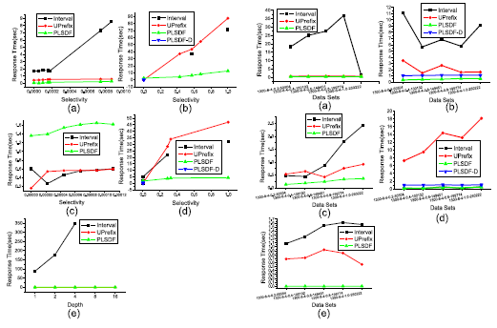
Response Time of Typical Operations(1/2)

Slide 24
Response Time of Typical Operations(2/2)
Impact of varying selectivity
  PLSDF stays at a disadvantage at a very low selectivity especially for Q2 and Q4
  Choose PLSDF-D at a low selectivity and switch to PLSDF when the selectivity exceeds some threshold
  No good solution
Scale-up performance
  Interval and Uprefix are affected by both the size of the DAG
  Unlike the other two labeling schemes, PLSDF and PLSDF-D perform good scalability in all cases

Slide 25
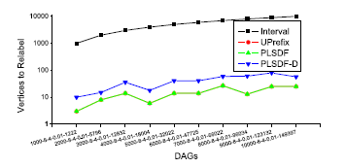
Effect of Updates
Ten DAGs whose vertices increase form 1000 to 10000 are generated and insert a new vertex into each DAG between bottom left leaf and the leaf’s parent in the spanning tree
PLSDF has exactly the same effect of updates as Uprefix
  While additional label of PLSDF-D questionless causes more vertices to be re-labeled

Slide 26
Conclusion
Prime number labeling scheme for DAG
  Takes advantage of the mapping between integers divisibility and vertices reachability
  No extra information is required to be stored for non-spanning tree edges
  The utilizations of elementary arithmetic operations avoid time-consuming data operations
  Performance is further improved with the optimization techniques
  Analysis also indicates that re-labeling only happens when a non-leaf vertex is inserted or removed

