Slide 1
DB2OWL: A Tool for Automatic Database-to-Ontology Mapping
Nadine Cullot, Raji Ghawi, Kokou Yetongnon
Laboratory LE2I, University of Burgundy
SEBD 2007
8 February 2012
Hye Chan, Bae

Slide 2
Outline
Introduction
DB2OWL tool
Conclusion
Discussion

Slide 3
Introduction
Data integration above heterogeneous information systems

Slide 4
Introduction
Data integration above heterogeneous information systems
My name is
Ontology!!!
Role as mediation

Slide 5
Introduction
Mapping from RDB to ontology is important
We propose DB2OWL tool
DB2OWL
mapping
Relational Database
Ontology

Slide 6
DB2OWL
The goal is to automatically create a new ontology from RDB
Case 1
OWL-DL
Case 2
Case 3
Ontology
Notes:
Mapping process starts by
Detecting some particular cases for tables in the database schema
According to the cases, each database component is converted
The created ontology is described in OWL-DL

Slide 7
DB2OWL
Basic mapping
table | column | constraint
class | property | relation

Slide 8
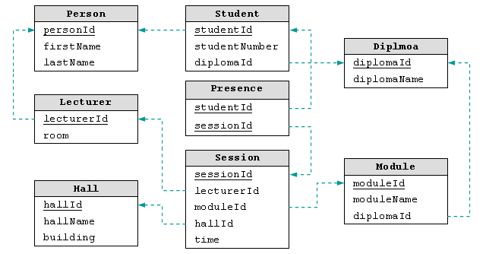
DB2OWL
Example database

Slide 9
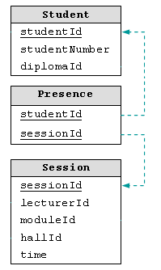
DB2OWL: different table cases
Case 1
A table T is used only to relate two other tables T1, T2
# of columns in T = # of both primary and foreign keys

Slide 10
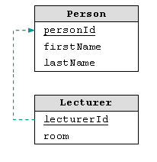
DB2OWL: different table cases
Case 2
A table T is related to another table T1
By a referential integrity constraint whose local attributes are also primary keys
All the primary keys of T are foreign keys

Slide 11
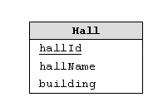
DB2OWL: different table cases
Case 3
Default case
Occurs when none of previous cases occur

Slide 12
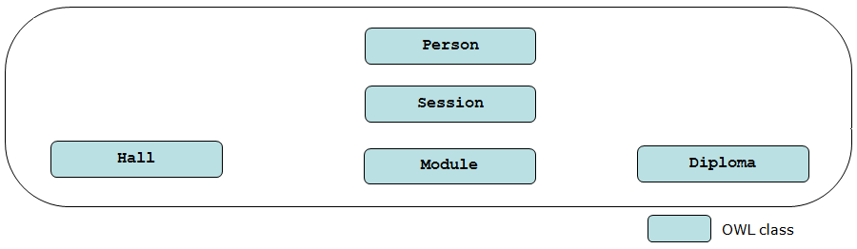
DB2OWL: mapping process
Database tables in case 3 are mapped to OWL classes

Slide 13
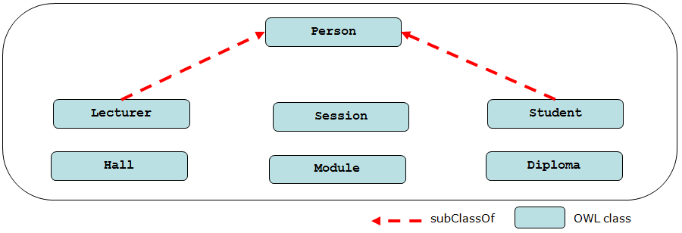
DB2OWL: mapping process
The tables in case 2 are mapped to subclasses of those classes corresponding to related tables

Slide 14
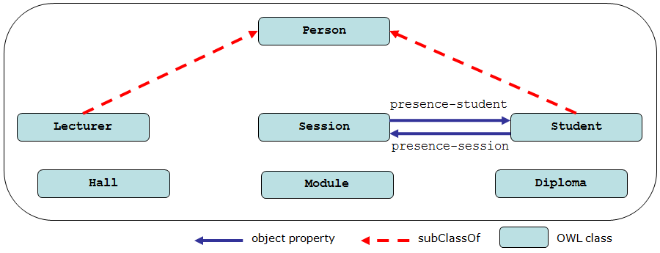
DB2OWL: mapping process
Each table in case 1 is expressed by object properties (not by class)

Slide 15
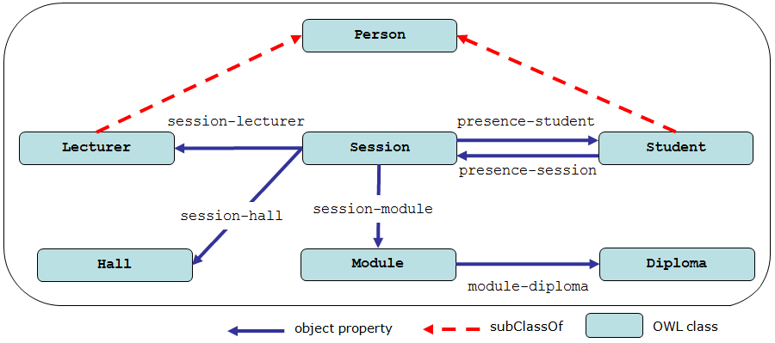
DB2OWL: mapping process
For tables in case 3,
Map referential constraints to object properties whose ranges are classes corresponding to related tables

Slide 16
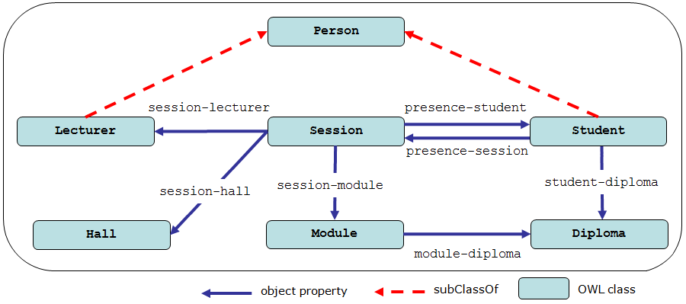
DB2OWL: mapping process
For tables in case 2 and have other referential constraints,
Map referential constraints to object properties whose ranges are classes corresponding to related tables

Slide 17
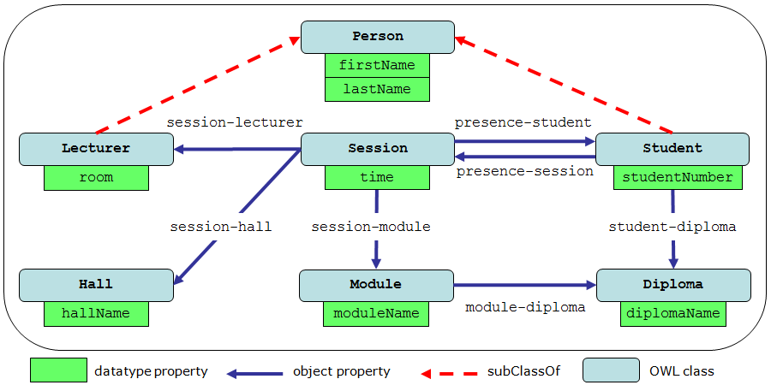
DB2OWL: mapping process
For all tables,
Map columns that are not foreign keys to datatype properties
Datatype property: XML schema data type

Slide 18
DB2OWL: mapping generation
R2O¹ is automatically generated during mapping process
A full description of the database schema
A set of concept map definitions
A set of relation and attribute map definitions
Document can be used by the query
To translate SPARQL into SQL
DB2OWL generates only the classes and properties but not the instances
¹R2O, an Extensible and Semantically Based Database-to-Ontology Mapping Language, Barrasa et al., SWDB2004

Slide 19
Conclusion
Presented DB2OWL tool to map RDB to OWL ontologies
Consider particular table cases
Take them into account while the mapping process
Implemented in JAVA and using JENA
Deals currently with Oracle and MySQL
Future work
To map several databases to one ontology
To map databases from other models such as object-relational model

Slide 20
Discussion
Strong point
Understanding about the basic RDB-to-ontology area
No experiment (strong or weak?)
Weak point
Cannot use the DB2OWL tool
More challenging remains?

