Slide 1
Enhancing Credibility Judgment of Web Search Results
Yusuke Yamamoto¹, Katsumi Tanaka²
JSPS Research Fellow & Kyoto University¹, Kyoto University²
CHI '11
October 6, 2011
Hye Chan Bae

Slide 2
Contents
Introduction
System design
Experiment
Conclusion

Slide 3

Information source
The Web is becoming important information source
Lightweight readings
Serious readings

Slide 4

Problem on Web information
Most information is not fact-checked
Web information is not always accurate or correct
20,000 medical web sites but over half are not checked by medical experts
Warning about Wikipedia
…
They can be easily misled by incorrect web information
Notes:
Sillence et al. reported that there are more than 20,000 medical web sites on the web
Denning et al. warned about the credibility of wikipedia

Slide 5

Credibility
Most research has focused on ranking a set of data
On the basis of relevancy or popularity
By analyzing similarity between
query and {documents, link structures, and user-behavior data}.
Let's start to discuss information quality
Web information credibility
Credibility?
A perceived quality and acceptance by receivers of msgs or senders of the msgs
A subjective quality
Its interpretation depends on the receivers and types of information
Notes:
Credibility는 지각된 품질로 사용자의 감정이 중요 factor이다. 따라서 subjective quality를 의미한다.
지각된 품질: 상대적이고 주관적으로 인식되는 품질
예) 명품 브랜드 조르지오 아르마니의 세컨 라인인 엠포리오 아르마니에서 나오는 시계는 좋다! -> 실제 30만원짜리 엠포리오 아르마니 속에 들어가는 시계 부품 원가는 중국산 50~100원짜리;; 결국 이미지 문제!!

Slide 6

Credibility (cont.)
In area of communication & social psychology
Credibility has been an important topic since 1950s
has developed practical methods to measure information credibility
Even so, it is difficult to assess the credibility of web information
Web pages often lack clues to judge the credibility
Credentials
Names of authors
References to information sources
Evidence information
…

Slide 7
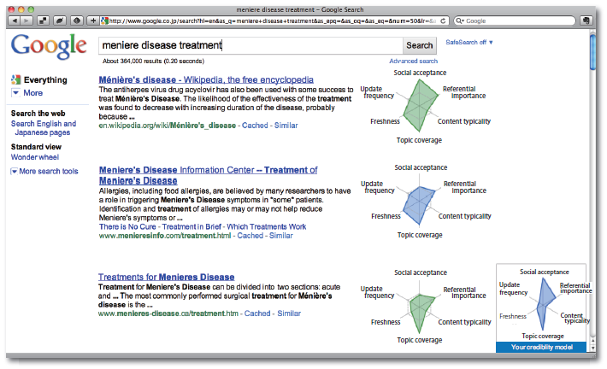
The aim of paper
Bridge the gap between
Credibility theory in social psychology
Search technology in web information retrieval
Propose a system
to help users judge the credibility of search result
Information credibility is a subjective quality
Systems should not measure the credibility without users

Slide 8
Contributions
Address the new concept of credibility-oriented web searches
Introduce and implement 3 functions
To help users judge the credibility of web search results
To search for credible web pages
3 functions
Analysis and visualization of scores of web search results
Prediction of users' credibility judgment model through users' feedback
Re-ranking of web search results based on users' credibility model
Examine how the system affects users' credibility judgment

Slide 9
Contents
Introduction
System design
Experiment
Conclusion

Slide 10
Requirements
Search results should contain clues from various viewpoints
Users can judge the credibility of Web search results
However, conventional web search results contain only
Titles
Snippets
URLs
Ranking orders
Users need to manually collect clues
By browsing or comparing other web pages
But it takes too long time!!
System has to automatically collect and aggregate the information necessary to judge a web page's credibility

Slide 11
Requirements (cont.)
Information credibility is a subjective quality
Criteria depend on the users and types of information
E.g., Apple products
Some users: unbiased web pages are credible
Other users: web pages which Apple enthusiasts appreciate are credible
System should rank web search results on the basis of users' credibility judgment model
System needs to predict user' credibility judgment model

Slide 12
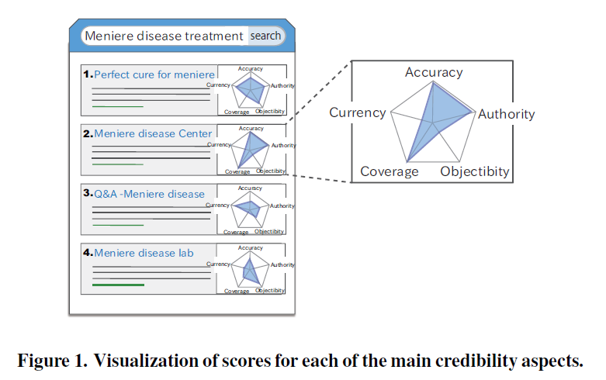
Requirements (cont.)
Propose the following 3 functions on system
Analysis and visualization of scores of web search results on main aspects to judge the credibility
Notes:
Accuracy: how accurate the web information is
Objectivity: how biased the web information is
Authority: about the author of the web page
Currency: when web pages were last updated
Coverage: how complete and comprehensive the web information is

Slide 13
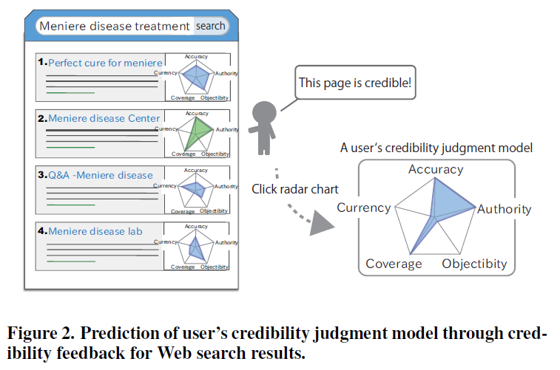
Requirements (cont.)
Propose the following 3 functions on system
Analysis and visualization of scores of web search results on main aspects to judge the credibility
Prediction of users' credibility judgment model through users' credibility feedback for web search results
Notes:
User's credibility judgment model: representation of how important the user think each of main credibility aspects to judge the credibility of web search results is

Slide 14
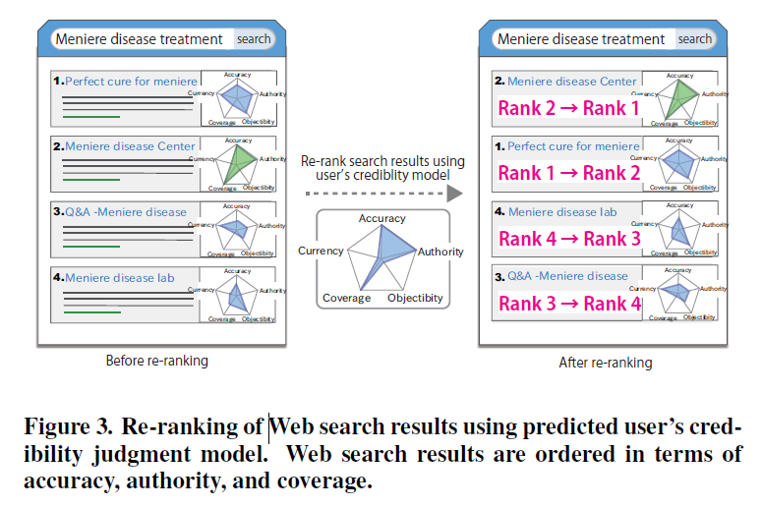
Requirements (cont.)
Propose the following 3 functions on system
Analysis and visualization of scores of web search results on main aspects to judge the credibility
Prediction of users' credibility judgment model through users' credibility feedback for web search results
Re-ranking of web search results based on predicted users' credibility model

Slide 15
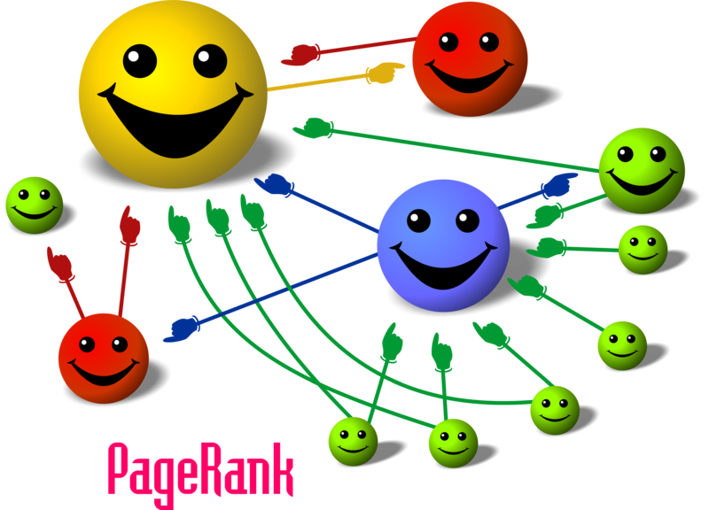
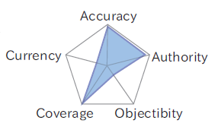
Credibility analysis of web search results for each of the main credibility factors
6 factors for measuring the main 5 credibility aspects
Accuracy: referential importance of web page
Assume that accurate web pages are often linked to by other web pages as references
Used PageRank (provided by Google)

Slide 16
Credibility analysis of web search results for each of the main credibility factors (cont.)
6 factors for measuring the main 5 credibility aspects
Authority: social reputation of web page
Assume that if a lot of people believe or highly regard certain web pages, the web pages are authoritative
Used social bookmarks – Hatena Bookmark service
Notes:
하테나 북마크: 소셜 북마크 공유 서비스
-> 페이스북의 like수

Slide 17
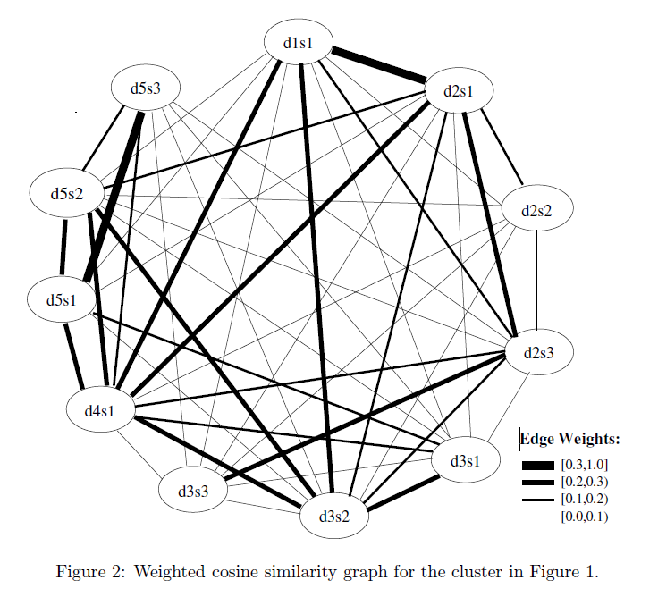
Credibility analysis of web search results for each of the main credibility factors (cont.)
6 factors for measuring the main 5 credibility aspects
Objectivity: content typicality of web page
Assume that if a web page is similar to many other web pages about a given query, the web page is objective
Used LexRank algorithm
Notes:
LexRank algorithm은 그래프 기반으로 text contents를 요약하는 알고리즘이다.
각각의 node가 text contents를 의미하고 text node간의 textual similarity가 edge의 weight로 표현된다.

Slide 18
Credibility analysis of web search results for each of the main credibility factors (cont.)
6 factors for measuring the main 5 credibility aspects
Coverage: coverage of technical topics on web page
Used the method to search Wikipedia for technical terms [Nakatani et al., 2009]
Extracts the terms that Wikipedia articles only in specific categories link to as technical terms
Calculates the number of technical terms on the web page

Slide 19

Credibility analysis of web search results for each of the main credibility factors (cont.)
6 factors for measuring the main 5 credibility aspects
Currency: freshness and update frequency of web page
Obtain a list from Wayback Machine of Internet Archive
$T=\left\{t_{1}, t_{2}, …, t_{n}\right\} \left(t_{1}<…<t_{n}\right)$
Freshness: $C−t_{n} \left(C :constant\right)$
Update frequency: $\left| T\right|$
Notes:
Wayback machine of internet archive: 특정 사이트들의 시간별 버전에 대한 캡쳐를 가지고 있는 사이트

Slide 20
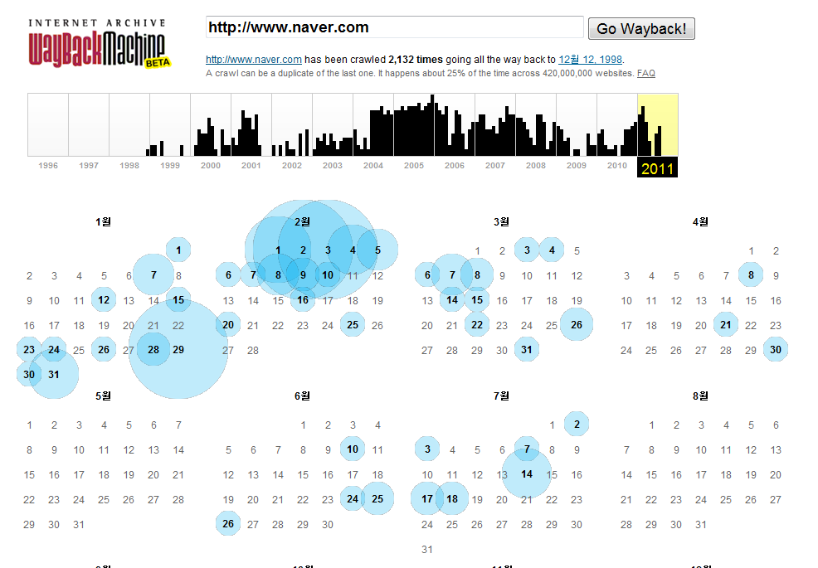
cf. Wayback Machine of Internet Archive

Slide 21
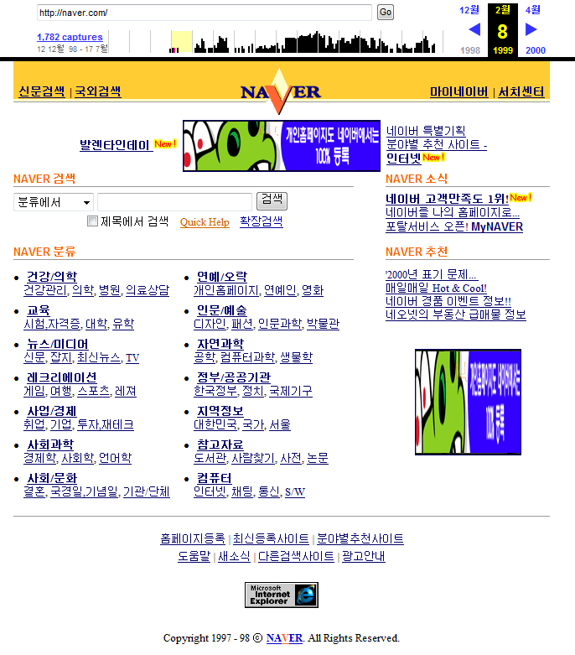
cf. Wayback Machine of Internet Archive

Slide 22
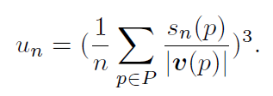
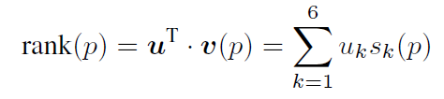
Re-ranking of web search results through credibility feedback
Users can feed them back to system
By double-clicking the radar charts of the credible web search results
Predicts users' credibility judgment model
System re-ranks web search results
in accordance with the predicted model
$$( s_{i}\left(p\right) :a normalized score of p on credibility factor i )$$
$$( u={\left(u_{1}, u_{2},…, u_{6}\right)}^{T} :user^{′}s credibility judgment model )$$
Notes:
P={p1,p2,…,pn} : 사용자가 credible하다고 판단한 web page의 set
U : Web page에 대한 각각의 credibility factor의 평균을 세제곱 (유저가 중요하다/하지않다에 대한 점수를 강조하기 위해 세제곱)

Slide 23
Contents
Introduction
System design
Experiment
Conclusion

Slide 24
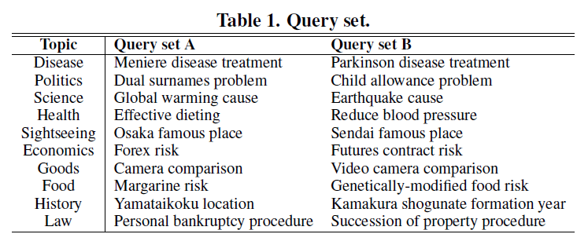
Experiment #1: Online user study
To investigate
which factors are important for users to judge the credibility of web search results about specific topics
How different the consistency of credibility judgment is depending on users' familiarity with topics
Notes:
10개 topic, 각각의 topic에 대해 2가지의 query
검색은 구글을 사용
검색 결과 중에 적합한 10개 결과를 임의로 선택하고 해당하는 실제 web page를 수집했다.
그리고 이 data를 실험 참가자에게 보여줌으로써 실험에 사용했다.

Slide 25
Experiment #1: Online user study (cont.)
Procedure
2 questions
How important they thought each of 9 factors was to judge the credibility of web information about one specific topic
How familiar the participants were with the topic
2 tasks
Participants rated each of 10 web search results using +chart interface
Without following their URL links
Participants rated each of actual web pages
Notes:
960명 설문회사를 통해 실험 수행
9 factors:
Context expertise
Social reputation
Update frequency
Content freshness
Authority of page creator
Content typicality
Evidence presentation
Objectivity
Accuracy

Slide 26
Experiment #1: Online user study (cont.)
+chart interface

Slide 27
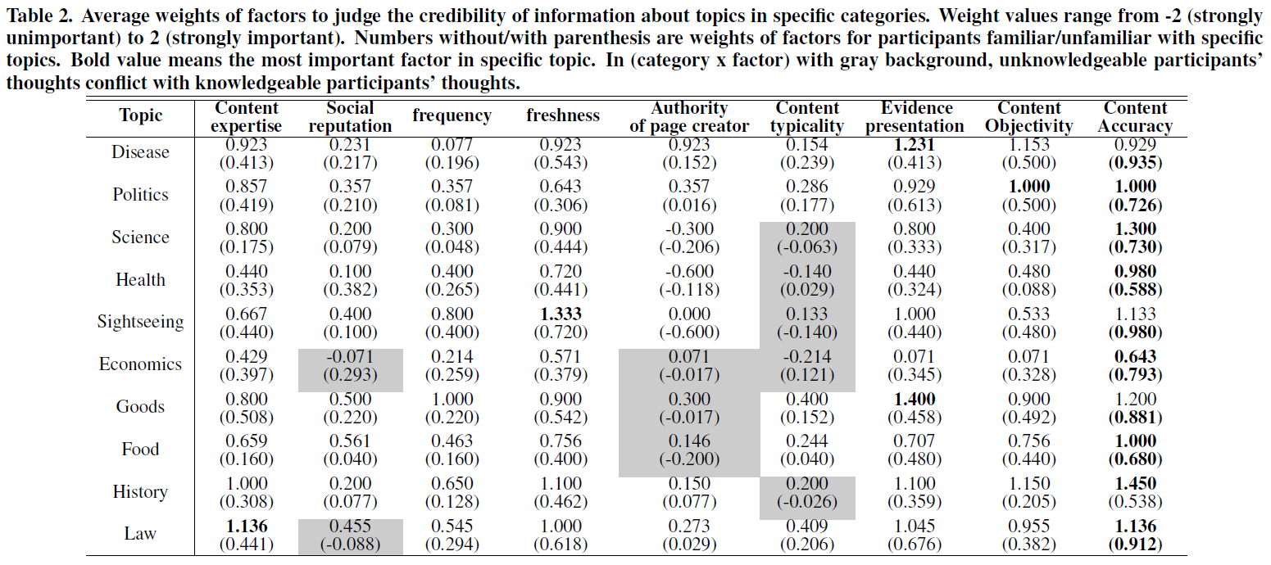
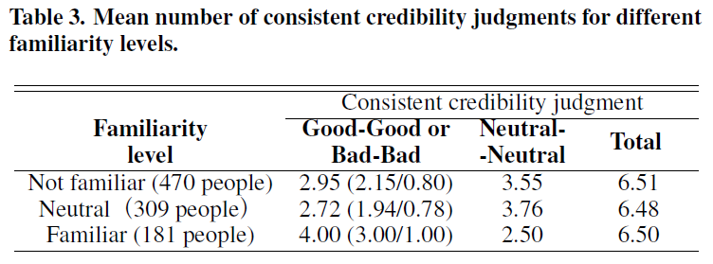
Experiment #1: Online user study (cont.)
Notes:
< 테이블2 >
그냥 숫자는 familiar user에 대한 credibility 평균, 괄호 안에 숫자는 unfamiliar user에 대한 credibility 평균
Unfamiliar user는 대부분 accuracy가 가장 중요한 factor로 생각한다. 하지만 그것 또한 자신있게 판단을 한 것은 아니다 (weight가 가장 높긴 하지만 수치 자체가 1보다 작다)
Familiar user는 accuracy 말고도 topic에 따라 가장 중요하다고 여기는 factor가 존재했다. 그리고 자신있게 판단을 내린 경우가 많다. (weight가 1보다 큰 경우가 많다)
그리고 familiar user와 unfamiliar user는 특정 topic에서 특정 factor에 대해 상이한 판단을 하는 점이 발견되기도 했다. (회색 네모영역)
-> 실험 결과 나열
< 테이블 3>
Consistent credibility: +chart search results에서 판단 & 해당 URL에 들어가서 판단한 credibility가 서로 일치하는지를 실험
먼저 테이블을 보기 전에 논문에서는, +chart interface가 URL을 직접 들어가 보지 않고도 해당 webpage의 credibility를 판단할 수 있도록 도움을 줄 수 있다고 가정하고 있다.
그것은 +chart search results에서의 판단 수치와 해당 URL에 직접 들어가서 판단한 credibility의 수치가 비례하기 때문에 추측 가능한 전제이다.
테이블 3은 10개의 webpage에 대해서 평가가 일치하는 평균 페이지 수를 나타내고 있다.
Consistency한 전체 수는 familiarity에 상관없이 비슷하지만, good-good or bad-bad의 항목에 대해서 familiar user의 수치가 훨씬 높음을 알 수 있다.
이것은 다시 말해서, 어떤 topic에 대해 familiar user가 +chart interface를 사용하게 되면 그렇지 않는 사람에 비해 더 consistent하고 clear한 credibility에 대한 판단을 내릴 수 있다는 것이다.

Slide 28
Experiment #2 : Laboratory study
To evaluate search efficiency of our system
Compared how many credible web pages could be selected from search results within a limited time
Using only Google interface & +chart interface
Procedure
Suppose you or one of your family has menuere disease. You are now searching for web pages that Google returned for "menuere disease treatment". Please select as many credible web pages as possible within three minutes.
System automatically showed the top 50 Google web search results
Notes:
어느 정도 시스템에 대해 이해하고 사용법을 숙지한 10명의 대학생 & 대학원생을 기준으로 실험

Slide 29
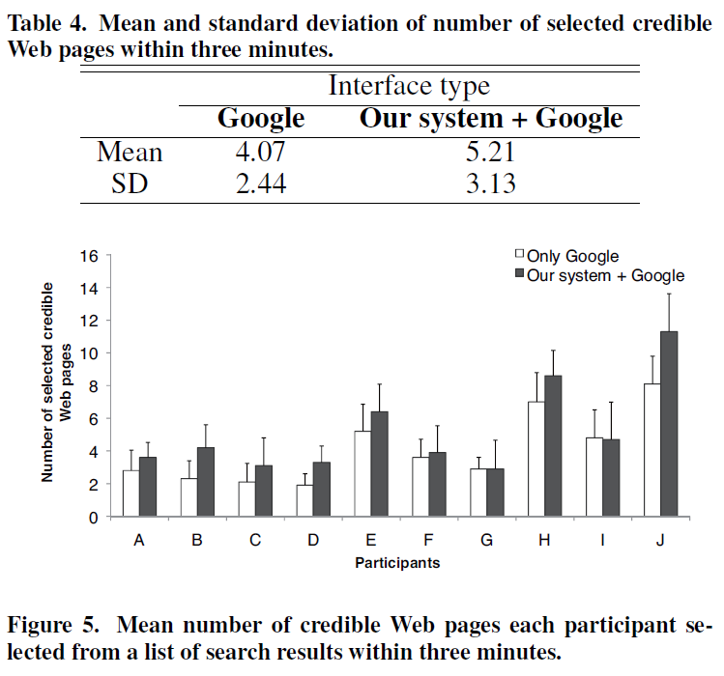
Experiment #2 : Laboratory study (cont.)
Notes:
테이블4를 통해 +chart interface에서 더 많은 credible page를 찾았다는 사실을 알 수 있다.
이 결과를 통해 제안하는 system이 제한된 시간에 더 많은 credible web page를 찾을 수 있게 해준다는 것을 알 수 있다.
그림 5에서 F, G, I 참가자를 제외하고는 전부 제안한 system을 사용한 경우에 더 많은 credible page를 찾을 수 있었다.
-> 종합해 볼 때, 이 새로운 시스템은 기존의 web search interface보다 어 빠르고 효율적으로 credible web page를 찾는데 도움을 준다는 사실을 알 수 있다.

Slide 30
Contents
Introduction
System design
Experiment
Conclusion

Slide 31
Conclusion
proposed the system To help users
judge the credibility of web search results
Find credible web pages from a list of web search results
System has 3 functions for credibility-oriented web searches
Visualization of score of web search results
Prediction of users' credibility judgment model
Re-ranking of web search results according to predicted users' credibility judgment model

Slide 32
Future work
Need more experiments where
Images in web pages are eliminated
Because visual designs often affect users' quality judgment
Provide easier credibility feedbacks for web pages
In experiment, some users didn't send credibility feedbacks
For users who are not familiar with search topics,
Have to think about additional help for more appropriate credibility judgments
Recommending judgment models of users who are familiar with the topics
Notes:
ELM 이론에 의하면 어떤 topic에 대한 지식이 충분하지 않은 사람은, 그것에 관한 정보에 대해 credible한지 아닌지에 대한 판단조차 명확하게 내릴 수 없을 확률이 높다고 한다.
따라서 topic에 대해 familiar user의 users’ judgment model을 unfamiliar user에게 추천하는 방법에 대해 생각해볼 필요가 있다.

Slide 33
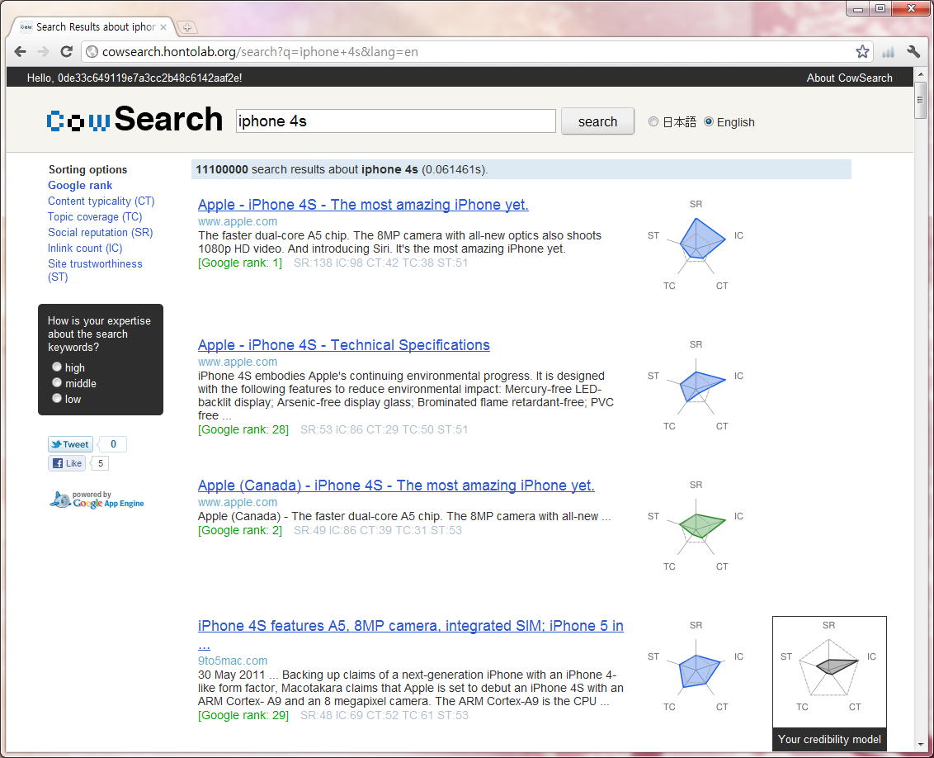
Thank you! & Demo
http://cowsearch.hontolab.org

