Slide 1

Session 19
Applying the Collaboration Diagram to the Case Study
Written by Thomas A. Pender
Published by Wiley Publishing, Inc.
October 20, 2011
Presented by So-min Kim

Slide 2
Contents
Building a Collaboration Diagram from a Scenario
Mapping the Sequence and Collaboration Diagram Elements to the Class Diagram

Slide 3
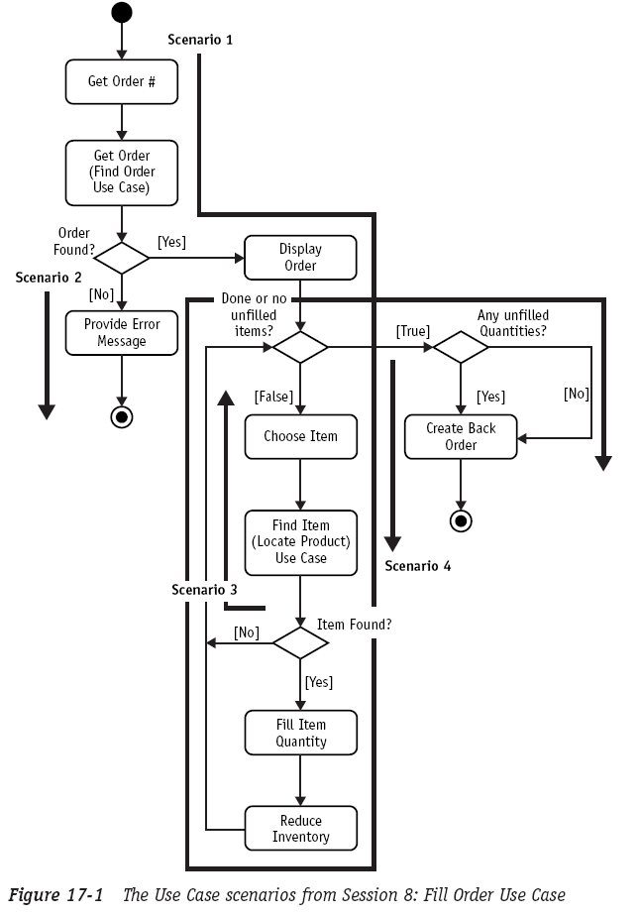

Building a Collaboration Diagram from a Scenario (1/10)

Slide 4
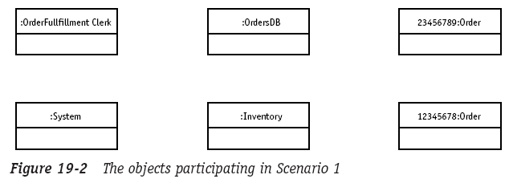
Building a Collaboration Diagram from a Scenario (2/10)
Scenario 1

Slide 5
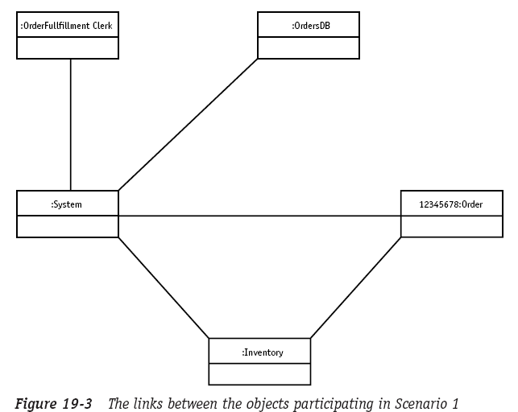
Building a Collaboration Diagram from a Scenario (3/10)
Scenario 1 (cont.)

Slide 6
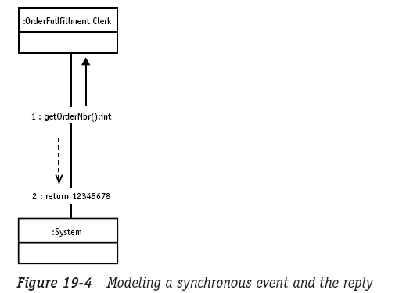
Building a Collaboration Diagram from a Scenario (4/10)
Scenario 1 (cont.)

Slide 7
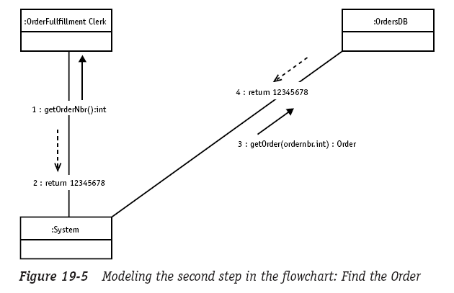
Building a Collaboration Diagram from a Scenario (5/10)
Scenario 1 (cont.)

Slide 8
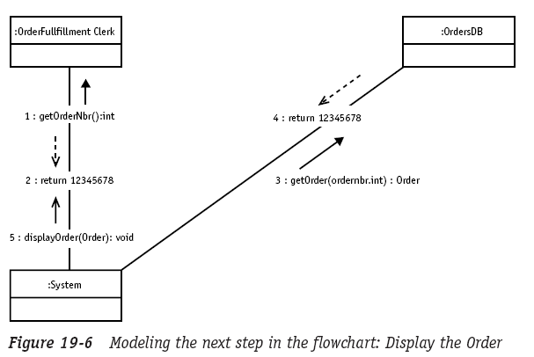
Building a Collaboration Diagram from a Scenario (6/10)
Scenario 1 (cont.)

Slide 9
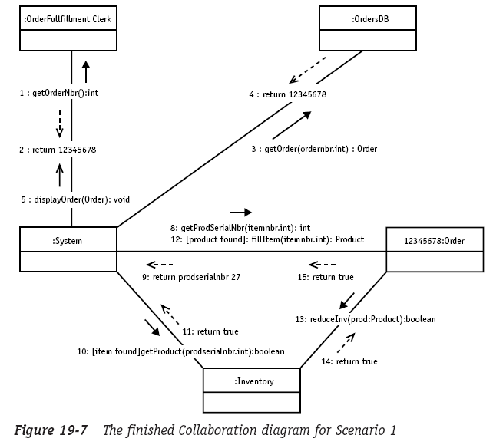
Building a Collaboration Diagram from a Scenario (7/)
Scenario 1 (cont.)

Slide 10
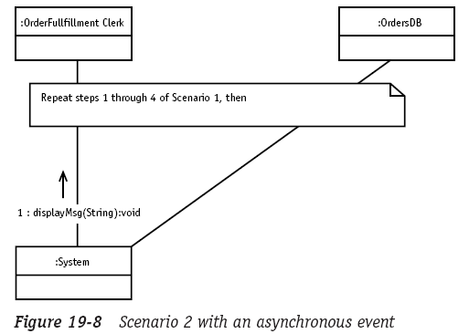
Building a Collaboration Diagram from a Scenario (8/10)
Scenario 2

Slide 11
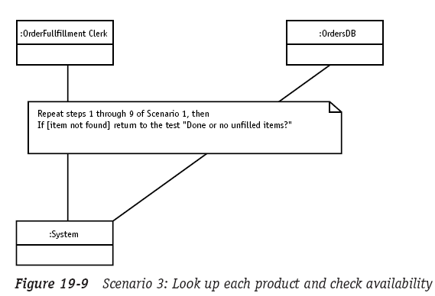
Building a Collaboration Diagram from a Scenario (9/10)
Scenario 3

Slide 12
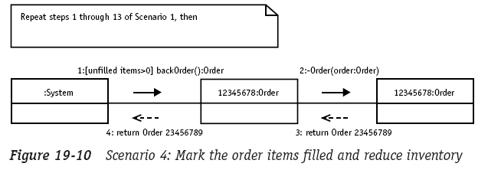
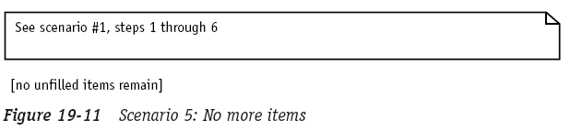
Building a Collaboration Diagram from a Scenario (10/10)
Scenario 4 & 5

Slide 13
Contents
Building a Collaboration Diagram from a Scenario
Mapping the Sequence and Collaboration Diagram Elements to the Class Diagram

Slide 14
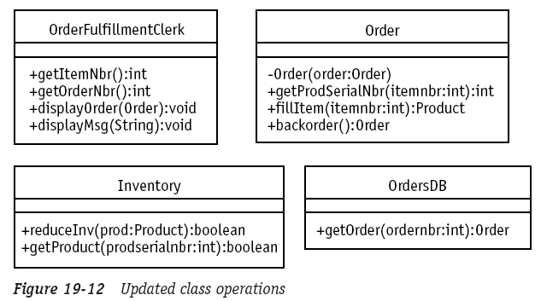
Mapping the Sequence and Collaboration Diagram Elements to the Class Diagram (1/1)
You need to map what you find in the interaction diagrams back to the Class diagram

Slide 15
The End

