Slide 1
Data Mining with Big Data
Zachary Miller, Brian Dickinson, William Deitrick, Wei Hu & Alex Hai Wang
Information Sciences 260, 2014
18 Mar 2016
Yubin Lim

Slide 2
Context
Introduction
Methods
Density-based clustering
k-Means based clustering
Evaluation

Slide 3
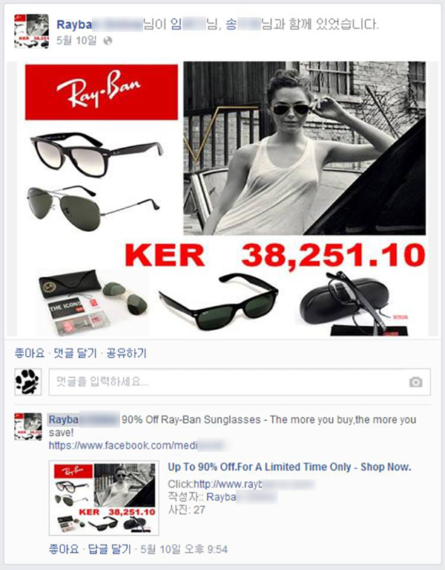
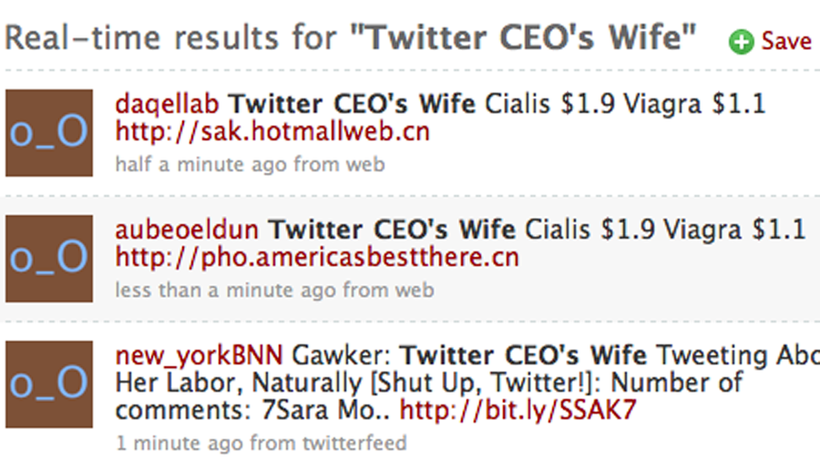
Introduction
Proliferation of SNS caused increased spam activity
Various unsolicited spam messages
Advertisement, pornography, phishing, viruses, etc.

Slide 4
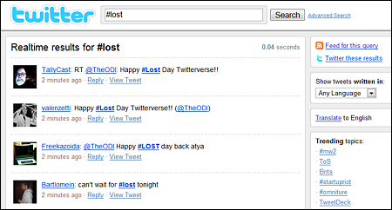
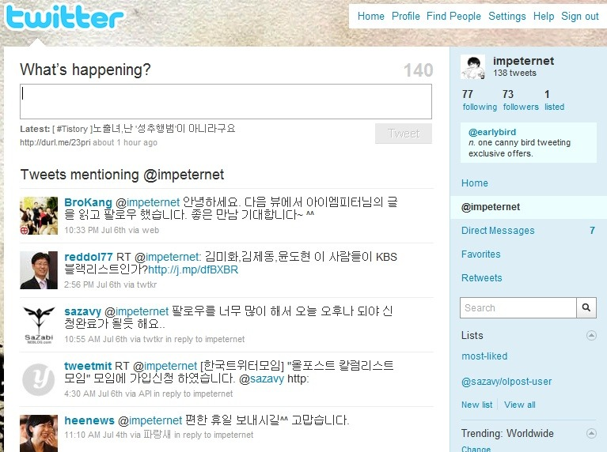
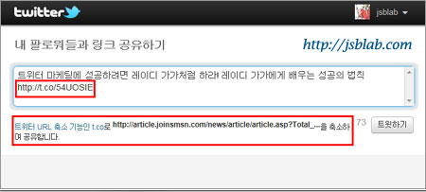
Introduction
Abuse of Twitter by spammers
Mention
Hashtag
Shortened URL

Slide 5
Introduction
 | classified | original
TP | spam | spam
FP | spam | normal
TN | normal | normal
FN | normal | spam

Slide 6
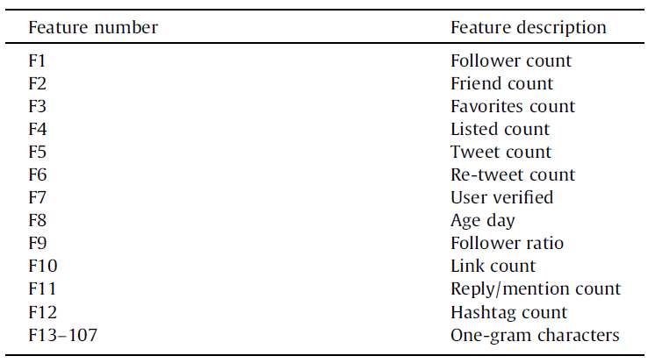
Features of Twitter
Twitter generates large volume of data fast
Stream mining method applied

Slide 7
Methods
Previous researches handled spam detection as classification problem
Identifying spammer as anomaly detection applying
Density-based clustering
DenStream
k-Means based clustering
StreamKM++

Slide 8
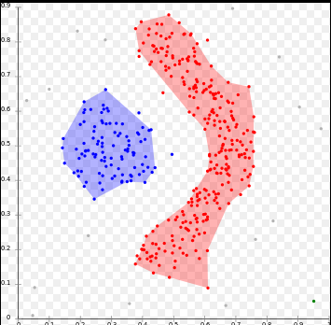
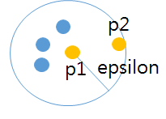
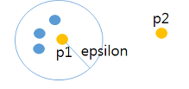
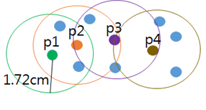
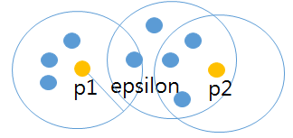
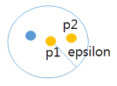
DBSCAN Density-Based Spatial Clustering of Applications with Noise
2 parameters
Maximum range of distance, ɛ
Minimum number of members
Example
Minimum number = 4
Density reachable
Density connected
Density unreachable

Slide 9
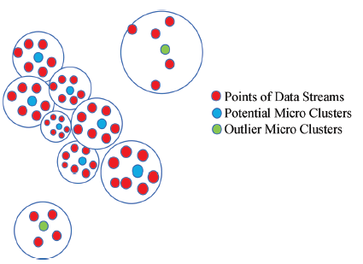
DenStream
Extend DBSCAN for handling dynamic data streams
Run DBSCAN with initial points
For each p from stream, merge to nearest cluster
Modified: never change outlier-cluster to p-cluster

Slide 10
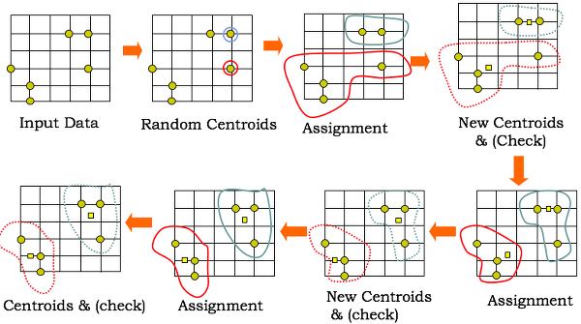
k-Means Clustering
Predefined number(k) of centroids
k-Means++
Choose initial centroids to be apart far enough

Slide 11
StreamKM++
Introduction of corset
Cluster based on coresets
Run k-means++ with initial data
If data from stream fill window -> run k-means++
Modified
Additional parameter ɛ as threshold

Slide 12
Combined
Run modified StreamKM++
Output no false negative
Run modified DenStream based on output
Notes:
실험 결과 FN이 0이었음 그래서 이거 먼저 쓰고,

Slide 13
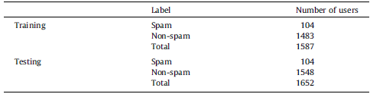
Evaluation
Dataset
Randomly chosen 3239 user accounts with sample tweets
3031 normal accounts
208 spam accounts
103 features
Methods
DenStream
StreamKM++
Combined

Slide 14
Evaluation
DenStream spam detection
StreamKM++ spam detection

Slide 15
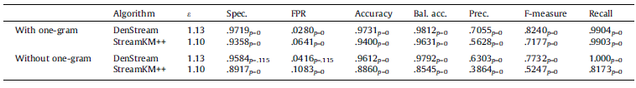




Evaluation
Comparison of 2 algorithms
Comparison with or without one-gram features
Comparison of 3 algorithms
Spec. |  | Accuracy |  | F-measure
$$2 ∗ \frac{precision ∗recall}{precision+recall}$$
$$\frac{TN}{FP+TN}$$
$$\frac{TP+TN}{P+N}$$

Slide 16
Contributions
Viewing spam identification as an anomaly detection problem
Introduction of 95 one-gram features
Using stream of real-time tweets with 2 clustering algorithms

