Slide 1
Clash of the Titans: MapReduce vs. Spark for Large Scale Data Analytics
Juwei Shi, Yunjie Qiu, Umar Farooq Minhas, Limei Jiao, Chen Wang, Berthold Reinwald, and Fatma Ozcan
IBM Research – China, IBM Almaden Research Center DEKE, MOE and School of Information, Renmin University of China Tsinghua University
VLDB 2015
Jul 23, 2018
Heymo Kou

Slide 2
Contents
Introduction
MapReduce and Spark
Who’s faster
Two profiling tools
Experiments
Conclusion

Slide 3


Introduction MapReduce and Spark
Massive Parallelized Framework for Big Data
JVM Based
Uses HDFS
Simple user APIs for parallism

Slide 4
Introduction MapReduce and Spark release history
Apache Hadoop
1.0 Initial release on Dec 2011
2.4.0 release on June 2014
2.6.0 release on Nov 2014
Latest 3.1.0 release on April 2018
Apache Spark
1.0 Initial release on May 2014
1.3.0 release on March 2015
Latest 2.3.0 release on Feb 2018

Slide 5
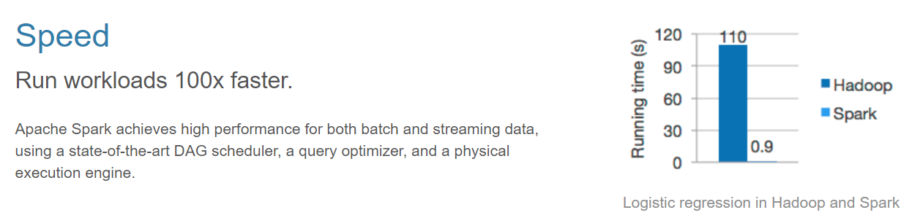
Introduction Who’s faster
From Apache Spark
Really?
Notes:
evaluate the major architectural components in MapReduce and Spark frameworks
shuffle, execution model, and caching
by using a set of important analytic workloads

Slide 6
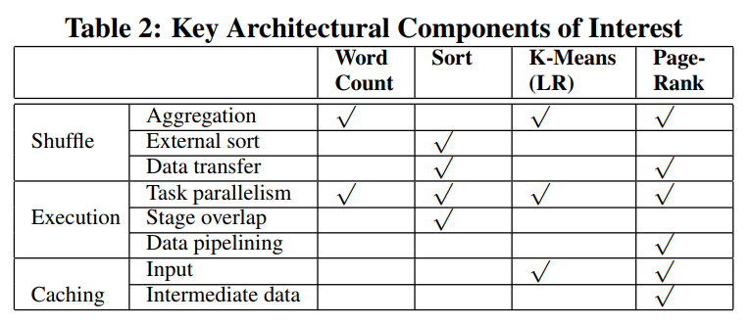
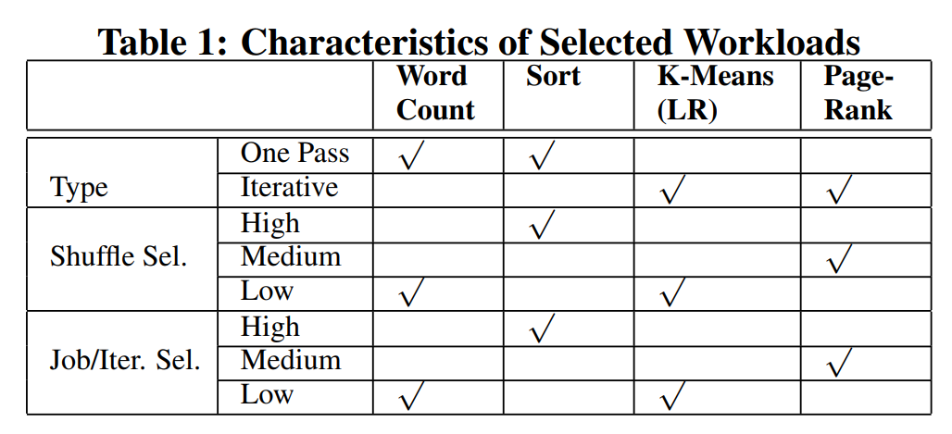
What to compare

Slide 7
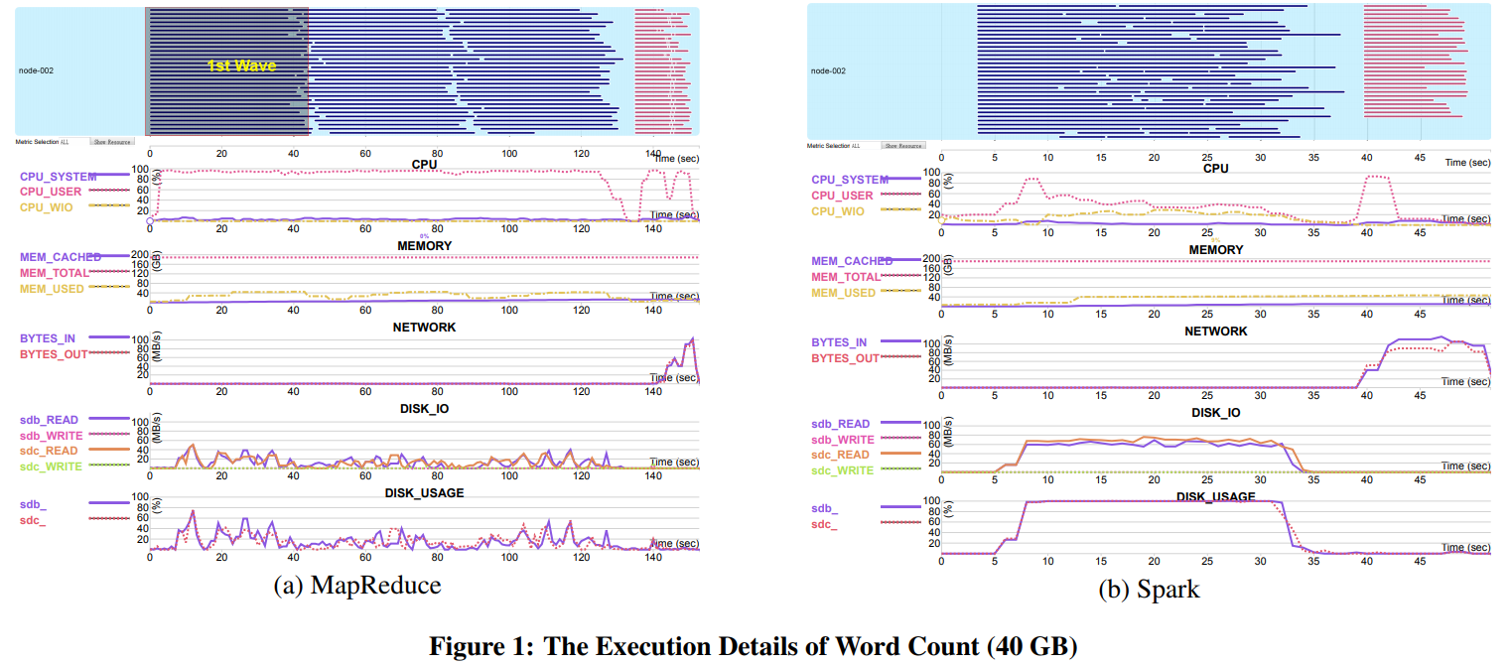

2 Profiling Tools
Execution Plan Visualization
Ganglia
MySQL
Fine-grained Time Break-down
Track where time is spent
Notes:
developed two profiling tools
correlate the task execution plan with the resource utilization and visualize correlation
We provide a break-down of the task execution time for in-depth analysis
quantify the performance differences between
Furthermore, we attribute these performance differences to different components which are architected differently in the two frameworks
expose the source of these performance differences by using a set of micro-benchmark experiments

Slide 8
Experiments Hardware Configuration
4 Nodes
32 CPU cores at 2.9 GHz
9 X 1T HDD 7200 RPM
190 GB Memory
Total
128 CPU cores
760 GB RAM
36 TB
Connected w/ 1 Gbps Ethernet switch
64-bit Red Hat Enterprise Linux 6.4 (kernel version 2.6.32)
About 100 m3.medium AWS nodes

Slide 9
Experiments Software Configuration
Hadoop 2.4.0 on Yarn
8 disks for intermediate data
HDFS w/ 128 MB block size
Replication factor of 3
32 containers per node (1 container / core)
Default JVM heap size : 3 GB per task
Spark 1.3.0 on HDFS 2.4.0
8 disks for intermediate data
8 Spark workers w/ 4threads each (1 thread / core)
Higher CPU utilization : 32 Spark workers w/ 1 thread each
JVM heap size : 16GB for spark drivers & executors

Slide 10
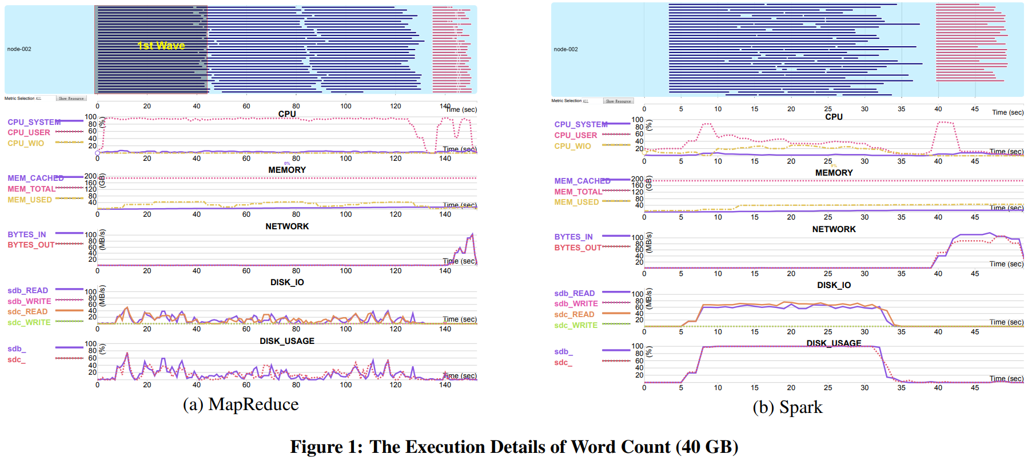
Experiments WordCount

Slide 11
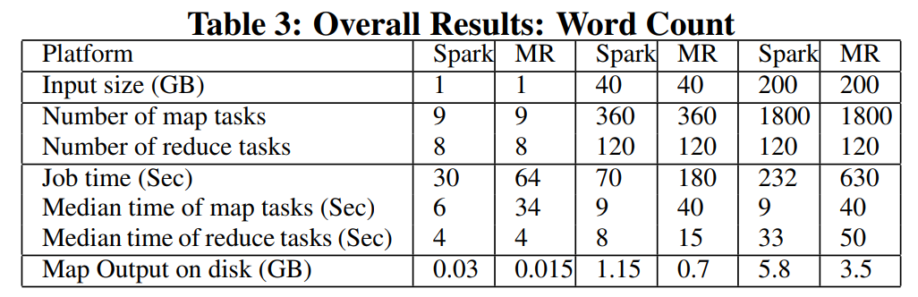
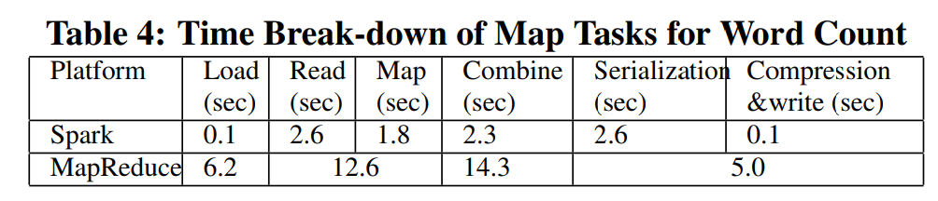
Experiments WordCount – Time Break-down

Slide 12
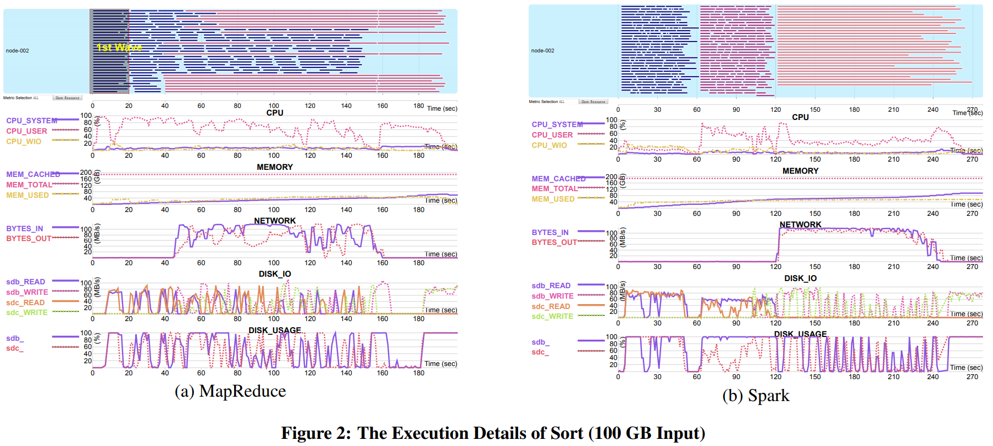
Experiments Sort

Slide 13
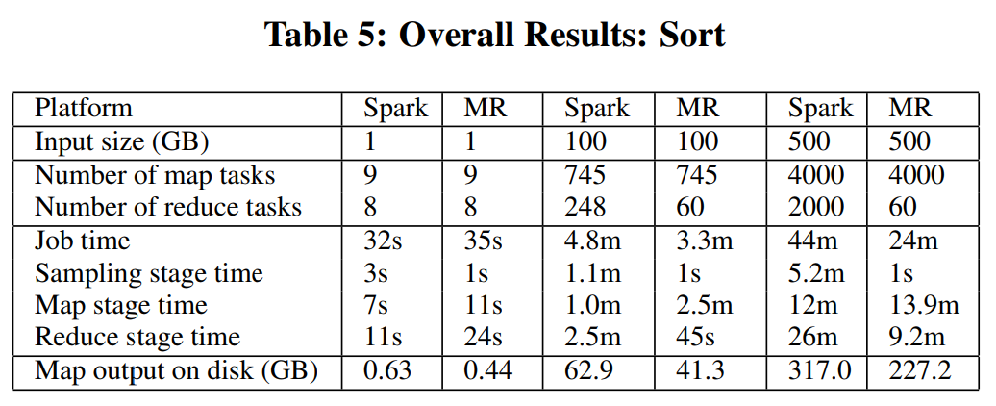
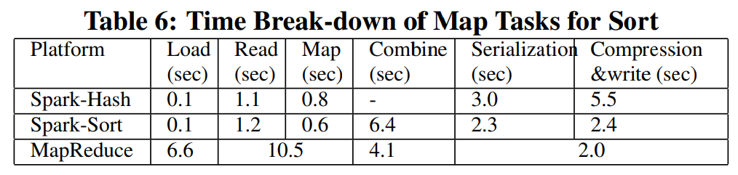
Experiments Sort – Time Break-down

Slide 14
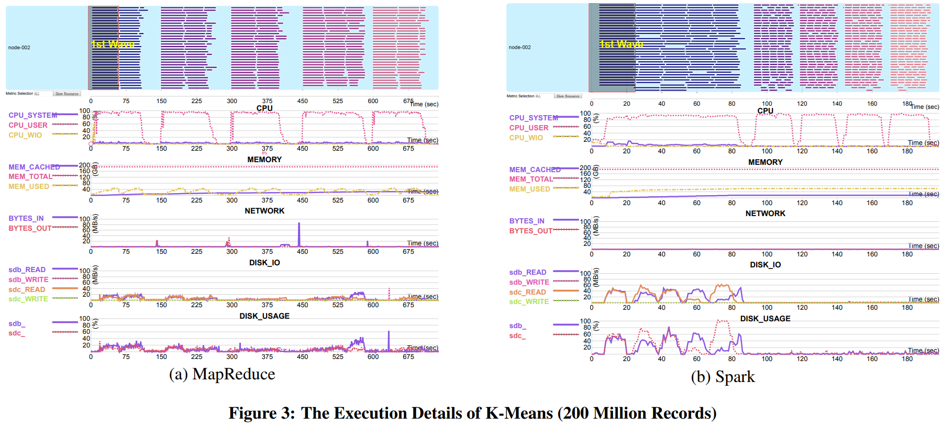
Experiments K-Means

Slide 15
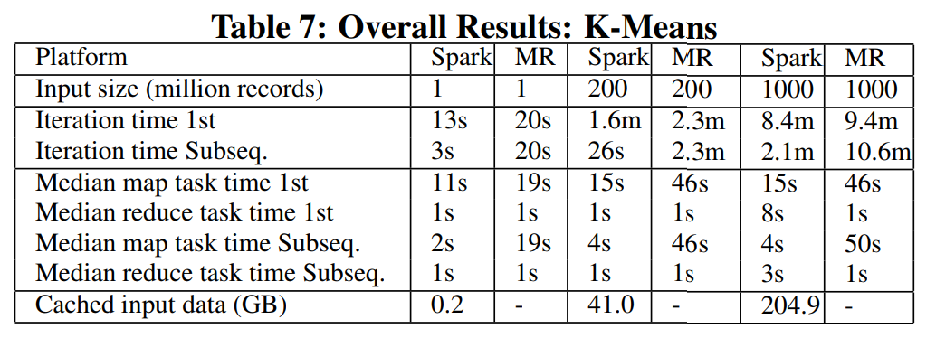
Experiments K-Means

Slide 16
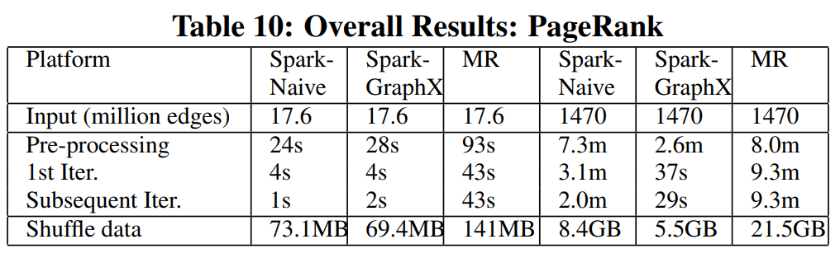
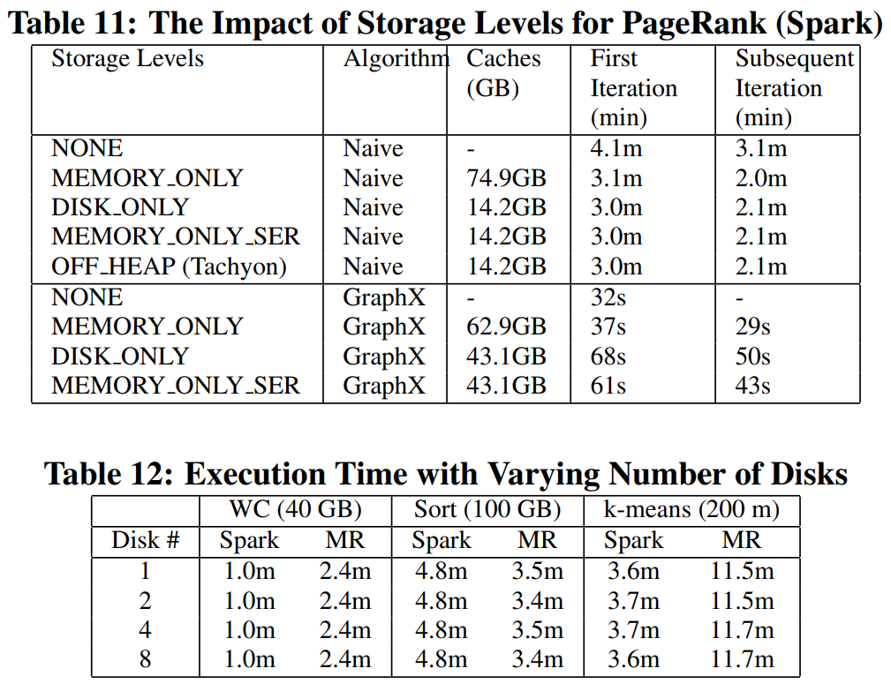
Experiments PageRank

Slide 17
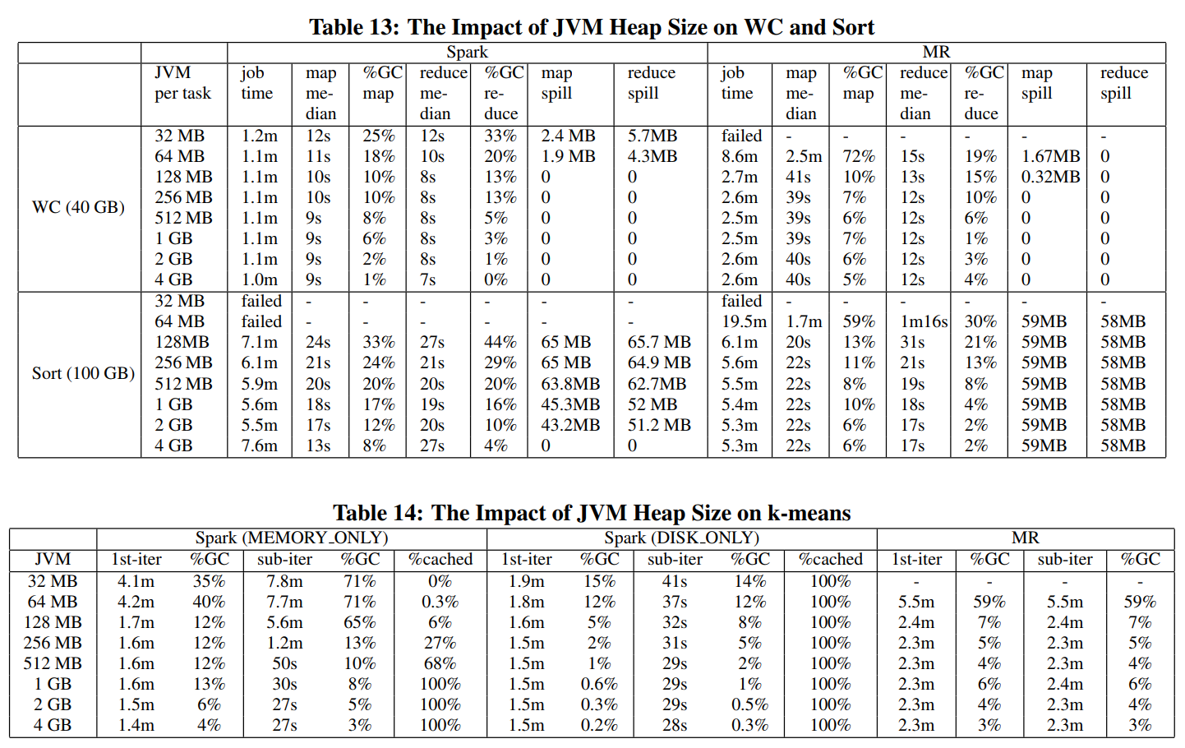
Experiments Various Configurations

Slide 18
Conclusion
Spark is faster
2.5x for Word Count
5x k-means and pageRank
hash-based aggregation efficiency
reduced CPU and disk overheads due to RDD caching in Spark
MapReduce is 2x faster than Spark on Sort
efficient for shuffling data than Spark

Slide 19
Suggestions
Developers
Improvements
System Administrators/Users
Majority of workloads are CPU-bound
Always compress intermediate results
For Spark, DISK_ONLY for iterative algorithms
Avoid GC
Researchers
You can research trade-off between
parallelism and context switching
in-memory and on-disk caching
serialization and memory consumption
Notes:
Spark
support the overlap between two stages with the shuffle dependency to hide the network overhead
improve the availability of block information in case of an executor failure to avoid re-computation of some tasks from the previous stage.
MapReduce
significantly reduce the task load time
consider thread-based parallelism among tasks to reduce the context switching overhead
provide hash-based framework as an alternative to the sort based shuffle
consider caching the serialized intermediate data in memory, or on disk for reuse across multiple jobs

