Slide 1
A Comparison of Join Algorithms for Log Processing in MapReduce
Spyros Blanas, Jignesh M.Patel (University of Wisconsin-Madison)
Vuk Ercegovac, Jun Rao (IBM Almaden Research Center)
SIGMOD, 2010
August 1, 2012
SNU IDB Lab.
Min Sup Lee

Slide 2
Outline
Introduction
Join Algorithms in MapReduce
Experimental Evaluation
Conclusion
Discussion

Slide 3
Introduction(1/3)
MapReduce
Hiding the details of parallelization
Fault tolerance
Load balancing
Log Processing
Important type of data analysis
A log of events
Click-stream
Phone call records
A sequence of transactions
Compute various statistics
Derive business insights from the data
Log Table
Call records | Number
2012.09.24.14:20.30 | 01011111111
2012.09.24.14:30.45 | 01044444444
2012.09.25.19:11.118 | 01055555555
2012.09.28.06:40.97 | 01022222222
2012.09.29.08:44.08 | 01022222222
…… | ……
Reference Table
Number | Name
01011111111 | 이민섭
01022222222 | 김태희
01033333333 | 이민정
01044444444 | 유인나
01055555555 | 배수지
…… | ……

Slide 4
Introduction(2/3)
Several reasons using MapReduce for log processing
Scalability
China Mobile gathers 5-8TB of records per day
Facebook collect 6TB of new log data everyday
Flexibility
A log record may change over time
Fault tolerance support
Keep the analysis job going even in the event of failures

Slide 5
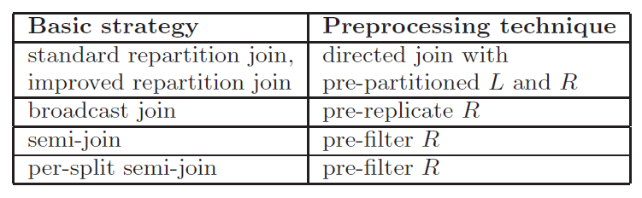
Introduction(3/3) Adapting well-known join algorithms
MapReduce has difficulty in using joins
Provide a detailed description of several equi-join implementation
Conduct an extensive experimental evaluation

Slide 6
Outline
Introduction
Join Algorithms in MapReduce
Experimental Evaluation
Conclusion
Discussion

Slide 7

Join Algorithms in MapReduce Problem Statement
Consider an equi-join (| L |>>| R |)
A log table L
A reference table R
Join result are stored in DFS
Two additional functions : init() and close()
Called before and after each map or reduce task

Slide 8
Join Algorithms in MapReduce Repartition Join
The most commonly used join strategy in the MapReduce framework
L and R are dynamically partitioned on the join key
The corresponding pairs of partitions are joined

Slide 9
Join Algorithms in MapReduce Standard Repartition Join
Tags the records
Map Phase
Reduce Phase
Splits of R or L
(Distributed File System)
Intermediate results
Local disk
L
2012-5555 | L: DS A
Buffer
DB B 2008-2424
DS A 2012-5555
2012-5555 | R: Lee
2008-2424 | L: DB B
2008-0909 | L: GA D
2012-5555 | L: DS A
R
2008-0909 | L: GA D
2012-5555 | R: Lee
Kim 2009-1111
Lee 2012-5555
…….
2005-3682 | L: OPT A
2009-1111 | L: ML C
2009-1111 | R: Kim
2009-1111 | R: Kim
2005-3682 | L: OPT A
2008-2424 | L: DB B
2009-1111 | L: ML C
L
.
.
.
GA D 2008-0909
ML C 2009-1111
OPT A 2005-3682
Notes:
Partitioned, sorted and merged by the framework

Slide 10
Join Algorithms in MapReduce Standard Repartition Join
Reduce Phase
Buffer
B_{R} | 2012-5555 | R: Lee
Output File
(Distributed File System)
B_{L} | 2008-0909 | L: GA D
 | 2012-5555 | L: DS A
Student ID | Name | Log
2009-1111 | Kim | ML C
2012-5555 | Lee | DS A
B_{R} | 2009-1111 | R: Kim
B_{L} | 2005-3682 | L: OPT A
 | 2008-2424 | L: DB B
 | 2009-1111 | L: ML C

Slide 11
Join Algorithms in MapReduce Improved Repartition Join
Potential problem of standard repartition join
All records have to be buffered
→ Out of memory
May not fit in memory
Data is highly skewed
Improved repartition join
The output key is changed to a composite of the join key and the table tag
The partitioning & grouping function is customized
Records from R are buffered
Records from L are streamed

Slide 12
Join Algorithms in MapReduce Improved Repartition Join
Compose the join key and the table tag
Map Phase
Reduce Phase
Splits of R or L
(Distributed File System)
Intermediate results
Local disk
L
2012-5555 L | L: DS A
Buffer
DB B 2008-2424
DS A 2012-5555
2012-5555 R | R: Lee
2008-2424 L | L: DB B
2008-0909 L | L: GA D
2012-5555 L | L: DS A
R
2008-0909 L | L: GA D
2012-5555 R | R: Lee
Kim 2009-1111
Lee 2012-5555
…….
2005-3682 L | L: OPT A
2009-1111 L | L: ML C
2009-1111 R | R: Kim
2009-1111 R | R: Kim
2005-3682 L | L: OPT A
2008-2424 L | L: DB B
2009-1111 L | L: ML C
L
GA D 2008-0909
ML C 2009-1111
OPT A 2005-3682
Notes:
Partitioned, sorted and merged by the framework

Slide 13
Join Algorithms in MapReduce Improved Repartition Join
Reduce Phase
Buffer
B_{R} | 2012-5555 | R: Lee
Output File
(Distributed File System)
L records are streamed
Student ID | Name | Log
2009-1111 | Kim | ML C
2012-5555 | Lee | DS A
B_{R} | 2009-1111 | R: Kim
L records are streamed

Slide 14
Join Algorithms in MapReduce Directed Join
Preprocessing for repartition join (Directed join)
Both L and R have already been partitioned on the join key
Pre-partitioning L on the join key
Matching partitions from L and R can be directly joined

Slide 15
Join Algorithms in MapReduce Directed Join – Initialization Phase
Disk 1
Preprocessing for repartition join
Each map task is scheduled on a split of L_{i}
R_{i} is retrieved from the DFS
A main-memory hash is built on it
L 1
R 1-1
R 1-2
Disk 2
Hash Table
L 2
R 1-1
R 1-2
R 1-2
Disk 3
L 3
R 3

Slide 16
Join Algorithms in MapReduce Directed Join – Map Phase
Disk 1
The map function scans each record from a split of L_{i}
Probe the hash table to do the join
L 1
R 1-1
R 1-2
Disk 2
Hash Table
L 2
R 1-1
R 1-2
R 1-2
Disk 3
L 3
R 3

Slide 17
Join Algorithms in MapReduce Broadcast Join
In most applications, |R|<<|L|
Simply broadcast the smaller table R
To avoid sorting on both tables and network overhead
Dynamically decides whether to build the hash table on L or R

Slide 18
Join Algorithms in MapReduce Broadcast Join
Load all the partitions of R
Extract the join key
The corresponding partitions are joined
Hash Table
R 1
R 2
R 3
Disk 1
Disk 2
Disk 3
R 1
R 2
R 3
L 1
L 2
L 3

Slide 19
Join Algorithms in MapReduce Semi-Join
Semi-Join
Many records in R may not be referenced by any records in table L
In Facebok, user table has hundreds of millions of records
Avoid sending the records in R that will not join with L
The implementation has three phases
Log Table
Time | ID
2012.09.24.14:20.30 | Bbbb
2012.09.24.14:30.45 | Bbbb
2012.09.25.19:11.118 | Cccc
2012.09.28.06:40.97 | Bbbb
2012.09.29.08:44.08 | Cccc
2012.09.29.09:34.22 | Bbbb
2012.09.30.08:12.43 | Bbbb
2012.10.01.14:02.36 | Cccc
….. | …..
Reference Table
ID | Name
Aaaa | 이민섭
Bbbb | 김태희
Cccc | 이민정
Dddd | 유인나
Eeee | 배수지
…… | ……

Slide 20
Join Algorithms in MapReduce Semi-Join
The first phase
Sending only the unique keys to the map output
Consolidate all the unique keys into a single file L.uk
A
1
2
3
2. Send
unique key
1. Projection
A | B | C
1 | 4 | 7
2 | 5 | 8
3 | 6 | 9
A | D | E | F
3 | 10 | 13 | 16
4 | 11 | 14 | 17
5 | 12 | 15 | 18
A
3
3. Make a single file L.uk

Slide 21

Join Algorithms in MapReduce Semi-Join
The second phase
Load L.uk into a main-memory hash table
Iterate through each record in R
Make a list of files R_{i}
Hash Table
3 …
L.uk
A
3
R₁
R₂
R₃
Disk 1
Disk 2
Disk 3
R 1
R 2
R 3
L 1
L 2
L 3

Slide 22
Join Algorithms in MapReduce Semi-Join
The third phase
All the R_{i} are joined with L
R₁
R₂
R₃
Join
Join
Join
Disk 1
Disk 2
Disk 3
R 1
R 2
R 3
L 1
L 2
L 3

Slide 23
Outline
Introduction
Join Algorithms in MapReduce
Experimental Evaluation
Conclusion
Discussion

Slide 24
Experimental Evaluation Environment
System Specification
A 100-node cluster
2.4GHz Intel Core 2 Duo processor
4GB of DRAM and two SATA disks
Red Hat Enterprise Server 5.2 running Linux 2.6.18
Network Specification
Two racks - The 100 nodes
Two map and two reduce tasks (each node)
The rack level bandwidth is 32Gb/s
35MB/s cross-rack node-to-node bandwidth
version 0.19.0, HDFS (128MB block size)

Slide 25
Experimental Evaluation Datasets
 | Event Log (L) | User Info (R)
Join column size | 10 bytes | 5 bytes
Record size | 100bytes (average) | 100 bytes (exactly)
Total size | 500GB | 10MB~100GB
Join result is a 10 bytes join key n-to-1 join many users are inactive All the records in L always appear in the result To fix the fraction of R that was referenced by L to be 0.1%, 1%, or 10% To simulate some active users, a Zipf distribution was used

Slide 26
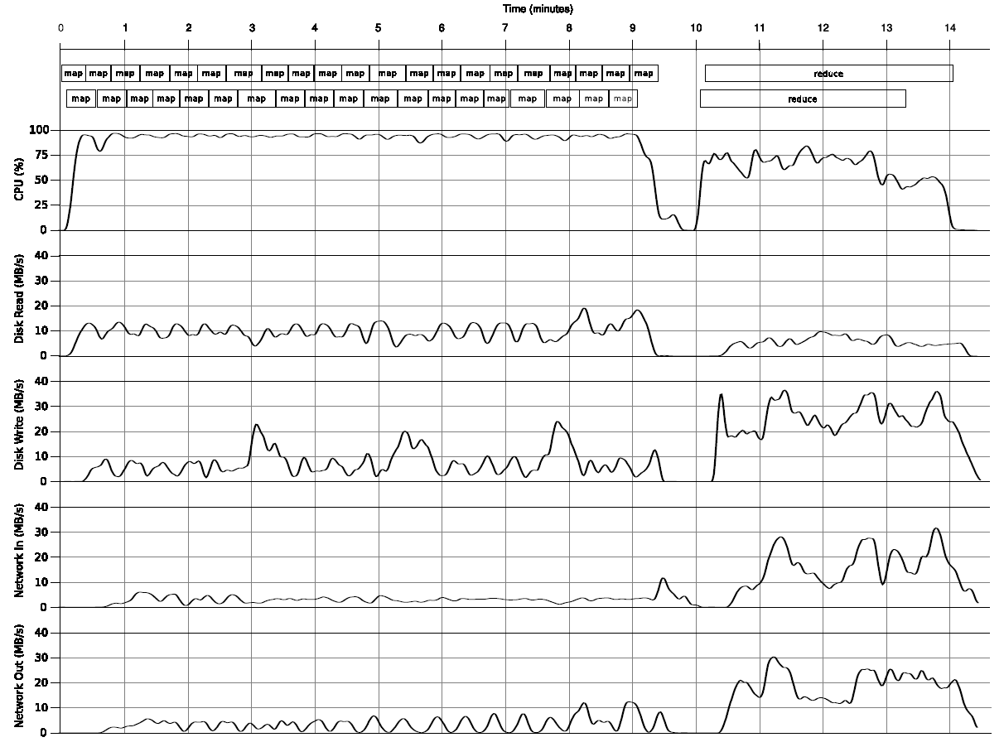
Experimental Evaluation System Behavior – Standard Repartition join
The Map phase was clearly CPU-bound
The disk and the network activities were moderate
The node was almost idle for 30 seconds between 9 and 10 minute mark

Slide 27
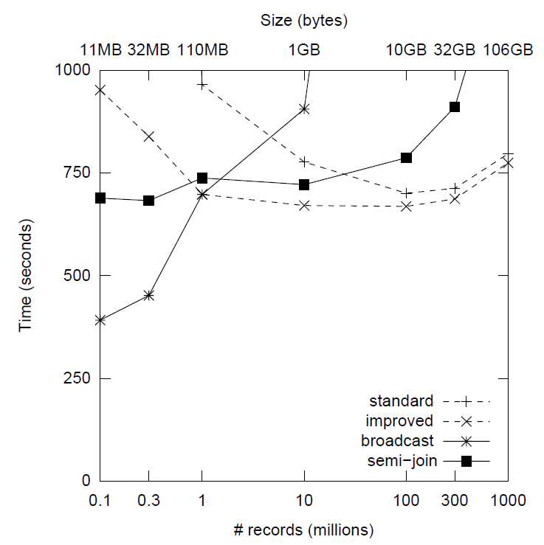

Experimental Evaluation Experimental Results
Standard repartition join decreased initially
But then surprisingly increased
As R got smaller, there were more records in L with the same join key
R
L

Slide 28
Experimental Evaluation Experimental Results
Broadcast join
Its performance improved as the size of R
R had 1M records or less, It was always better than the improved repartition join
The performance degraded rapidly as R got bigger
Because the cost of transferring R to every node
Semi-join
Never the best algorithm
Because of the relatively high overheads of scanning L from HDFS

Slide 29
Outline
Introduction
Join Algorithms in MapReduce
Experimental Evaluation
Conclusion
Discussion

Slide 30
Conclusion
MapReduce has more built-in computational overheads
Input record interpretation
Checksum validation
Task initialization
Choosing the right strategy
Most of the join algorithms have the tradeoffs

Slide 31
Outline
Introduction
Join Algorithms in MapReduce
Experimental Evaluation
Conclusion
Discussion

Slide 32
Discussion
Strong points
Showed a detailed description of several equi-join implementations for the MapReduce framework
Designed various practical preprocessing techniques
Weak points

Slide 33
Thank you

