Slide 1
Spark Streaming
Dongjun Lee
December 21, 2016

Slide 2
Real-time Analytics
Streaming Analytics Architecture
Service Configuration and Coordination
Zookeeper
Data-Flow Management in Streaming Analysis
Kafka, Flume
Processing Streaming Data
Spark Streaming, Storm, Samza, Flink
Storing Streaming Data
NoSQL (Redis, MongoDB, Cassandra)

Slide 3
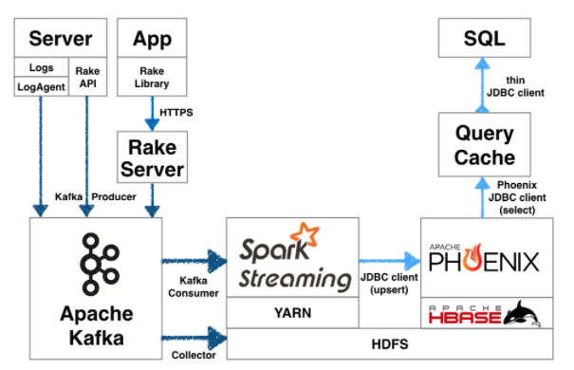
Real-time Analytics
Streaming analytics architecture example
Notes:
http://readme.skplanet.com/?p=12465

Slide 4
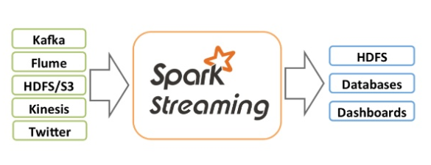
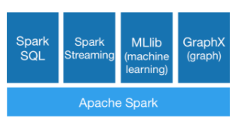
Spark Streaming - Overview
Spark streaming is an extension of Spark API
Scalable, high-throughput, fault tolerant stream processing of live data streams
Data can be ingested from many sources (Kafka, Flume, TCP sockets ..)
Can be processed using complex algorithms expressed with high-level functions (ex. Map, reduce, join, window)
Processed data can be pushed out to filesystems or databases.
Can apply Spark’s machine learning and graph processing algorithms on data stream

Slide 5
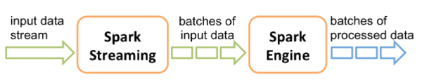
Spark Streaming - Overview
How internally it works
Receives live input data streams and divides the data into batches
Then processed by the Spark engine to generate the final stream of results in batches.
Dstream
Spark streaming provides a high-level abstraction called discretized stream(Dstream)
Represents a continuous stream of data
Can be created either from data or by applying high-level operations on other Dstreams
Internally Dstream is represented as a sequence of RDDs
Notes:
Like RDD’s transformation and action

Slide 6
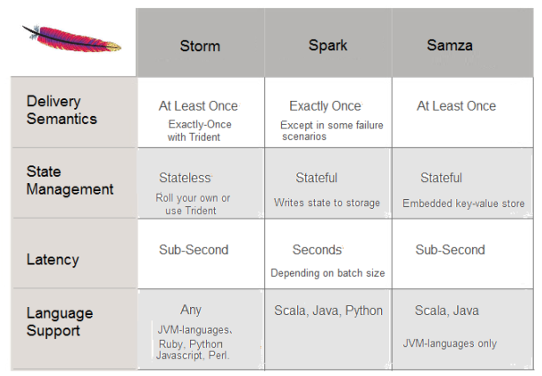
Compare to Other Frameworks

Slide 7
Paper
Discretized Streams: Fault-Tolerant Streaming Computation at Scale (ACM 2013)
Introduction
Goals and Background
Discretized Streams (D-streams)
Computational Model
Timing Considerations
D-stream API
Consistency Semantics
Unification with Batch & Interactive Processing
System Architecture
Fault and Straggler Recovery
Evaluation

Slide 8
Plan for Tutorial
Based on Spark Streaming Programming Guide
http://spark.apache.org/docs/latest/streaming-programming-guide.html
Final goal for Spark Streaming tutorial is Kafka + Spark Streaming Integration
http://spark.apache.org/docs/latest/streaming-kafka-integration.html (Kafka + Spark Streaming Integration Guide)

Slide 9
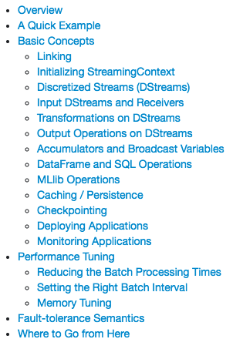
Plan for Tutorial (cont.)

Slide 10
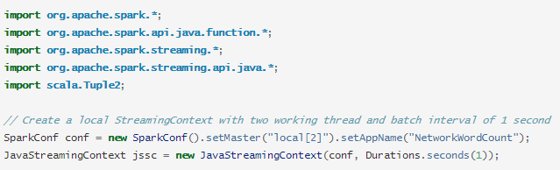
A Quick Example
Simple Spark Streaming program example
Count the number of words in text data received from a data server listening on a TCP socket.
First, we create a JavaStreamingContext object.
Main entry point for all streaming functionality.
Create a local StreamingContext with two execution threads, and a batch interval of 1 second.

Slide 11
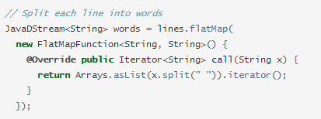
A Quick Example (cont.)
Create a Dstream that represents streaming data
Each record in this stream is a line of text, then we want to split the lines by space into words.
flatMap is DStream operation that creates a new DStream by generating multiple new records from each record in the source DStream

Slide 12
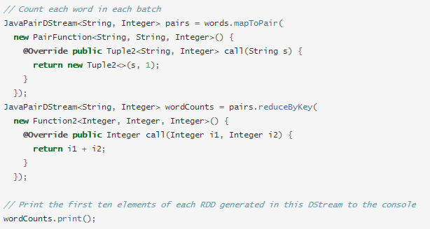
A Quick Example (cont.)
Next, we count these words
The words Dstream is mapped to a Dstream of (word, 1) pairs.
Then it is reduced to get the frequency of words in each batch of data

Slide 13

A Quick Example (cont.)
To start the processing after all the transformations have been setup, we finally call start method

Slide 14
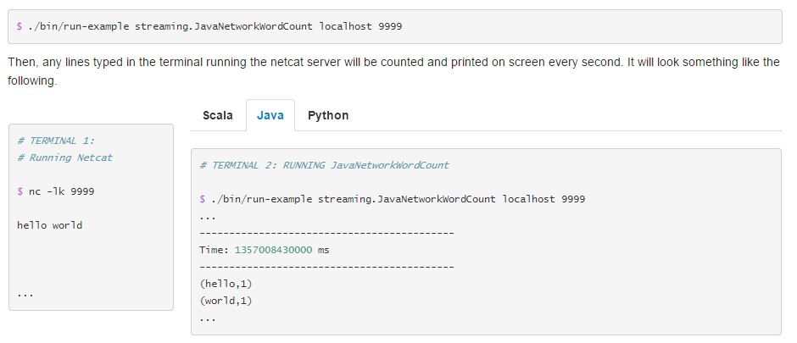
A Quick Example (cont.)
How to run the example
Using NetCat as a data server

Slide 15
Demo
Environment
JAVA 1.8
Spark 2.0.2
Maven 3.3.3
See the demo

Slide 16
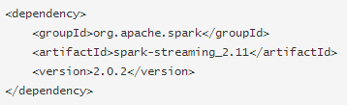
Basic Concepts - Linking
Spark streaming is available through Maven central.
Add the following dependency to your Maven project.
What is Maven?
Project management and comprehension tool.
Can manage a project’s build, reporting and documentation from a central piece of information. (pom.xml)

Slide 17
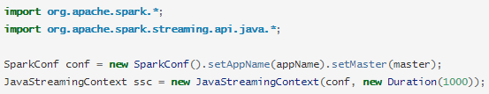
Basic Concepts – Initializing StreamingContext
A JavaStreamingContext object can be created from a SparkConf object
appName parameter is a name for your application to show on the cluster UI
master is a Spark, Mesos, or YARN cluster URL
Notes:
appName parameter is a name for your application to show on the cluster UI.

Slide 18
Basic Concepts – More about StreamingContext
After a context is defined, you have to do the following.
1. Define the input sources by creating input DStreams.
2. Define the streaming computations by applying transformation and output operations to DStreams.
3. Start receiving data and processing it using streamingContext.start()
4. Wait for the processing to be stopped (manually or due to any error) using streamingContext.awaitTermination().
5. The processing can be manually stopped using streamingContext.stop().
Points to remember
Once a context has been started, no new streaming computations can be set up or added to it.
Once a context has been stopped, it cannot be restarted.
Only one StreamingContext can be active in a JVM at the same time.
A SparkContext can be re-used to create multiple StreamingContexts, as long as the previous StreamingContext is stopped (without stopping the SparkContext) before the next StreamingContext is created.

Slide 19
Input DStreams and Receivers
Basic Sources
File Streams : For reading data from files on any file system compatible with the HDFS API (HDFS, S3, NFS etc.)
Queue of RDDs as a Stream : For testing a Spark Streaming application with test data, one can also create a DStream based on a queue of RDDs
Advanced Sources (with external non-Spark libraries)
Kafka
Flume
Kinesis
Custom Sources
Input Dstreams can also be created out of custom data sources.
All you have to do is implement a user-defined receiver that can receive data from the custom sources and push it into Spark

Slide 20
For next seminar
Transformations on Dstreams
How the data from the input Dstream to be modified.
Similar to “transformations” for RDDs
Output Operations on Dstreams
How Dstream’s data to be pushed out to external systems (like a database or file systems)
Similar to “actions” for RDDs
Some design patterns
Deploying Applications
Monitoring Applications (Using Administrator UI)
Performance Tuning

Slide 21
Plan
12월 4주
Spark Streaming
tutorial 및 demo 남은 부분 진행
1월 1주 ~ 1월 2주
Kafka + Spark Streaming integration (+Zookeeper?)
tutorial 및 demo 진행
1월 2주 ~ 1월 3주
MLlib introduction
tutorial 및 demo 진행
1월 3주 ~ 1월 4주
Integrate MonetDB to our system
tutorial 및 demo 진행
Git 운영 계획
Notes:
https://github.com/dongjun-Lee/SparkTutorial

