Slide 1
QOM━Quick Ontology Mapping
Marc Ehrig and Steffen Staab
Institute AIFB, University of Karlsruhe
ISWC 2004
January 4, 2012
Sengyu Rim
SNU IDB Lab.

Slide 2
Outline
Introduction
Background
Process
Evaluation and Results
Conclusion
Discussion

Slide 3

Introduction
Здравствуйте
HELLO!
Actually we are talking about same thing!
SO
Mapping the same meaning of the content is important!

Slide 4
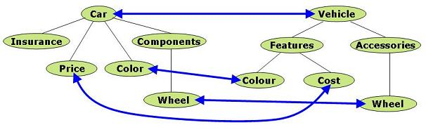
Introduction
Semantic mapping(alignment) between ontologies is a necessary precondition when we use different ontologies
Important to establish interoperation between agents or services

Slide 5
Introduction
Previous work has been laid exclusively on improvement of effectiveness
The quality of proposed mappings
It is not sufficient to provide best possible mappings only
Peer-to-peer systems also need efficiency
We present an approach that considers both the quality of mapping as well as the run-time complexity
Compromise between effectiveness and efficiency
The complexity of QOM is of O(n·log(n)) against O(n²) of other approaches

Slide 6
Outline
Introduction
Background
Process
Evaluation and Results
Conclusion
Discussion

Slide 7
Background
The definition of ontology O
Set of concepts C
Corresponding subsumption hierarchy H_{C}
Relation R exits between single concepts
An entity i ∈I is an instance of a class
The definition of mapping
based on the vocabulary ε, of all terms e ∈ ε and based on the set of possible ontologies
e ∈ C∪R ∪I
map: ε x O x O ε
with ∀ e ∈O₁(∃f∈O₂:map(e,O₁,O₂)=f∨map(e,O₁,O₂)=⊥)

Slide 8
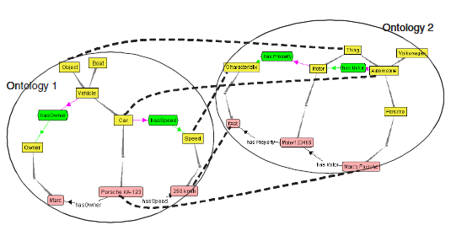
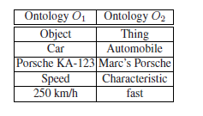
Background
Example

Slide 9
Outline
Introduction
Background
Process
Evaluation and Results
Conclusion
Discussion

Slide 10
Process
A canonical process that subsumes all the mapping approaches
Feature engineering
Transform the initial representation into RDFS
Selection of next search
Choose a restricted subset of candidate concepts pairs to compute similarity
Similarity computation
Determine the similarity values of candidate mappings
Similarity aggregation
Aggregate different similarity values into a single aggregated one
Interpretation
uses the individual or aggregated similarity values to derive mappings
Iteration
Iteration is performed over the whole process

Slide 11

Process
Mapping process
Mapping table is returned after finishing all the steps

Slide 12
Process
Features of ontology entities
Identifiers: string with dedicated formats, such as unified resource identifiers(URIs) or RDF labels
RDF/S features: such as properties or subclass relations
Derived features: which constrain or extend simple RDFS primitives
OWL primitives: such as an entity being the same as another entity
Domain Specific Features: features which only apply to a certain domain with a predefined shared ontology

Slide 13
Process
Similarity computation
Object equality: based on logical assertions
Explicit equality: logical assertion already forces two entities to be equal
String similarity: the similarity of two strings on a scale from 0 to 1
SimSet: determine to what extent two sets of entities are similar
Interpretation
Each entity may only participate in one mapping
Assign mappings based on a threshold t
Greedy strategy

Slide 14
Process
Direct instance VS instance
An individual i is a DIRECT-INSTANCE-OF class C if i is an instance-of C and there is no other subclass of C defined in the current ontology of which i is also an instance-of
object
instance
auto
instance
Benz
S600
Benz
direct
instance

Slide 15
Process
Naïve Ontology Mapping(NOM)-straightforward baseline
Feature engineering: represent the ontologies in RDFS
Search step selection: all entities of the first ontology are compared with all entities of the second ontology
Similarity computation: similarity computation is done by using a wide range of similarity functions
Similarity aggregation: assign the weight to individual similarity measure and sum the values
Interpretation: it applies a threshold to discard spurious evidence of similarity
Iteration
The first round uses only labels and string similarity
more sophisticated structural similarity measures for following rounds

Slide 16
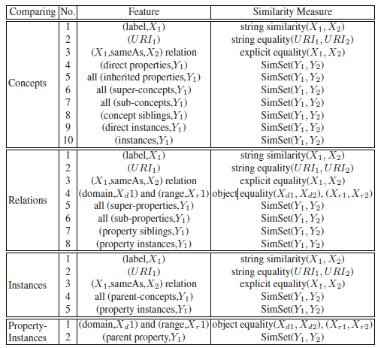
Process
Example-Features and similarity measures in NOM

Slide 17
Process
QOM-Quick Ontology Mapping
Feature engineering: like NOM
Search step selection: lower the number of candidate mappings
Random: a simple approach to limit the number of candidate mappings
Label: only compare the entity pairs whose labels are near to each other in the sorted list
Hierarchy: compare from high level to low level
Similarity computation: restrict the range of costly features
Similarity aggregation: like NOM
Interpretation: like NOM
Iteration: like NOM

Slide 18
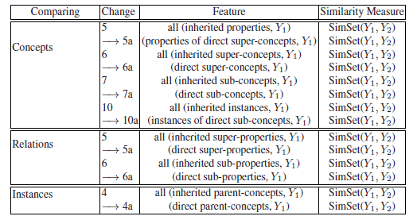
Process
Example-Features and similarity measures in QOM

Slide 19
Outline
Introduction
Background
Process
Evaluation and Results
Conclusion
Discussion

Slide 20

Evaluation and Results
Metrics:
Data sets: students were asked to independently create and map ontologies based on a website describing Russia
Russia 1: 160 possible mappings with a large number of similar labels
Russia 2: 215 possible mappings with a small number of similar labels
Evaluation strategy
PROMPT: simple and fast algorithm to be baseline to the speed
NOM: quality baseline because of its high effectiveness
QOM: novel approach focusing on efficiency

Slide 21
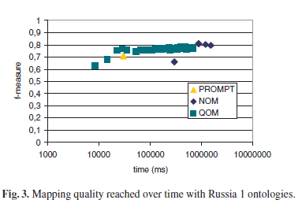
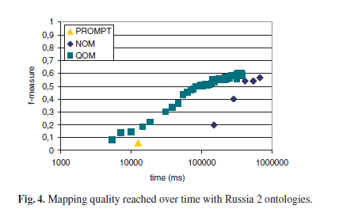
Evaluation and Results
Experiments

Slide 22
Evaluation and Results
Results
PROMPT strategy is not satisfactory for ontologies with a small number of similar labels
NOM strategy reaches high value at the cost of time
QOM Strategy reaches high quality very quality
QOM achieving 20 times higher number of iterations than NOM within the given time

Slide 23
Conclusions
We have devised a generic process model to compromise between effectiveness and efficiency
Developed the run-time from O(n²) to O(n·log(n))

Slide 24
Outline
Introduction
Background
Process
Evaluation and Results
Conclusion
Discussion

Slide 25
Discussion
Strong point
Marginal modification results in high performance
Weak point
Just modified 2 steps of all, maybe more steps can be modified to a higher performance

Slide 26
Thank you!!!

