Slide 1
Distinguishing influence-based contagion from homophily-driven diffusion in dynamic networks
Sinan Aral, Lev Muchnik, and Arun Sundararajan
PNAS 2009
Hyewon Lim

Slide 2
Abstract
Peer influence and social contagion (also homophily)
Evidence of assortative mixing, temporal clustering of behavior
A dynamic matched sample estimation framework
To distinguish influence and homophily effects in dynamic networks
Findings
Previous methods overestimate peer influence in product adoption decisions by 300 – 700%
Homophily explains >50% of the perceived behavioral contagion

Slide 3
Outline
Introduction
Data
Evidence of Assortative Mixing and Temporal Clustering
Methods
Results
Discussion

Slide 4
Introduction
Model the dynamics of viral spreading
Using assumptions about susceptibility rates, transition probabilities, and their relationships to network structure
Few large-scale empirical observations of networked contagions exist to validate these assuptions
A key challenge in identifying true contagions
To distinguish peer-to-peer influence from homophily

Slide 5
Introduction
Peer-to-peer influence
A node influences or causes outcomes in its neighbors
Influence-driven contagions
Self-reinforcing and display rapid, exponential, and less predictable diffusion
Homophily
Dyadic similarities between nodes create correlated outcome patterns among neighbors that merely mimic viral contagions without direct causal influence
Homophily-driven contagions
Goberned by the distributions of characteristics over nodes

Slide 6
Introduction
Substantiate claims of peer influence and contagion in networks using two empirical patterns
Assortative mixing
Correlations of behaviors among linked nodes
Temporal clustering
Temporal interdependence of behaviors among linked nodes
While evidence of assortative mixing and temporal clustering in outcomes may indicate peer influence, such outcomes may also be explained by homophily

Slide 7
Introduction
Develop a matched sample estimation framework to distinguish influence and homophily effects in dynamic networks
Findings
Previous methods significantly overestimate peer influence
Mistakenly identifying homophilous diffusion as influence-driven contagion

Slide 8
Data
Daily instant messaging (IM) traffic among 27.4M users of Yahoo.com
Yahoo! Go
The day-by-day adoption of a mobile service application launched in July 2007
Precise attribute and dynamic behavioral data from desktop, mobile, and Go platforms
Users’ demographics, geographic location, mobile device type and usage, and per-day page views of different types of content
Sampled users
Registered >14B page views
Sent 3.9B messages over 89.3M distinct relationships

Slide 9
Outline
Introduction
Data
Evidence of Assortative Mixing and Temporal Clustering
Methods
Results
Discussion

Slide 10
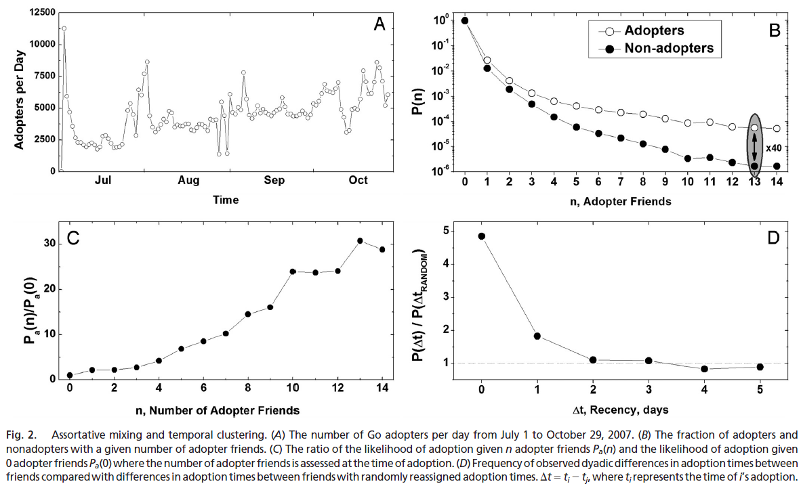
Evidence of Assortative Mixing and Temporal Clustering
Observe strong evidence of both assortative mixing and temporal clustering in Go adoption
At the end of the 5-month period,
Adopters have a 5-fold higher percentage of adopters in their local networks
Adopters receive a 5-fold higher percentage of messages from adopters than non-adopters
Notes:
Fig 2B: # adopter friends (x축)를 가진 adopters/nonadopters의 수
Fig 2C: # adopter friends가 증가할 수록 adoption 될 확률이 dramatically 증가
Fig 2D: 친구일 경우(randomly assign 한 것 보다) 이틀 사이에 100% ~ 500% 더 adoption될 확률이 높음

Slide 11
Evidence of Assortative Mixing and Temporal Clustering
Evidence of assortative mixing and temporal clustering may suggest peer influence
Homophily could also explain assortative mixing and temporal clustering
Do social choices and behaviors exhibit assortative mixing and temporal clustering in networks because of influence or homophily, and when is one explanation more likely than the other?
Attempt to describe a scalable and widely applicable alternative method to distinguish homophily and influence

Slide 12
Outline
Introduction
Data
Evidence of Assortative Mixing and Temporal Clustering
Methods
Results
Discussion

Slide 13
Methods
Homophily creates a selection bias
Treatments are not randomly assigned
Adopters are more likely to be treated because of similarity with their neighbors
Regression analysis are insufficient
Only establish correlation
Matched sampling
Estimate causal treatment effects

Slide 14

Methods
Propensity score matching
T_{it} : the treatment status (# friends who have adopted) of i on day t
X_{it} : the vector of demographic and behavioral covariates of I
Choose an untreated match j for all treated nodes i
|p_{it} – p_{jt}| is minimized
To explain temporal clustering
Defined treated users as those with friends who had adopted within certain time intervals of one another

Slide 15
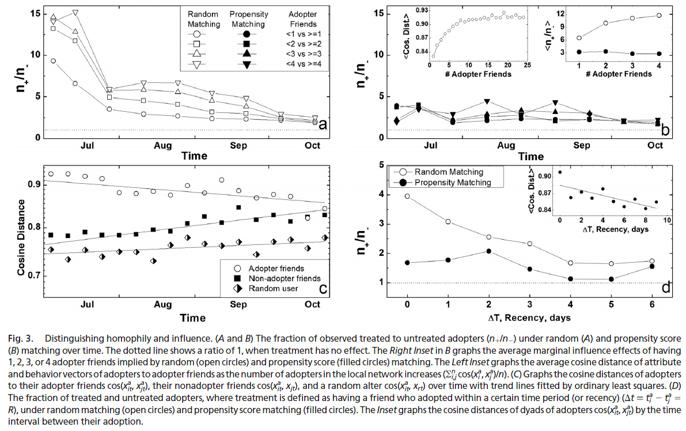
Results
Notes:
3A 는 random matching의 결과, 3B는 propensity score로 matching한 결과: 여기서는 condition (vectore X_{it}) 없이 matching 함

Slide 16
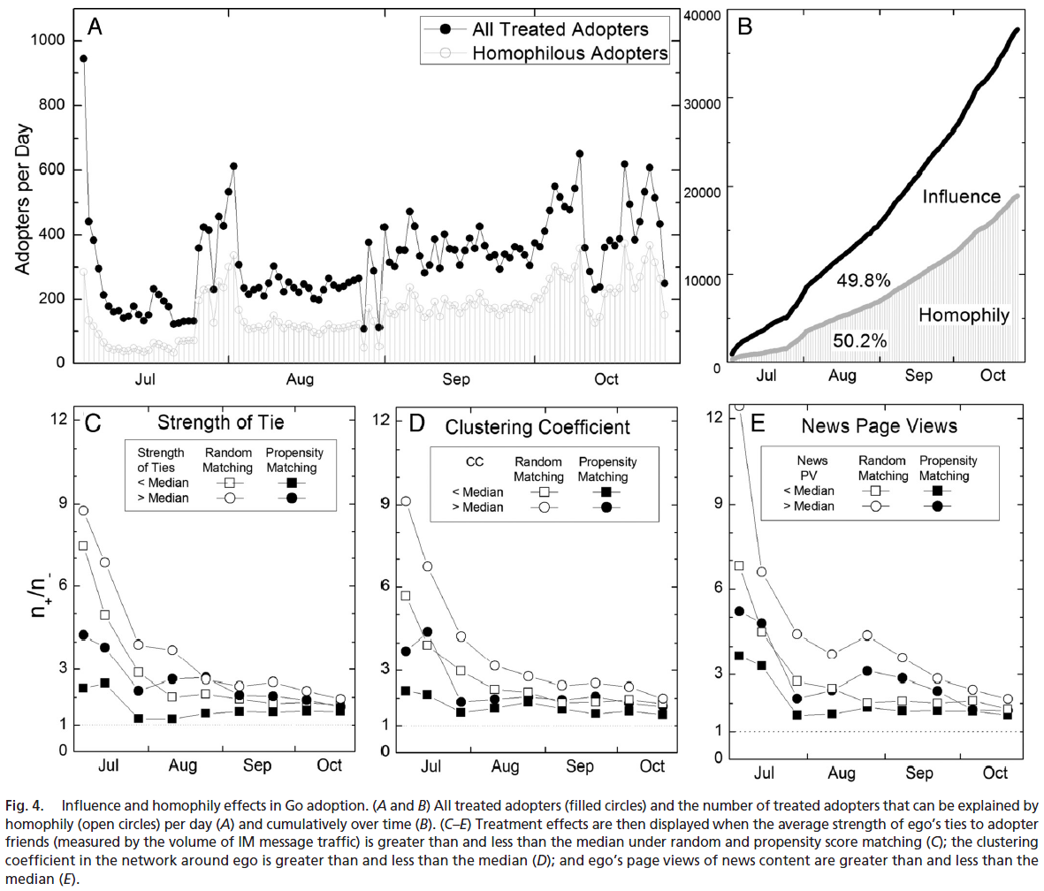
Results

Slide 17
Outline
Introduction
Data
Evidence of Assortative Mixing and Temporal Clustering
Methods
Results
Discussion

Slide 18
Discussion
A key challenge in identifying the existence and strength of true contagion
Distinguish peer influence process from alternative processes such as homophily
Present a generalized statistical framework
for distinguishing peer-to-peer influence from homophily in dynamic networks of any size
Previous methods
Overestimate Peer influence by 300-700%
Homophily explains >50% of the perceived behavioral contagion
Homophily can account for a great deal of what appears at first to be a contagious process
Influence is also over estimated in large clusters of adopters
In these cluster the homophily effect is more pronounced

Slide 19
Discussion
Different subsets of the population
display various susceptibilities to potential influence
Limitations
Unobserved and uncorrelated latent homophily and unobserved confounding factors or contextual effect may also contribute
Yahoo! Go 2.0 does not exhibit direct network externalities
Yahoo! Go 2.0’s adopation is not likely to be driven by the desire to communicate with one’s friends by using the application

Slide 20
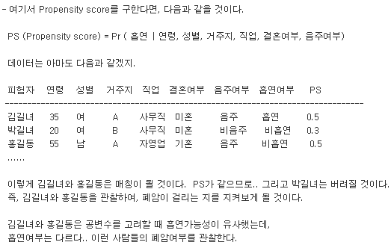
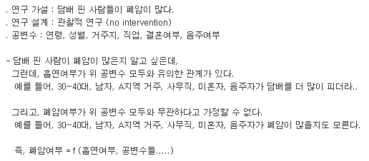
Propensity Score Methods
목적
대조군과 시험군을 random하게 assign하여 공변수가 효과 측정에 미칠 수 있는 bias를 방지
http://blog.naver.com/p0gang/40107322142

