Slide 1
ST-AGRID: A Spatio Temporal Grid Density Based Clustering and Its Application for determining the Potential Fishing Zones
D. Fitrianah, A. N. Hidayanto, H. Fahmi, J. Lumban Gaol and A. M. Arymurthy
Universitas Indonesia, Universitas Mercu Buana
International Journal of Software Engineering and Its Applications 2015 Vol 9
January 22, 2016
Heymo Kou

Slide 2
Contents
Introduction
Related works
Algorithm
Validation

Slide 3
Introduction
Increase in spatio-temporal data mining
Medicine, security, environment, Biology
Previous spatial mining cannot perform temporal
Should Time considered as additional vector to spatial?
Or treat different

Slide 4
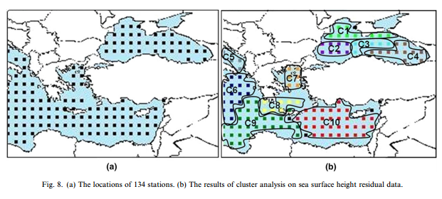
Related works
ST-DBSCAN [Derya Birant, ‘07]
Spatio-Temporal version of DBSCAN method

Slide 5
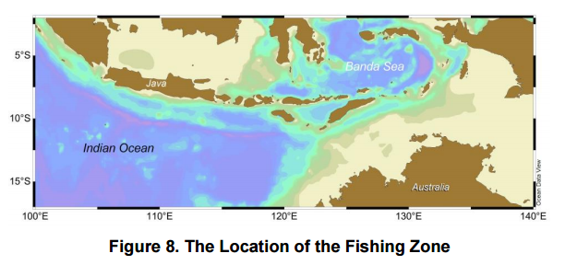
Data set
Fishery data from Indian Ocean 2000 ~ 2004
Using Ocean Data View software

Slide 6
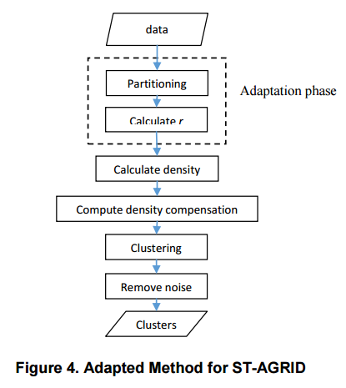
Algorithm
r – neighborhood radius for each data point

Slide 7
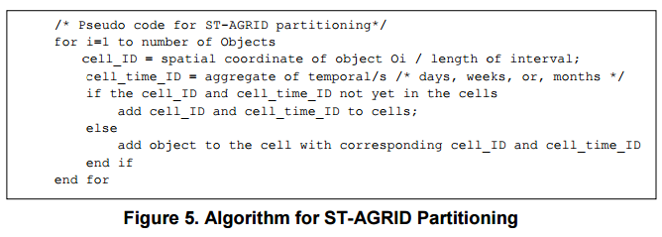
Partitioning

Slide 8


Computing distance threshold / densities
Neighborhood distance (spatial)
Densities

Slide 9
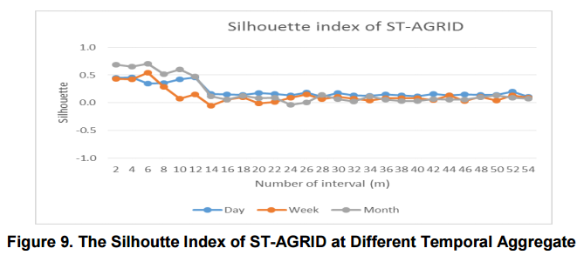
Validating the Clustering Result
Silhouette Equation
Validate clusters
Similarity of one object to other objects

Slide 10
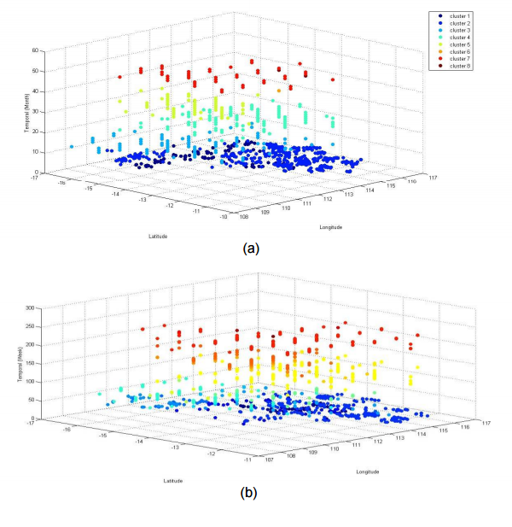
Result

Slide 11

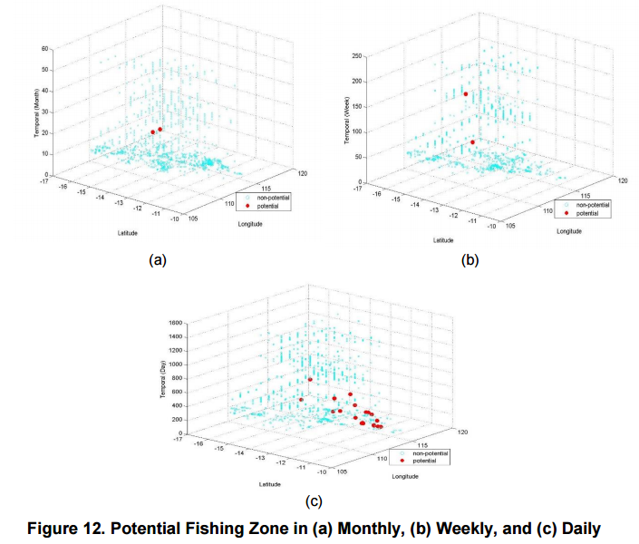
Determining the Potential Fishing Zone
Formula for determining the potential fishing zone

