Slide 1
Top-K Aggregation Queries Over Large Networks
Xifeng Yan¹, Bin He², Feida Zhu³ and Jiawei Han⁴
Univ. of California at Santa Barbara¹, IBM Almaden Research Center²
Singapore Management Univ. ³, Univ. of Illinois at Urbana-Champaign⁴
ICDE ’10
13 July 2011
Taewhi Lee

Slide 2
Outline
Introduction
Forward Processing
Backward Processing
Experimental Results
Conclusion

Slide 3










Computing Aggregate Values Over Neighbors
1
1
SUM(u) = 6
AVG(u) = 6/8
1
1
0
1
0
1

Slide 4
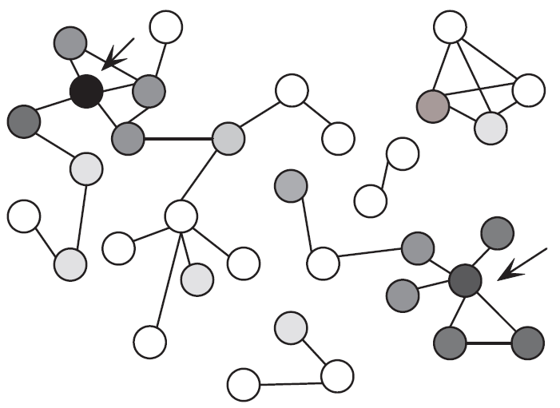
Computing Aggregate Values Over Neighbors
Example: find top-k candidates in LinkedIn 1. who have experiences in DB research 2. who are referred by professionals in the same domain

Slide 5
Top-K Neighborhood Aggregation Query
Find nodes that have top-k highest over their h-hop neighbors
Applications
Professionals recommendation on LinkedIn
Book recommendation on Amazon
Target Marketing on Facebook
Gene function finding in biological networks

Slide 6
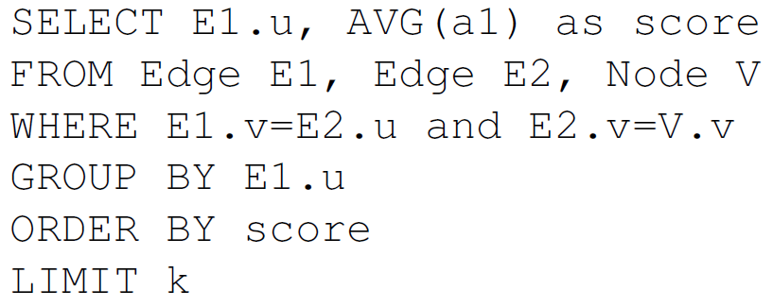
Limitations in Using Relational Query Engine
Expensive to execute self-join two large edge tables
Node
Edge
v | a1 | a2
1 | 1 | …
2 | 0.5 | …
… | … | …
u | v
1 | 2
2 | 3
… | …
Simple SQL example (only 2nd hop nodes are counted)
…
1
3
2
…
Hard to build index on the node attribute
The relevance function is provided on the fly in many real-life applications

Slide 7
Outline
Introduction
Forward Processing
Backward Processing
Experimental Results
Conclusion

Slide 8
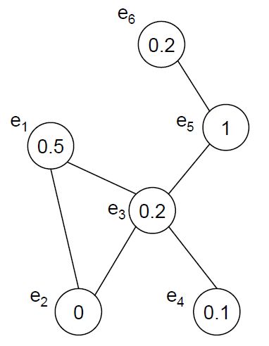


Naïve Forward Processing
Example: compute SUM function for 1-hop
Check each node
Find its h-hop neighbors
Aggregate their values together
Select the top k nodes
→ Too expensive for a large graph
# of edges to be accessed = m^{h}|V| (m: # of neighbors on avg)

Slide 9
Key Issues
How to design an efficient and effective pruning algorithm?
Which order should be used for node processing?
Differential Index
# of neighbor decreasing order (in SUM function)

Slide 10
Differential Index
the set of distinct nodes in u’s h-hop neighborhood
Differential index delta(v – u)
The # of nodes in S(v), but not in S(u) for every node u and its neighbor node v
u | v | delta(v-u)
e3 | e1 | 0
e3 | e2 | 0
e3 | e4 | 0
e3 | e5 | 1
… | … | …
Pre-computed & stored

Slide 11


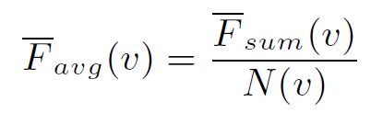


Computing Upper Bound
Upper bound for SUM aggregates
1 (max)
Differential index
u | v | delta(v-u)
e3 | e1 | 0
e3 | e2 | 0
e3 | e4 | 0
e3 | e5 | 1
… | … | …
Upper bound
estimation
1

Slide 12
Ordering Nodes
Difficult to obtain
Very sensitive to each query and the graph structure
SUM: # of their h-hop neighbors N(u)
Nodes with large N(u) often have high aggregate values
N(u) is pre-computed and used in pruning
u | N(u)
e1 | 3
e2 | 3
e3 | 5
… | …

Slide 13
Outline
Introduction
Forward Processing
Backward Processing
Experimental Results
Conclusion

Slide 14


Backward Processing Example
Compute SUM function for 1-hop

Slide 15
Backward Processing
Send each node’s score to all of its neighbor nodes
When all the scores are backward distributed, calculate the aggr. value of all the nodes
Select the top k nodes
Must wait until all of nodes are distributed
Only need to non-zero nodes (cannot be skipped)

Slide 16
Forward vs. Backward Processing
Both have some advantages and disadvantages
Most nodes have 0 score?
Yes
No
Backward processing
Forward processing
Is there a way to combine the two approaches together?

Slide 17
Partial Backward Algorithm
Step 1. Backward processing
Partial distribution on a subset of nodes whose score > Γ
According to their scores in a descending order
Step 2. Forward processing
Add all nodes into a priorityQ according to upper bound
Naïve forward processing until we find a node’s upper bound < top-k lower bound

Slide 18



Enhanced Backward Processing
Compute SUM function for 1-hop
Simultaneous fwd & bwd processing in step 1
1
0.5
0.5
1
1
0.5

Slide 19
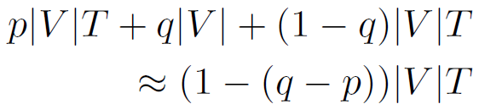
Distribution Ratio
Cost of backward distribution
p|V|: # of nodes to be distributed (with the highest score)
q|V|: # of nodes to be removed with forward pruning
T: average time of searching the h-hop neighbors

Slide 20
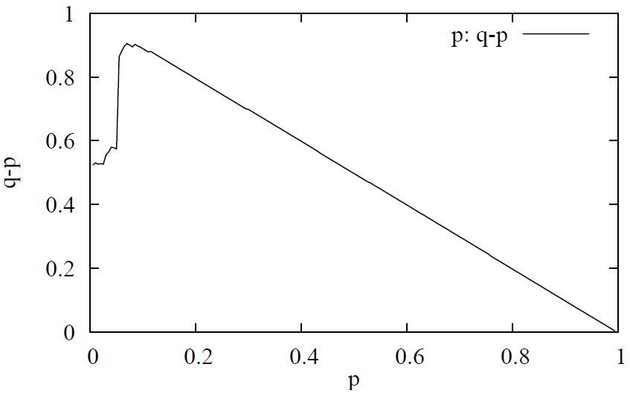
Estimating the Distribution
Sample m nodes randomly & find their h-hop neighbors
Max. q-p is low(< 50%) ➔ Skip the backward processing

Slide 21
Outline
Introduction
Forward Processing
Backward Processing
Experimental Results
Conclusion

Slide 22
Experiment Settings
Dataset | # of nodes | # of edges
Condensed Matter Collaboration Network (co-authorships) | 40K | 180k
Citation Network (patent citations) | 3M | 16M
Intrusion Network (IP traffic data) | 2.5M | 4.3M
2-hop queries, SUM & AVG aggregate functions
2.5GHz Xeon quad core CPU, 8GB RAM
Fedora 8, GNU C++ with LEDA library

Slide 23


Assigning Relevance Scores
Designed mixture function to mimic the setting of relevance functions in real-life applications
Random assignment function f_{r}
Random aspect of a node selection process
Value has an exponential distribution
Random walk procedure f_{w}
Many members in a community have a high relevance score → likely other members will have a high score too
Blacking ratio: % of nodes to be assigned “1”

Slide 24
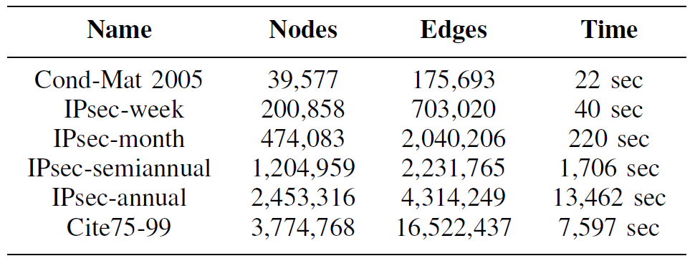
Index Construction Time
Many large hubs
(Large h-hop neighbor sets)

Slide 25
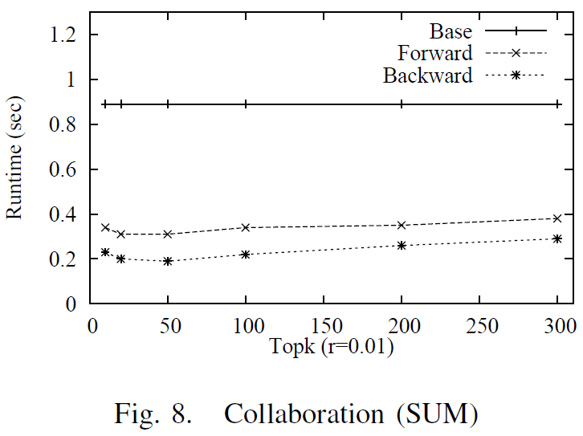
Run-time: Top-k SUM Queries

Slide 26
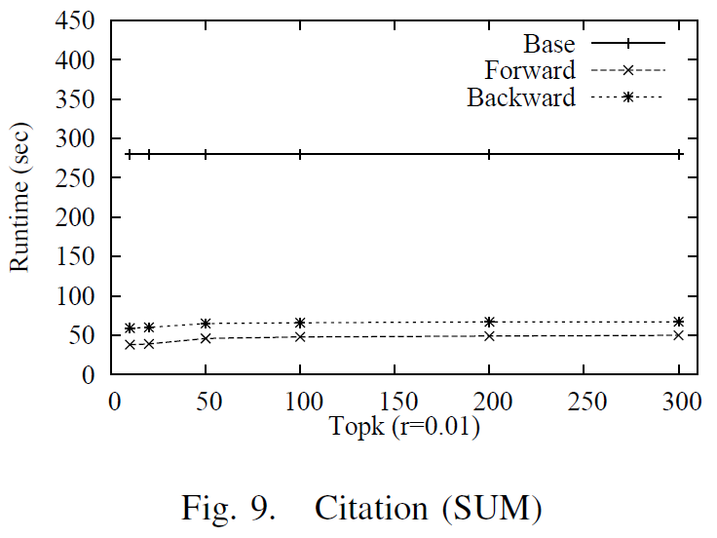
Run-time: Top-k SUM Queries

Slide 27
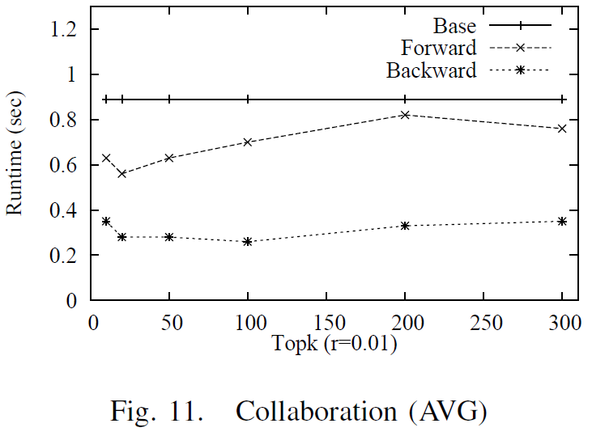
Run-time: Top-k AVG Queries

Slide 28
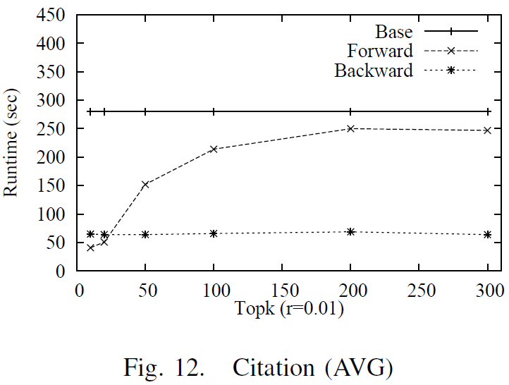
Run-time: Top-k AVG Queries
AVG queries are more difficult for forward processing
➔ Upper bound is not tight

Slide 29
Outline
Introduction
Forward Processing
Backward Processing
Experimental Results
Conclusion

Slide 30
Conclusion
Defined top-k local aggregation query problem over large network
Proposed two novel pruning techniques
Forward pruning using differential index
Backward distribution using partial aggregation

Slide 31
Thank You!
Any questions or comments?

Slide 32
Solving Top-K Aggregation on Graphs
P1. Evaluate the individual strength of a node f(u)
e.g., 0/1, [0,1]
P2. Evaluate the collective strength of a node F(u)
f(v₁), f(v₂), …, f(v_{m}) → F(u)
e.g.) SUM: f(v₁) + … + f(v_{m}), AVG: (f(v₁) + … + f(v_{m})) / n
P3. Find top-k nodes with the highest scores
Relevance function
Neighborhood aggregate
Top-k neighborhood aggregate

