Slide 1
Non First Normal Form Relations: An Algebra Allowing Data Restructuring
Serge Abiteboul and Nicole Bidoit
JCSS’86
7 April 2015
Hyesung Oh
Notes:
Journal of System Sciences

Slide 2
Outline
Introduction
Verso instance
Format
Operations
Existence dependency
Expressive power of Verso selection
Conclusion

Slide 3
Introduction
1NF(first normal form)
Definition
“A relation is in first normal form if the domain of each attribute contains only atomic values, and the value of each attribute contains only a single value from that domain.”
Not convenient for handling a variety of databases applications
Verso model
Data is organized in Non 1NF relations
Verso instance
Some attributes in Verso instance are atomic
Values for other attributes are Verso instances(recursive)

Slide 4
Outline
Introduction
Verso instance
Format
Operations
Existence dependency
Expressive power of Verso selection
Conclusion

Slide 5
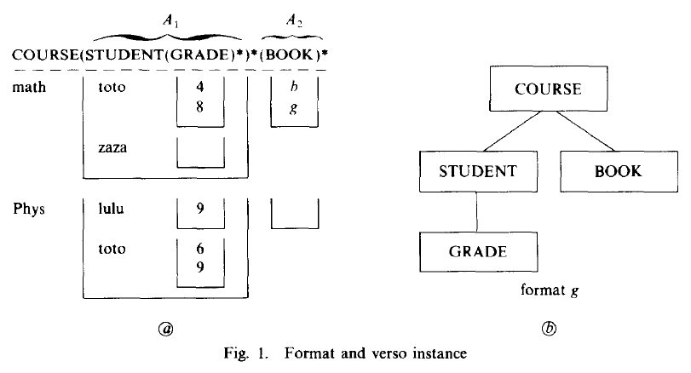
Verso instance
Data structure of the Verso model
5 unary operations
Extension, projection, selection, restriction, and renaming
5 binary operations
Union, intersection, difference, join, and Cartesian product
A department example
Does not exist(null value)
Notes:
F1.a Verso instance
F1.b format

Slide 6
Outline
Introduction
Verso instance
Format
Operations
Existence dependency
Expressive power of Verso selection
Conclusion

Slide 7
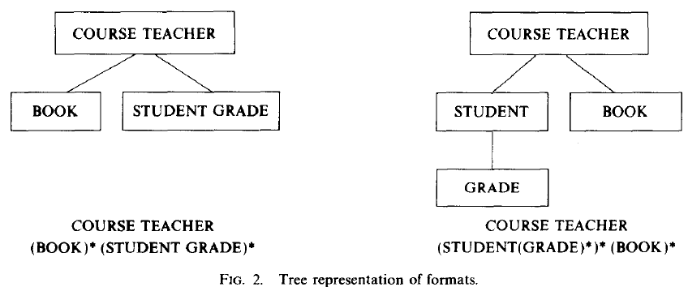
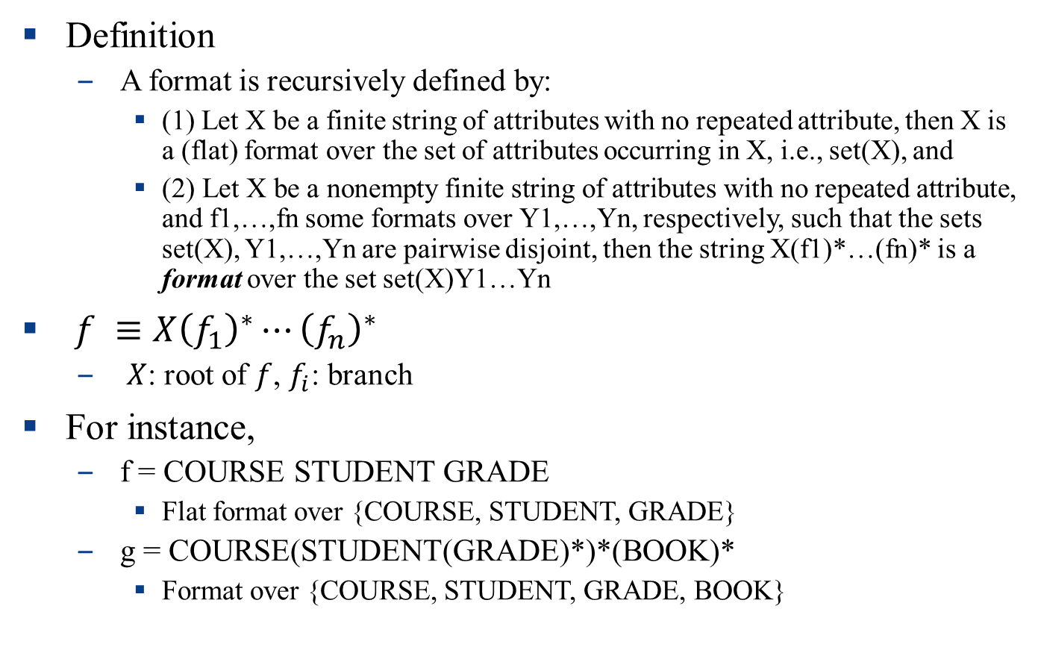
Format
Definition
A format is recursively defined by:
(1) Let X be a finite string of attributes with no repeated attribute, then X is a (flat) format over the set of attributes occurring in X, i.e., set(X), and
(2) Let X be a nonempty finite string of attributes with no repeated attribute, and f1,…,fn some formats over Y1,…,Yn, respectively, such that the sets set(X), Y1,…,Yn are pairwise disjoint, then the string X(f1)*…(fn)* is a format over the set set(X)Y1…Yn
$f ≡{X\left(f_{1}\right)}^{∗}⋯{\left(f_{n}\right)}^{∗}$
$X$: root of $f$, $f_{i}$: branch
For instance,
f = COURSE STUDENT GRADE
Flat format over {COURSE, STUDENT, GRADE}
g = COURSE(STUDENT(GRADE)*)*(BOOK)*
Format over {COURSE, STUDENT, GRADE, BOOK}

Slide 8
Outline
Introduction
Verso instance
Format
Operations
Existence dependency
Expressive power of Verso selection
Conclusion

Slide 9
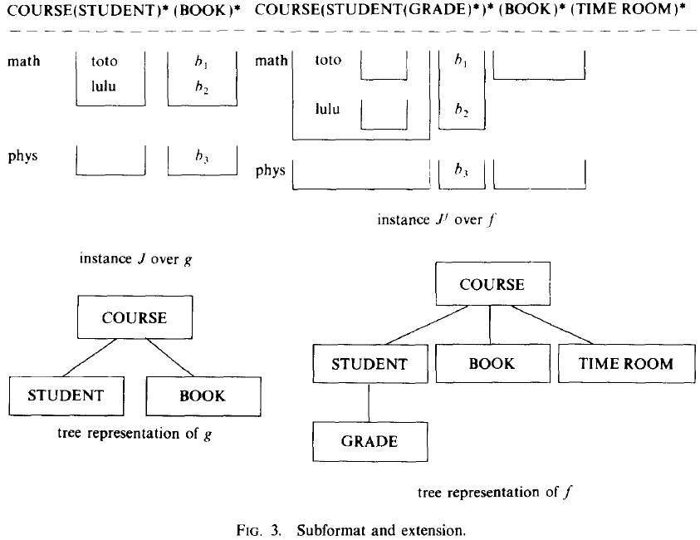
Subformat and Extension
g = COURSE(STUDENT)*(BOOK)*
f = COURSE(STUDENT(GRADE)*)*(BOOK)*(TIME ROOM)*
g is subformat of the format f

Slide 10
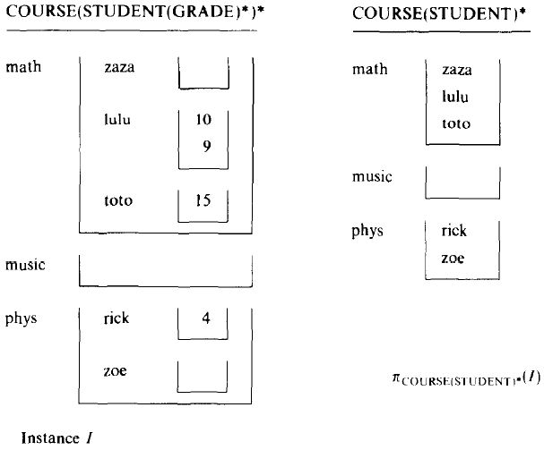
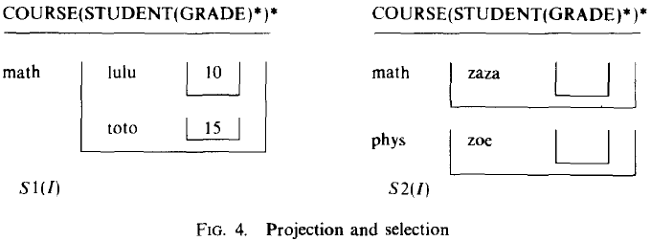

Projection and Selection
S1 = COURSE: COURSE = math(?(STUDENT: ($∃$(GRADE: GRADE $≥$ 10))))
S2 = COURSE: ($∃$(STUDENT: ($∄$(GRADE))))
Notes:
(Q1) give the list of math students who got a grade larger than 10, and
(Q2) give the courses in which some student is registered and did not get any
grade for this course.

Slide 11
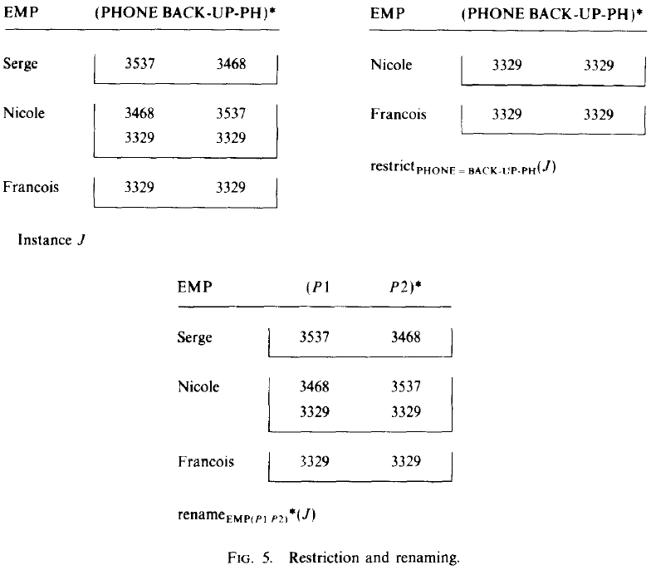
Restriction and Renaming

Slide 12
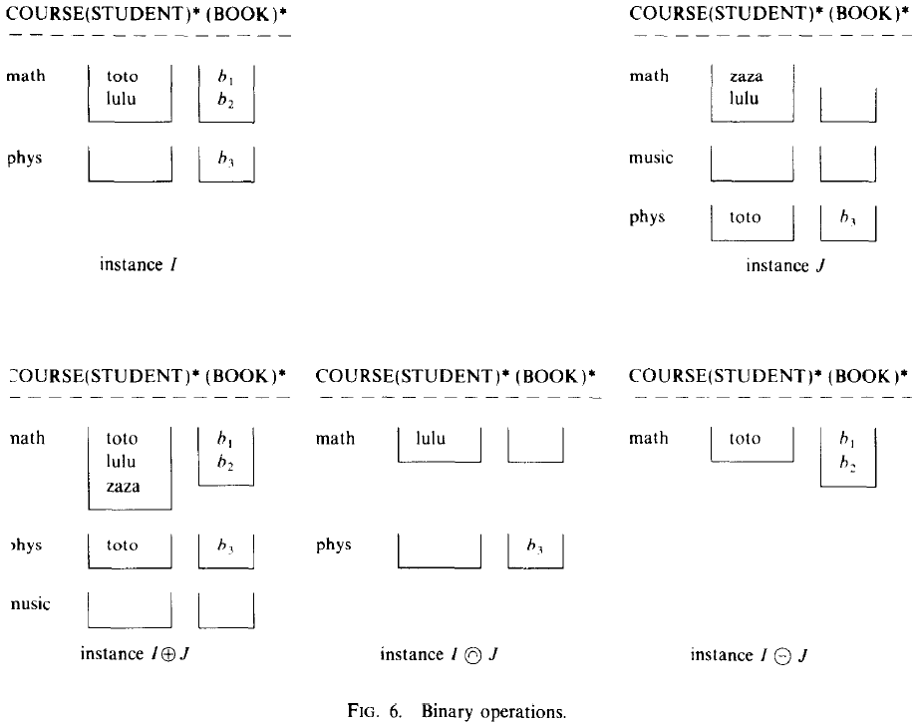
Binary operations

Slide 13
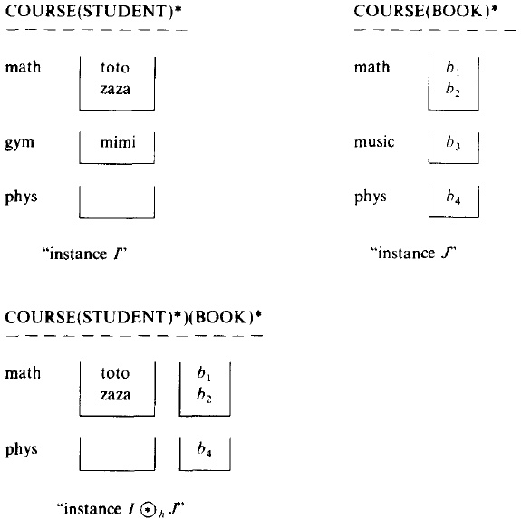
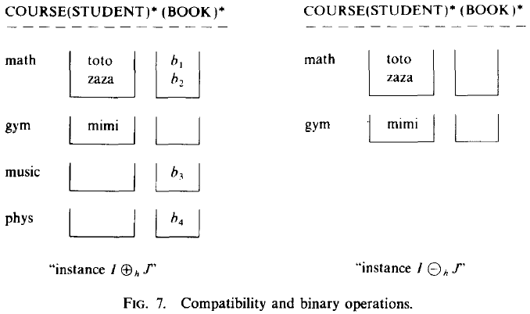
Compatibility and Binary operations

Slide 14
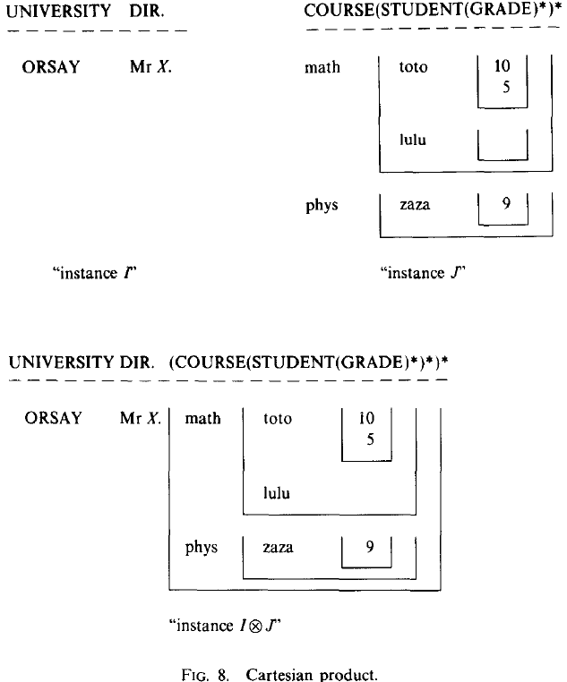

Cartesian product
$I⊗j=\left\{<uJ>\right| u in I\}$
u must be flat format

Slide 15
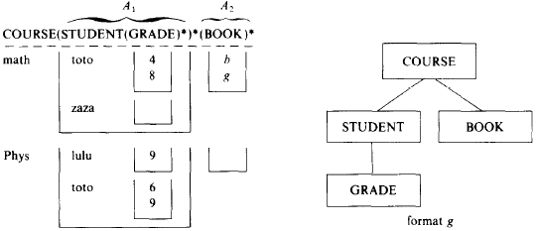
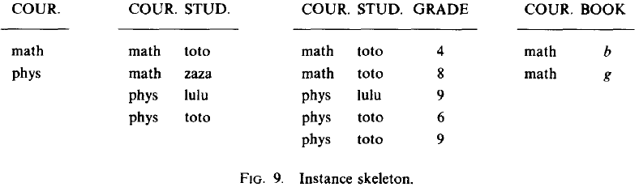
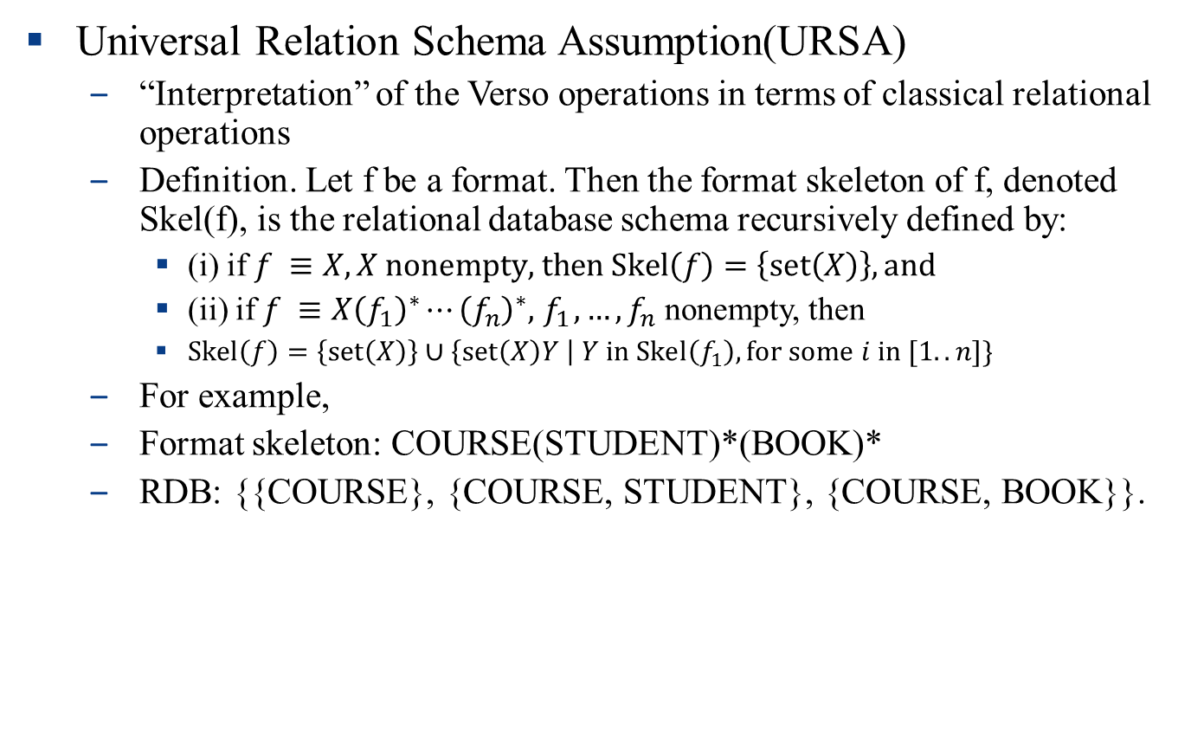
URSA Interpretation of Verso model
Universal Relation Schema Assumption(URSA)
“Interpretation” of the Verso operations in terms of classical relational operations
Definition. Let f be a format. Then the format skeleton of f, denoted Skel(f), is the relational database schema recursively defined by:
(i) if $f ≡X, X \text{nonempty}\text{, }\text{then} \text{Skel}\left(f\right)=\left\{\text{set}\left(X\right)\right\}, \text{and}$
(ii) if $f ≡{X\left(f_{1}\right)}^{∗}⋯{\left(f_{n}\right)}^{∗},{ f}_{1},…,f_{n}$ nonempty, then
$\text{Skel}\left(f\right)=\left\{\text{set}\left(X\right)\right\}∪\left\{\text{set}\left(X\right)Y \right| Y \text{in} \text{Skel}\left(f_{1}\right), \text{for} \text{some} i \text{in} [1..n]\}$
For example,
Format skeleton: COURSE(STUDENT)*(BOOK)*
RDB: {{COURSE}, {COURSE, STUDENT}, {COURSE, BOOK}}.

Slide 16
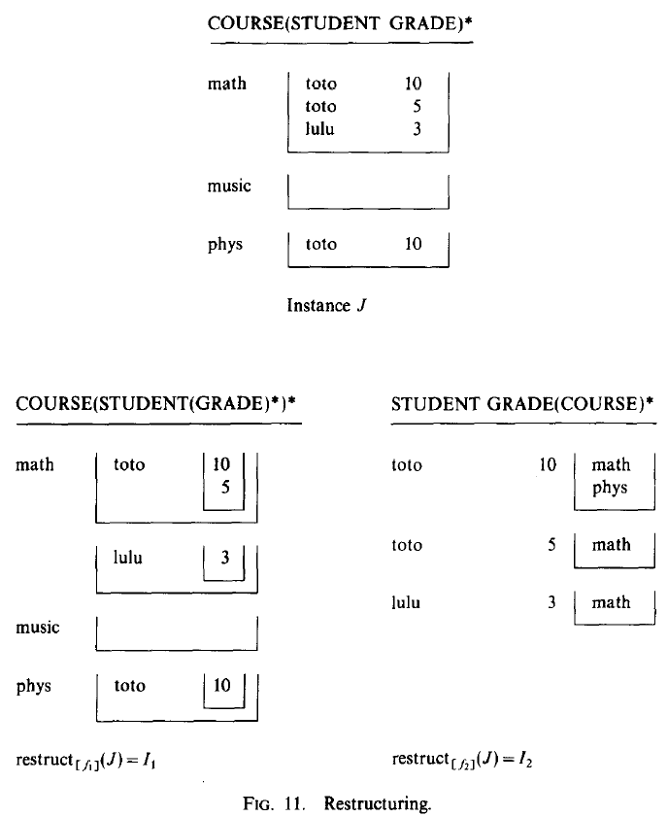
Restructuring
Allows one to modify the data structure
f1 = COURSE(STUDENT(GRADE)*)*
f2 = STUDENT GRADE(COURSE)*

Slide 17
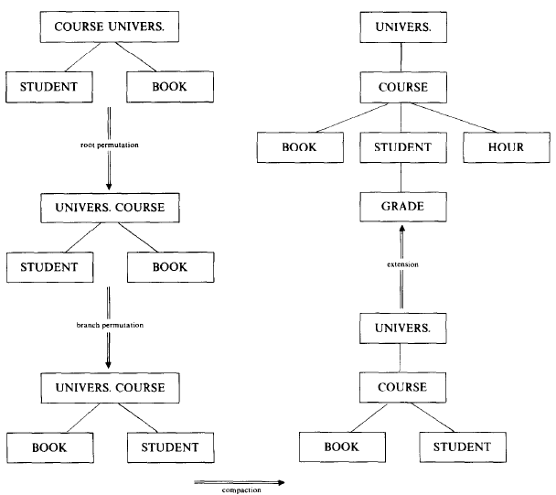
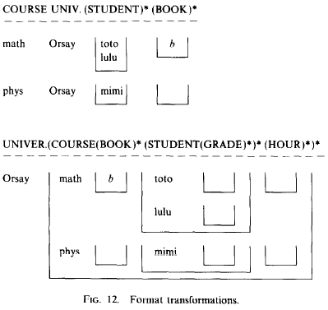
Format Transformation
Notes:
Root permutation, branch permutation, compaction, extension

Slide 18
Outline
Introduction
Verso instance
Format
Operations
Existence dependency
Expressive power of Verso selection
Conclusion

Slide 19
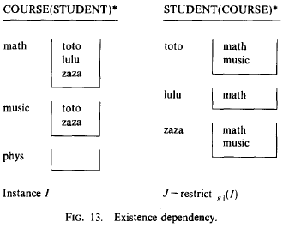
Existence dependency
When restructuring I, we lost the “phys” COURSE
There is no STUDENT registered in the COURSE in I

Slide 20
Outline
Introduction
Verso instance
Format
Operations
Existence dependency
Expressive power of Verso selection
Conclusion

Slide 21
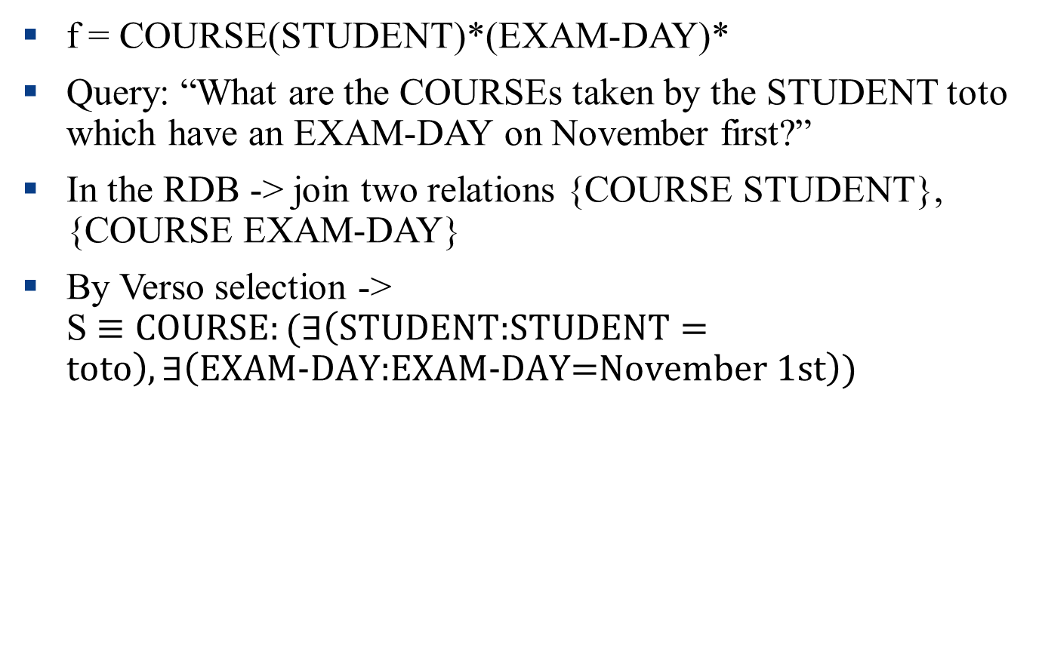
Expressive power of Verso selection
f = COURSE(STUDENT)*(EXAM-DAY)*
Query: “What are the COURSEs taken by the STUDENT toto which have an EXAM-DAY on November first?”
In the RDB -> join two relations {COURSE STUDENT}, {COURSE EXAM-DAY}
By Verso selection -> S $≡\text{COURSE}:(∃\left(\text{STUDENT}\text{:}\text{STUDENT}=\text{toto}\right), ∃\left(\text{EXAM}\text{-}\text{DAY}\text{:}\text{EXAM}\text{-}\text{DAY}\text{=}\text{November}\text{ 1}\text{st}\right))$

Slide 22
Outline
Introduction
Verso instance
Format
Operations
Existence dependency
Expressive power of Verso selection
Conclusion

Slide 23
Conclusion
Nice approach
But, how to implement and optimize?

