Slide 1

Modern Information Retrieval
Ricardo Baeza-Yates and Berthier Ribeiro-Neto
Chapter 7. Text Operations
July 13, 2010
Kangpyo Lee

Slide 2
Contents
Introduction
Document Preprocessing
Text Compression
Trends & Research Issues

Slide 3
Introduction (1)
Goal
To preprocess the text of the documents in the collection to determine the index terms
Observations
Some words carry more meaning than others
Usually, noun words are most representative of a document content
Text operations performed during the preprocessing phase
Elimination of stop words
Stemming
The building of a thesaurus
Compression

Slide 4
Introduction (2)
Why preprocessing?
Using the set of all words in a collection to index its documents generates too much noise for the retrieval task
One way to reduce this noise
To reduce the set of words which can be used to index the documents
Viewed as a process of controlling the size of the vocabulary
The use of a controlled vocabulary leads to an improvement in retrieval performance

Slide 5
Introduction (3)
Opponents
Controlling the size of the vocabulary introduce an additional step in the indexing process which is frequently not easily perceived by the users
E.g. ‘the house of the lord’
Text transformations done at preprocessing time might make it more difficult for the user to interpret the retrieval task
Some Web search engines are giving up text operations entirely & simply indexing all the words in the text
Despite a more noisy index, the retrieval task is simpler (e.g. a full text search) & more intuitive to a common user

Slide 6
Introduction (4)
Precision vs. efficiency
Text normalization & the building of a thesaurus
=> improving the precision of the documents retrieved
Text compression
=> improving the efficiency (in terms of query response time) of the retrieval process in the world of very large digital libraries

Slide 7
Document Preprocessing (1)
Five text operations
(1) Lexical analysis of the text
Treating digits, hyphens, punctuation marks, & the case of letters
(2) Elimination of stopwords
Filtering out words with very low discrimination values for retrieval purposes
(3) Stemming of the remaining words
Removing affixes
Allowing the retrieval of documents containing syntactic variations of query terms
(4) Selection of index terms
Determining which words/stems will be used as an indexing elements
(5) Construction of term categorization structures such as a thesaurus, or extraction of structure directly represented in the text
Allowing the expansion of the original query with related terms

Slide 8
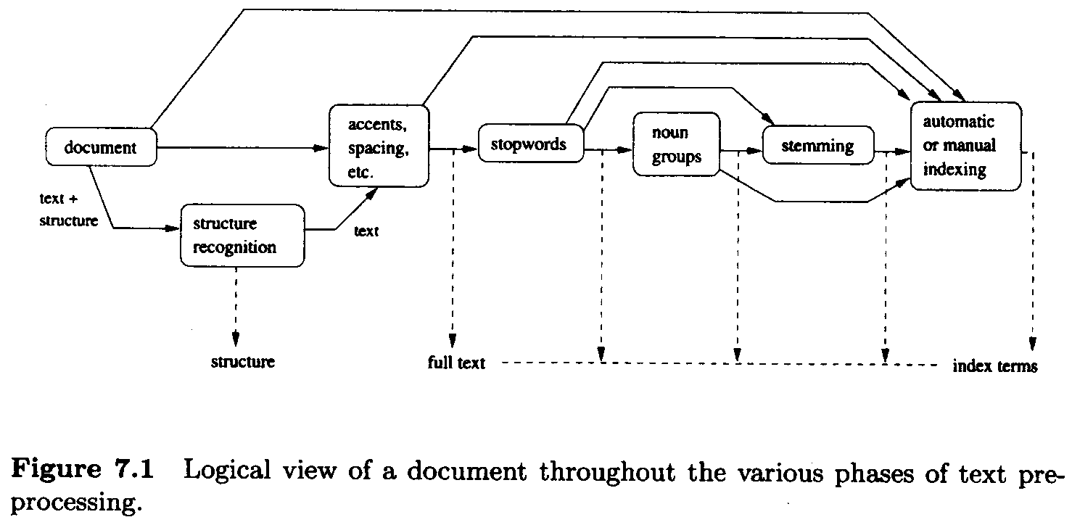
Document Preprocessing (2)
The logical view of the documents which results after each of the above phases is completed

Slide 9
Document Preprocessing (3)
Lexical analysis of the text
Converting a stream of characters into a stream of words
One of the major objectives: the identification of the words in the text
At first glance, recognizing spaces as word separators
Considering with care the following four particular cases
Digits
Hyphens
Punctuation marks
The case of the letters

Slide 10
Document Preprocessing (4)
Lexical analysis of the text (cont’d)
Digits
Numbers are usually not good index terms because they are inherently vague without a surrounding context
E.g. the # of deaths due to car accidents between 1910 & 1989 -> {deaths, car, accidents, years, 1910, 1989} ???
In general, it is wise to disregard numbers as index terms
Digits might appear mixed within a word
E.g. 510B.C.
Removing all words containing sequences of digits unless specified otherwise (through regular expressions)
Hyphens
Breaking up hyphenated words
E.g. state-of-the-art = state of the art
Words which include hyphens as an integral part
E.g. gilt-edge, B-49, etc.
Adopt a general rule & specify the exceptions on a case by case basis

Slide 11
Document Preprocessing (5)
Lexical analysis of the text (cont’d)
Punctuation marks
Normally removed entirely
Very particular scenarios that require the preparation of a list of exceptions
E.g. in a program code, x.id != xid
The case of the letters
Usually not important for the identification of index terms
Normally converting all the text to either lower or upper case
Very particular scenarios that require the distinction
E.g. documents which describe details about the command language of UNIX
Careful thoughts should be given to all these text operations because they might have a profound impact at document retrieval time
This is why some Web search engines are avoiding text operations altogether

Slide 12
Document Preprocessing (6)
Elimination of stopwords
Too frequent among the documents in the collection to be good discriminators
A word which occurs in 80% of the documents in the collection is useless for purposes of retrieval
An additional important impact: reducing the size of the indexing structure considerably!
40% or more solely with the elimination of stopwords
From articles, prepositions, & conjunctions to some verbs, adverbs, & adjectives
In [Frakes & Baeza-Yates, 1992], a list of 425 stopwords is illustrated
Elimination of stopwords might reduce recall
E.g. ‘to be or not to be’

Slide 13
Document Preprocessing (7)
Stemming
Syntactical variations which prevent a perfect match between a query word & a respective document word
E.g. plurals, gerund forms, & past tense suffixes
Stem: the portion of a word which is left after the removal of its affixes (i.e. prefixes & suffixes)
E.g. connect -> connected, connecting, connection, & connections
Thought to be useful for improving retrieval performance
Reducing variants of the same root word to a common concept
Reducing the size of the indexing structure

Slide 14
Document Preprocessing (8)
Stemming (cont’d)
Affix removal stemming is intuitive, simple, & can be implemented efficiently
The most important part is suffix removal
The Porter stemming algorithm
Uses a suffix list for suffix stripping
Applies a series of rules to the suffixes of the words in the text
s → Ø
sses → ss
…
E.g. the word stresses yields the stem stress

Slide 15
Document Preprocessing (9)
Index terms selection
The identification of noun groups
Most of the semantics is carried by the noun words
Noun group: a set of nouns whose syntactic distance in the text does not exceed a predefined threshold
Done through the systematic elimination of verbs, adjectives, adverbs, connectives, articles, & pronouns
Clustering nouns which appear nearby in the text into a single indexing component (or concept)

Slide 16
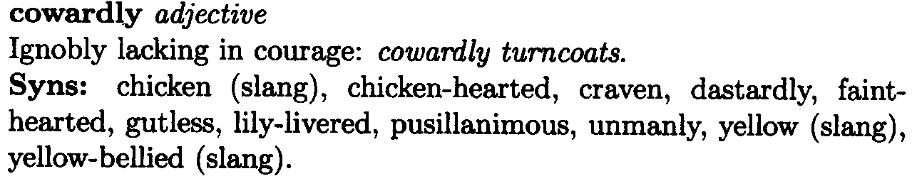
Document Preprocessing (10)
Thesauri
Thesaurus
A reference to a treasury of words (Greek & Latin origins)
A classification scheme composed of words & phrases whose organization aims at facilitating the expression of ideas in a written text
E.g. Roget’s thesaurus
The motivation for building a thesaurus
Using a controlled vocabulary for the indexing & searching
Important advantages
Normalization of indexing concepts
Reduction of noise
Identification of indexing terms with a clear semantic meaning
Retrieval based on concepts rather than on words

Slide 17
Document Preprocessing (11)
Thesauri (cont’d)
Thesaurus index terms
The indexing components of the thesaurus
Used to denote a concept which is the basic semantic unit for conveying ideas
Thesaurus term relationships
Synonyms & near-synonyms
BT: Broader Term
NT: Narrower Term
RT: Related Term
The use of thesauri in IR
Using a thesaurus for assisting the user with the search for related terms
Unfortunately, does not work well in general
Because the relationship captured in a thesaurus frequently are not valid in the local context of a given user query

Slide 18
Text Compression (1) - Motivation
Text compression
About finding ways to represent the text in fewer bits or bytes
By identifying & using structures that exist in the text
Becoming an important issue in an IR environment
Reducing costs associated with space requirements, I/O overhead, & communication delays
Less storage space
Less time to be transmitted over a communication link
Less time to search directly the compressed text
Requiring the time necessary to code & decode the text
A successful idea
Words (rather than characters) are the atoms on which most IR systems are built
These word-based compression methods allow random access to words within the compressed text

Slide 19
Text Compression (2) - Basic Concepts
Two general approaches to text compression
Statistical methods
Rely on generating good probability estimates (of appearance in the text) for each symbol
Modeling: estimating the probability on each next symbol
Coding: converting the symbols into binary digits
Huffman coding & arithmetic coding
Dictionary methods
Substitute a sequence of symbols by a pointer to a previous occurrence of that sequence
No distinction between modeling & coding
Ziv-Lempel family

Slide 20
Trends & Research Issues
Stopwords elimination, stemming, & index terms selection
Controversy regarding the potential improvements to retrieval performance
No conclusive evidence
Some Web search engines index all the words in the text regardless of their syntactic nature or their role in the text
Thesauri
Not clear that automatic query expansion using thesaurus-based techniques can yield improved retrieval performance

Slide 21
Thank You

