Slide 1
Incorporating sentiment into tag-based user profiles and resource profiles for personalized search in folksonomy
Haoran Xie et al.
Information Processing and Management, 52, 2016
26 Feb 2016
Hyewon Lim

Slide 2
Outline
Introduction
The Methodology of SenticRank
Experiment
Conclusion

Slide 3

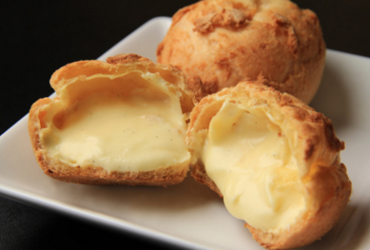
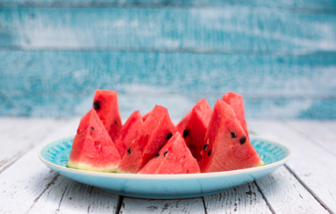


Introduction
Tag-based profile technique
Model users and resources by a vector of relevant tags
dessert
sweet
yummy
food
dessert
fruit
$$\vec{u_{x}}= <dessert :1>$$
$$\vec{r_{a}}= <sweet :1, yummy :1>$$
$$\vec{r_{b}}= <food :1, dessert :1, fruit :1>$$

Slide 4
Introduction
User-generated tags can be very emotional and subjective
Conventional measurements neglect the sentiment aspect of user-generated tag
Build the sentiment links between tags
“creamy” and “sweet” (or “yummy”)
User history:
Query: creamy, food
dessert
sweet
yummy
food
dessert
fruit

Slide 5
Outline
Introduction
The Methodology of SenticRank
Experiment
Conclusion

Slide 6
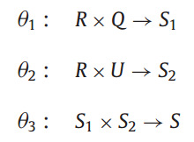
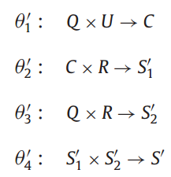

The Methodology of SenticRank
SenticRank
A generic framework of incorporating sentiments into tag-based profiles for personalized search
Problem formulation
$$θ :U×R×Q→S$$
Users, resources, queries, and the set of ranking scores
Content-based method
Collaborative method
→ Resource content relevance
→ find a set of similar users
→ User interest relevance

Slide 7
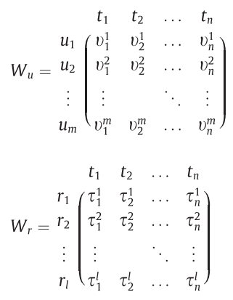





The Methodology of SentiRank
Mapping tag spaces to sentiment spaces
$$η : 𝕎→𝕍$$
$$V=W⊙D$$
Sentiment dimension
d₁
d₂
d_{x}
Tag/ term
Tag-based user/resource profile
Sentiment-based user/resource profile
$\vec{u_{i}}=(t_{1} :υ_{1}^{i},t_{2} :υ_{2}^{i}$, …, $t_{n} :υ_{n}^{i}$)
$\vec{u_{i}^{∗}}=(d_{1} :ε_{1}^{i},d_{2} :ε_{2}^{i}$, …, $d_{n} :ε_{n}^{i}$)
$\vec{r_{a}}=(t_{1} :τ_{1}^{a},t_{2} :τ_{2}^{a}$, …, $t_{n} :τ_{n}^{a}$)
$\vec{r_{a}^{∗}}=(d_{1} :ε_{1}^{a},d_{2} :ε_{2}^{a}$, …, $d_{n} :ε_{n}^{a}$)

Slide 8
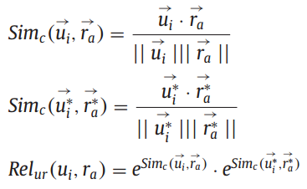


The Methodology of SentiRank
Content-based sentiment rank
User interest relevance
Resource content relevance
Final score for candidate resources ranking
* Alternatives of similarity to replace cosine similarity:
Euclidean distance, Manhattan distance, …
: tag-based resource profile similarity
: sentiment-based resource profile similarity

Slide 9


The Methodology of SentiRank
Collaborative sentiment rank
Discover a set of similar users
Final score for candidate resources ranking

Slide 10




The Methodology of SentiRank
Sentiment vector (SenticNet 3.0)
$$\vec{u_{x}}= <dessert :1.0>$$
$$\vec{r_{a}}= <sweet :0.7, yummy :0.9>$$
$$q=(creamy, food)$$
 | pleasantness | attention | sensitivity | aptitude | polarity
dessert | +0.092 | -0.051 | +0.000 | +0.000 | +0.048
creamy | +0.092 | +0.000 | +0.028 | +0.134 | +0.066
food | +0.055 | +0.000 | +0.028 | +0.089 | +0.039
sweet | +0.112 | +0.000 | +0.000 | +0.141 | +0.084
yummy | +0.076 | +0.000 | +0.028 | +0.113 | +0.063
$$\vec{r_{a}^{∗}}=(+0.1468,+.0.000,+0.0252,+0.2004,+0.1155)$$
$$=0.7 ×0.112+0.9×0.076$$
$$\vec{q^{∗}}=(+0.0735,+0.0000,+0.00280,+0.1115,+0.525)$$
: equal weight

Slide 11


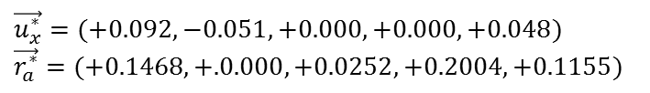

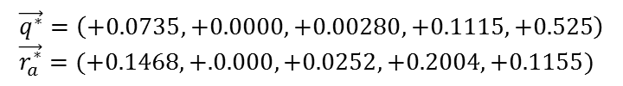
The Methodology of SentiRank
Final ranking score =
User interest relevance * Resource content relevance
User interest relevance
Tag-based cosine similarity = 0
Sentiment-based cosine similarity = 0.5989
Final ranking score
Resource content relevance
$$\vec{u_{x}}= <dessert :1.0> \\ \vec{r_{a}}= <sweet :0.7, yummy :0.9>$$
$$\vec{u_{x}^{∗}}=(+0.092,−0.051,+0.000,+0.000,+0.048)$$
$$\vec{r_{a}^{∗}}=(+0.1468,+.0.000,+0.0252,+0.2004,+0.1155)$$
$$\vec{q^{∗}}=\left(+0.0735,+0.0000,+0.00280,+0.1115,+0.525\right) \\ \vec{r_{a}^{∗}}=(+0.1468,+.0.000,+0.0252,+0.2004,+0.1155)$$

Slide 12
Outline
Introduction
The Methodology of SenticRank
Experiment
Conclusion

Slide 13
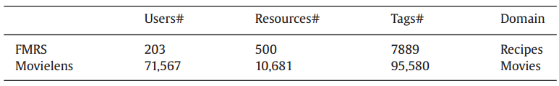
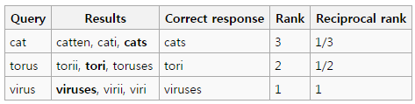
Experiment
Dataset
Metrics
P@N: Precision
Measure the accuracy of a particular search strategy
MRR (Mean Reciprocal Rank)
How quickly a search strategy can assist users to finding their desired resources
MRR = (1/3 + 1/2 + 1)/3 = 11/18
* from Wikipedia: https://en.wikipedia.org/wiki/Mean_reciprocal_rank

Slide 14
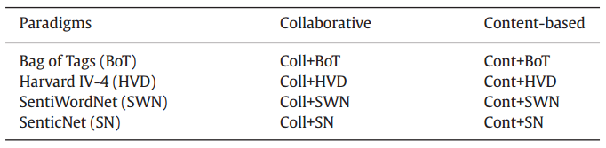
Experiment
Methods
BoT: only use of tag-based profiles
HVD: 10,000+ words, sentiments belong to 15 groups
SWN: based on WordNet, 117,659 words
SN: 30,000 affect-driven concepts, polarity and 4 sentiment dimensions
Coverage in Movielens
40.5%, 42.8% and 77.4% respectively

Slide 15
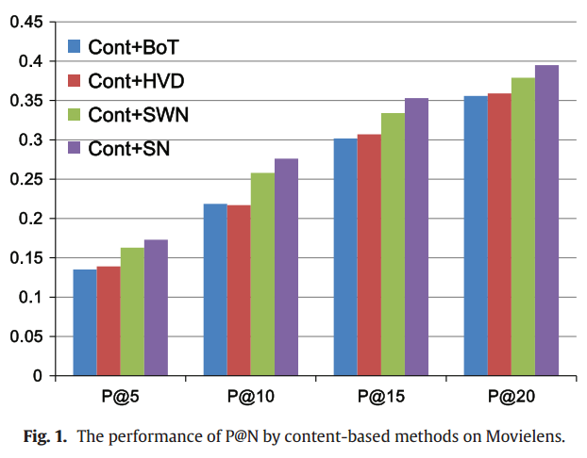
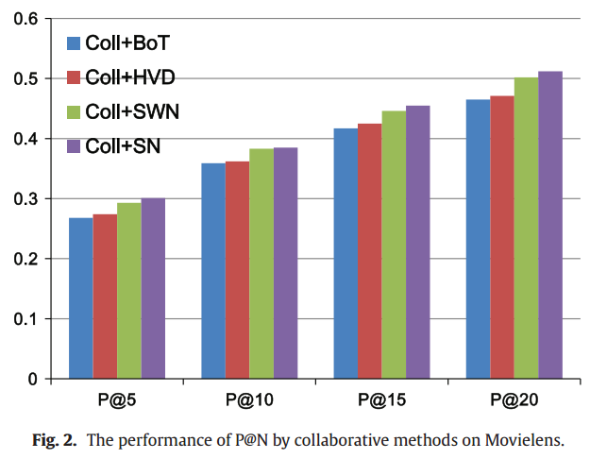
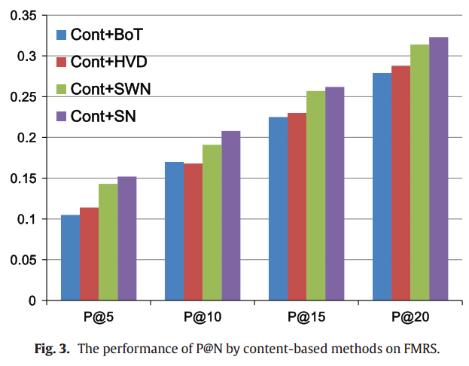
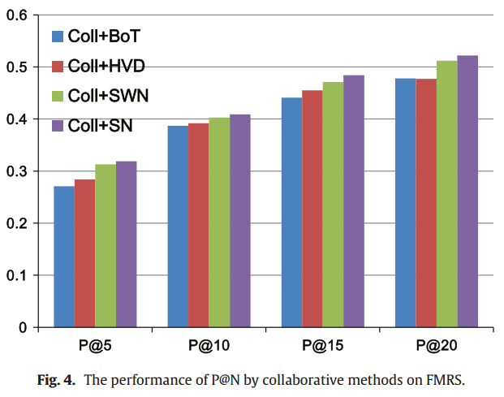
Experiment
Overall performance
Movielens
FMRS
Notes:
1) Tag에 sentiment를 쓰면 좋다
2) Cont < coll
3) Sentiment dictionary에 따라 영향을 받는다
4) 데이터 셋의 크기나 종류에 구애받지 않는다

Slide 16
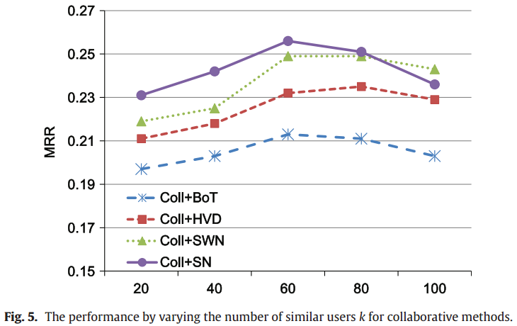
Experiment
Influence of parameters and alternatives
The impact of k
The impact of similarity measurements
Does not significantly influence the performance
The values of MRR: Sim_{c} = 0.151, Sim_{e} = 0.148, Sim_{n} = 0.152
(Cosine similarity, inverse of Euclidean distance, inverse of Manhattan distance)

Slide 17
Conclusion
Future work
For the relevance scores
Studying impact of various aggregation functions
For the issue of ambiguity in tags
Employing the context-aware techniques of sentiment
To obtain more powerful user profile
Integrating user profile enrichment techniques

