Slide 1
Java Servlet & JSP
SNU OOPSLA Lab.
October 2005

Slide 2
Contents
Overview
History
CGI vs. Java Servlet
Java Servlet vs. JSP
How Servlet Works
Servlet Example
How JSP Works
JSP Container
JSP Constructs and Examples
Online Resources

Slide 3
Overview(1/3)
What is servlet?
  Servlet is platform-independent, server-side Java component which extend an HTTP server
    Like mini web server
    HttpServlet – Dynamic page generation(HTML, XML, ...)
  Superior to inefficient CGI and proprietary APIs(ISAPI, NSAPI, ...)

Slide 4
Overview(2/3)
What is JSP(Java Server Page)?
  JSP separates content presentation from content generation
  Provides a simple and fast way to build dynamic page content(HTML, XML, etc)
  HTML with embedded Java code
  Extensible with components & custom tags
JSP and ASP
  similar, but the differences are
    ASP is based on MS-specific technologies such as IIS, Visual Basic
    JSP can be applied to much more platforms such as Solaris, Linux, FreeBSD without any kind of code-level conversion

Slide 5
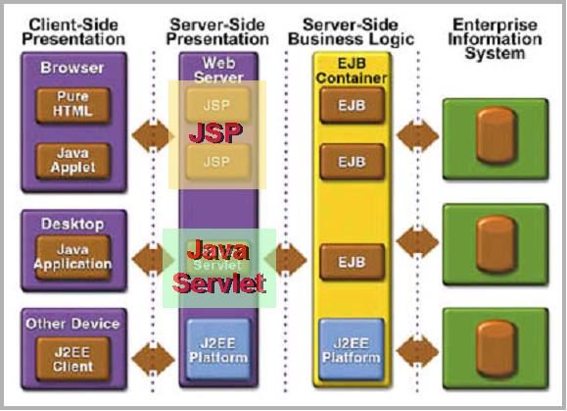
Overview(3/3)
The J2EE Architecture

Slide 6
History(1/2)
History of Java Servlet
  Sun introduced Java Servlet in 1996
  Java Servlet Developers Kit released in 1997
  J2EE 1.3 beta released in 2001, which contained servlet 2.3
  J2EE 1.4 released in 2005, which contained servlet 2.4

Slide 7
History(2/2)
History of JSP
  James Gosling’s work on a Web Server in Java in 1994/1995 became the foundation for servlets
  A larger project emerged in 1996 with Pavani Diwanji as lead engineer
  The JSP group, with Larry Cable and Eduardo Pelegri-Llopart as leads, delivered JSP 1.0 in 1999 June and JSP 1.1 in 1999 December
  The JSP 1.2 specification went final in 2001, which added the ability for validating JSP pages through the XML views of a JSP page
  JSP 2.0 released in 2003, which included a simple Expression Language, tag files, substantial simplifications for writing tag handlers in Java and the notion of JSP fragments

Slide 8
CGI vs. Java Servlet(1/2)
CGI
Earliest technology used for dynamic web generation
HTTP requests are served by programs written in C, C++, Perl etc.
It has drawback of creating separate process for each user request ➔ Lack of Scalability
Java Servlet
Java classes are loaded dynamically to expend server functionality
Requests are efficiently handled by threads

Slide 9
CGI vs. Java Servlet(2/2)
Browser 1
CGI 1
Web
Server
Browser 2
CGI 2
Browser N
CGI N
CGI
Web
Client
Web
Server
HTTP Request
HTTP Response
Servlet
API
Servlet
Servlet

Slide 10
JSP and Servlet
JavaServer Pages are based on Servlet technology
  JSP container is a Servlet
  Each JSP is compiled into runtime Servlet
  Same performance and portability benefits from Servlet technology but with the ease of use of markup language
Best of both worlds for web designers and web developers

Slide 11
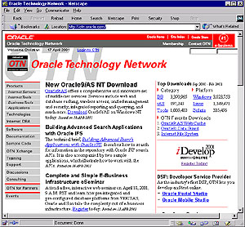
How Servlet Works
Http Client
doGet() {
Process request from Client using Request object;
Send response to client via the Response object;
}
Request
Response
Session

Slide 12
Servlet Example(1/3)
javax.servlet.GenericServlet
javax.servlet.Servlet
javax.servlet.http.HttpServlet
your servlet
public class HelloServlet extends HttpServlet {
public void doGet(HttpServletRequest request,
HttpServletResponse response)
throws ServletException, IOException
{
PrintWriter out = response.getWriter();
out.setContentType(“text/html”);
out.println("<html><body>");
out.println(”<h1>Hello There!</h1>");
out.println("</body></html>");
out.close();
}

Slide 13
Servlet Example(2/3)
public class FormServlet extends HttpServlet {
public void doPost(HttpServletRequest request,
HttpServletResponse response)
throws ServletException, IOException
{
PrintWriter out = response.getWriter();
out.setContentType(“text/xml”);
out.println("<?xml version=\"1.0\"?>");
out.println("<Employee>”);
out.println(“<Name>Bob</Name>”);
out.println("<Empno>12345</Empno>”);
out.println("</Employee>”);
out.close();
}

Slide 14
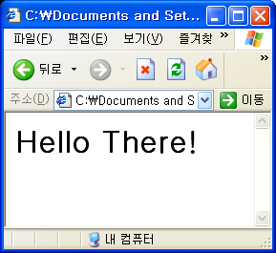
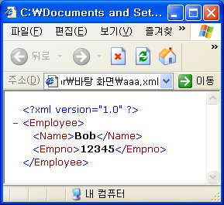
Servlet Example(3/3)
Results
HelloServlet
FormServlet

Slide 15
How JSP Works
JSP
Java
Servlet
Translator
Compiler
Runner
JSP
Source
Hello.jsp
Generated
file
Hello.java
Output
of Hello
HTML /XML
Servlet class
Hello
JSP runtime

Slide 16
JSP Container
Servlet/JSP requires a Container
Apache Tomcat is the reference implementation of the Servlet/JSP Specs
It is open source, small, install quickly,and is FREE
Web Site: http://jakarta.apache.org/tomcat
It include a simple HTTP 1.1 server, good enough for development and small intranets

Slide 17
JSP Constructs and Examples
JSP Constructs
  Comment
  Declaration
  Expression
  Scriptlet

Slide 18
JSP Constructs and Examples – Comment
Generates a comment that is sent to the client
Comment Types
  HTML Comment: <!-- comment -->
  JSP Comment: <%-- comment --%>
  Java Comment: // comment, /* comment */
Example
<html>
<body>
<!– HTML Comment -->
<%-- JSP Comment --%>
<%
// Java Comment
/* Java Comment */
%>
</body>
</html>

Slide 19
JSP Constructs and Examples – Declaration
Declares a variable or method
Syntax
  <%! declarations %>
Example
<%!
boolean isSameString(String a, String b) {
return a.equals(b);
}
%>
<html>
<body>
bjlee and hjk is
<%= isSameString(“bjlee”,“hjk”) ? “” : “not” %>
same string
</body>
</html>

Slide 20
JSP Constructs and Examples – Expression
Scripting language expression that is evaluated and converted to ‘String’
Syntax
  <%= expression %>
Example
<html>
<body>
<%
for (int i = 0; i < 10; i++) {
%>
<%= i %>,
<%
}
%>
</body>
</html>

Slide 21
JSP Constructs and Examples – Scriptlet
Contains a code fragment valid in the page
Syntax
  <% code fragment %>
Example
<%@ page import=“java.util.*” %><%-- java class import --%>
<html><body bgcolor=“white”>
<%
String name = “Byung-Joon Lee”;
StringTokenizer st = new StringTokenizer(name, “ “);
while ( st.hasMoreTokens() ) {
%>
<%= st.nextToken() %>
<%
}
%>
</body></html>

Slide 22
Online Resources
The Java Programming Language Second Edition, Ken Arnold and James Gosling, Addison-Wesley
Online Courses - Tutorials & Training: Beans, http://java.sun.com/developer/onlineTraining/Beans/
JSP Core Syntax reference for Tomcat

