Slide 1
Introduction to Ensemble Methods
Heymo Kou
Jan 2nd, 2017

Slide 2
Contents
Ensemble learning
Voting
Bootstrap resampling
Bagging
Boosting
Adaboost
Stacking
Performance comparison
Example using Scikit-learn

Slide 3
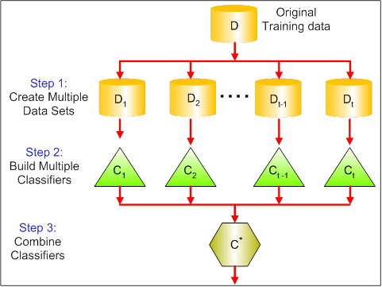
Ensemble Learning
Basic idea
Build different experts
Let them vote
Combine multiple learners
Homogenous
Identical learners
Heterogenous
Different learners
Proof of ensemble model works

Slide 4
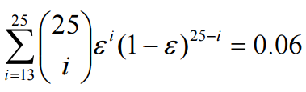
Why ensemble works
Suppose there are 25 base classifiers
Each classifier has error rate, ε = 0.35
Assume classifiers are independent
Probability that the ensemble classifier makes a wrong prediction:

Slide 5
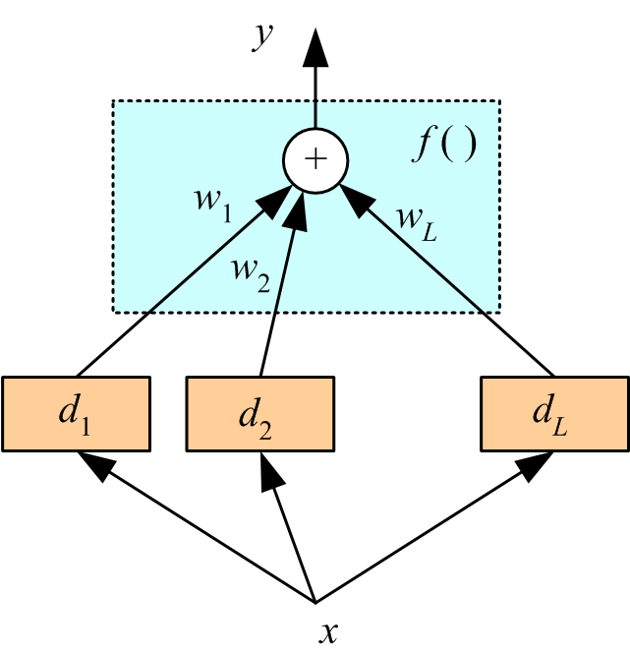

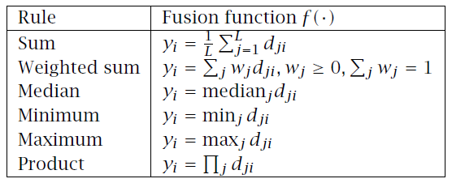
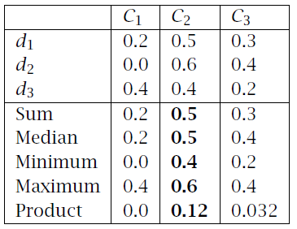
Voting
Democratic decision making
Linear combination
Lecture Notes for E Alpaydın 2010 Introduction to Machine Learning 2e © The MIT Press (V1.0)

Slide 6
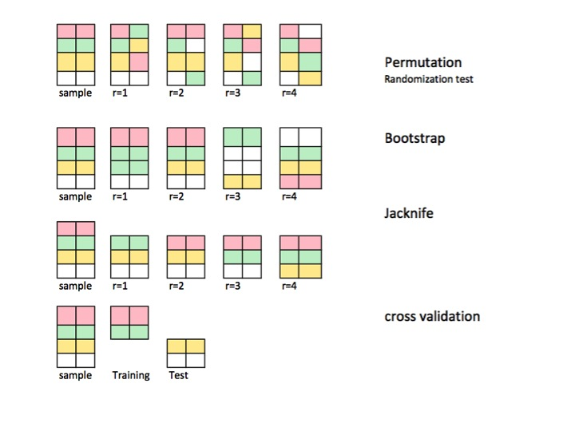
Bootstrapping Resampling [Bradley Efron 1992]
Bootstrapping
Resample with replacement
http://stats.stackexchange.com/questions/104040/resampling-simulation-methods-monte-carlo-bootstrapping-jackknifing-cross
Notes:
Breakthroughs in Statistics
Subsampling
Sampling without replacement

Slide 7
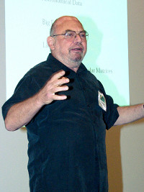
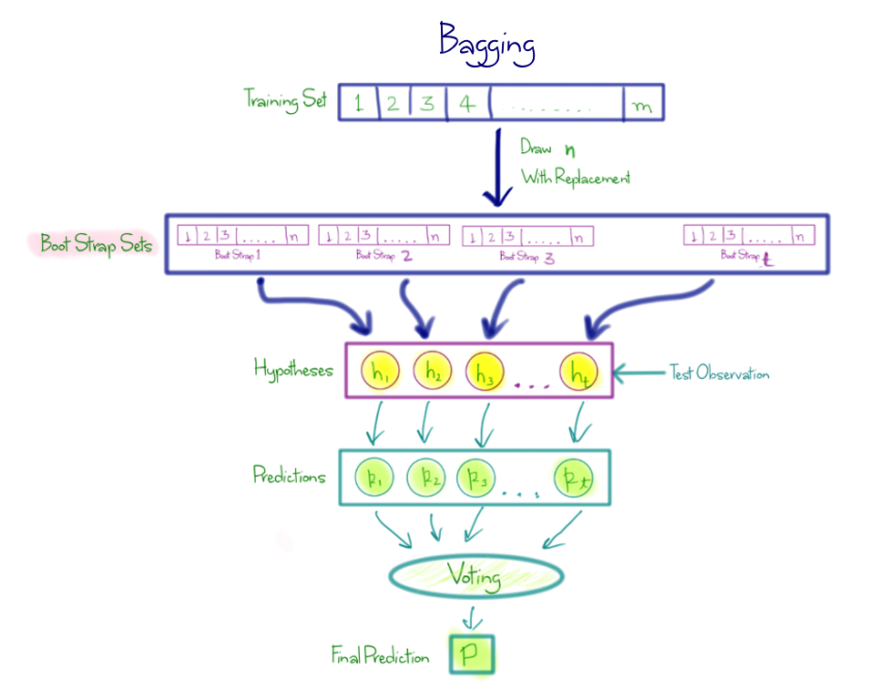
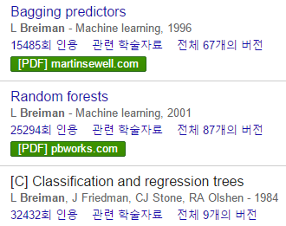
Bagging
Bootstrap AGGregatING (BAGGING)
Bagging Predictors [Leo Breiman 1996]
Notes:
Machine Learning Journal 1996

Slide 8
Boosting [Michael Kearns, 1988]
Machine Learning class project
Thoughts on Hypothesis Boosting
http://www.cis.upenn.edu/~mkearns/papers/boostnote.pdf
“Does there exist a boosting algo that turns a weak learner into a strong learner?”
Weak learning
Predict better than random guessing
Notes:
(that can produce arbitrarily accurate hypotheses)

Slide 9
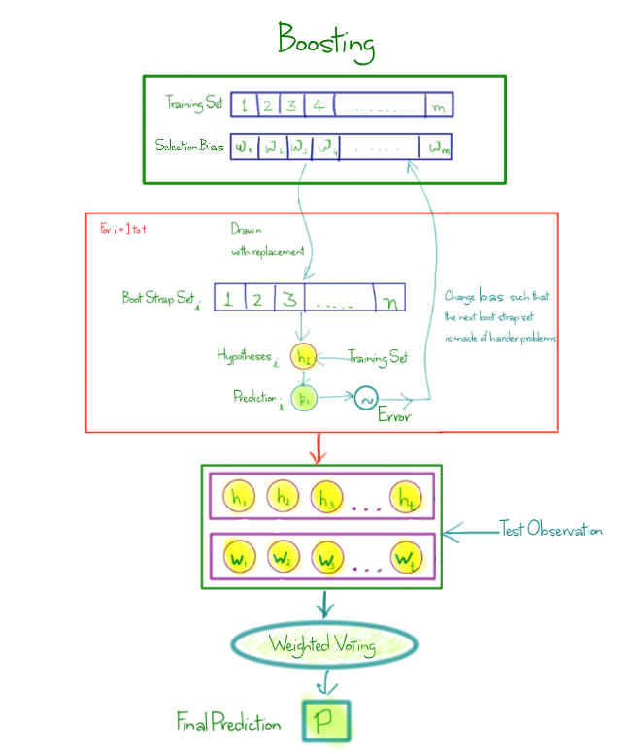
AdaBoosting
Adaptive Boosting
Very general
Any weak learner

Slide 10
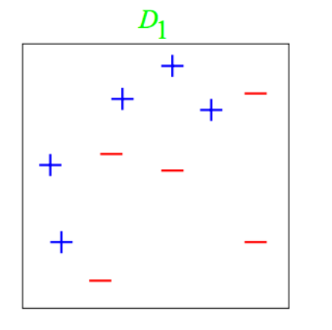
Adaboost : Example [1/3]
Weak classifiers
Vertical or horizontal half-planes (decision stumps)

Slide 11
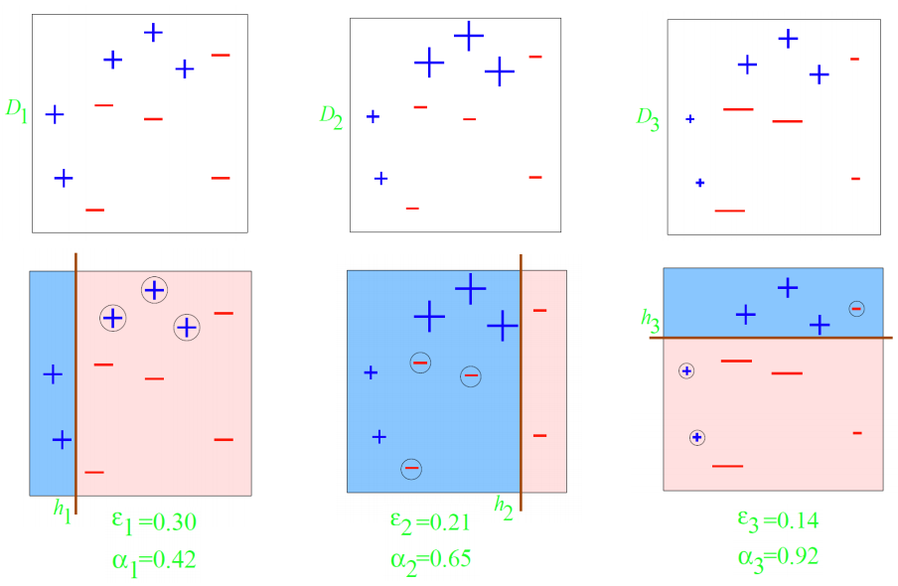
Adaboost : Example [2/3]

Slide 12
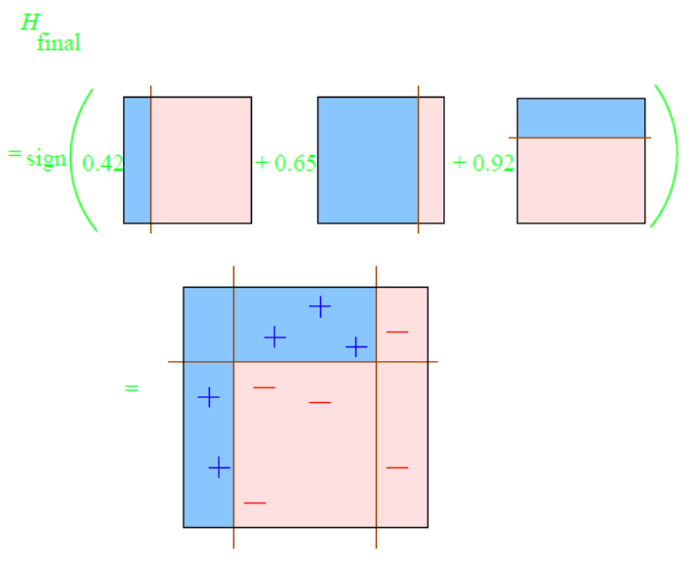
Adaboost : Example [3/3]

Slide 13
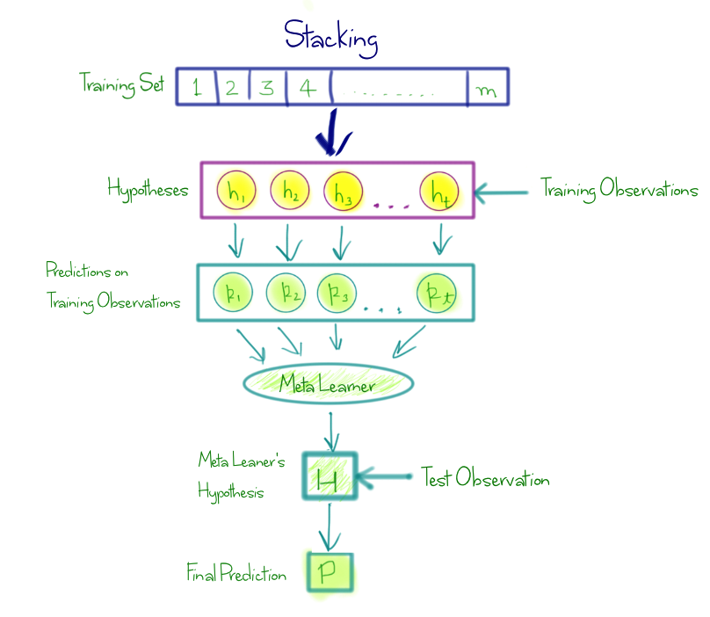
Stacking [David H. Wolpert 1992]
Stacked Generalization
2 layers of learner
Basic learner
Meta learner
Learn learner’s pattern

Slide 14
Ensemble Selection
Training S’
H = {2000 models trained using S’}
Validation V’
S
Maintain ensemble model as combination of H:
h(x) = h₁(x) + h₂(x) + … + h_{n}(x)
+ h_{n+1}(x)
Denote as h_{n+1}
Add model from H that maximizes performance on V’
Repeat
Models are trained on S’
Ensemble built to optimize V’
Caruana, Rich, et al. "Ensemble selection from libraries of models." Proceedings of the twenty-first international conference on Machine learning. ACM, 2004.

Slide 15
An Empirical Evaluation of Supervised Learning in High Dimensions [Caruana et al., ICML 2008]
Better
ANN | Artificial Neural Network
BAGDT | Bagged Decision Tree
BSTDT | Boosted Decision Tree
KNN | K-nearest neighborhoods
SVM | Support Vector Machine
LR | Logistic Regression
BSTST | Boosted stumps
PRC | Perceptron
RF | Random Forest
Kent Ridge Bio-medical Dataset http://datam.i2r.a-star.edu.sg/datasets/krbd/

Slide 16
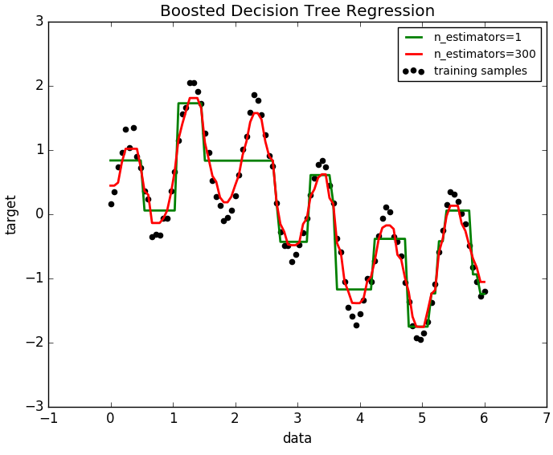
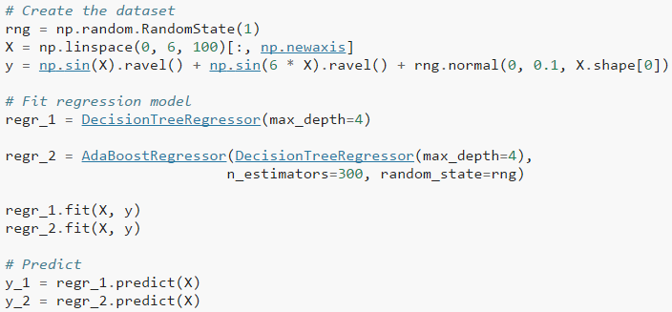
Sample using Scikit-learn [1/2]
ML Package in Python
Current version 0.18.1
http://scikit-learn.org
Decision Tree Regression VS Adaboosted DTR
http://scikit-learn.org/stable/auto_examples/ensemble/plot_adaboost_regression.html#sphx-glr-auto-examples-ensemble-plot-adaboost-regression-py

Slide 17
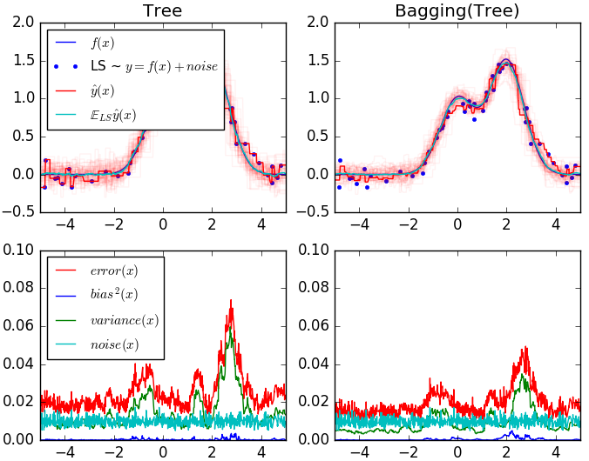
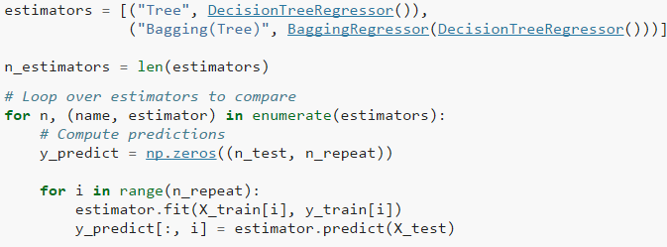
Sample using Scikit-learn [2/2]
Bagged Decision Tree Regression
http://scikit-learn.org/stable/auto_examples/ensemble/plot_adaboost_regression.html#sphx-glr-auto-examples-ensemble-plot-adaboost-regression-py

Slide 18
Summary
Bagging
Keep models
Strong to noisy data
Simplest way
Not recommend to use on stable classifiers
Boosting
Combine models
Tends to achieve greater accuracy than that of bagging

Slide 19
Reference
Caruana, Rich, Nikos Karampatziakis, and Ainur Yessenalina. "An empirical evaluation of supervised learning in high dimensions." Proceedings of the 25th international conference on Machine learning. ACM, 2008.
Lecture Notes for E Alpaydın 2010 Introduction to Machine Learning 2e © The MIT Press (V1.0)
http://www.scholarpedia.org/article/Ensemble_learning
Efron, Bradley. "Bootstrap methods: another look at the jackknife." Breakthroughs in Statistics. Springer New York, 1992. 569-593.
Caruana, Rich, et al. "Ensemble selection from libraries of models." Proceedings of the twenty-first international conference on Machine learning. ACM, 2004.

