Slide 1
SEEKING STABLE CLUSTERS
IN THE BLOGOSPHERE
VLDB 2007, VIENNA
Nilesh Bansal, Fei Chiang, Nick Koudas
University of Toronto
Frank Wm. Tompa
University of Waterloo
SNU IDB Lab.
Chung-soo Jang
MAR 21, 2008

Slide 2
Content
Introduction
Related Work
Cluster Generation
Stable Clusters
  Cluster Graph
  Breadth First Search
  Depth First Search
  Adapting the Threshold Algorithm
  Normalized Stable Clusters
  Online Version
Experiments
  Cluster Generation
  Stable Clusters
  Qualitative Results
Conclusions

Slide 3
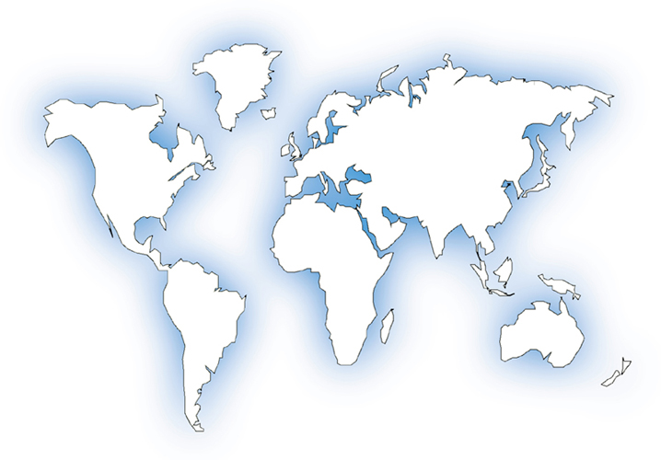







Introduction (1)
The Blogosphere
67M KNOWN BLOGS
100K NEW EVERYDAY
DOUBLING EVERY 200 DAYS

Slide 4
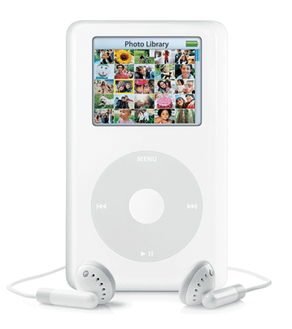
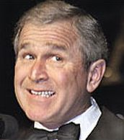


Introduction (2)
What are they writing about in blogosphere?
PERSONAL LIFE
PRODUCT REVIEWS
POLITICS
TECHNOLOGY
TOURISM
SPORTS
ENTERTAINMENT

Slide 5

Introduction (3)
Why should we care?
  Huge data repository
  Will continue to grow
  Extracting public opinions
  Valuable insights
    MARKET RESEARCH
    PUBLIC RELATION STRATEGIES
    CUSTOMER OPINION TRACKING

Slide 6
Introduction (4)
The Blogoscope
  University of Toronto
  Live blog search and analysis engine
  Tracking over 13 million blogs, 100 million posts
  Serves thousands of daily visitors
  Visit: www.blogscope.net

Slide 7
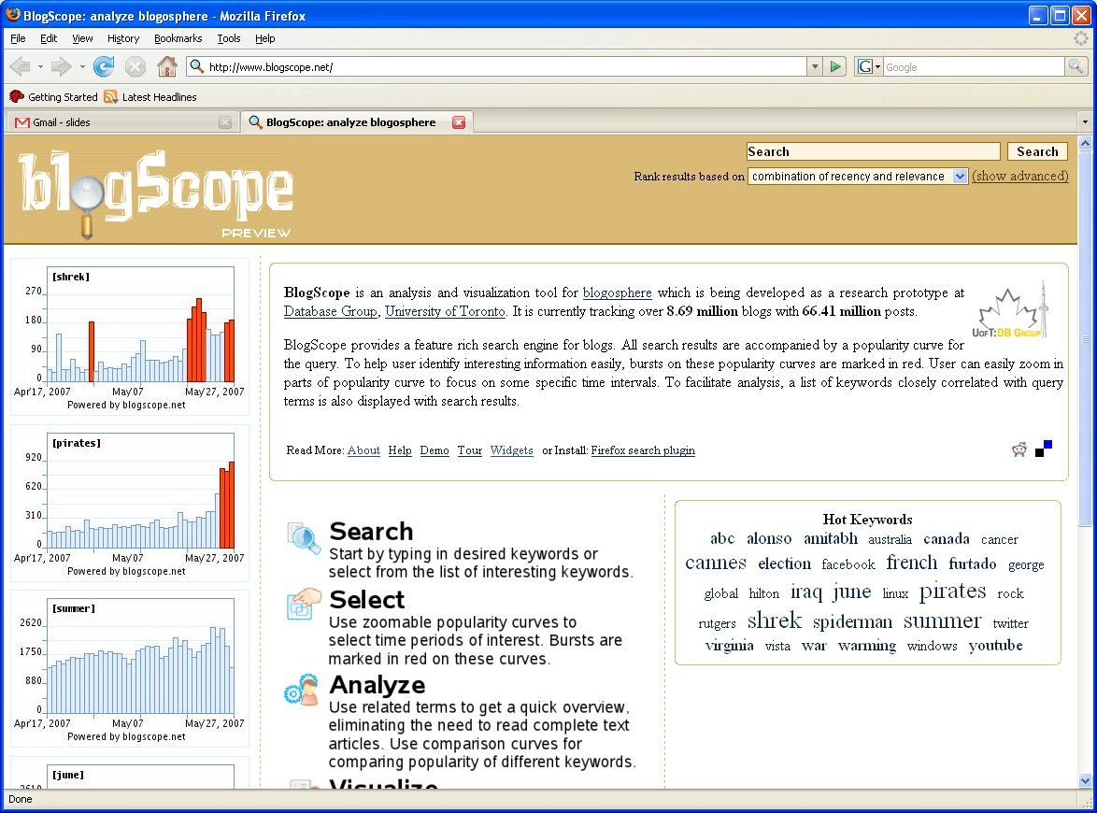
Introduction (5)
The Blogoscope
Hot
Keywords

Slide 8
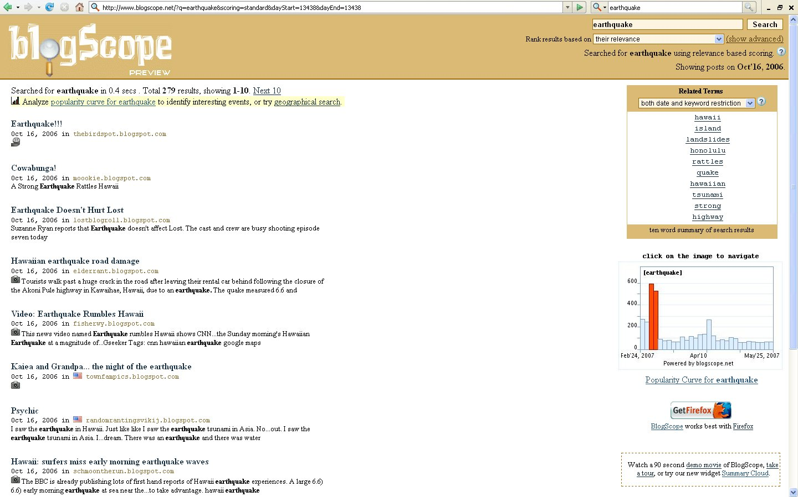
Geo
Search
Related
Terms
Search
Results
Popularity
Curve

Slide 9
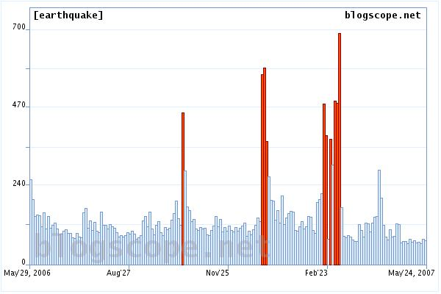
Taiwan
Undersea
Earthquake
Sumatra Earthquake
Hawaii Earthquake

Slide 10
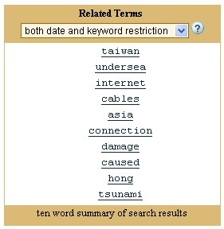
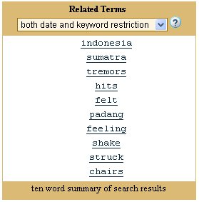
December 15 2006
March 06 2007

Slide 11
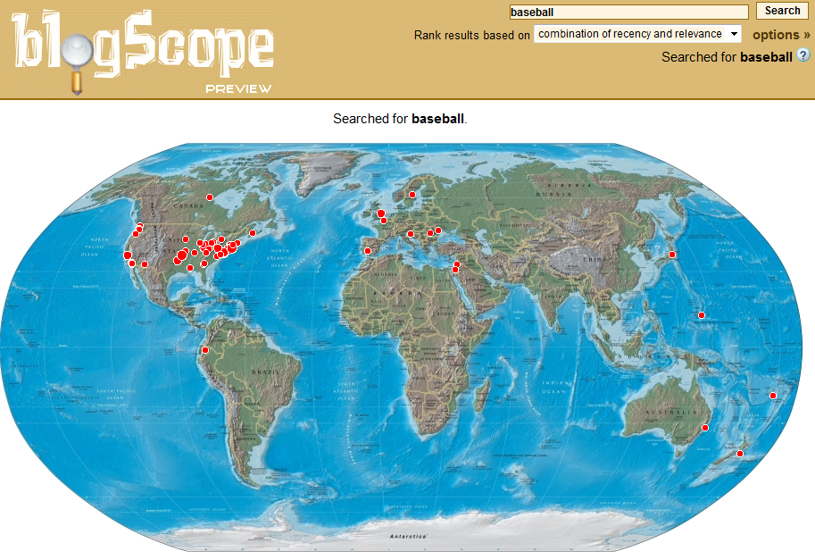
Baseball ON JAN 09 2007

Slide 12
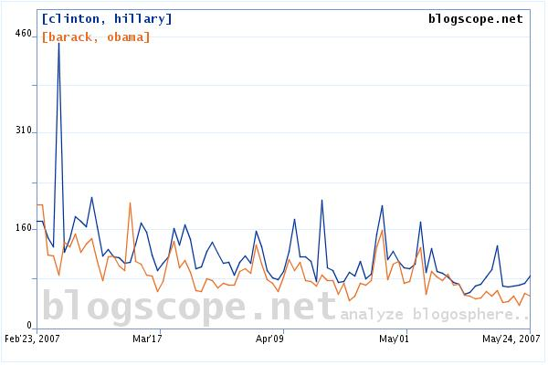

Slide 13
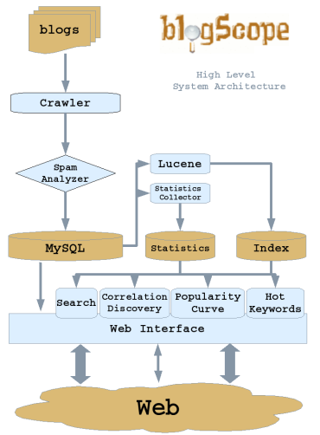




Slide 14
Introduction (5)
Challenges and opportunities
  Various stories => Topics evolve => keywords align together
  A specific topic or event => A set of keywords forming a cluster.
    Note that such keyword clusters are temporal (associated with specific time periods) and transient.
      As topics recede, associated keyword clusters dissolve, because their keywords do not appear frequently together anymore.
    Identifying such clusters for specific time intervals is a challenging problem.
  Our Goal: Finding persistent chatter (keyword cluster)

Slide 15
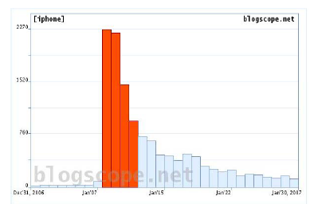
Introduction (6)
Persistent Chatter
  Apple iPhone – January 2007
    Jan first week: Anticipation of iPhone release
    Jan 9th: iPhone release at Macworld
    Jan 10th: Lawsuit by Cisco
    Jan third week: Decrease
    in chatter about iPhone

Slide 16
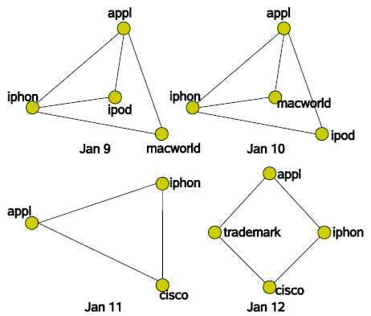
Introduction (7)
Stable Clusters - Apple iPhone
  Persistent for 4 days
    Topic drifts
    Starts with
    discussion about
    Apple in general
    Moves towards
    the Cisco lawsuit

Slide 17
Introduction (8)
Why stable cluster?
  Information Discovery
    Monitor the buzz in the Blogosphere
    “What were bloggers talking about in April last year?”
  Query refinement and expansion
    If the query keyword belongs to one of the cluster, good
  Visualization?
    Show keyword clusters directly to the user

Slide 18
Introduction (9)
Contribution in this paper
  Efficient algorithm to identify keyword clusters
    BlogScope data contains over 13M unique keywords
    Applicable to other streaming text sources
      Flickr tags, News articles
  Formalize the notion of stable clusters
  Efficient algorithms to identify stable clusters
    BFS, DFS and TA
    Amenable to online computation over streaming data
  Using real dataset, experimental evaluation

Slide 19
Content
Introduction
Related Work
Cluster Generation
Stable Clusters
  Cluster Graph
  Breadth First Search
  Depth First Search
  Adapting the Threshold Algorithm
  Normalized Stable Clusters
  Online Version
Experiments
  Cluster Generation
  Stable Clusters
  Qualitative Results
Conclusions

Slide 20
Related Work (1)
Graph partitioning
  A topic of active research topic
  A k-way graph partitioning
    Graph G
    => K mutually exclusive subsets of vertices of approximately the
    same size such that the number of edges of G that belong to
    different subsets is minimized.
    NP-HARD
    Several heuristic technique
      Especially, multilevel graph bisection
        Kernighan-Lin based on cut-size reduction when changing node
      Constraint that number of partitions has to be specified in advance

Slide 21
Related Work (2)
Correlation clustering
  Drop of this constraint
  Production of graph cuts
    Given a graph in which each edge is marked with a ‘+’ or a ‘-’, correlation clustering produces a partitioning of the graph such that the number of ‘+’ edges within each cluster and the number of ‘-’ edges across clusters is maximized.
  NP-HARD
  Several approximation algorithms
    Very interesting theoretically, but far from practical.
    Moreover the existing algorithms require the edges to have binary labels, which is not the case in the applications we have in mind.

Slide 22
Related Work (3)
Alternative formulation of graph clustering
  Flake’s Solving the problem using network flows.
  Drawback
    A sensitivity parameter ∂ before executing the algorithm, and the
    ∂ choice of affects the solutions produced significantly.
    The running time of such an algorithm is prohibitively large
    O(V E), for V vertices and E edges, both of which are in the order of millions in our problem.
    required six hours to conduct a graph cut on agraph with a few thousand edges and vertices.)
    Unclear how to set parameters of this algorithm, and no guidelines

Slide 23
Related Work (4)
Measures for evaluating clusters
  Been utilized in the past to assess associations between keywords in a corpus
    We employ some of these techniques to infer the strength of association between keywords during our cluster generation process.

Slide 24
Content
Introduction
Related Work
Cluster Generation
Stable Clusters
  Cluster Graph
  Breadth First Search
  Depth First Search
  Adapting the Threshold Algorithm
  Normalized Stable Clusters
  Online Version
Experiments
  Cluster Generation
  Stable Clusters
  Qualitative Results
Conclusions

Slide 25
Cluster Generation (1)
Definitions for organizing keyword graph
  D: the set of interesting text documents
  D∈ D: represented as a bag of words
  u, v: kewords
  AD(u, v): 1, if both u and v are present in D
  0, otherwise
  A(u,v)=∑D∈DAD(u, v): the count of documents in D that
  contains both u and v
  Triplets of the form (u, v, A(u,v))
  V: the union of all keywords in these triplets

Slide 26
Cluster Generation (2)
Definitions for organizing keyword graph
  Triplets of the form (u, v, A(u,v))
    Each triplet represents an edge E with weight A(u, v) in graph G over vertices V
  A(u) : the number of documents in D containing the keyword u
  A(u, ‾u): the number of documents containing u but not v.

Slide 27
Cluster Generation (3)
BlogScope crawler
  fetches all newly created blog posts at regular time intervals.
  D: the set of all blog posts created in a temporal interval
  A(u, v) : the number of blog posts created in the selected temporal interval containing both u and v.
  Indexing around 75 million blog posts, and fetches over 200,000 new posts everyday.
  Needs for the effective computation of the triplets (u, v,A(u, v))

Slide 28

Cluster Generation (4)
The process of computation of the triplets
  [pass 1]
  [pass 2]
    Stemming and removal of stop words
  [pass 3]
    All keyword pairs , A(u)=(u, u)
  [pass 3]
    A file with all keyword pair sorted lexicography => triplets
{D}

Slide 29
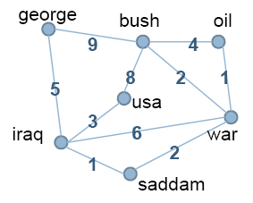
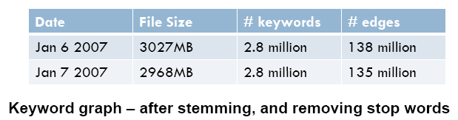
Cluster Generation (5)
The result of computation of the triplets

Slide 30
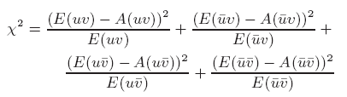
Cluster Generation (6)
The result of computation of the triplets
  Filtering process
    Given graph G, we first infer statistically significant associations between pairs of keywords in this graph.
    Null Hypothesis
      if one keyword appears in n1 fraction of the posts and another keyword in a fraction n2 we would expect them both to occur together in n1n2 fraction of posts.
    The test of null hypothesis
      c

Slide 31
Cluster Generation (7)
The result of computation of the triplets
  Filtering process
  In Χ square test, if , u and v are correlated at
  the 95% confidence level.
    => Null hypothesis (True)
    This test can act as a filter omitting edges from G not correlated according to the test at the desired level of significance.

Slide 32

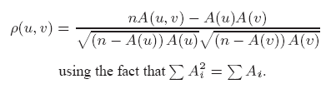
Cluster Generation (8)
The result of computation of the triplets
  How about a correlation strength?
    Χ square test doesn’t capture a correlation strength
    So we need other measure for a correlation strength
    d

Slide 33
Cluster Generation (9)
The result of computation of the triplets
  P(u, v)
    Criteria between strong correlation and a week correlation
    Reduced by eliminating all edges with values of less than a specific threshold. (p> 0.2)
    Importance of correlations
      The strong ones offer good indicators for query refinement (e.g., for a query keyword we may suggest the strongest correlation as a refinement)
      Help for tracking the nature of ‘chatter’ around specific keywords.

Slide 34
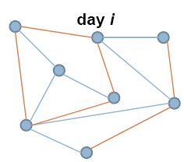
Cluster Generation (10)
The result of computation of the triplets
  Only strong associations remain after pruning
G=>G’

Slide 35
Cluster Generation (11)
Our aim => Extracting keyword clusters
  Segmenting the Keyword Graph
    Graph clustering algorithms [KK’98, FRT’05]
      We don’t know the number of clusters
      High computational complexity
      Graph may not fit in main memory
    Correlation clustering [BBC’04] – expensive
    Our aim => fast, suitable for graphs
      Bi-connected components
      An articulation point in a graph is a vertex such that its removal makes the graph disconnected. A graph with at least two edges is bi-connected if it contains no articulation points.

Slide 36
Cluster Generation (12)
Our aim => Extracting keyword clusters
  Segmenting the Keyword Graph
    Bi-connected components
      A biconnected component of a graph is a maximal biconnected graph.
      An articulation point in a graph is a vertex such that its removal makes the graph disconnected.
      A graph with at least two edges is bi-connected if it contains no articulation points.

Slide 37
Cluster Generation (13)
Our aim => Extracting keyword clusters
  Segmenting the Keyword Graph
    Why do we use bi-connected components in segmenting the keyword graph?
      The underlying intuition is that nodes in a biconnected component survived pruning, due to very strong pair-wise correlations.
      This problem is a well studied one [7]CLRS.

Slide 38
Cluster Generation (14)
Our aim => Extracting keyword clusters
  Segmenting the Keyword Graph
    Why do we use bi-connected components in segmenting the keyword graph?
      The underlying intuition is that nodes in a biconnected component survived pruning, due to very strong pair-wise correlations.
      This problem is a well studied one [7]CLRS.

Slide 39
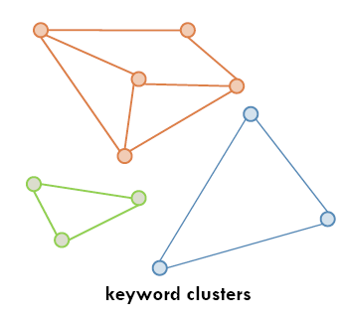
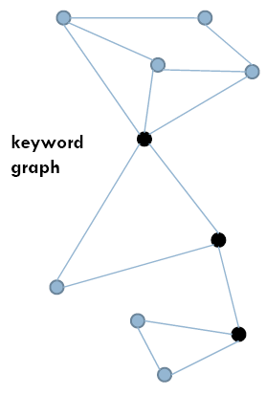

Cluster Generation (15)
Our aim => Extracting keyword clusters
  Bi-connected components

Slide 40
Cluster Generation (16)
Our aim => Extracting keyword clusters
  Finding Bi-connected components
    Efficient algorithm exists – single pass
    Realizable in secondary storage [CGGTV’05]
    Perform a DFS on the graph
    Maintain two numbers, un and low, with each node

Slide 41
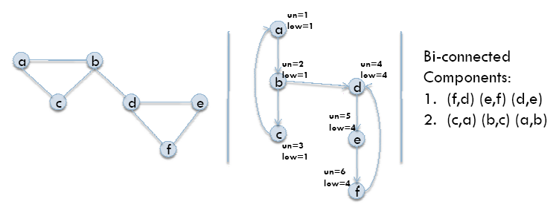
Cluster Generation (17)
Our aim => Extracting keyword clusters
  Finding Bi-connected components

Slide 42
Content
Introduction
Related Work
Cluster Generation
Stable Clusters
  Cluster Graph
  Breadth First Search
  Depth First Search
  Adapting the Threshold Algorithm
  Normalized Stable Clusters
  Online Version
Experiments
  Cluster Generation
  Stable Clusters
  Qualitative Results
Conclusions

Slide 43
Cluster Graph (1)
Graph over clusters from three time steps
  Max temporal gap size, g=1
  Three keyword clusters on each time step
  Each node is a keyword cluster
  Add a dummy source and sink, and make edges directed
  Edge weights represent similarity between clusters

Slide 44
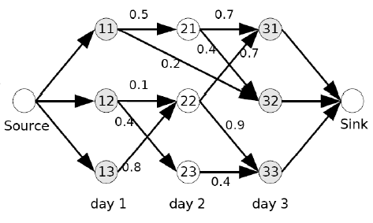
Cluster Graph (2)

Slide 45
Cluster Graph (3)
Formal Problem Definition
  Weight of path = sum of participating edge weights
    Definition: kl-Stable clusters
  Find top-k paths of length l with highest weight
    Definition: normalized stable clusters
  Find top-k paths of minimum length lmin of highest weight normalized by their lengths

Slide 46
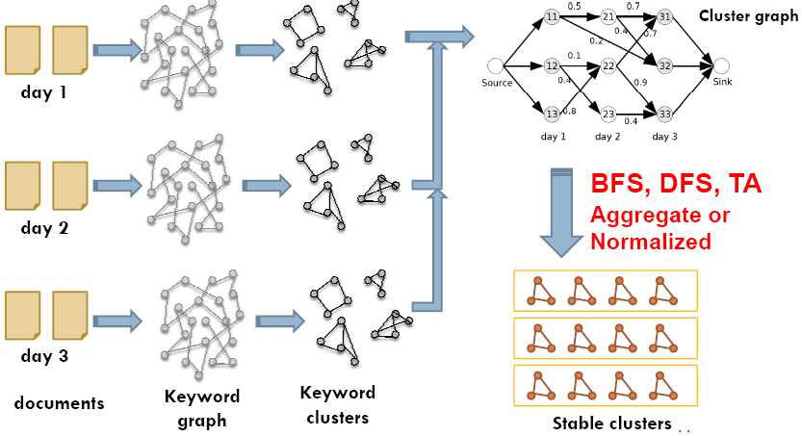
Cluster Graph (4)
Outline for kl-Stable Clusters

Slide 47
Content
Introduction
Related Work
Cluster Generation
Stable Clusters
  Cluster Graph
  Breadth First Search
  Depth First Search
  Adapting the Threshold Algorithm
  Normalized Stable Clusters
  Online Version
Experiments
  Cluster Generation
  Stable Clusters
  Qualitative Results
Conclusions

Slide 48
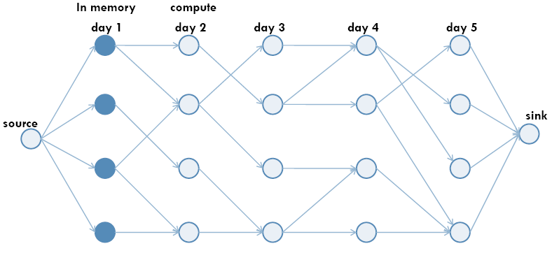
Breadth First Search (1)

Slide 49
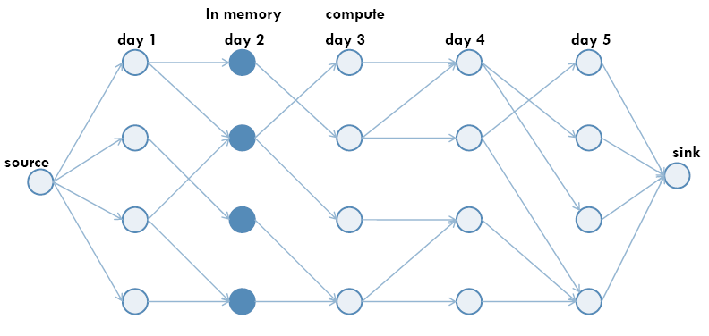
Breadth First Search (2)

Slide 50
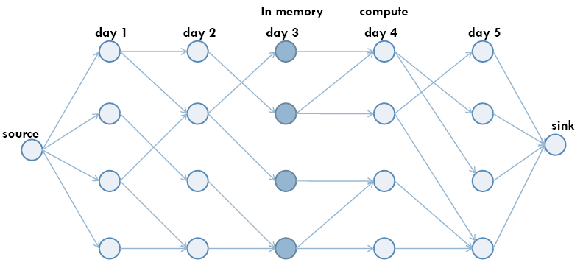
Breadth First Search (3)

Slide 51
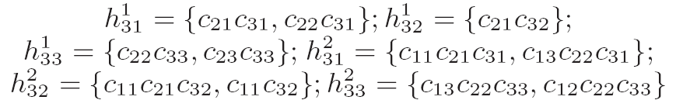
Breadth First Search (4)

Slide 52
Breadth First Search (5)
BFS Analysis
  Algorithm requires a single pass over all Gi
    I/O linear in number of clusters (sequential I/O only)
  Needs enough memory to keep all clusters from past g+1 time steps in memory
  If enough memory is not available, multiple pass required
    Similar to block nested join
  Amenable to streaming computation
    Can easily update as new data arrives

Slide 53
Content
Introduction
Related Work
Cluster Generation
Stable Clusters
  Cluster Graph
  Breadth First Search
  Depth First Search
  Adapting the Threshold Algorithm
  Normalized Stable Clusters
  Online Version
Experiments
  Cluster Generation
  Stable Clusters
  Qualitative Results
Conclusions

Slide 54
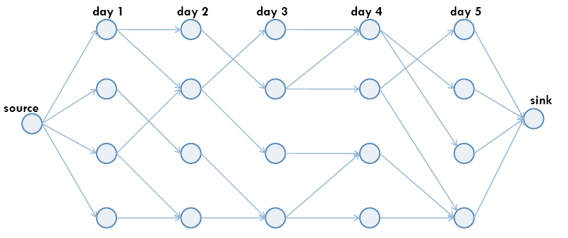
Depth First Search (1)

Slide 55
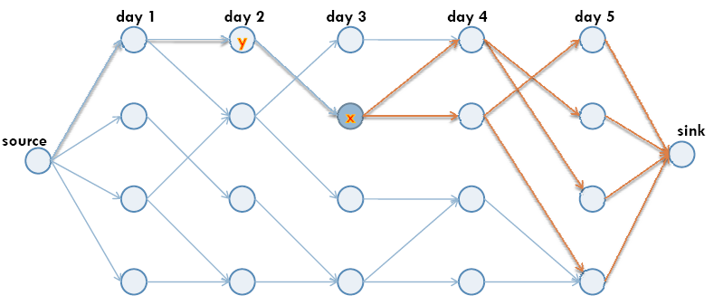
Depth First Search (2)

Slide 56
Depth First Search (3)

Slide 57
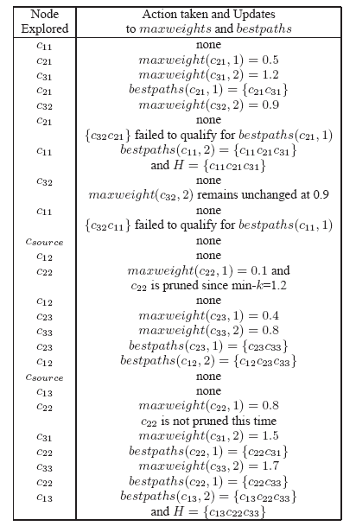
Depth First Search (4)

Slide 58
Depth First Search (5)
DFS Analysis
  The number of I/O accesses is proportional the number of edges in cluster graph
  Small memory requirement
    Keeps the stack in the memory
    Size of the stack bounded by total number of temporal intervals
  Can be easily updated as new data arrives

Slide 59
Content
Introduction
Related Work
Cluster Generation
Stable Clusters
  Cluster Graph
  Breadth First Search
  Depth First Search
  Adapting the Threshold Algorithm
  Normalized Stable Clusters
  Online Version
Experiments
  Cluster Generation
  Stable Clusters
  Qualitative Results
Conclusions

Slide 60
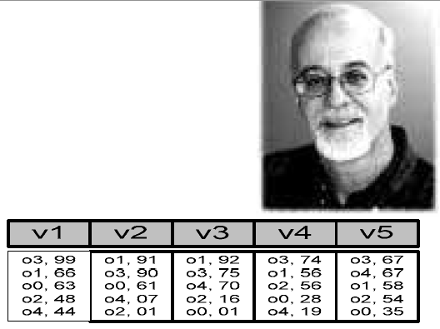
Adapting the Threshold Algorithm (1)
Fagin’s* Threshold Algorithm (TA)
  Long studied and well understood.
ΤΑ Algorithm
  Read all grades of an object once
  seen from a sorted access
    No need to wait until the lists give k common objects
  Do sorted access (and corresponding random accesses) until you have seen the top k answers.
  How do we know that grades of seen objects are higher than the grades of unseen objects ?
  Predict maximum possible grade unseen objects

Slide 61
Adapting the Threshold Algorithm (2)
ΤΑ Algorithm
L₁
L₂
a: 0.9
d: 0.9
Seen
b: 0.8
a: 0.85
c: 0.72
b: 0.7
T = min(0.72, 0.7) = 0.7
.
.
.
.
f: 0.6
.
.
.
.
Possibly unseen
f: 0.65
Threshold value
d: 0.6
c: 0.2

Slide 62
Adapting the Threshold Algorithm (3)
Example of ΤΑ Algorithm
  Step 1: - parallel sorted access to each list
  For each object seen:
  - get all grades by random access
  - determine Min(A1,A2)
  - amongst 2 highest seen ? keep in buffer
L₁
L₂
(a, 0.9)
(d, 0.9)
ID
A₁
A₂
Min(A₁,A₂)
(b, 0.8)
(a, 0.85)
a
0.9
0.85
0.85
(c, 0.72)
(b, 0.7)
d
0.6
0.9
0.6
.
.
.
.
.
.
.
.
(d, 0.6)
(c, 0.2)

Slide 63
Adapting the Threshold Algorithm (4)
Example of ΤΑ Algorithm
  Step 2: - Determine threshold value based on objects currently seen under sorted access. T = min(L1, L2)
  - 2 objects with overall grade ≥ threshold value ? Stop else go to next entry position in sorted list and repeat step 1
L₁
L₂
a: 0.9
d: 0.9
ID
A₁
A₂
Min(A₁,A₂)
b: 0.8
a: 0.85
a
0.9
0.85
0.85
c: 0.72
b: 0.7
d
0.6
0.9
0.6
.
.
.
.
.
.
.
.
d: 0.6
c: 0.2
T = min(0.9, 0.9) = 0.9

Slide 64
Adapting the Threshold Algorithm (5)
Example of ΤΑ Algorithm
  Step 1 (Again): - parallel sorted access to each list
L₁
L₂
(a, 0.9)
(d, 0.9)
ID
A₁
A₂
Min(A₁,A₂)
(b, 0.8)
(a, 0.85)
(c, 0.72)
(b, 0.7)
a
0.9
0.85
0.85
.
.
.
.
.
.
.
.
d
0.6
0.9
0.6
b
0.8
0.7
0.7
(d, 0.6)
(c, 0.2)
Notes:
Sorted acces = sequential access

Slide 65
Adapting the Threshold Algorithm (6)
Example of ΤΑ Algorithm
  Step 2 (Again)
L₁
L₂
a: 0.9
d: 0.9
ID
A₁
A₂
Min(A₁,A₂)
b: 0.8
a: 0.85
c: 0.72
b: 0.7
a
0.9
0.85
0.85
b
0.8
0.7
0.7
.
.
.
.
.
.
.
.
d: 0.6
c: 0.2
T = min(0.8, 0.85) = 0.8

Slide 66
Adapting the Threshold Algorithm (7)
Example of ΤΑ Algorithm
  Situation at stopping condition
L₁
L₂
a: 0.9
d: 0.9
ID
A₁
A₂
Min(A₁,A₂)
b: 0.8
a: 0.85
c: 0.72
b: 0.7
a
0.9
0.85
0.85
b
0.8
0.7
0.7
.
.
.
.
.
.
.
.
d: 0.6
c: 0.2
T = min(0.72, 0.7) = 0.7

Slide 67
Adapting the Threshold Algorithm (8)
Fagin’s* Threshold Algorithm (TA)
  Why is the threshold correct?
    Because the threshold essentially gives us the maximum Score for the objects not seen (<= τ)
  Advantages:
    The number of object accessed is minimized!

Slide 68
Adapting the Threshold Algorithm (9)
D1
D2
D3
a: 0.9
d: 0.9
d: 0.9
ID
A₁
A₂
A3
Min(A₁,A₂)
b: 0.8
a: 0.85
a: 0.85
a
c: 0.72
b: 0.7
b: 0.7
b
.
.
.
.
.
.
.
.
.
.
.
.
d: 0.6
c: 0.2
c: 0.2

Slide 69
Content
Introduction
Related Work
Cluster Generation
Stable Clusters
  Cluster Graph
  Breadth First Search
  Depth First Search
  Adapting the Threshold Algorithm
  Normalized Stable Clusters
  Online Version
Experiments
  Cluster Generation
  Stable Clusters
  Qualitative Results
Conclusions

Slide 70
Normalized Stable Clusters (1)
Find top-k paths of length greater than lmin with highest weight normalized by their length
  stability(π) = weight(π)/length(π)
Both the BFS or DFS based techniques can be used
weight(π)/length(π) is not monotonic
  Makes pruning tricky

Slide 71
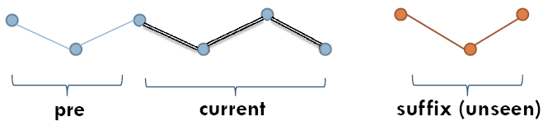
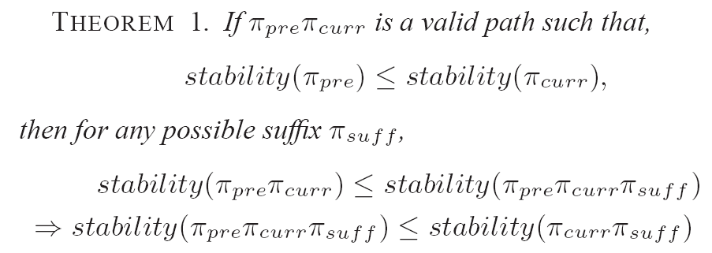
Normalized Stable Clusters (2)
Theorem 1

Slide 72
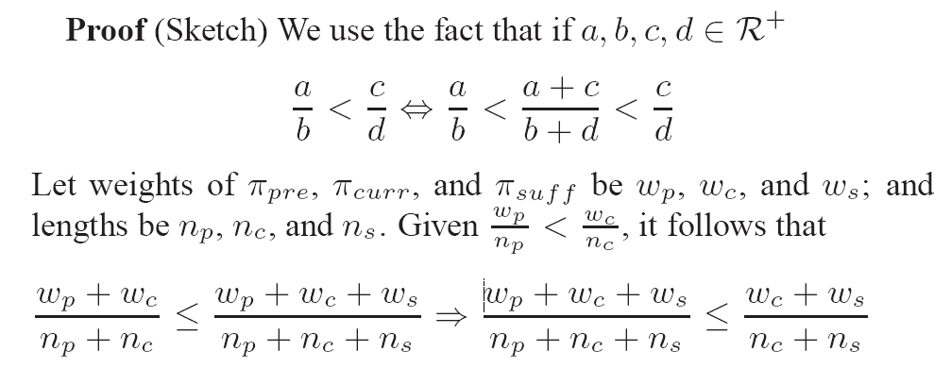
Normalized Stable Clusters (3)
Proof of Theorem 1

Slide 73
Content
Introduction
Related Work
Cluster Generation
Stable Clusters
  Cluster Graph
  Breadth First Search
  Depth First Search
  Adapting the Threshold Algorithm
  Normalized Stable Clusters
  Online Version
Experiments
  Cluster Generation
  Stable Clusters
  Qualitative Results
Conclusions

Slide 74
Online Version (1)
New data arriving at every time interval.
  The need of the algorithms presented to be amenable to incremental adjustment
  A point of view in data structures:
    BFS based algorithm: Good online version
    DFS based algorithm: Not an online streaming algorithm
      Our DFS: Incremental fashion as new data arrives.

Slide 75
Content
Introduction
Related Work
Cluster Generation
Stable Clusters
  Cluster Graph
  Breadth First Search
  Depth First Search
  Adapting the Threshold Algorithm
  Normalized Stable Clusters
  Online Version
Experiments
  Cluster Generation
  Stable Clusters
  Qualitative Results
Conclusions

Slide 76
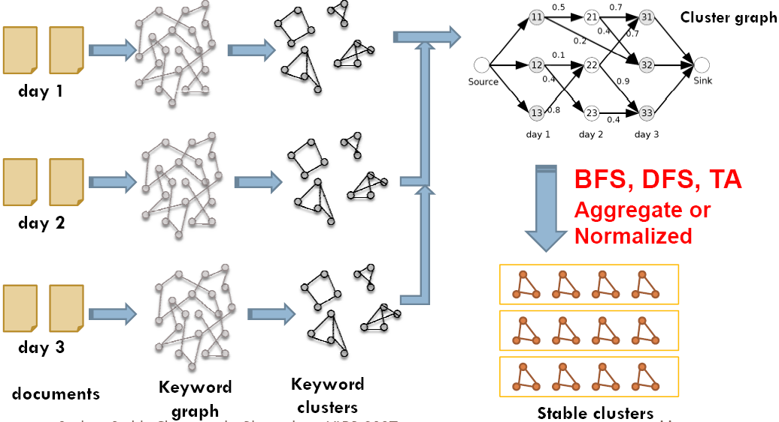
Experiments (1)
Process Outline

Slide 77
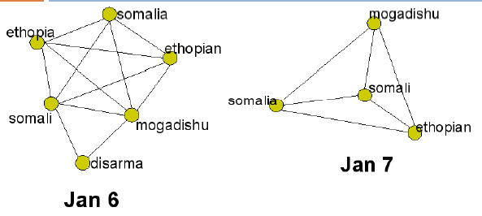
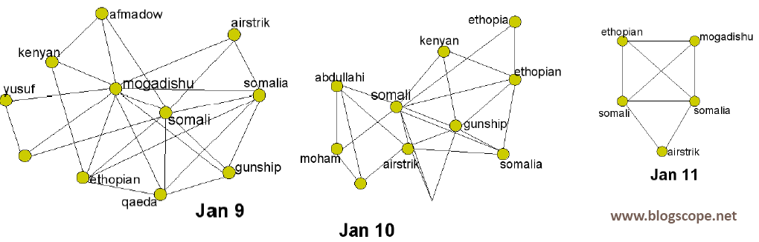
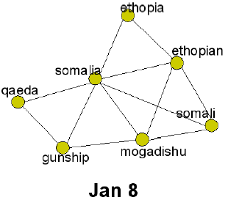
Experiments (2)
We present results from blog postings in the week of Jan 6th
Around 1100-1500 clusters were produced for each day
  Threshold of 0.2 used for correlation coefficient
The battle by Islamist militia against the Somali forces and Ethiopian troops. On Jan 9, Abdullahi Mogadishu US gunships attack Al-qaeda targets.

Slide 78
Content
Introduction
Related Work
Cluster Generation
Stable Clusters
  Cluster Graph
  Breadth First Search
  Depth First Search
  Adapting the Threshold Algorithm
  Normalized Stable Clusters
  Online Version
Experiments
  Cluster Generation
  Stable Clusters
  Qualitative Results
Conclusions

Slide 79
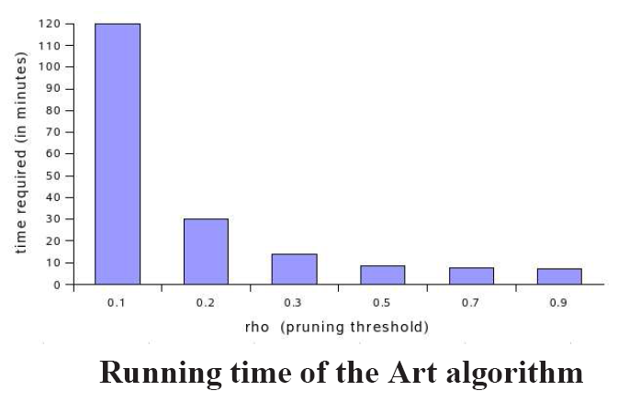
Cluster Generation (1)

Slide 80
Content
Introduction
Related Work
Cluster Generation
Stable Clusters
  Cluster Graph
  Breadth First Search
  Depth First Search
  Adapting the Threshold Algorithm
  Normalized Stable Clusters
  Online Version
Experiments
  Cluster Generation
  Stable Clusters
  Qualitative Results
Conclusions

Slide 81
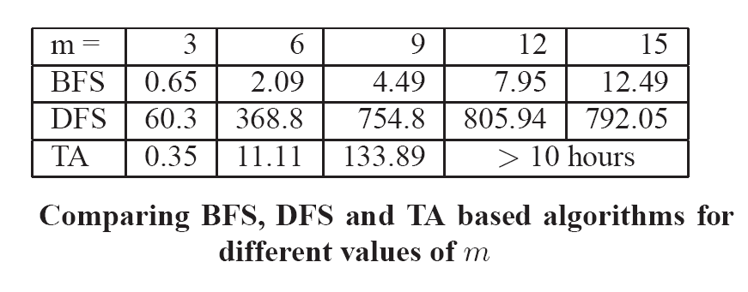
Stable Clusters (1)
Time
Space
  for finding top-3 paths of length 6 on a dataset with n = 2000, m = 9 and g = 0,
  Less than 22MB RAM for DFS
  35MB for BFS.

Slide 82
Stable Clusters (2)
Time
Space
  for finding top-3 paths of length 6 on a dataset with n = 2000, m = 9 and g = 0,
  Less than 22MB RAM for DFS
  35MB for BFS.

Slide 83
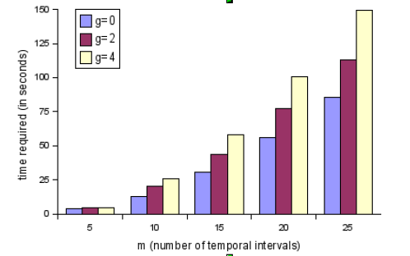
Stable Clusters (3)
Running times for BFS based algorithm seeking top-5 full paths for different values of g as the number of temporal intervals is increased from 5 to 25. Number of nodes per temporal interval was fixed at n = 1000 and average out degree was set to d = 5.

Slide 84
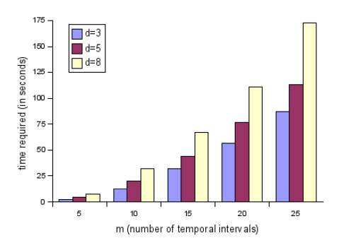
Stable Clusters (4)
Running times for BFS based algorithm seeking top- 5 full paths for different values of d as the number of temporal intervals is increased from 5 to 25. Number of nodes per temporal interval was fixed at n = 1000 and gap size was set to g = 2.

Slide 85
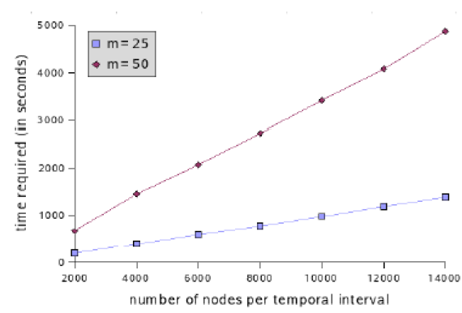
Stable Clusters (5)
Running time for BFS seeking top-5 paths. m is the number of time steps. Average out degree set to 5, and max gap size set to 1.

Slide 86
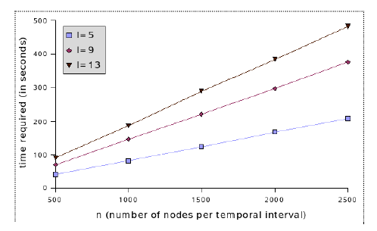
Stable Clusters (6)
Running time for DFS as we increase the number for nodes in each time step and length of l Seeking top 5 path in a graph over 6 time steps

Slide 87
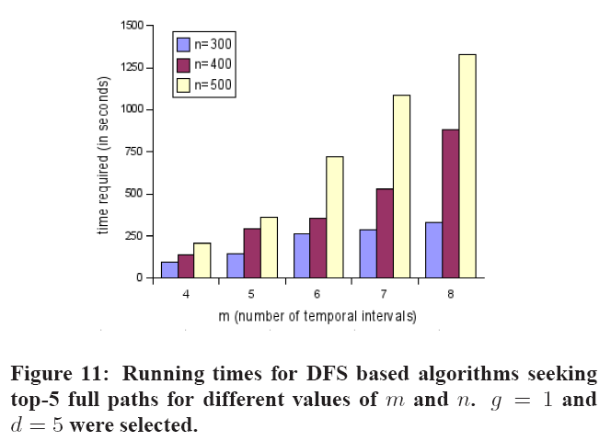
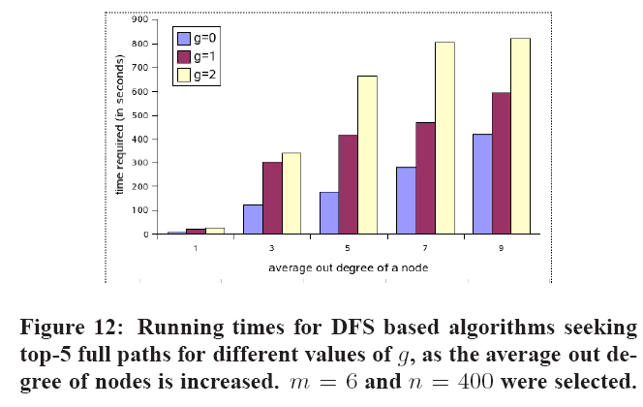
Stable Clusters (7)

Slide 88
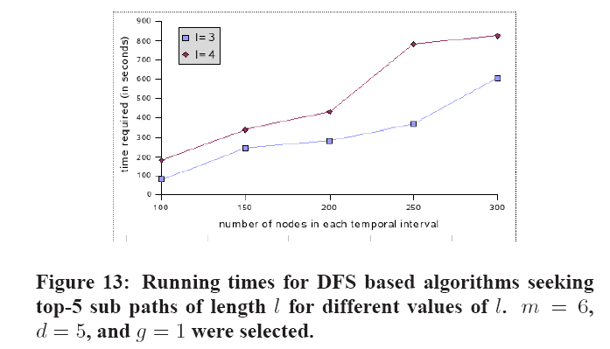
Stable Clusters (8)

Slide 89
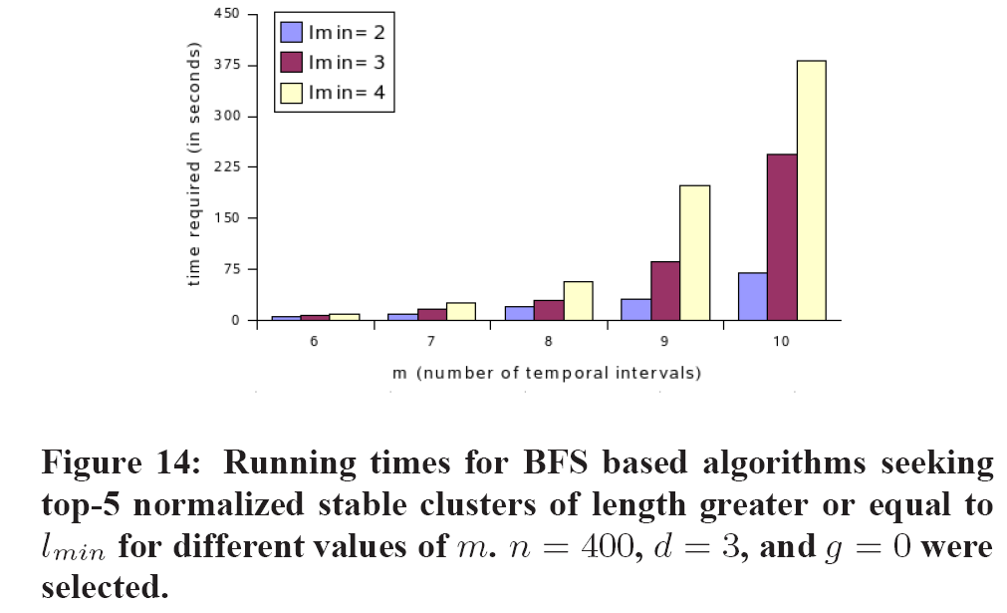
Stable Clusters (9)

Slide 90
Content
Introduction
Related Work
Cluster Generation
Stable Clusters
  Cluster Graph
  Breadth First Search
  Depth First Search
  Adapting the Threshold Algorithm
  Normalized Stable Clusters
  Online Version
Experiments
  Cluster Generation
  Stable Clusters
  Qualitative Results
Conclusions

Slide 91
Qualitative Results
Capturing clusters of keywords with strong pairwise correlations
Capturing the dynamic nature of stories in the blogosphere, and their evolution with time.
Handling topic drifts

Slide 92
Content
Introduction
Related Work
Cluster Generation
Stable Clusters
  Cluster Graph
  Breadth First Search
  Depth First Search
  Adapting the Threshold Algorithm
  Normalized Stable Clusters
  Online Version
Experiments
  Cluster Generation
  Stable Clusters
  Qualitative Results
Conclusions

Slide 93
Conclusions
Formalize the problem of discovering persistent chatter in the blogosphere
  Applicable to other temporal text sources
Identifying topics as keyword clusters
Discovering stable clusters
  Aggregate stability or normalized stability
  3 algorithms, based on BFS, DFS, and TA
Experimental Evaluation

