Slide 1
ASP.NET
(Active Server Page)
SNU OOPSLA Lab.
October 2005

Slide 2
Contents
Overview
  History of ASP
.NET Framework
Features of ASP.NET
How ASP.NET works
Example of ASP.NET
Controls of ASP.NET
  Web Form
  Web Form Control
  Data Control
Online Resources

Slide 3
Overview
ASP
  The leading web app development platform
    Nearly 1 million developers using ASP today
  Simple and approachable model for web developers to get started
    No compilers required – “just hit save”
    Easy to use languages and object model
ASP.NET is a revolutionary advance of ASP
  Making it easier to build web apps
  Making it easier to deploy web apps
  Making it easier to operate web apps
  Providing great performance and scalability
Supported platforms
  Windows NT 4 / IIS 4, Windows 2000 / IIS 5, ++
  Open hosting APIs

Slide 4
History of ASP.NET(1/2)
ASP 1.0 (1996)
  Introduced as an add-on of IIS 3.0
  Based on VBScript
  Use ADO to query database within an ASP page
ASP 2.0 (1997)
  Introduced with NT option pack 4.0(IIS 4.0)
  Can use external components
ASP 3.0 (1999)
  IIS 5.0(Windows 2000)
  Improved to use COM+ services
IIS : Internet Information Services
ADO : ActiveX Data Object

Slide 5
History of ASP.NET(2/2)
ASP.NET 1.0 (2000)
  Not simple ASP 4.0 but total changes of framework : .NET framwork
  Challenges of classical ASP
    Code readability : spaghetti code
    Coding overhead : require a lot of code
    Performance : interpreted every time they executed
    Sessions can’t be shared across Web servers
    No intrinsic support for caching
    etc…
ASP.NET 2.0 is released (2004)
  Increase developer productivity: Reduce the number of lines of code required by 70%

Slide 6
.NET Framework(1/3)
.NET Framework is a collection of technologies for the development and deployment of .NET software systems
Common Language Runtime (CLR)
  Unifies programming models
  Provides robust and secure execution environment
  Supports multiple programming languages
  Provides core services
    Memory management (Garbage Collection)
    Thread management
    Remoting
    Manage Code Execution
  “Like” Java Runtime Environment (JRE)
  Code is NOT interpreted by CLR, but managed
Common Language Specification
  Set of features guaranteed to be in all languages

Slide 7
.NET Framework(2/3)
Aim of .NET : seamless interoperability
  A component in any .NET language can:
    Inherit from any other .NET language class
    Call the methods of any other .NET language class
    Subclass any class from any .NET language
Benefits of .Net
  Rich UI Toolkit, even for the web (ASP.Net)
  Language independence (VB.Net, C#, J#, C++, COBOL, and others)
  Standard based (XML, SOAP, HTTP)
  Interoperability with COM
  .Net Framework Library
    Rich set of classes

Slide 8
.NET Framework(3/3)
Visual Basic®
C++
C#
JScript®
…
Common Language Specification
ASP.NET: Web Services
and Web Forms
Windows
Forms
ADO.NET: Data and XML
Base Class Library
Common Language Runtime

Slide 9
Features of ASP.NET
Object Oriented and Event Driven Programming
Code behind : separate HTML and server script
Language independent programming
  Developer can use Visual Basic, C#, Visual C++ or …
Independency to client
  Developer doesn’t need consider user’s web browser
Improved performance and security
  Runtime compilation : not a scripting language
  Support caching
Supports XML web service
  UDDI, WSDL, SOAP
Speed and ease of deployment

Slide 10
Main Differences
ASP
VB Script – Less Powerful
Top-down programming - like most scripting languages
No separation between logic and presentation
Multiple Forms per page
.Net
VB.Net or C# - More Powerful
Language independent
Control/Event based programming – similar to VB6
Separation between logic and presentation
Only one form per page

Slide 11
How ASP.NET works (1/3)
Initial Request
User’s request
Return results
Find ASP page
Cache the image
Compiled
.ASPX
Make compiled image
Not interpreted!

Slide 12
How ASP.NET works (2/3)
Another Request for the same page
User’s request
Return results
Compiled
.ASPX

Slide 13
How ASP.NET works (3/3)
If a change is made to the ASPX
User’s request
Return results
Find ASP page
Cache the image
Compiled
.ASPX
Recompile the image

Slide 14
Example of ASP.NET (1/4)
start.aspx
ASP.NET Directive
Specify used language
<%@ Page language=“C#"%>
<HTML>
<Script runat="server">
void btnSubmit_OnClick(Object sender, EventArgs e)
{
lbl1.Text = “Hello World!";
}
</Script>
<body>
<form runat="server">
<asp:Label id="lbl1" runat="server" /><br>
<asp:Button id="btn1" runat="server"
Text="Click" OnClick="btnSubmit_OnClick" />
</form>
</body>
</HTML>
Server side script
Event Handler
ASP.NET web form
Note one page can haveonly one web form
ASP.NET web control

Slide 15
Example of ASP.NET (2/4)
Result
Client Web Browser
Hello World!
Click
Click

Slide 16
Example of ASP.NET (3/4)
Result
ASP.NET server control
Before user clicks the button,
this control is invisible
Client Web Browser
<asp:Label id="lbl1" runat="server" /><br>
Hello World!
Click
ASP.NET server control
All have Id and Text attributes
Create browser-specific HTML
<asp:Button id="btn1" runat="server“ Text="Click" OnClick="btnSubmit_OnClick" />
Event handler function
This function specifies what to do
when some event occurs.
In these case, it changes “lbl1” control’s text
void btnSubmit_OnClick(Object sender, EventArgs e)
{
lbl1.Text = “Hello World!";
}

Slide 17
Example of ASP.NET (4/4)
Round trip
Client Browser
Server
start.aspx
Event handler
btnSubmit_OnClick
Event occurs
Send data
Event occurs
lbl1
Post Data
lbl1=“”
submit=btn1
btn1

Slide 18
Web Form
Web Form
  Stands ASPX page
  Contains several controls and event handlers
  (like Window Programming Form)
Event driven programming
  Can control each properties, events and methods of web form control at server side
Render results to various type
  DHTML, HTML3.2, WML, etc…
  Automatically check client browser type

Slide 19
Web form control (1/2)
HTML control
  Primitive control
  One-to-one correspondence with the XHTML elements
Web control
  MS defined control
  A larger and richer collection than the HTML controls
  A weaker connection to the XHTML elements
Data control
  Using for data manipulation
  DataGrid, DataList, Repeater, etc …
Rich control : combination of several controls
Validation control : validating user input data

Slide 20
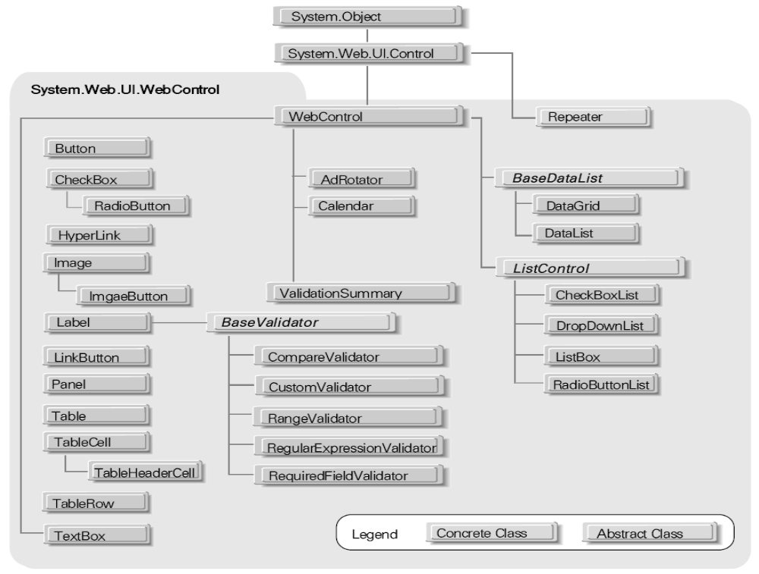
Web form control (2/2)
Web control structure

Slide 21
Data Control
Bind to many data sources
  Collections
    Array
    HashTable
  ADO.NET
    DataReader
    DataSet
  XML
ADO.NET
  A part of the .NET Framework
  Consists of a set of classes used to handle data access
  Entirely based on XML
  Has, unlike ADO, no Recordset object

Slide 22
ADO.NET (1/3)
Set of objects for accessing data
DataSet object
  A snapshot of data from the database
  Separate and distinct from any data stores
Connection object
  For connection to and managing transactions against a database
DataAdapter object
  Object that connects to the database to fill the DataSet
  For pushing data into a DataSet, and reconciling data against a database
DataSet
Authors
Connection
Database
Authors
DataAdapter
Select … from Authors

Slide 23
ADO.NET (2/3)
Several ASP.NET Web controls are designed to display database data
DataView
  DataGrid displays data as a table
  Repeater doesn’t have default output
  DataList makes it easy to output data in columns

Slide 24
ADO.NET (3/3)
DataSet
DataTable
DataTable
Connection
Stored procedure
DataView
Database
Windows and Web controls
Data Store
Server

Slide 25
Summary
ASP.NET is a rich web application platform
Combines simplicity and power
Easy to deploy and maintain
Reliable, highly available and scalable

Slide 26
Online Resources
VS .Net
http://msdn.microsoft.com/library/default.asp?url=/library/en-us/vsintro7/html/vbconVisualStudioSharedWalkthroughs.asp
ASP .Net
http://www.asp.net/Default.aspx?tabindex=0&tabid=1
ASP.NET Quick Tutorial
http://www.asp.net/Tutorials/quickstart.aspx
ADO .Net
http://www.w3schools.com/ado/default.asp

