Slide 1
Tibero 6 Installation Guide
Internet Database Lab.
Notes:
Journal of Parallel and Distributed Computing

Slide 2
Tibero 6?
Database Management System(DBMS)
Produced by TmaxData
Compatible with Oracle Database, including SQL
Using Oracle Database syntax
SQL standard coverage
No commercial database system covers whole SQL standard
Covers most of SQL-92’s Entry level and part of Intermediate level
Also covers part of SQL-99 and SQL-2003
Notes:
3 levels : Entry level(80%), Intermediate level, full level

Slide 3
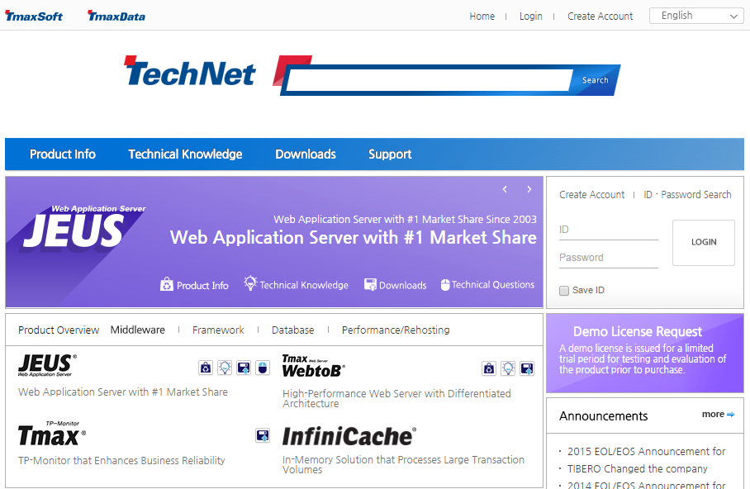
TechNet Site
Korean Site
http://technet.tmaxsoft.com/ko/front/main/main.do
English Site
http://technet.tmaxsoft.com/en/front/main/main.do

Slide 4

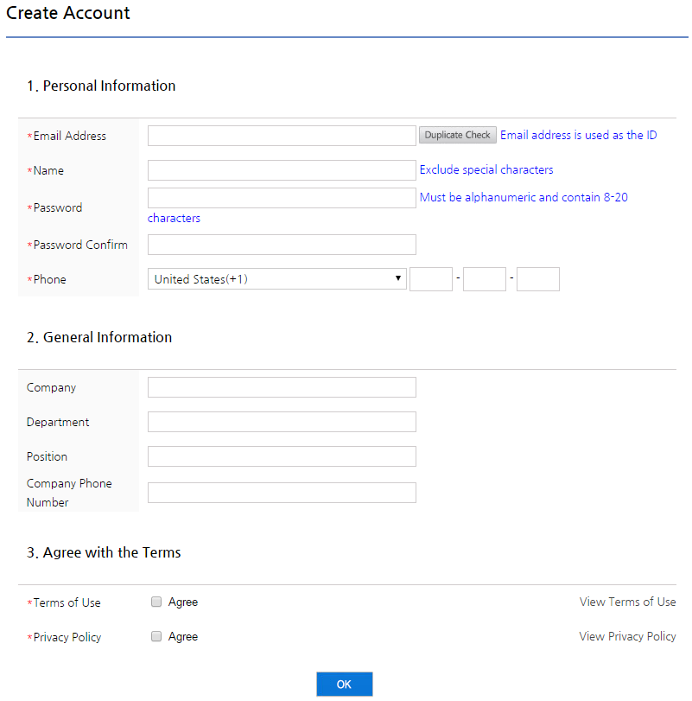
Membership Registration
1. Click Create Account button
2. Fill empty information text boxes with necessary marks(*)

Slide 5
Login and Download
1. Type your ID, PW information and click login button
2. Click Downloads button
2. click
1. login

Slide 6
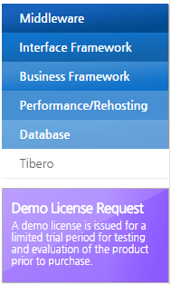
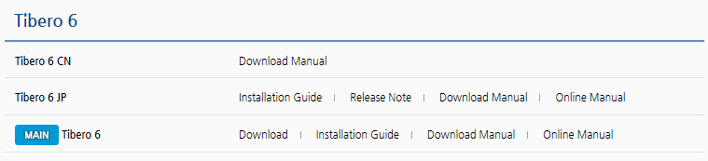
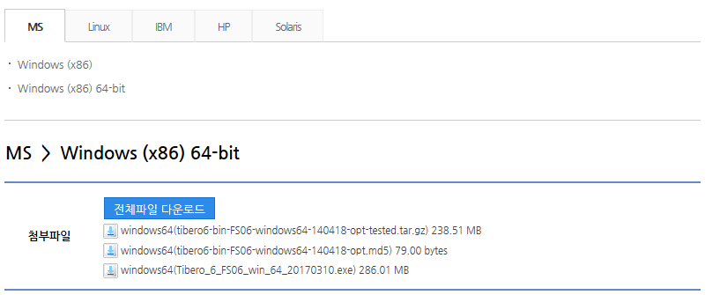
Database Download
1. Click Database button
2. Click Tibero
English download page
3. Click Download Tibero 6 and select OS
.exe file is available only through Korean web site now
Download .exe file

Slide 7
Prerequisite & Requirements
MS Windows 7 operating system
512MB RAM, 300MB HDD Space
Compiler, supporting C99
Later version of JDK 1.5.17
Microsoft Visual C++ 2008 Redistributable Package(x64)
Microsoft.NET Framework 3.5 SP1
Demo License

Slide 8
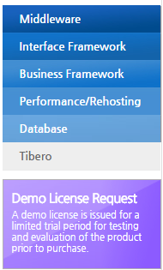
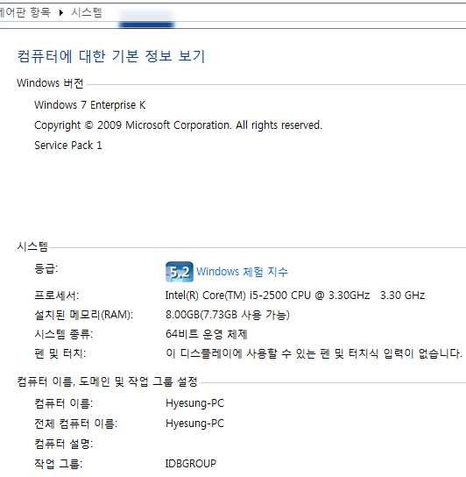
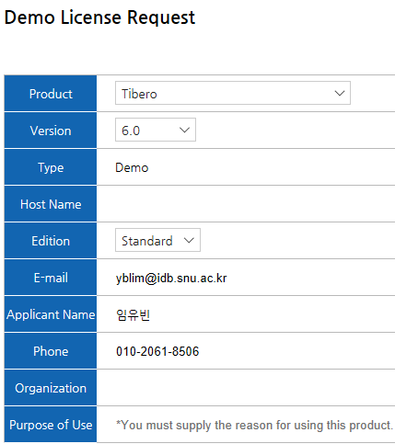
Demo License Request
Click Demo License Request
Demo License file will be sent to E-mail account

Slide 9
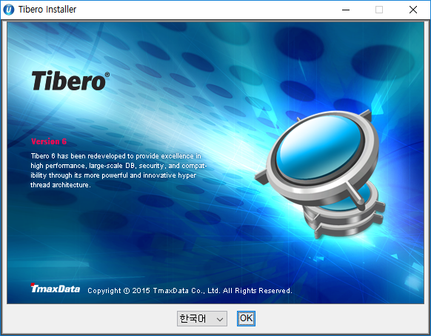
Tibero Installation [1/12]
Execute Tibero~.exe file
Select your language and click OK button

Slide 10
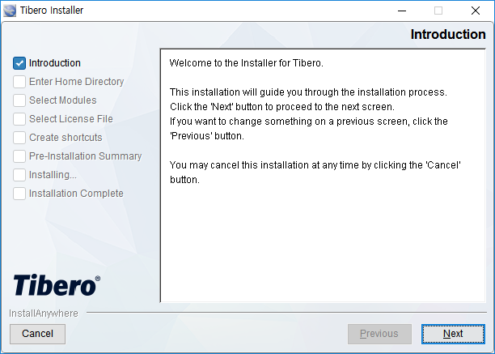
Tibero Installation [2/12]
Click Next button

Slide 11
Tibero Installation [3/12]
Click Next button

Slide 12
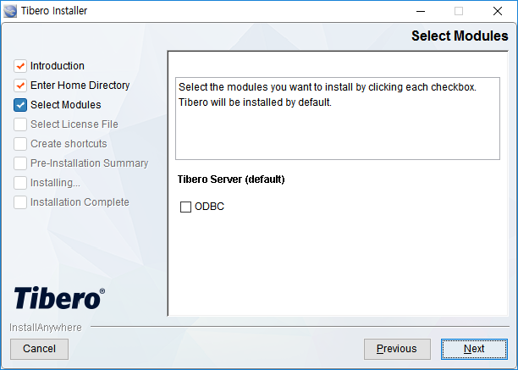
Tibero Installation [4/12]
Click Next button

Slide 13
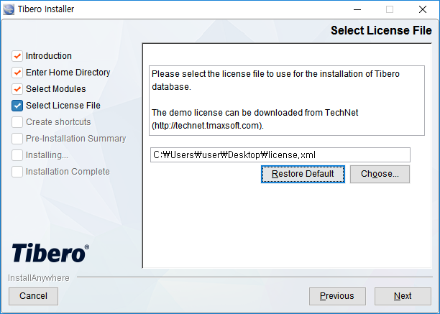
Tibero Installation [5/12]
Choose the path to license.xml file, download before
Click Next button

Slide 14
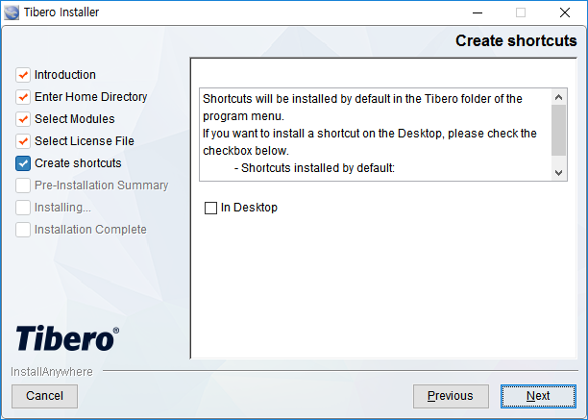
Tibero Installation [6/12]
Click Next button

Slide 15
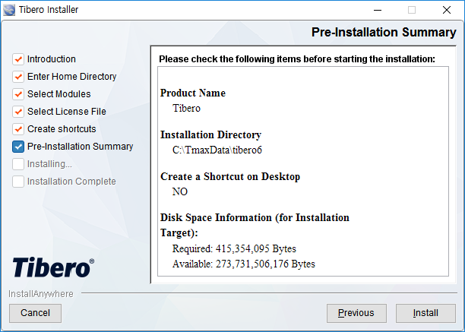
Tibero Installation [7/12]
Click Install button

Slide 16
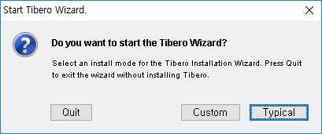
Tibero Installation [8/12]
Start Tibero Wizard in Typical mode after the installing process finished

Slide 17
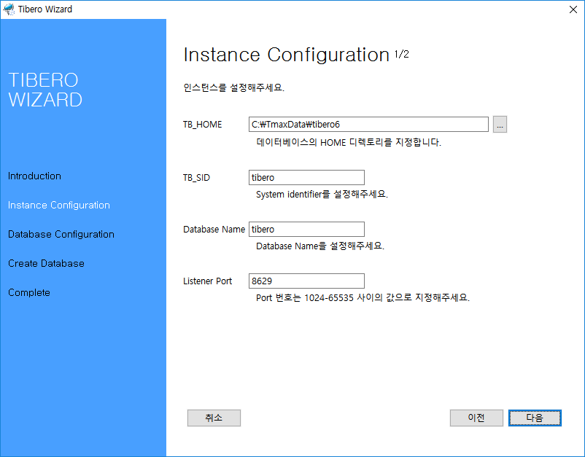
Tibero Installation [9/12]
Type TB_SID -> tibero, Database Name -> tibero
Click Next button

Slide 18
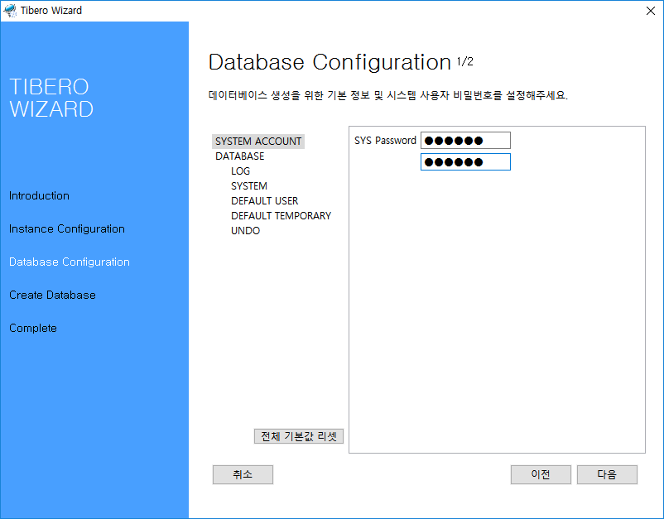
Tibero Installation [10/12]
Type SYS Password -> tibero
Click Next button

Slide 19
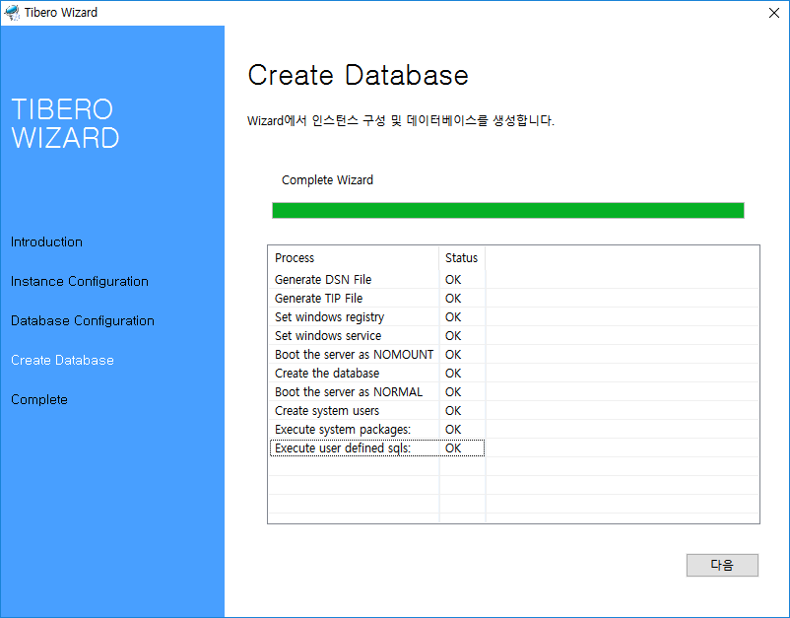
Tibero Installation [11/12]
Click Next button

Slide 20
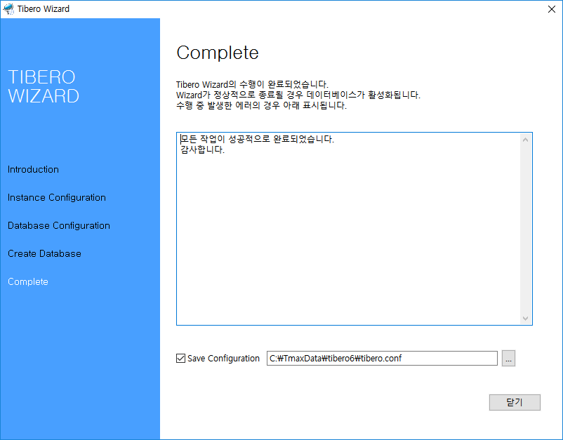
Tibero Installation [12/12]
Click Close button

Slide 21
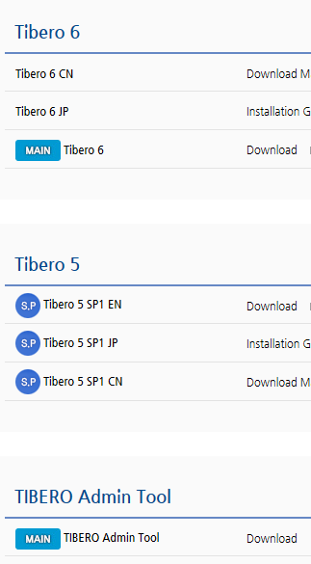
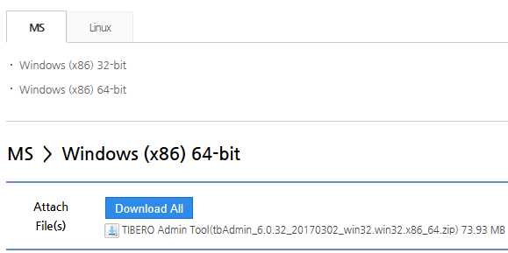
TbAdmin Install
TbAdmin
DB development and management with GUI for TIBERO
Back to Downloads – Database – Tibero menu on TechNet site
TIBERO Admin Tool Download – download .zip file
Unzip and execute tbAdmin.exe file

Slide 22
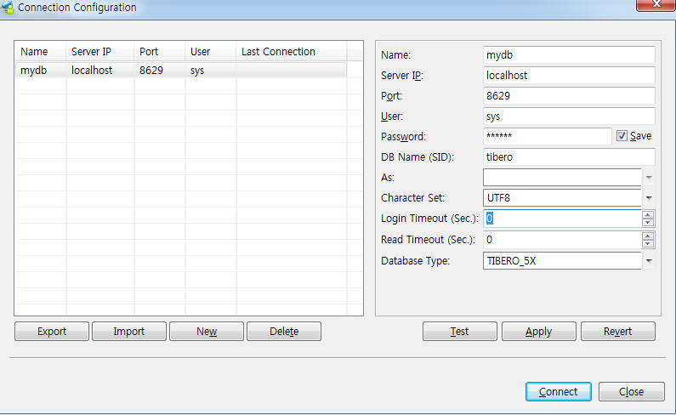
TbAdmin
Start -> TbAdmin
Password -> tibero
Apply -> Test -> Connect

