Slide 1
Chapter 26:
PostgreSQL

Slide 2
Database System Concepts
Chapter 1: Introduction
Part 1: Relational databases
  Chapter 2: Relational Model
  Chapter 3: SQL
  Chapter 4: Advanced SQL
  Chapter 5: Other Relational Languages
Part 2: Database Design
  Chapter 6: Database Design and the E-R Model
  Chapter 7: Relational Database Design
  Chapter 8: Application Design and Development
Part 3: Object-based databases and XML
  Chapter 9: Object-Based Databases
  Chapter 10: XML
Part 4: Data storage and querying
  Chapter 11: Storage and File Structure
  Chapter 12: Indexing and Hashing
  Chapter 13: Query Processing
  Chapter 14: Query Optimization
Part 5: Transaction management
  Chapter 15: Transactions
  Chapter 16: Concurrency control
  Chapter 17: Recovery System
Part 6: Data Mining and Information Retrieval
  Chapter 18: Data Analysis and Mining
  Chapter 19: Information Retreival
Part 7: Database system architecture
  Chapter 20: Database-System Architecture
  Chapter 21: Parallel Databases
  Chapter 22: Distributed Databases
Part 8: Other topics
  Chapter 23: Advanced Application Development
  Chapter 24: Advanced Data Types and New Applications
  Chapter 25: Advanced Transaction Processing
Part 9: Case studies
  Chapter 26: PostgreSQL
  Chapter 27: Oracle
  Chapter 28: IBM DB2
  Chapter 29: Microsoft SQL Server
Online Appendices
  Appendix A: Network Model
  Appendix B: Hierarchical Model
  Appendix C: Advanced Relational Database Model

Slide 3
Part 9: Case studies
(Chapters 26 through 29).
Chapter 26: PostgreSQL
Chapter 27: Oracle
Chapter 28: IBM DB2
Chapter 29: Microsoft SQL Server.
These chapters outline unique features of each of these systems, and describe their internal structure.
They provide a wealth of interesting information about the respective products, and help you see how the various implementation techniques described in earlier parts are used in real systems.
They also cover several interesting practical aspects in the design of real systems.

Slide 4
Overview
26.1 Introduction
26.2 User Interfaces
26.3 SQL Variations and Extensions
26.4 Transaction Management in PostgreSQL
26.5 Storage and Indexing
26.6 Query Processing and Optimization
26.7 System Architecture
Summary & Bibliographical Notes

Slide 5
Introduction
PostgreSQL runs over virtually all Unix-like operating systems, including Linux and Apple Macintosh OS X
PostgreSQL can be run over Microsoft Windows under the Cygwin environment, which provides Linux emulation under Windows
This chapter surveys how the PostgreSQL works, starting from user interfaces and languages and continuing into the core of the system
Notes:
history

Slide 6
Overview
26.1 Introduction
26.2 User Interfaces
26.3 SQL Variations and Extensions
26.4 Transaction Management in PostgreSQL
26.5 Storage and Indexing
26.6 Query Processing and Optimization
26.7 System Architecture
Summary & Bibliographical Notes

Slide 7
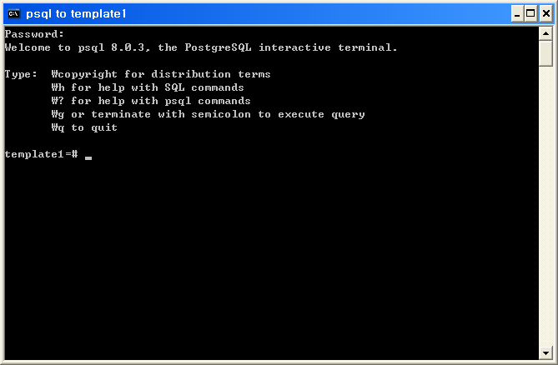
User Interfaces
The standard PostgreSQL
  Based on command-line tools for administrating the database
  Offers a comprehensive set of programming interfaces
  A wide range of commercial and open-source graphical tools exist

Slide 8
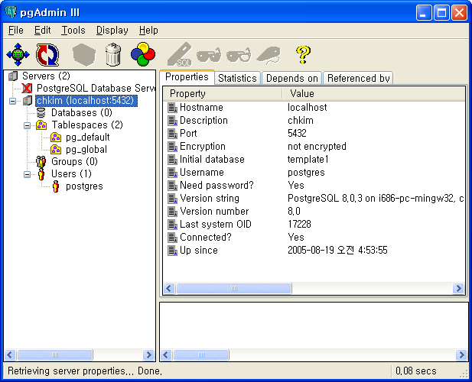
User Interfaces(Cont.)

Slide 9
User Interfaces (cont.)
Interactive Terminal Interfaces
  main interactive terminal client, psql
    modeled after the Unix shell
    execute SQL commands on the server
    performs several other operations
    features
      Variables
      SQL interpolation
      Command-line editing
  pgtksh, pgtclsh(versions of the Tk and Tcl include PostgreSQL bindings)
    Tcl/Tk is a flexible scripting language for rapid prototyping

Slide 10
User Interfaces (cont.)
Graphical Interfaces
  Graphical tools for administration
    pgAcess
    pgAdmin
  Graphical tools for database design
    TORA
    Data Architect
  Works with several commercial forms-design and report-generation tools
    Rekall
    GNU Report Generator
    GNU Enterprise

Slide 11
User Interfaces (cont.)
Programming Language Interfaces
  Provides native interfaces for
    ODBC
    JDBC
    Bindings for most programming languages
      C / C++ / PHP / Perl / Tcl / Tk / ECPG / Python / Ruby
  C API for PostreSQL: libpq
    supports syncronous/asyncronous execution of SQL commands and prepared statements
    re-entrant
    Thread-safe
    Environment variables for certain parameters
    Optional password file for connections

Slide 12
Overview
26.1 Introduction
26.2 User Interfaces
26.3 SQL Variations and Extensions
26.4 Transaction Management in PostgreSQL
26.5 Storage and Indexing
26.6 Query Processing and Optimization
26.7 System Architecture
Summary & Bibliographical Notes

Slide 13
SQL Variations and Extensions
PostgreSQL
  ANSI SQL compliant
  supports almost all entry-level SQL92 features and many of the intermediate- and full-level features
  supports several of the SQL:1999 features
  Data can be easily loaded into OLAP servers

Slide 14
SQL Variations and Extensions (Cont.)
The PostgreSQL Type System
  Base types
  Composite types
  Domains
  Pseudotypes
  Polymorphic types
Nonstandard Types
  data type for complex numbers
  type for ISBN/ISSN
  geometric data type
    point, line, lseg, box, polygon, path, circle
  data types to store network addresses
    cidr(IPv4), inet(IPv6), macaddr(MAC)

Slide 15
SQL Variations and Extensions (Cont.)
Rules and Other Active-Database Features
  PostgreSQL supports
    SQL constraints
      check constraints
      not-null constraints
      primary key constraints
      foreign key constraints
      restricting and cascading deletes
    Triggers
      Useful for nontrivial constraints and consistency checking or enforcement
    Query-rewriting rules

Slide 16
SQL Variations and Extensions (Cont.)
PostgreSQL rules system
  allows to define query-rewrite rules on the DB server
  Intervenes between the query parser and the planner
  modifies queries on the basis of the set of rules
  General syntax for declaring rules
  create rule rule_name as
  on { select | insert | update | delete }
  to table [ where rule_qualification ]
  do [instead] { nothing | command | ( command; command…)}

Slide 17
SQL Variations and Extensions (Cont.)
Rules
  PostgreSQL uses rules to implement views
  create view myview as select * from mytab;
  → create table myview (same column list as mytab)
  create rule return as on select to myview do instead
  select * from mytab;
  create view syntax is more concise and it also prevents creation of views that reference each other
  rules can be used to define update actions on views explicitly, but view can not

Slide 18
SQL Variations and Extensions (Cont.)
Example(when the user wants to audit table updates)
create rule salary_audit as on update to employee
where new.salary < > old.salary
do insert into salary_audit
values ( current_timestamp, current_user,
new.emp_name, old.salary, new.salary );

Slide 19
SQL Variations and Extensions (Cont.)
Example(more complicated insert/update rule)
  salary increases stored in salary_increases (emp_name, increase)
  Define dummy table approved_increases with the same fields
  create rule approved_increases_insert
  as on insert to approved_increases
  do instead
  update employee
  set salary = salary + new.increase
  where emp_name = new.emp_name;
  Then the following query will update all salaries in employee table at once
  Insert into approved_increases select * from salary_increases;

Slide 20
SQL Variations and Extensions (Cont.)
Extensibility
  RDB systems are extended
    by changing the source code or
    by loading extension modules
  PostgreSQL stores information about system in system catalogs
  Extended easily through extension of system catalogs
  Also incorporate user-written code by dynamic loading of shared objects
  contrib module includes
    user functions(array iterators, fuzzy string matching, cryptographic functions)
    base types(encrypted passwords, ISBN/ISSNs, n-dimensional cubes)
    index extensions(RD-trees, full-text indexing)

Slide 21
SQL Variations and Extensions (Cont.)
Types
  PostgreSQL allows to define composite types and extend the available base types
  create type city_t as ( name varchar(80), state char(2))
  Example of adding base type to PostgreSQL
  typedef struct Complex{
  double x;
  double y;
  }Complex;

Slide 22
SQL Variations and Extensions (Cont.)
Types(Cont.)
  User must define functions to read or write values of the new data type in the text format
  Assume that the I/O functions are complex_in and complex_out
  New data type can be registered like that:
  create type complex{
  internallength = 16,
  input = complex_in,
  output = complex_out,
  alignment = double
  };

Slide 23
SQL Variations and Extensions (Cont.)
Functions
  Can be stored and executed on the server
  PostgreSQL suppoorts function overloading
  Can be written as statements using SQL or several procedural languages
  PostgreSQL has an API for adding functions written in C
  Declaration to register the user-defined function on the server is
    create function complex_out(complex)
    returns cstring
    as ‘shared_object_filename’
    language C immutable strict;

Slide 24
SQL Variations and Extensions (Cont.)
Functions(Cont.)
  Example for the text output of complex values
  pg_function_info_v1(complex_out)
  Datum complex_out(pg_function_args){
  Complex *complex = (Complex*)pg_getarg_pointer(0);
  char *result;
  result = (char*)palloc(100);
  snprintf(result, 100, “(%g,%g)”, complex->x, complex->y);
  pg_return_cstring(result);
  }

Slide 25
SQL Variations and Extensions (Cont.)
Functions(Cont.)
  Aggregate functions
    operate by updating a state value via a state transition function
    final function can be called to compute the return value
    extending example for sum aggregate function
    create aggregate sum(
    sfunc = complex_add,
    basetype = complex,
    stype = complex,
    initcond = ‘(0,0)’
    );

Slide 26
SQL Variations and Extensions (Cont.)
Functions(Cont.)
  PosgreSQL call the appropriate function, on the basis of the actual type of its argument
  basetype: argument type
  stype: state value type

Slide 27
SQL Variations and Extensions (Cont.)
Index Extensions
  PostgreSQL supports B-tree, hash, R-tree and Gist indices
  All indices can be easily extended
  Need definition operator class to encapsulate the followings two:
    Index-method strategies
      operators that can be used as qualifiers in where clause
      depends on the index type
      B-tree indices: <, <=, =, >=, >
      Hash indices: =
      R-tree indices: contained, to-the-left, etc
    Index-method support routines
      functions to support the operation of indices

Slide 28
SQL Variations and Extensions (Cont.)
Index Extensions(Cont.)
  Example(declaration for operators)
    create operator class complex_abs_ops
    default for type complex using btree as
    operator 1 < (complex, complex),
    operator 2 <= (complex, complex),
    operator 3 = (complex, complex),
    operator 4 >= (complex, complex),
    operator 5 > (complex, complex),
    function 1 complex_abs_cmp(complex, complex);

Slide 29
SQL Variations and Extensions (Cont.)
Procedural Languages
  functions and procedures can be written in procedural languages
  PostgreSQL defines API to support any procedural languages
  programming languages are trusted or untrusted
  if untrusted, superuser previleges can allow them to access the DBMS and the file system
    PL/pqSQL
      trusted language
      adds procedural programming capabilities to SQL
      similar to Oracle’s PL/SQL
    PL/Tcl, PL/Perl, and PL/Python
      use the power of Tcl, Perl and Python
      have bindings that allow access the DB via language-specific interfaces

Slide 30
SQL Variations and Extensions (Cont.)
Server Programming Interface(SPI)
  API that allows running arbitrary SQL commands inside user-defined C functions
  function definitions can be implemented with essential parts in C
  functions can use the full power of RDB system engine

Slide 31
Overview
26.1 Introduction
26.2 User Interfaces
26.3 SQL Variations and Extensions
26.4 Transaction Management in PostgreSQL
26.5 Storage and Indexing
26.6 Query Processing and Optimization
26.7 System Architecture
Summary & Bibliographical Notes

Slide 32
Transaction Management in PostgreSQL
Concurrency control
  MVCC and 2-PL is implemented in PostgreSQL
  DML statements use MVCC schema
  DDL statements is based on standard 2-PL

Slide 33
Transaction Management in PostgreSQL(Cont.)
PostgreSQL Isolation Levels
  The SQL standard also defines 3 weak levels of consistency
  Weak consistency levels provide a higher degree of concurrency
  3 phenomena that violates serializability
    Nonrepeatable read
      Transaction reads same object twice during execution
      Get a different value although a transaction has not changed the value
    Dirty read
      Transaction reads values written by other transaction that has not committed yet
    Phantom read
      Transaction re-executes a query returning a set of rows that satisfy search condition
      The set has changed by other recently committed transaction

Slide 34
Transaction Management in PostgreSQL(Cont.)
PostgreSQL Isolation Levels(Cont.)
  PostgreSQL supports read committed and serializable
  Definition of the 4 SQL isolation level
Isolation level | Dirty Read | Unrepeatable Read | Phantom
Read Uncommitted | Maybe | Maybe | Maybe
Read Committed | Maybe | Maybe | Maybe
Repeated Read | Maybe | Maybe | Maybe
Serializable | No | No | No

Slide 35
Transaction Management in PostgreSQL(Cont.)
Concurrency Control for DML Commands
  The MVCC Protocol
    Maintain different versions of a row at different points in time
    guarantees all transactions see the consistent versions of data with the transaction’s view
    Each transaction sees a snapshot of the committed data at the time the transaction was started
    The snapshot can be different from current state of data
    Readers access the most recent version of a row from the snapshots
    Writers create their own copy of the row to be updated
    The only conflict that blocks transaction is occurred if two writers try to update the same row

Slide 36



Transaction Management in PostgreSQL(Cont.)
PostgreSQL Implementation of MVCC
  Tuple visibility defines which of the potentially many versions of a row in a table is valid
  Tuple are visible for a transaction if 2 following conditions hold
    The tuple was created by started running and was committed before started running
    Updates were executed by that either
      Is aborted or
      Started running after or
      Was in process at the start of or

Slide 37
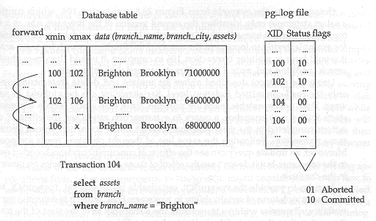
Transaction Management in PostgreSQL(Cont.)
PostgreSQL Implementation of MVCC(Cont.)
  Example

Slide 38
Transaction Management in PostgreSQL(Cont.)
PostgreSQL Implementation of MVCC(Cont.)
  2 conditions that needs to be satisfied for a tuple to be visible
    The creation-transaction ID in the tuple header
      Is a committed transaction according to the pg_log file
      Is less than the transaction counter stored at query start in SnapshotData
      Was not in process at query start according to SnapshotData
    The expire-transaction ID
      Is blank or aborted
      Is greater than the transaction counter stored at query start in SnapshotData
      Was in process at query start according to SnapshotData

Slide 39
Transaction Management in PostgreSQL(Cont.)
PostgreSQL Implementation of MVCC(Cont.)
  Interaction with SQL statements
    insert
      no interaction with the concurrency-control protocol
    select
      depends on the isolation level
      If the isolation level is read committed, creates a new SnapshotData
      check the target tuples which are visible
    update, delete
      like as select statement
      If there is another concurrently executing transaction,
        update/delete can proceed if the transaction is aborted
        The search criteria of the update/delete must be evaluated again if the transaction commits
      update/delete includes updating the header information of the old tuple as well as creating a new tuple

Slide 40
Transaction Management in PostgreSQL(Cont.)
PostgreSQL Implementation of MVCC(Cont.)
  MVCC for update/delete provides only the read-committed isolation level
  Serializability can be violated in several ways
    Nonrepeatable reads
    Phantom reads
    Concurrent updates by other queries to the same row
  Ways of PostgreSQL MVCC to eliminate violations of serializability
    Queries use a snapshot as of the start of the transaction, rather than the start of the individual query
    The way update/delete are processed is different in serializable mode compared to read-committed mode

Slide 41
Transaction Management in PostgreSQL(Cont.)
Implications of Using MVCC
  Storage manager must maintain different versions of tuples
  Developing concurrent applications takes extra care compared to systems where standard 2PL is used
  Performance depends on the characteristics of the workload running on it
PostgreSQL frees up space
  Storing multiple versions of row consumes excessive storage
  Periodically frees up space by identifying and deleting versions of rows that are not needed any more
  Implemented in form of the Vacuum command
  Vacuum runs as a daemon in the background or by user
  Vacuum can operate in parallel with normal reading and writing

Slide 42
Transaction Management in PostgreSQL(Cont.)
Vacuum
  Vacuumn full compacts the table to minimize number of disk blocks
  Vacuum full requires an exclusive lock on each table
  Can use the optional parameter analyze to collect statistics
Care for MVCC of PostgreSQL
  Porting application to PostgreSQL needs extra care for data consistency
  To ensure data consistency, an application must use
    select for update or
    lock table to get a lock explicitly

Slide 43
Transaction Management in PostgreSQL(Cont.)
DDL Concurrency Control
  MVCC don’t protect transactions against operations that affect entire tables
  DDL commands acquire explicit locks before their execution
  These locks are table based
  Locks are acquired/released in accordance with strict 2PL protocol
  All locks can be acquired explicitly through the lock table command

Slide 44
Transaction Management in PostgreSQL(Cont.)
Lock name | Conflicts with | Acquired by
ACCESS SHARE | ACCESS EXCLUSIVE | Select query
ROW SHARE | EXCLUSIVE | select FOR update query
ROW EXCLUSIVE | SHARE UPDATE EXCLUSIVE | update delete insert queries
SHARE UPDATE EXCLUSIVE | SHARE UPDATE EXCLUSIVE SHARE ROW EXCLUSIVE EXCLUSIVE ACCESS EXCLUSIVE | VACUUM
SHARE | ROW EXCLUSIVE SHARE UPDATE EXCLUSIVE SHARE ROW EXCLUSIVE ACCESS EXCLUSIVE | Create index
SHARE ROW EXCLUSIVE | ROW EXCLUSIVE SHARE UPDATE EXCLUSIVE SHARE ROW EXCLUSIVE ACCESS EXCLUSIVE | ㅡ

Slide 45
Transaction Management in PostgreSQL(Cont.)
Lock name | Conflicts with | Acquired by
EXCLUSIVE | ROW SHARE ROW EXCLUSIVE SHARE UPDATE EXCLUSIVE SHARE SHARE ROW EXCLUSIVE ACCESS EXCLUSIVE | ㅡ
ACCESS EXCLUSIVE | CONFLICTS WITH LOCK OF ALL MODES | DROP table ALTER table VACUUM FULL

Slide 46
Transaction Management in PostgreSQL(Cont.)
DDL Concurrency Control(Cont.)
  Deadlock detection is based on time-outs
    detection is triggered if a transaction has been wait for a lock for more than 1 sec
    detection algorithm
      constructs a wait-for graph based on lock table
      searches the wait-for graph for circular dependencies
      If exists, aborts deadlock detection and returns an error
      otherwise, continues waiting on the lock

Slide 47
Transaction Management in PostgreSQL(Cont.)
Locking and indices
  Depends on the index type
  Gist and R-tree
    used the simple index-level locks that are held for the entire duration of the command
  Hash index
    used page-level locks that are released after the page is processed for higher concurrency
    page-level lock for hash indices is not deadlock free
  B-tree index
    used short-term share/exclusive page-level index locks
    page-level lock for B-tree is deadlock free
    released immediately after each index tuple is fetched of inserted

Slide 48
Transaction Management in PostgreSQL(Cont.)
Recovery
  PostgreSQL employs WAL-based recovery after version 7.1
  Recovery need not undo
    aborting transaction records in the pg_clog file entry
    versions of rows left behind is invisible to all other transactions
  The only problem with this approach
    transaction aborts before the process doesn’t create pg_clog yet
    To handle this,
      checks the status of another transaction in pg_clog
      finds the “in progress”
      checks whether the transaction is running on any process
        If no process is currently running, decides “Abort”
  MVCC logs the status of every transaction in the pg_clog

Slide 49
Overview
26.1 Introduction
26.2 User Interfaces
26.3 SQL Variations and Extensions
26.4 Transaction Management in PostgreSQL
26.5 Storage and Indexing
26.6 Query Processing and Optimization
26.7 System Architecture
Summary & Bibliographical Notes

Slide 50
Storage and Indexing
Design philosophy of data layout and storage
  A simple and clean implementation
  Ease of administration
DB are partitioned into database clusters
All data and meta data with a cluster are stored in the same directory in file system
PostgreSQL does not support tablespces
PostgreSQL support only cooked file systems, not raw disk partitions
Performance limitations
  Limits efficient using the available storage resources
  The use of cooked file systems results in double buffering

Slide 51
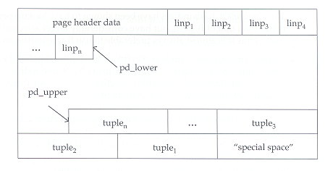
Storage and Indexing(Cont.)
Tables
  primary unit of storage is table
  tables are stored in heap files
  heap files use a form of the standard slotted-page

Slide 52
Storage and Indexing(Cont.)
Slotted-page format for PostgreSQL tables consists of
  page header
  an array of line pointer
    offset
    Length of a specific tuple in the page
  tuples
    stored in reverse order of line pointers from the end of the page

Slide 53
Storage and Indexing(Cont.)
The length of a tuple is limited
  by the length of a data page
  difficult to store very long tuples
  If PostgreSQL encounters a large tuple,
    tries to toast individual large columns
    The data in toasted column is a pointer for the data outside the page

Slide 54
Storage and Indexing(Cont.)
Indices
  Index types
    B-tree
    Hash
    R-tree
    Gist
  Other Index Variations
    Multicolumn indices
    Unique indices
    Indices on expressions
    Operator classes
    Partical indices

Slide 55
Overview
26.1 Introduction
26.2 User Interfaces
26.3 SQL Variations and Extensions
26.4 Transaction Management in PostgreSQL
26.5 Storage and Indexing
26.6 Query Processing and Optimization
26.7 System Architecture
Summary & Bibliographical Notes

Slide 56
Query Processing and Optimization
Steps to process the query on PostgreSQL
  Receives a query
  Parsing
  Construct a query plan
  Execute the query plan

Slide 57
Query Processing and Optimization(Cont.)
Query Rewrite
  Is responsible for the PostgreSQL rules system
  Rules are only defined by users and by the definition of views
  A rule is registered in the system using the create rule command
  Information on the rule is stored in the catalog
  The catalog is used during query rewrite to uncover all candidate rules for a given query
  The rewrite phase
    At first, deals with all update, delete, insert statements by firing all appropriate rules
    All the remaining rules involving only select statements are fired
    The rules are repeatedly checked until no more rules need to be fired

Slide 58
Query Processing and Optimization(Cont.)
Query planning and Optimization
  Planning begins bottom-up from the rewritten query’s innermost subquery
  Optimizer in PostgreSQL
    cost based
    The actual process of optimization is based on one of the two:
      Standard planner
        dynamic programming algorithm
      Genetic query optimizer
        algorithm developed to solve TSP
        dynamic programming algorithm are very expensive if the number of tables in a query is large
        used on PostgreSQL

Slide 59
Query Processing and Optimization(Cont.)
Query planning and Optimization(Cont.)
  The query-optimization phase
    construct a query plan that is a tree of relational operators
    operators represent a operation on sets of tuples
  Crucial to the cost model is
    estimation of the total number of tuples at each operator
    is inferred on the basis of statistics maintained on each relation
    The DBA must ensure that these statistics are current by running the analyze command periodically

Slide 60
Query Processing and Optimization(Cont.)
Query Executor
  Access methods
    Sequential scans
      Scanned sequentially from the first to last blocks
      Each tuple is returned to the caller only if it is visible
    Index scans
      Given an index range, returns a set of matching tuples
  Join methods
    PostgreSQL supports sort merge joins, nested-loop joins and a hybrid hash join
  Sort
  Aggregation

Slide 61
Query Processing and Optimization(Cont.)
Triggers and Constraints
  Not implemented in the rewrite phase
  But implemented as part of the query executor
  When registered by the user, the details are associated with the catalog information
  The executor checks for candidate triggers and constraints if tuples are changed for update, delete and insert

Slide 62
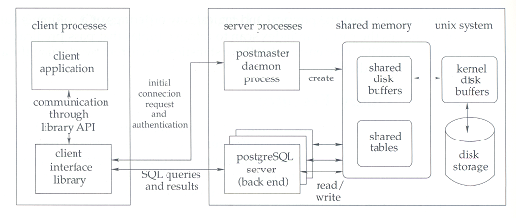
Query Processing and Optimization(Cont.)

Slide 63
Overview
26.1 Introduction
26.2 User Interfaces
26.3 SQL Variations and Extensions
26.4 Transaction Management in PostgreSQL
26.5 Storage and Indexing
26.6 Query Processing and Optimization
26.7 System Architecture
Summary & Bibliographical Notes

Slide 64
System Architecture
System architecture follows the process-per-transaction model
Postmaster
  a central coordinating process
  manages the PostgreSQL sites
  is responsible for
    initializing and shutting down the server
    handling connection request from new clients
    constantly listens for new connections on a known port
    assigns each new client to a back-end server process
    once assigns a client to a back-end server, the client interacts only with the back-end server

Slide 65
System Architecture(Cont.)
Client applications
  connect to the PostgreSQL server
  submit queries through one of the DB API
Back-end server process
  is responsible for executing the queries by the client
  can handle only a single query at a time
  to execute in parallel, an application must maintain multiple connections to the server
  back-end server can be executing concurrently
  access DB data through the main-memory buffer pool as a shared memory to have same view of data

Slide 66
Overview
26.1 Introduction
26.2 User Interfaces
26.3 SQL Variations and Extensions
26.4 Transaction Management in PostgreSQL
26.5 Storage and Indexing
26.6 Query Processing and Optimization
26.7 System Architecture
Summary & Bibliographical Notes

Slide 67
Summary(1)
PostgreSQL is an open-source object-relational database management system. Currently, PostgreSQL supports SQL92 and SQL:1999 and offers features such as complex queries, foreign keys, triggers, views, transactional integrity, and multiversion concurrency control.
In addition, users can extend PostgreSQL with new data types, functions, operators or index methods.
PostgreSQL works with a variety of programming languages(including C, C++, Java, Perl, Tcl, and Python)
PostgreSQL boasts sophisticated features such as the Multi-Version Concurrency Control (MVCC), point in time recovery, tablespaces, asynchronous replication, nested transactions (savepoints), online/hot backups, a sophisticated query planner/optimizer, and write ahead log for fault tolerance.

Slide 68
Summary(2)
It supports international character sets, multibyte character encodings, Unicode, and in is locale-aware for sorting, case-sensitivity, and formatting. It is highly scalable both in sheer quantity of data it can manage and and in the number of concurrent users it can accommodate. There are active PostgreSQL systems in production environments that manage in excess of 4 terabytes of data

Slide 69
Bibliographical Notes(1)
Extensive on line documentation of PostgreSQL
http://www.postgresql.org
Until PostgreSQL version 8, the only way to run PostgreSQL under Microsoft Windows was by using Cygwin, details are at
http://www.cygwin.com
Books on PostgreSQL include
Douglas and Douglas[2003]
Stinson
Rules as used in PostgreSQL
Stonebraker et al.[1990]
The Gist structure is described in
Hellerstein et al.[1995]

Slide 70
Bibliographical Notes(2)
The PostgreSQL administration tools, pgAccess and pgAdmin are described at
http://www.pgaccess.org
http://www.pgadmin.org
The PostgreSQL database design tools, TORA and Data Architect are described at
http://www.globecom.se/tora
http://www.thekompany.com/products/dataarchitect
The report-generation tools GNU Report Generator and GNU Enterprise are described at
http://www.gnu.org/software/grg
http://www.gnuenterprise.org
The Mondrian OLAP server is described at
http://mondrian.sourceforge.net

Slide 71
Overview
26.1 Introduction
26.2 User Interfaces
26.3 SQL Variations and Extensions
26.4 Transaction Management in PostgreSQL
26.5 Storage and Indexing
26.6 Query Processing and Optimization
26.7 System Architecture
Summary & Bibliographical Notes

Slide 72
End of Chapter

