Slide 1
V-SMART-Join: A Scalable MapReduce Framework for All-Pair Similarity Joins of Multisets and Vectors
Ahmed Metwally, Google
Christos Faloutsos,
SCS, Carnegie Mellon University
VLDB 2012
30 August 2013
SNU IDB Lab.
Hyesung Oh

Slide 2
Outline
Introduction
Classifying Sim Measures and Partial Results
The Annotated Index Insight
Algorithms: Build Index and Compute Similarity
Evaluation Results
Conclusion

Slide 3
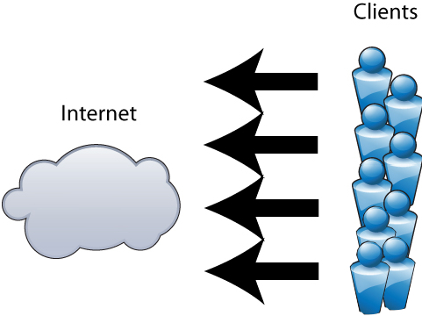
Introduction
Identifying load balancing IPs
Same user body behind a load balancer: same decision for all its IPs
Applications:
Click fraud detection based on source IP address
Advertising targeting based on the IP address geo

Slide 4
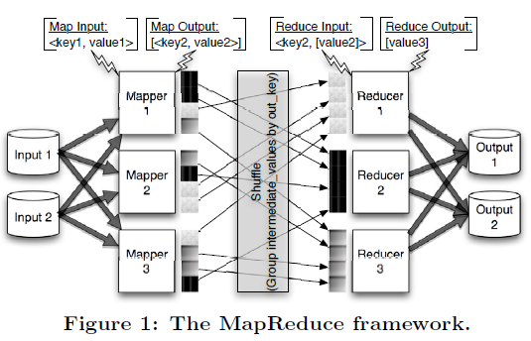
Mapreduce
Mapreduce
key, value w/ Mapper and Reducer
facilitate crunching huge datasets
using shared-nothing clusters of commodity machines

Slide 5
Multiset
Generalization of the notion of set in which members are allowed to appear more than once
e.g., {a, a, b, b, b, c} = {a, b, a, b, b, c}

Slide 6
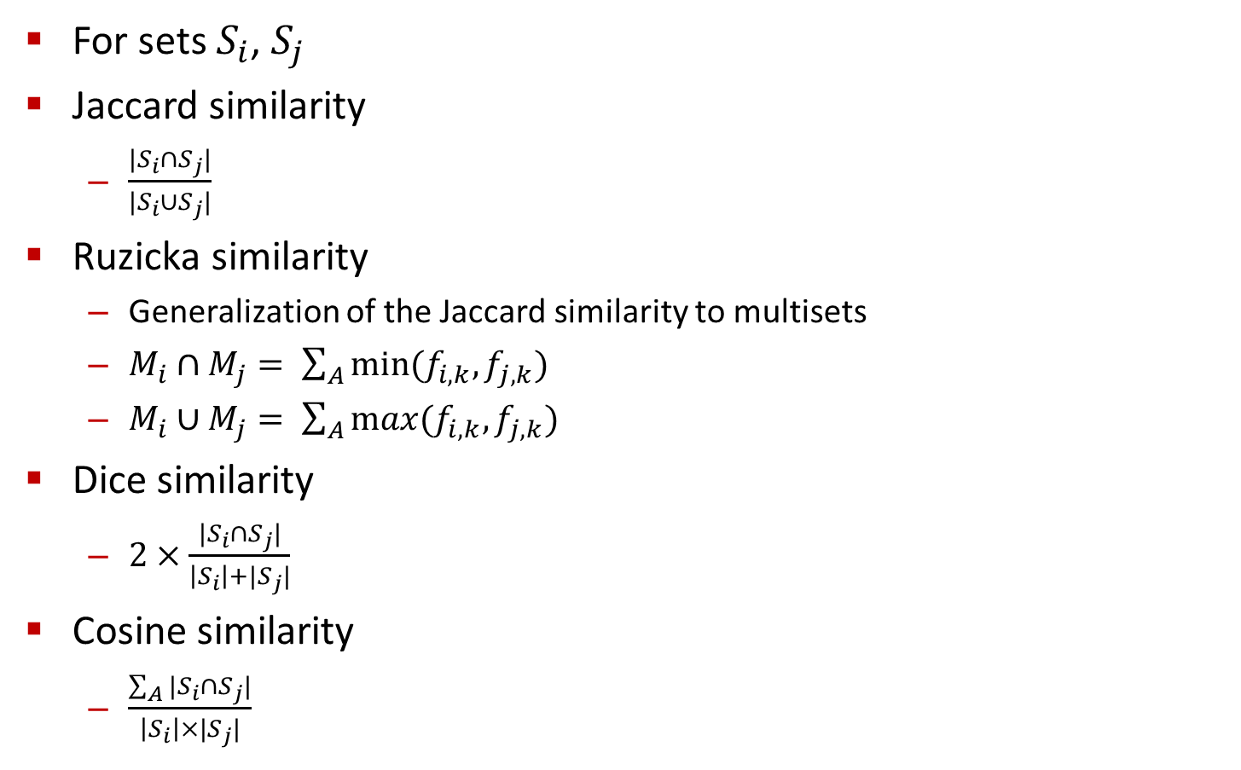
Similarity
For sets $S_{i}$, $S_{j}$
Jaccard similarity
$\frac{|S_{i}∩S_{j}|}{|S_{i}∪S_{j}|}$
Ruzicka similarity
Generalization of the Jaccard similarity to multisets
$M_{i}∩M_{j}= \sum_{A}{min⁡(f_{i,k},f_{j,k})}$
$M_{i}∪M_{j}= \sum_{A}{max(f_{i,k},f_{j,k})}$
Dice similarity
$2×\frac{|S_{i}∩S_{j}|}{\left|S_{i}\right|+|S_{j}|}$
Cosine similarity
$\frac{\sum_{A}{|S_{i}∩S_{j}|}}{\left|S_{i}\right|×|S_{j}|}$

Slide 7
Main Steps
1- IP Representation
A multiset or a bag of cookies
{ , , , } = { , , , } = {⟨ , 1⟩, ⟨ , 2⟩, ⟨ , 1⟩}
Representable as large sparse vector
2- Find all similar pairs of multisets/vectors
A pair is similar if similarity exceed a threshold, t
3- Apply a graph clustering algorithm
A similar pair represent an edge
Find all dense graphs in a huge sparse graph using MR
M_{i}
a_{k}
f_{i, k}

Slide 8
Similarity Measures
Commutative
Sim(M_{i}, M_{j}) = Sim(M_{j}, M_{i})
Shuffling Invariance Property (SIP)
Order of the alphabet does not impact similarity of two sets/multisets/vectors
Sim( , )
=
Sim( , )
Nominal Similarity Measures (NSMs) exhibit (SIP)
Examples of NSMs:
Jaccard, Cosine, Lp, Chi-square, Kullback–Leibler divergence (and the related)
Examples of non-NSMs:
Earth Mover’s Distance (EMD), Kolmogorov–Smirnov distance. (and the related)
2
1
0
6
3
4
1
0
1
0
6
2
4
1
0
3

Slide 9
NSMs and Partial Results
General form of NSMs
Sim(M_{i}, M_{j}) = F(Π₁^{A} (g₁(f_{i,k}, f_{j,k})),
Π₂^{A} (g₂(f_{i,k}, f_{j,k})),
…
Π_{L}^{A} (g_{L}(f_{i,k}, f_{j,k})))
F combine several partial results on the form Π_{l}^{A} (g_{l}(f_{i,k}, f_{j,k})).
Each Π_{l}^{A} (g_{l}(f_{i,k}, f_{j,k})) is an aggregation over the A, the alphabet, using Π_{l}.
Ruzicka(M_{i}, M_{j}) = |M_{i} ∩ M_{j} | / |M_{i} ∪ M_{j}|
= Σ^{A}min(f_{i,k}, f_{j,k}) / Σ^{A}max(f_{i,k}, f_{j,k})
g₁ is the min() function, g₂ is the max() function
Π₁ and Π₂ are summations, and F is division

Slide 10
Classifying NSMs’ Partial Results
Do we need to scan the entire alphabet, A, to compute Π₁^{A}(g₁(f_{i,k}, f_{j,k}))?
Classify partial results based on elements needed in the calculation
Unilateral partial results: Only needs to scan elements in one of M_{i} or M_{j}.
Conjunctive partial results: Only needs to scan elements in M_{i} ∩ M_{j}.
Disjunctive partial results: Only needs to scan elements in M_{i} ∪ M_{j}.
Ruzicka(M_{i}, M_{j}) = (M_{i} ∩ M_{j} ) / (M_{i} ∪ M_{j})
= Σ^{A}min(f_{i,k}, f_{j,k}) / Σ^{A}max(f_{i,k}, f_{j,k})
g₁, the min() function, is conjunctive, g₂, the max() function, is disjunctive.
Disjunctive partial results are harder handle ➔ convert to other forms
Ruzicka(M_{i}, M_{j}) = Σ^{A}min(f_{i,k}, f_{j,k}) /
(Σ^{A}first_arg(f_{i,k}, f_{j,k}) + Σ^{A}second_arg(f_{i,k}, f_{j,k}) - Σ^{A}min(f_{i,k}, f_{j,k}))
g₁ and g₄, the min() function, are conjunctive; g₂, the first_arg() function, and g₃, the second_arg() function, are both unilateral.

Slide 11
Insight for High Scalability
End goal:
An inverted index from elements to multisets.
The unilateral partial results of each multiset is joined with it in the index.
Hence, the annotated index
Already contains the unilateral partial results for all multisets
Can be used to compute the conjunctive partial results for all pairs sharing an element
Hence, can be used to compute the similarity of all pairs of multisets.
Example, the red and green index entries provide enough information for Sim(M₁, M₃)
{⟨M₁, Uni(M₁)⟩, ⟨M₄, Uni(M₄)⟩}
{⟨M₁, Uni(M₁)⟩, ⟨M₃, Uni(M₃)⟩, ⟨M₅, Uni(M₅)⟩}
{⟨M₂, Uni(M₂)⟩}
{⟨M₁, Uni(M₁)⟩, ⟨M₃, Uni(M₃)⟩}

Slide 12
Building the Annotated Index
Simple trick:
Compute Uni(M_{i}) for each M_{i}, in one scan on the dataset.
Join Uni(M_{i}) to all the elements of M_{i},
i.e., convert the input tuples to augmented tuples
⟨M_{i}, m_{i,k}⟩ → ⟨M_{i}, Uni(M_{i}), m_{i,k}⟩
MapReduce builds an implicit annotated index on the reduce keys.
For each augmented tuple, ⟨M_{i}, Uni(M_{i}), m_{i,k}⟩, the mapper emits the element a_{k} as the key and ⟨M_{i}, Uni(M_{i}), f_{i,k}⟩ as the value
The reducer receives all the multisets sharing a_{k} and their Uni(M_{i}) values.
Two fundamental questions:
How to convert the input tuples to the augmented tuples (join Uni(M_{i}))?
How to compute the similarity from the implicit annotated index?

Slide 13
Algorithm 1 for augmenting tuples: Online-Aggregation
Mapper
Emits the input tuple twice, once with secondary key 0 and once with secondary key 1.
⟨M_{i}, m_{i,k}⟩ → ⟨M_{i}, 0, f_{i,k}⟩, ⟨M_{i}, 1, m_{i,k}⟩
Shuffler
Sorts all mapper output by secondary key
Reducer
For M_{i}, receives all tuples with secondary key 0 first, then tuples with key 1
Uses the tuples with secondary key 0 to compute Uni(M_{i})
Emits the value(s) of Uni(M_{i}) with each tuple it scans with secondary key 1
⟨M_{i}, (0, (f_{i,k})∗), (1, (m_{i,k})∗)⟩→ (⟨M_{i}, Uni(M_{i}), m_{i,k}⟩)∗
Use of secondary keys
Uni(M_{i})
f_{i,k} with Secondary Key = 0
m_{i,k} with Secondary Key = 1

Slide 14
Algorithm 2 for augmenting tuples: Lookup
Multiset | Unilateral
M₁ | Uni(M₁)
M₂ | Uni(M₂)
… | …
M_{|S|} | Uni(M_{|S|})
Step1: Computes Uni(M_{i}) for each M_{i}
Mapper1
Emits f_{i,k} for al the elements, keyed by M_{i}
⟨M_{i}, m_{i,k}⟩ → ⟨M_{i}, f_{i,k}⟩
Reducer1
For M_{i}, receives all f_{i,k} values, compute Uni(M_{i}), and emits it to a lookup table
⟨M_{i}, (f_{i,k})∗⟩→ ⟨M_{i}, ⟨Uni(M_{i}) ⟩⟩
Step2: Joins Uni(M_{i}) for each M_{i}
Mapper2
Loads the lookup table, for each input tuple, looks up Uni(M_{i}) and joins.
⟨M_{i}, m_{i,k}⟩ → ⟨M_{i}, Uni(M_{i}), m_{i,k}⟩
Reducer2
Does nothing. Optimizations in the paper to join with the similarity phase.
Lookup table size is proportional to the number of multisets
m_{i,k} for multiset M_{i}

Slide 15
Algorithm 3 for augmenting tuples: Sharding
Hybrid between Online-Aggregation and Lookup
First MR step
builds lookup table only for multisets with a large number of distinct elements
Second MR step
Either joins the input tuples with Uni(M_{i}) if the lookup table has the data
Or computes Uni(M_{i}) on the fly, since M_{i} does not have a lot of distinct elements (hence can fit in memory).
Does not use secondary keys
Does not have scalability problems of the Lookup algorithm

Slide 16
The Similarity Phase
Step1: Builds inverted index and finds all pairs sharing elements
Mapper1
Builds the annotated index by emitting the augmented tuples keyed by a_{k}
⟨M_{i}, Uni(M_{i}), m_{i,k}⟩ → ⟨a_{k},⟨M_{i}, Uni(M_{i}), f_{i,k}⟩⟩
Reducer1
Emits all the pairs of multisets sharing an element
⟨a_{k},(⟨M_{i}, Uni(M_{i}), f_{i,k}⟩)* ⟩ →(⟨ ⟨M_{i}, M_{j}, Uni(M_{i}), Uni(M_{j})⟩,⟨f_{i,k}, f_{j,k}⟩ ⟩)*
Step2: Computes the partial results and the similarities
Mapper2 (Identity Mapper)
Reducer2
Has all the information necessary to compute the similarity between the pair.
⟨⟨Mi, M_{j}, Uni(M_{i}), Uni(M_{j} )⟩, (⟨f_{i,k}, f_{j,k}⟩)* ⟩ → ⟨ M_{i}, M_{j} , Sim(M_{i}, M_{j} )⟩

Slide 17
Setup and Datasets
Setup
Compared against state of the art VCL [Vernica et al., SIGMOD’10]
Same number of machines
1G ram, 10G Disk
Median-of-5 measurements
Two Datasets
Smaller Dataset
82M IPs and 133M unique cookies
Realistic Dataset
454M IPs and 2.2B unique cookies

Slide 18
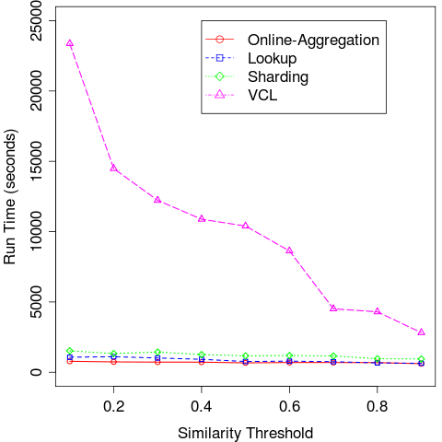
Comparison on Small Dataset (Various Thresholds)
Number of machines = 500

Slide 19
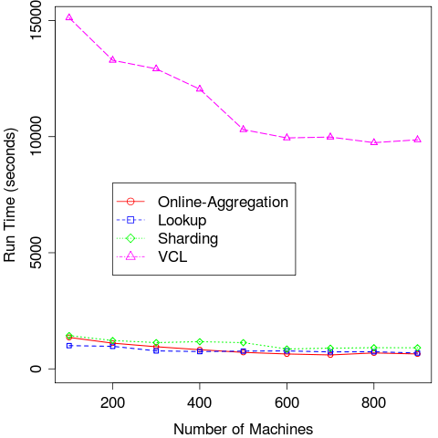
Comparison on Small Dataset (Scalability)
Similarity threshold = 0.5

Slide 20
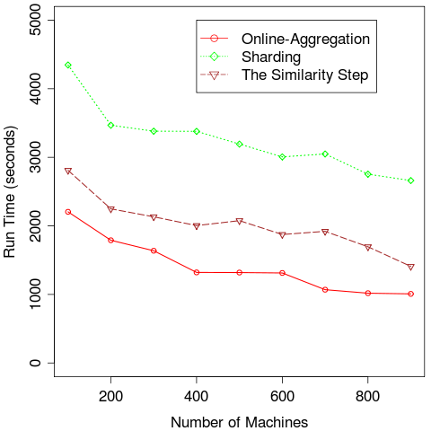
Comparison on Realistic Dataset (Scalability)
Similarity threshold = 0.5

Slide 21
A Note on the Identified Proxies
For each similarity threshold, manually analysis IPs to discover FPs
FPs are IPs identified as proxies, but manual investigation disproves
Threshold = 0.1 yields highest coverage and highest FPs
To reduce FPs, filter small IPs (contributing < 50 cookies)
After weeding out small IPs, number of cookies more than two orders of magnitude number of IPs
Discovered proxies
Most of discovered proxies in Europe
Yet, most active load balancers were in Saudi Arabia and North Korea
Load balancers spanned several subnets, and comprised thousands of IPs

Slide 22
Conclusion
Contributions
A classification of partial results for computing NSMs
A two staged self similarity framework that is
Versatile (works with sets, multisets, and vectors)
Scalable (with the number of machines, entities, and elements)
Well Engineered (can be run on both MR and Hadoop)
Experimental verification
Lesson learned
Algorithms devised for MR can be more efficient and scalable than those de- vised by adopting sequential algorithms for this distributed setting
Limitations
NSMs expressible in terms of unilateral and conjunctive partial results
Sharding algorithm assumes sparse spaces (not suitable for distributions)

Slide 23
QnA
감사합니다!

