Slide 1
Efficient Subgraph Matching on Billion Node Graphs
Zhao Sun, Hongzhi Wang,
Bin Shao, Xaixun Wang,
and Jianzhong Li 30 January 2013
SNU IDB Lab.
Hyesung Oh

Slide 2
Outline
Introduction
Contribution
Method
Query optimization
Experimental results
Conclusions
Discussion

Slide 3
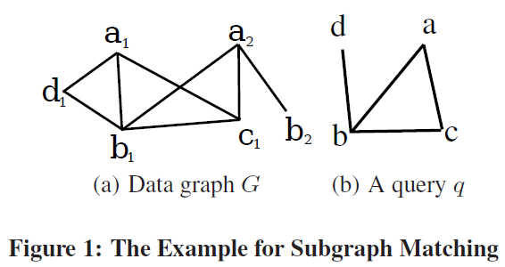
Introduction
Subgraph matching
Retrieve all subgraphs of G that are isomorphic to Q.

Slide 4
Introduction
Graphs serve as important data structures in many fields.
Large graphs
Social network
Facebook
800 millions of vertices
Average degree is 130
Web graph
2.1 billion vertices
15 billion edges
Graphs in biology
Subgraph matching on large graphs is in demand!

Slide 5
Existing Method
No index : Only work for “toy” graphs
Ullmann’s Algorithm
VF2
Edge index : Costly join, a subset of subgraph queries
RDF-3X
BitMat
Frequent subgraph index : Costly frequent subgraph finding
Subdue
SpiderMine
Reachability/Neighborhood index : Large size index
Rjoin
GraphQL
Zhao’s algorithm
GADDI
Notes:
No index -> 1k scale
Edge index -> SPARQL can only express a subset of …
Frequent subgraph index -> + a large number of frequent subgraphs lead to large index size, queries that do not contian frequent subgraphs are not very well supported

Slide 6
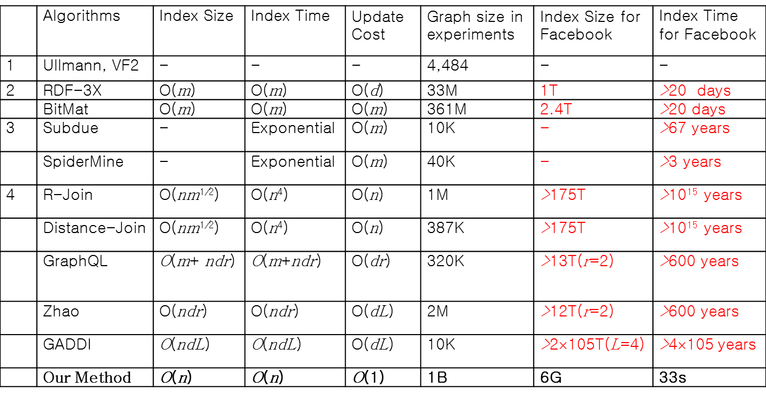
Comparison

Slide 7
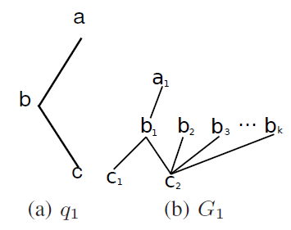
Exploration VS. Joins
Join
Decompose query graph into subgraphs and join the results
Pros
Decomposed queries can be directly answered by graph engine
Cons
Join operations are expensive
A lot of intermediary results produced in vain
Useless results

Slide 8
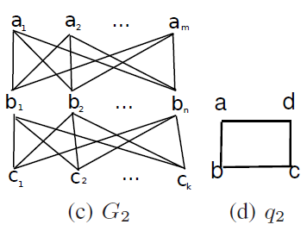
Exploration VS. Joins
Exploration
Matching subgraphs by graph exploration
Pros
Reduce intermediary results
Avoid join operation
Cons
Naïve exploration is more expensive than join -> (c )
Not all subgraph queries can be answered without join -> (d)
?

Slide 9
Contribution
Subgraph matching w/o graph index
Ignore index space or index update cost
Query optimization for query partitioning
Avoid expensive join operations
w/o data statistics
Consumes very little memory
Important for computing in the memory cloud

Slide 10
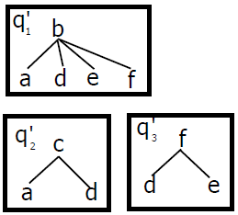
Overview
Basic idea
Exploration to avoid useless intermediary results
Basic Unit: STwig
Two level tree structure
Three Steps
Query decomposition and STwig ordering
Exploration
Join

Slide 11
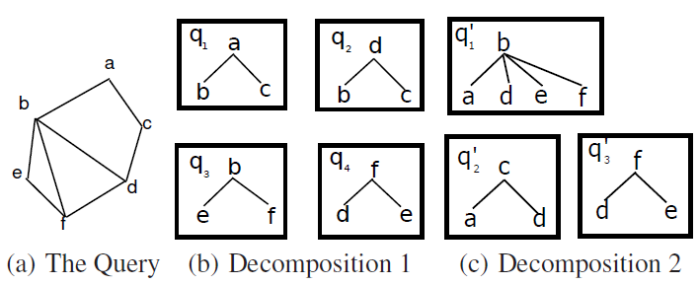

Query Decomposition and STwig Ordering
Decompose a query into a set of STwigs
Create a linear order of the STwigs
$q_{1}$, $q_{2}$, …, $q_{k}$

Slide 12
Exploration
H_{a} {a_{1,} a₂, a₃}
H_{b} {b_{1,} b₂, b₃ , b₄}
H_{c} {c_{1,}c₂,c₃}
H_{d {}d_{1,} d_{2,} d_{3}}
H_{a} {a_{1,} a₂, a₃}
H_{b} {b_{1,} b₂, b₃ , b₄}
H_{c} {c_{1,}c₂,c₃}
H_{a} {}
H_{b} {}
H_{c} {}

Slide 13
Join
Join intermediary results to generate final results
Two optimizations
Join order selection
Pipeline join
Save memory
Block-based pipeline join
Notes:
전체의 멀티웨이 조인이 수행되기 전에 블록기반의 파이프라인 조인이 수행되면서 부분적인 결과를 만들어낸다.
특별히 우리는 조인을 여러 단계로 나누고 각각의 단계에서 각각의 Stwig에 대해 한 블록만이 조인에 참가하게 된다.

Slide 14
Infrastructure
Trinity
Memory Cloud
Efficient graph exploration
Query Proxy
Subgraph Query
client
Results
Query Plan
Results
Query Plan
Query Plan
Results
Results
Intermediate Results
Intermediate Results
Server
Intermediate Results
Server
Server

Slide 15
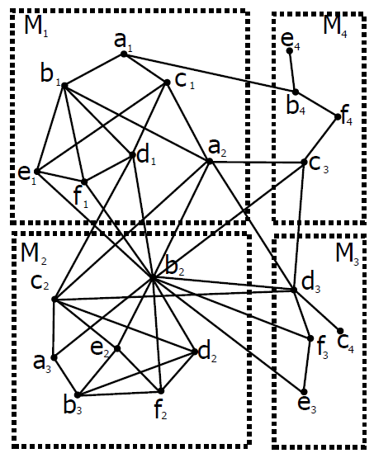
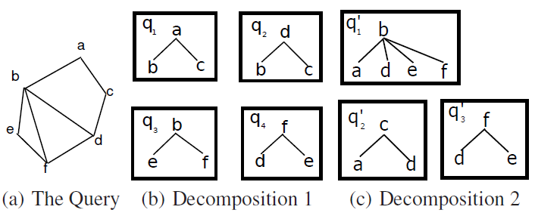
Distributed Subgraph Matching
Query decomposition and STwig ordering
Exploration
Join
Load necessary intermediate results

Slide 16
Query Optimization
Query decomposition
STwig order selection
Head STwig and load set selection

Slide 17
Query Decomposition
Goal: Minimize the STwig number
Polynomial equivalent to minimum vertex cover problem
Solve with the approximate algorithm for minimum vertex cover problem with ratio bound 2
Vertex cover
A set of vertices which touch all the edges of a graph

Slide 18
STwig Order Selection
Rules
Select edges connected to previous selected edges
Select edges incident to nodes with high selectivity
Rank function

Slide 19
Load Set Selection
Goal: Access only required computer in the join phrase
Cluster graph
=> k Load s from j to join with t

Slide 20
Head STwig Selection
Select a STwig as the first one for join during processing
Communication cost
Compute minimal d(s)
Compute all-pair shortest path M in query pattern
STwig with minimal d(s) is selected as q_{s}
min d(s) ⇒ min T(s)

Slide 21
Experiment Environment
Hardware
Cluster 1: 8 machines. Each has 32 GB DDR3 RAM and two 2.53 GHz Intel Xeon E5540 CPU. Network adapter: Broadcom BCM5709C NetXtreme II GigE
Cluster 2: 12 machines. Each has 48 GB DDR3 RAM and two 2.67 GHz Intel Xeon E5650 CPU. Dual network adapters: 1 Gbps HP NC382i DP Multifunction Gigabit Server Adapter and 40 Gbps Mellanox IPoIB Adapter
Software: Windows server 2008 R2; C# with .NET Framework 4
Data set
Real data
US Patents: 3,774,768 nodes; 16,522,438 edges; 418 labels
Wordnet: 82,670 nodes; 133,445 edges; 5 labels
Synthetic data: RMAT graph
Default: #node=64M, #degree=64, #label_density=0.0001
Query set
DFS: DFS from a randomly chosen node
Random: randomly adding E edges among N given nodes

Slide 22
Experiments on Real Data
For DFS query, run time increases significantly from node count 7
For random query, the run time is nearly linear with the query size
The edge number in a query has small impact on the run time
DFS
Random
Edge

Slide 23
Experiments on Real Data
Speedup Experiments
The run time is significantly reduces as machine number increases
The run time decreases sub-linearly with the machine number
The speedup ratio for DFS is greater than that for RANDOM
DFS
Random

Slide 24
Experiments on Real Data
Scalability experiments
Graph load time
Even when the graph size scales to 1B, it can be loaded in our system within a few hundreds of seconds
Node number (M) | 1 | 4 | 16 | 64 | 256 | 1024
Load Time (ms) | 2101 | 4515 | 9726 | 36409 | 66506 | 265801

Slide 25
Experiments on Synthetic Data
Scalability Experiments
Run time is not sensitive to total node count
Our approach scales well as graph grows large

Slide 26
Experiments on Synthetic Data
Varying With Parameters
The run time increases sub-linearly with graph density
The run time decreases when the label number increases

Slide 27
Conclusions
Subgraph matching is one of the most basic operations.
combine the benefits of subgraph join and graph exploration without using heavy structural indices.
Query optimization techniques and a parallel algorithm
Experimental results demonstrate that our method can scale to billion-node graphs.

Slide 28
Discussion
Strong points
Great time complexity
Weak points

