Slide 1
Hadoop: The Definitive Guide Chap. 8 MapReduce Features
Kisung Kim

Slide 2
Contents
Counters
Sorting
Joins
Side Data Distribution

Slide 3
Counters
Counters are a useful channel for gathering statistics about the job
Useful for problem diagnosis
Ex) # of invalid records
Easier to use and to retrieve than logging
Built-in counters
Report various metrics for Map-Reduce jobs
Map-Reduce Framework | Map input records
 | Map skipped records
 | Combine input records
 | Reduce output records
File Systems | Filesystem bytes read
 | Filesystem bytes written
Job Counters | Launched map tasks
 | Failed map tasks
 | Data-local map tasks
 | Rack-local map tasks
Some of Built-in Counters

Slide 4
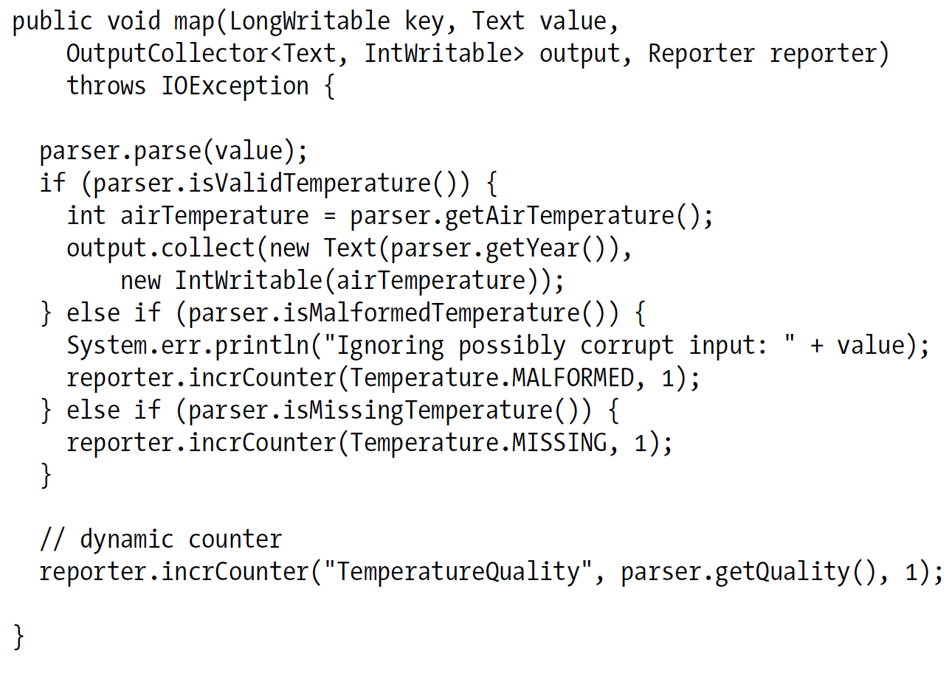
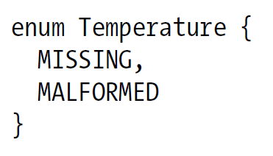
User-Defined Java Counter
MapReduce allows user code to define a set of counters, which are then incremented as desired in the mapper or reducer
Counters are defined by a Java enum
The name of the enum is the group name
The enum’s fields are the counter names

Slide 5
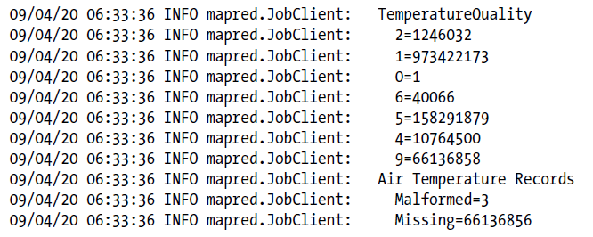

User-Defined Java Counter
When the job has successfully completed, it prints out the counters at the end
Readable names of counters
Create a properties file named after the enum, using an underscore as a separator for nested classes
MaxTemperatureWithCounters_Temperature.properties

Slide 6
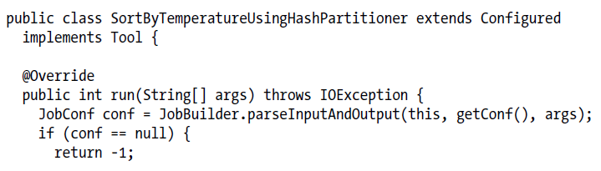
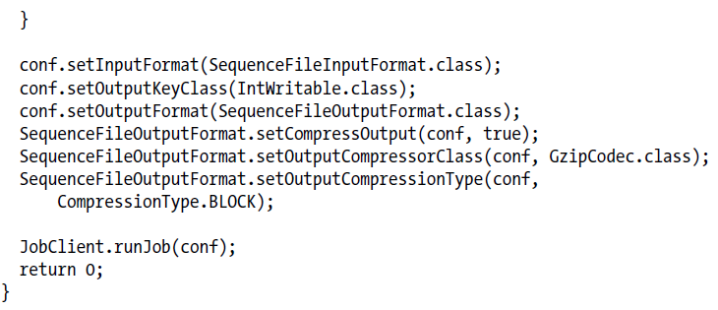
Sorting
By default, MapReduce will sort input records by their keys
This job produces 30 output files, each of which is sorted
However, there is no easy way to combine the files (partial sort)

Slide 7

Total Sort
Produce a set of sorted files that, if concatenated, would form a globally sorted file
Use a partitioner that respects the total order of the output
Ex) Range partitioner
Although this approach works, you have to choose your partition sizes carefully to ensure that they are fairly even so that job times aren’t dominated by a single reducer
Example: bad partitioning
To construct more even partitions, we need to have a better understanding of the distribution for the whole dataset

Slide 8

Sampling
It’s possible to get a fairly even set of partitions, by sampling the key space
The InputSampler class defines a nested Sampler interface whose implementations return a sample of keys given an InputFormat and JobConf
Type of sampler
Random sampler
Split sampler
Interval sampler

Slide 9
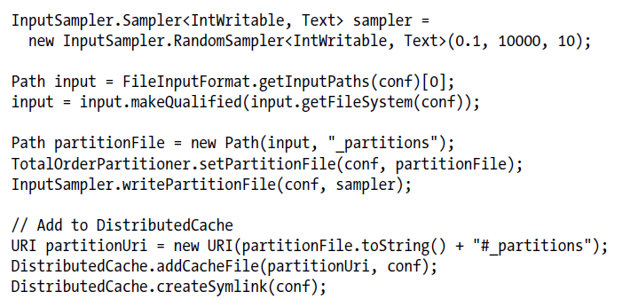

Example of Sampling
RandomSampler
Chooses keys with a uniform probability (here, 0.1)
There are also parameters for the maximum number of samples to take, and the maximum number of splits to sample (here, 10000 and 10)
Samplers run on the client, making it important to limit the number of splits that are downloaded, so the sampler runs quickly

Slide 10
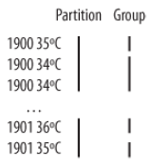
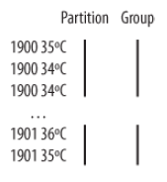

Secondary Sort
For any particular key, the values are not sorted
Even not stable from one run to the next
Example: calculating the maximum temperature for each year
It is possible to impose an order on the values by sorting and grouping the keys in a particular way
Make the key a composite of the natural key and the natural value.
The key comparator should order by the composite key, that is, the natural key and natural value.
The partitioner and grouping comparator for the composite key should consider only the natural key for partitioning and grouping

Slide 11
Map-Side Join
A map-side join works by performing the join before the data reaches the map function
Requirements
Each input dataset must be divided into the same number of partitions
It must be sorted by the same key (the join key) in each source
All the records for a particular key must reside in the same partition
Above requirements actually fit the description of the output of a MapReduce job
A map-side join can be used to join the outputs of several jobs that had the same number of reducers, the same keys, and output files that are not splittable
Use a CompositeInputFormat from the org.apache.hadoop.mapred.join package to run a map-side join
MapReduce Job for Sorting
Dataset 1
Map for Merge
Map
Reduce
Map
Dataset 2
Map
Reduce

Slide 12
Reduce-Side Join
More general than a map-side join
Input datasets don’t have to be structured in any particular way
Less efficient as both datasets have to go through the MapReduce shuffle
Idea
The mapper tags each record with its source
Uses the join key as the map output key so that the records with the same key are brought together in the reducer
Multiple inputs
The input sources for the datasets have different formats
Use the MultipleInputs class to separate the logic for parsing and tagging each source.
Secondary sort
To perform the join, it is important to have the data from one source before another

Slide 13
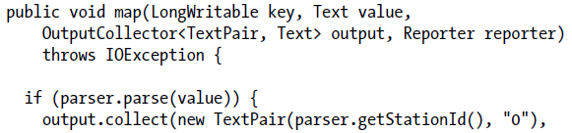

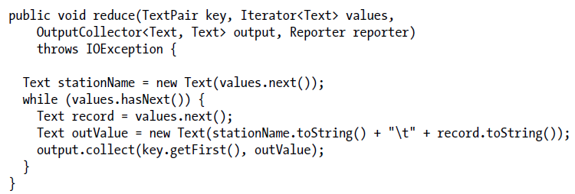
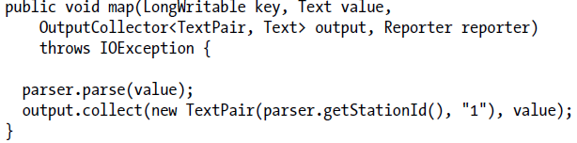
Example: Reduce-Side Join
The code assumes that every station ID in the weather records has exactly one matching record in the station dataset

Slide 14
Side Data Distribution
Side data
Extra read-only data needed by a job to process the main dataset
The challenge is to make side data available to all the map or reduce tasks (which are spread across the cluster)
Cache in memory in a static field
Using the Job Configuration
Distributed Cache

Slide 15
Using the Job Configuration
Set arbitrary key-value pairs in the job configuration using the various setter methods on JobConf
Useful if one needs to pass a small piece of metadata to tasks
Don’t use this mechanism for transferring more than a few kilobytes of data
The job configuration is read by the jobtracker, the tasktracker, and the child JVM, and each time the configuration is read, all of its entries are read into memory, even if they are not used

Slide 16
Distributed Cache
Distribute datasets using Hadoop’s distributed cache mechanism
Provides a service for copying files and archives to the task nodes in time for the tasks to use them when they run
GenericOptionsParser
Specify the files to be distributed as a comma-separated list of URIs as the argument to the -files option
This command will copy the local file stations-fixed-width.txt to the task nodes

Slide 17
Distributed Cache
Hadoop copies the file specified by the –file and -archives options to the jobtracker’s filesystem (normally HDFS)
Before a task is run, the tasktracker copies the files from the jobtracker’s filesystem to a local disk
The tasktracker also maintains a reference count for the number of tasks using each file in the cache
After the task has run, the file’s reference count is decreased by one, and when it reaches zero it is eligible for deletion
Files are deleted to make room for a new file when the cache exceeds a certain size—10 GB by default

