Slide 1
Serializable Isolation for Snapshot Databases
Michael J. Cahill, Uwe Röhm, and Alan D. Fekete
University of Sydney
ACM Transactions on Database Systems 2009
30 Mar 2012
Presentation @ IDB Lab. Seminar
Presented by Jee-bum Park

Slide 2
Outline
Introduction
Background
Isolation Levels
Snapshot Isolation
Write Skew
Serializable Snapshot Isolation
Performance Evaluation
Conclusion
Discussion

Slide 3
Introduction
Transaction processing
A powerful model from business data processing
Each real-world change is performed through a program which executes multiple database operations

Slide 4
Introduction
Transaction processing
A powerful model from business data processing
Each real-world change is performed through a program which executes multiple database operations
Date | User | Items
2012-03-29 | okbem | bread, milk

Slide 5
Introduction
Transaction processing
A powerful model from business data processing
Each real-world change is performed through a program which executes multiple database operations
Date | User | Items
2012-03-29 | okbem | bread, milk
2012-03-30 | okbem | bread, Chic-Choc

Slide 6
Introduction
Transaction processing
A powerful model from business data processing
Each real-world change is performed through a program which executes multiple database operations
Date | User | Items
2012-03-29 | okbem | bread, milk
2012-03-30 | okbem | bread, Chic-Choc
2012-03-30 | alice | bread, beer

Slide 7
Introduction
Transaction processing
A powerful model from business data processing
Each real-world change is performed through a program which executes multiple database operations
Date | User | Items
2012-03-29 | okbem | bread, milk
2012-03-30 | okbem | bread, Chic-Choc, milk, beer
2012-03-30 | alice | bread, beer

Slide 8
Introduction
ACID properties

Slide 9
Introduction
ACID properties
Atomicity
Consistency
Isolation
Durability

Slide 10
Introduction
ACID properties
Atomicity
All or nothing, despite failures
Consistency
Maintains data integrity
Isolation
No problems from concurrency
Durability
Changes persist despite crashes

Slide 11
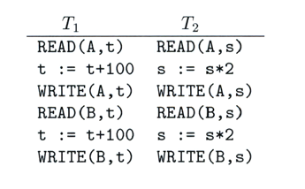
Introduction
Serializability
Used to define the correctness of an interleaved execution of several transactions

Slide 12
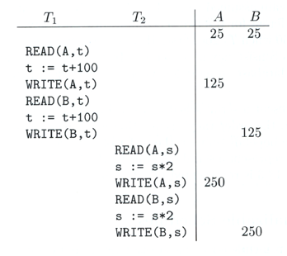
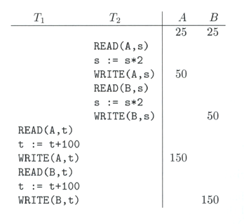
Introduction
Serializability
Used to define the correctness of an interleaved execution of several transactions

Slide 13
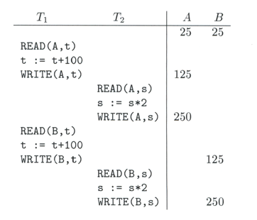
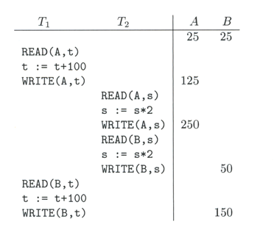
Introduction
Serializability
Used to define the correctness of an interleaved execution of several transactions

Slide 14
Outline
Introduction
Background
Isolation Levels
Snapshot Isolation
Write Skew
Serializable Snapshot Isolation
Performance Evaluation
Conclusion
Discussion

Slide 15
Background – Isolation Levels
SQL standard offers several isolation levels
Each transaction can have level set separately
Serializable
This is the highest isolation level
Commit-duration locks on data and indices (2PL)
Repeatable read
Commit-duration locks on data
Read committed
Short duration read locks, commit-duration write locks
Read uncommitted
This is the lowest isolation level
No read locks, commit-duration write locks

Slide 16
Background – Isolation Levels
SQL standard offers several isolation levels
Each transaction can have level set separately
Read anomalies
Dirty read
Non-repeatable read
Phantom read

Slide 17
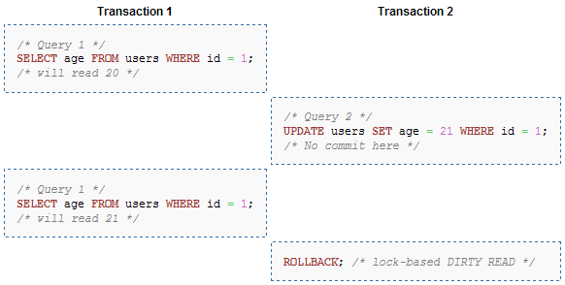
Background – Isolation Levels
SQL standard offers several isolation levels
Each transaction can have level set separately
Dirty read

Slide 18
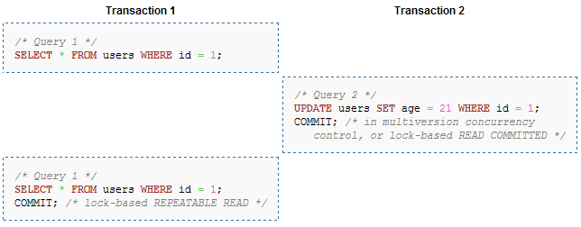
Background – Isolation Levels
SQL standard offers several isolation levels
Each transaction can have level set separately
Non-repeatable read

Slide 19
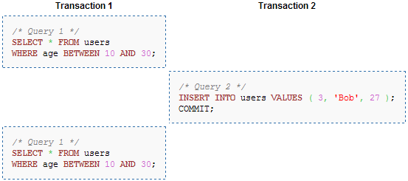
Background – Isolation Levels
SQL standard offers several isolation levels
Each transaction can have level set separately
Phantom read

Slide 20
Background – Isolation Levels
SQL standard offers several isolation levels
Each transaction can have level set separately
Isolation level | Dirty read | Non-repeatable read | Phantom
Read uncommitted | Yes | Yes | Yes
Read committed | No | Yes | Yes
Repeatable read | No | No | Yes
Serializable | No | No | No

Slide 21
Background – Snapshot Isolation
A concurrency control mechanism
Multiple versions
Version number timestamp of writing transaction
First-committer-wins rule
Commits T only if no other concurrent transaction has already written data that T intends to write
T1 | T2 | T3
W(Y := 1) Commit
 | Start R(X) → 0 R(Y)→ 1
 |  | W(X:=2) W(Z:=3) Commit
 | R(Z) → 0 R(Y) → 1 W(X:=3) Commit-Req Abort
Concurrent updates not visible
Own updates are visible
Not first-committer of X
Serialization error, T2 is rolled back

Slide 22
Background – Snapshot Isolation
Reading is never blocked, and reads do not block writes
Performance similar to read committed
Avoids the usual anomalies
No dirty read
No lost update
No non-repeatable read
No phantom

Slide 23
Background – Snapshot Isolation
Write-write conflict example
T1: X ← 1 – X
T2: X ← 1 – X
T1 | T2
R(X)
W(X)
 | R(X)
 | W(X)
 | Commit
Commit

Slide 24
Background – Snapshot Isolation
Write-write conflict example
T1: X ← 1 – X
T2: X ← 1 – X
T1 (X = 0) | T2 (X = 0)
R(X)
W(X)
 | R(X)
 | W(X)
 | Commit
Commit

Slide 25
Background – Snapshot Isolation
Write-write conflict example
T1: X ← 1 – X
T2: X ← 1 – X
T1 (X = 0) | T2 (X = 0)
R(X)
W(X)
 | R(X)
 | W(X)
 | Commit
Commit

Slide 26
Background – Snapshot Isolation
Write-write conflict example
T1: X ← 1 – X
T2: X ← 1 – X
T1 (X = 0) | T2 (X = 0)
R(X)
W(X) (X = 1)
 | R(X)
 | W(X)
 | Commit
Commit

Slide 27
Background – Snapshot Isolation
Write-write conflict example
T1: X ← 1 – X
T2: X ← 1 – X
T1 (X = 0) | T2 (X = 0)
R(X)
W(X) (X = 1)
 | R(X)
 | W(X)
 | Commit
Commit

Slide 28
Background – Snapshot Isolation
Write-write conflict example
T1: X ← 1 – X
T2: X ← 1 – X
T1 (X = 0) | T2 (X = 0)
R(X)
W(X) (X = 1)
 | R(X)
 | W(X) (X = 1)
 | Commit
Commit

Slide 29
Background – Snapshot Isolation
Write-write conflict example
T1: X ← 1 – X
T2: X ← 1 – X
T1 (X = 0) | T2 (X = 0)
R(X)
W(X) (X = 1)
 | R(X)
 | W(X) (X = 1)
 | Commit
Commit

Slide 30
Background – Snapshot Isolation
Write-write conflict example
T1: X ← 1 – X
T2: X ← 1 – X
T1 (X = 0) | T2 (X = 0)
R(X)
W(X) (X = 1)
 | R(X)
 | W(X) (X = 1)
 | Commit
Commit (abort)

Slide 31
Background – Write Skew
Read-write conflict example
T1: Y ← X
T2: X ← Y
T1 | T2
R(X)
 | R(Y)
W(Y)
 | W(X)
Commit
 | Commit

Slide 32
Background – Write Skew
Read-write conflict example
T1: Y ← X
T2: X ← Y
T1 (Y = 2) | T2 (X = 1)
R(X)
 | R(Y)
W(Y)
 | W(X)
Commit
 | Commit

Slide 33
Background – Write Skew
Read-write conflict example
T1: Y ← X
T2: X ← Y
T1 (Y = 2) | T2 (X = 1)
R(X)
 | R(Y)
W(Y)
 | W(X)
Commit
 | Commit

Slide 34
Background – Write Skew
Read-write conflict example
T1: Y ← X
T2: X ← Y
T1 (Y = 2) | T2 (X = 1)
R(X)
 | R(Y)
W(Y)
 | W(X)
Commit
 | Commit

Slide 35
Background – Write Skew
Read-write conflict example
T1: Y ← X
T2: X ← Y
T1 (Y = 2) | T2 (X = 1)
R(X)
 | R(Y)
W(Y) (Y = 1)
 | W(X)
Commit
 | Commit

Slide 36
Background – Write Skew
Read-write conflict example
T1: Y ← X
T2: X ← Y
T1 (Y = 2) | T2 (X = 1)
R(X)
 | R(Y)
W(Y) (Y = 1)
 | W(X) (X = 2)
Commit
 | Commit

Slide 37
Background – Write Skew
Read-write conflict example
T1: Y ← X
T2: X ← Y
T1 (Y = 2) | T2 (X = 1)
R(X)
 | R(Y)
W(Y) (Y = 1)
 | W(X) (X = 2)
Commit
 | Commit

Slide 38
Background – Write Skew
Read-write conflict example
T1: Y ← X
T2: X ← Y
T1 (Y = 2) | T2 (X = 1)
R(X)
 | R(Y)
W(Y) (Y = 1)
 | W(X) (X = 2)
Commit
 | Commit

Slide 39
Background – Write Skew
SI does not guarantee serializable executions
Write skew
SI breaks serializability when transactions modify different items
Not very common in practice
Application developers should be careful about write skew

Slide 40
Outline
Introduction
Background
Isolation Levels
Snapshot Isolation
Write Skew
Serializable Snapshot Isolation
Performance Evaluation
Conclusion
Discussion

Slide 41
Serializable Snapshot Isolation
Add two flags to each transaction
InConflict and OutConflict
SIRead locks
To indicate rw-conflict
Does not block anything, just for record keeping
Kept even after transaction commits
When T1 requests a write lock
T1.OutConflict = true
T2.InConflict = true if SIRead lock acquired by T2
Abort T if both T.InConflict and T.OutConflict are set

Slide 42
Serializable Snapshot Isolation
Read-write conflict example
T1: Y ← X
T2: X ← Y
T1 In = false, Out = false | T2 In = false, Out = false
R(X)
 | R(Y)
W(Y)
 | W(X)
Commit
 | Commit

Slide 43
Serializable Snapshot Isolation
Read-write conflict example
T1: Y ← X
T2: X ← Y
T1 (Y = 2) In = false, Out = false | T2 (X = 1) In = false, Out = false
R(X)
 | R(Y)
W(Y)
 | W(X)
Commit
 | Commit

Slide 44
Serializable Snapshot Isolation
Read-write conflict example
T1: Y ← X
T2: X ← Y
T1 (Y = 2) In = false, Out = false | T2 (X = 1) In = false, Out = false
R(X) (SIRead X)
 | R(Y)
W(Y)
 | W(X)
Commit
 | Commit

Slide 45
Serializable Snapshot Isolation
Read-write conflict example
T1: Y ← X
T2: X ← Y
T1 (Y = 2) In = false, Out = false | T2 (X = 1) In = false, Out = false
R(X) (SIRead X)
 | R(Y) (SIRead Y)
W(Y)
 | W(X)
Commit
 | Commit

Slide 46
Serializable Snapshot Isolation
Read-write conflict example
T1: Y ← X
T2: X ← Y
T1 (Y = 2) In = false, Out = TRUE | T2 (X = 1) In = TRUE, Out = false
R(X) (SIRead X)
 | R(Y) (SIRead Y)
W(Y) (Y = 1)
 | W(X)
Commit
 | Commit

Slide 47
Serializable Snapshot Isolation
Read-write conflict example
T1: Y ← X
T2: X ← Y
T1 (Y = 2) In = TRUE, Out = TRUE | T2 (X = 1) In = TRUE, Out = TRUE
R(X) (SIRead X)
 | R(Y) (SIRead Y)
W(Y) (Y = 1)
 | W(X) (X = 2)
Commit
 | Commit

Slide 48
Serializable Snapshot Isolation
Read-write conflict example
T1: Y ← X
T2: X ← Y
T1 (Y = 2) In = TRUE, Out = TRUE | T2 (X = 1) In = TRUE, Out = TRUE
R(X) (SIRead X)
 | R(Y) (SIRead Y)
W(Y) (Y = 1)
 | W(X) (X = 2)
Commit (abort)
 | Commit

Slide 49
Serializable Snapshot Isolation
Read-write conflict example
T1: Y ← X
T2: X ← Y
T1 (Y = 2) In = TRUE, Out = TRUE | T2 (X = 1) In = TRUE, Out = TRUE
R(X) (SIRead X)
 | R(Y) (SIRead Y)
W(Y) (Y = 1)
 | W(X) (X = 2)
Commit (abort)
 | Commit (abort)

Slide 50
Serializable Snapshot Isolation
Read-write conflict example 2
T1: Y ← X
T2: X ← Y
T1 In = false, Out = false | T2 In = false, Out = false
R(X)
 | R(Y)
W(Y)
Commit
 | W(X)
 | Commit

Slide 51
Serializable Snapshot Isolation
Read-write conflict example 2
T1: Y ← X
T2: X ← Y
T1 (Y = 2) In = false, Out = false | T2 (X = 1) In = false, Out = false
R(X)
 | R(Y)
W(Y)
Commit
 | W(X)
 | Commit

Slide 52
Serializable Snapshot Isolation
Read-write conflict example 2
T1: Y ← X
T2: X ← Y
T1 (Y = 2) In = false, Out = false | T2 (X = 1) In = false, Out = false
R(X) (SIRead X)
 | R(Y)
W(Y)
Commit
 | W(X)
 | Commit

Slide 53
Serializable Snapshot Isolation
Read-write conflict example 2
T1: Y ← X
T2: X ← Y
T1 (Y = 2) In = false, Out = false | T2 (X = 1) In = false, Out = false
R(X) (SIRead X)
 | R(Y) (SIRead Y)
W(Y)
Commit
 | W(X)
 | Commit

Slide 54
Serializable Snapshot Isolation
Read-write conflict example 2
T1: Y ← X
T2: X ← Y
T1 (Y = 2) In = false, Out = TRUE | T2 (X = 1) In = TRUE, Out = false
R(X) (SIRead X)
 | R(Y) (SIRead Y)
W(Y) (Y = 1)
Commit
 | W(X)
 | Commit

Slide 55
Serializable Snapshot Isolation
Read-write conflict example 2
T1: Y ← X
T2: X ← Y
T1 (Y = 2) In = false, Out = TRUE | T2 (X = 1) In = TRUE, Out = false
R(X) (SIRead X)
 | R(Y) (SIRead Y)
W(Y) (Y = 1)
Commit
 | W(X)
 | Commit

Slide 56
Serializable Snapshot Isolation
Read-write conflict example 2
T1: Y ← X
T2: X ← Y
 | T2 (X = 1) In = TRUE, Out = false
 | R(Y) (SIRead Y)
 | W(X)
 | Commit

Slide 57
Serializable Snapshot Isolation
Read-write conflict example 2
T1: Y ← X
T2: X ← Y
 | T2 (X = 1) In = TRUE, Out = false
 | R(Y) (SIRead Y)
 | W(X) (X = 2)
 | Commit

Slide 58
Serializable Snapshot Isolation
Read-write conflict example 2
T1: Y ← X
T2: X ← Y
 | T2 (X = 1) In = TRUE, Out = false
 | R(Y) (SIRead Y)
 | W(X) (X = 2)
 | Commit (?????)

Slide 59
Serializable Snapshot Isolation
Read-write conflict example 2
T1: Y ← X
T2: X ← Y
Maintain locks past commit
Release when all concurrent transaction terminated
T1 (Y = 2) In = false, Out = TRUE | T2 (X = 1) In = TRUE, Out = false
R(X) (SIRead X)
 | R(Y) (SIRead Y)
W(Y) (Y = 1)
Commit
 | W(X)
 | Commit

Slide 60
Outline
Introduction
Background
Isolation Levels
Snapshot Isolation
Write Skew
Serializable Snapshot Isolation
Performance Evaluation
Conclusion
Discussion

Slide 61
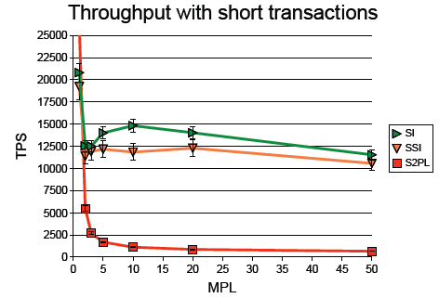
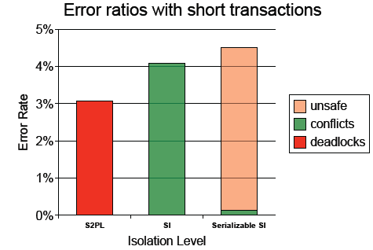
Performance Evaluation

Slide 62
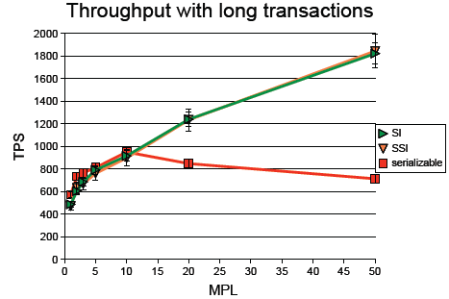
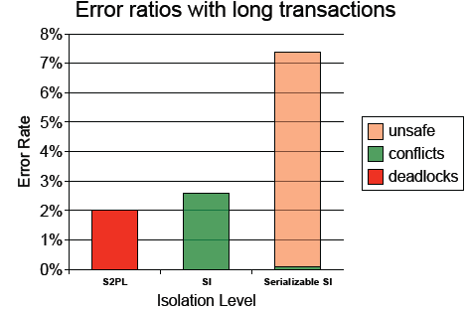
Performance Evaluation

Slide 63
Outline
Introduction
Background
Isolation Levels
Snapshot Isolation
Write Skew
Serializable Snapshot Isolation
Performance Evaluation
Conclusion
Discussion

Slide 64
Conclusion
Serializable SI
Performance better than 2PL
Correctness better than SI
Adopted in PostgreSQL 9.1 (2011-09-11)

Slide 65
Outline
Introduction
Background
Isolation Levels
Snapshot Isolation
Write Skew
Serializable Snapshot Isolation
Performance Evaluation
Conclusion
Discussion

Slide 66
Discussion
Free talking time

Slide 67
Thank You!
Any Questions or Comments?

