Slide 1
Tag-based
Social Interest Discovery
WWW 2008, Beijing, China.
Xin Li, Lei Guo, Yihong (Eric) Zhao
Yahoo! Inc.
701 First Avenue
Sunnyvale, CA 94089
SNU IDB Lab.
Chung-soo Jang
April 18, 2008

Slide 2
Content
Introduction
Related Work
Data Set
  Data Collection and Pre-Processing
  Users, URLs, and Tags
ANALYSIS OF TAGS
  An Example of Tags vs. Keywords
  The Vocabulary of Tags
  The Convergence of User’s Tag Selections
  Tags Matched by Documents
  Discovering Social Interest with Tags
ARCHITECTURE FOR SOCIAL INTEREST DISCOVERY
  Data Source
  Topic Discovery
  Clustering
  Indexing
  Online Version
EVALUATION RESULT
  The URL Similarity of Intra- and Inter- Topics
  User Interest Coverage
  Human Reviews
  Cluster Properties
Conclusions

Slide 3




Introduction (1)
The recent viral growth of social network system
Fundamental problem
  Discovering common interests shared by users

Slide 4
Introduction (2)
Two kinds of existing approaches
  User-centric
    Based on the social connections among users
    Graph connection analysis of Schwartz et al.and Ali-Hasan
    Facebook
    Non applicable in del.icio.us
  Object-centric
    Based on the common objects fetched by users
    Sripanidkulchai et al., and Guo: common interests in p2p network

Slide 5
Introduction (3)
Two kinds of existing approaches
  Object-centric
    Limitations
      Needs to other information of the objects
    Non applicable in del.icio.us
      del.icio.us, most of objects are unpopular.
      difficult to discover common interest topics of users on them.
Our approach focuses
  Directly detecting social interests or topics by taking advantage of user tags.

Slide 6
Introduction (4)
Two kinds of existing approaches
  Object-centric
    Limitations
      Needs to other information of the objects
    Non applicable in del.icio.us
      del.icio.us, most of objects are unpopular.
      difficult to discover common interest topics of users on them.
Our approach focuses
  Directly detecting social interests or topics by taking advantage of user tags.

Slide 7
Introduction (5)
Key observation of tag
  (1) Rich and large
    Enough to describe the main natural concepts of the web
  (2) For each URL, the number
    Much smaller than the number of the unique keywords
  (3) Different users may assign different tags
    Personal vocabulary , the summary of main concepts
    Compact and stable enough to characterize the same main concepts
  (4) Embracing different human judgments
    Help to identify the social interests in more finer granularity.

Slide 8
Introduction (6)
Our Motivation
  To exploit the human judgment contained in tags to discover social interests.
  Internet Social Interest Discovery development

Slide 9
Content
Introduction
Related Work
Data Set
  Data Collection and Pre-Processing
  Users, URLs, and Tags
ANALYSIS OF TAGS
  An Example of Tags vs. Keywords
  The Vocabulary of Tags
  The Convergence of User’s Tag Selections
  Tags Matched by Documents
  Discovering Social Interest with Tags
ARCHITECTURE FOR SOCIAL INTEREST DISCOVERY
  Data Source
  Topic Discovery
  Clustering
  Indexing
  Online Version
EVALUATION RESULT
  The URL Similarity of Intra- and Inter- Topics
  User Interest Coverage
  Human Reviews
  Cluster Properties
Conclusions

Slide 10
Related Work (1)
User-centric schemes
  Graph-based analysis
    M. F. Schwartz and D. C. M. Wood. [14]
    Referral[11]
      Co-occurrence of names with close proximity in web doc
    Clauset et al., [7]

Slide 11
Related Work (2)
Object-centric
  Shared interest
    Sripanidkulchai et al., [15] and by Guo et al., [9]
    P2P network
    Focusing on finding desired objects from users with the same interests
    Non-descriptive shared interests
    limiting the applications of shared interests, especially for Web social networks

Slide 12
Related Work (3)
Links and comments
  Ali-Hasan and Adamic [3]
    Extracting such relations
    But, non-trivial.
      A social bookmark system such as del.icio.us, no such relation exists.

Slide 13
Related Work (4)
Tagging
  Widely used
  Few experimental research
    Golder et al., [8]
    del.icio.us the proportion of frequencies of tags
      Tend to stabilize with time due to the collaborative tagging by all users.
    Halpin et al., [10]
      Distribution of frequency of del.icio.us tags for popular sites follows the power law.
      A generative model of collaborative tagging
        how power law distribution could arise and stabilize over time?

Slide 14
Related Work (5)
Tagging
  Few experimental research
    Brooks et al., [6]
      Clustering blog articles that share the same tag
      Analysis the effectiveness of tags for blog classification
      Average pair-wise similarity in tag-based clusters
        A little higher than that of randomly clustered articles
        Much lower than that of articles clustered with high tf×idf key words.
      Ours is based on the co-occurrence of multiple tags, instead of a single tag, thus can identify shared interests and cluster similar articles more accurately.

Slide 15
Content
Introduction
Related Work
Data Set
  Data Collection and Pre-Processing
  Users, URLs, and Tags
ANALYSIS OF TAGS
  An Example of Tags vs. Keywords
  The Vocabulary of Tags
  The Convergence of User’s Tag Selections
  Tags Matched by Documents
  Discovering Social Interest with Tags
ARCHITECTURE FOR SOCIAL INTEREST DISCOVERY
  Data Source
  Topic Discovery
  Clustering
  Indexing
  Online Version
EVALUATION RESULT
  The URL Similarity of Intra- and Inter- Topics
  User Interest Coverage
  Human Reviews
  Cluster Properties
Conclusions

Slide 16
Data Set (1)
Graph partitioning
  A topic of active research topic
  A k-way graph partitioning
    Graph G
    => K mutually exclusive subsets of vertices of approximately the
    same size such that the number of edges of G that belong to
    different subsets is minimized.
    NP-HARD
    Several heuristic technique
      Especially, multilevel graph bisection
        Kernighan-Lin based on cut-size reduction when changing node
      Constraint that number of partitions has to be specified in advance

Slide 17
Content
Introduction
Related Work
Data Set
  Data Collection and Pre-Processing
  Users, URLs, and Tags
ANALYSIS OF TAGS
  An Example of Tags vs. Keywords
  The Vocabulary of Tags
  The Convergence of User’s Tag Selections
  Tags Matched by Documents
  Discovering Social Interest with Tags
ARCHITECTURE FOR SOCIAL INTEREST DISCOVERY
  Data Source
  Topic Discovery
  Clustering
  Indexing
  Online Version
EVALUATION RESULT
  The URL Similarity of Intra- and Inter- Topics
  User Interest Coverage
  Human Reviews
  Cluster Properties
Conclusions

Slide 18





Analysis of Tags
Vector Space Model(VSM)
  Expression of a URL
    Two vector: v(all tags), v(all document keywords)
  Corpus with t terms and d documents
    A term-matrix = : Importance of term I in doc j
 | D1 | … | Dj
Term 1
… |  | aij
Term i

Slide 19
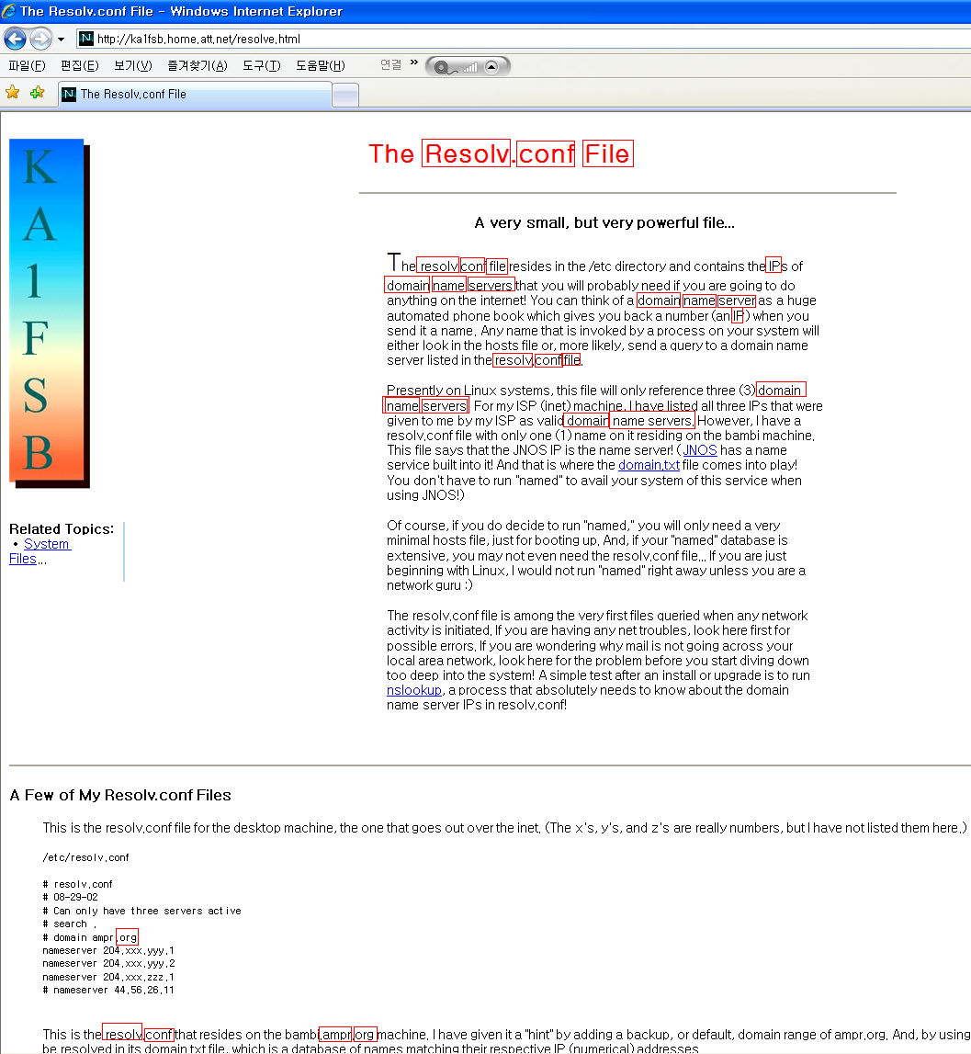
An Example of Tags vs Keywords (1)

Slide 20
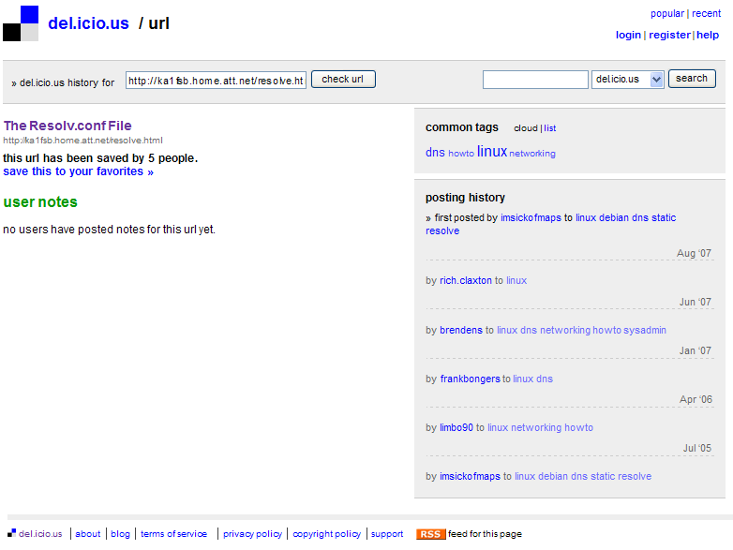
An Example of Tags vs Keywords (2)

Slide 21
An Example of Tags vs Keywords (3)
URL bookmarked by some users
  “resolv.conf” file in Linux operating systems.
  Top-10 keywords using both tf and tf×idf
[Table 1: An example of the tf and tf×idf keywords and user-generated tags of a user-saved URL]
URL | http://ka1fsb.home.att.net/resolve.html
Top tf keywords | domain,name,file,resolver,server,conf,network,nameserver,ip,org,ampr
Top tfidf keywords | ampr,domain,jnos,nameserver,conf,ka1fsb,resolver,ip,file,name,server
All tags | linux, howto, network, sysadmin,dns

Slide 22
An Example of Tags vs Keywords (4)
3 properties derived from Table 1
  First, The tags and keywords express the same content of the web page
    Tags and keywords both reflect the web page content
    Tags as high level abstraction
  Second, the tags are closer to the people’s understanding of the content than the keywords.
    Tags’s words summary ability : “sysadmin” and “dns”
  Third, some keywords are not useful in describing the general idea of the page.
    “ampr”, “org”, “jnos”, “ka1fsb”

Slide 23
An Example of Tags vs Keywords (5)
Conclusion from 3 properties
  Tag
    Barometer for human being’s judgments
    Good candidates to represent users’ interest.

Slide 24
The Vocabulary of Tags (1)
Our question
  Have the “most important” words of the document all been covered by the vocabulary of user-generated tags?
Answer
  Yes
Vocabulary coverage test of user-generated tags
  Randomly selected 7000 English documents
  Measurement about the importance of keywords
  Cumulative distribution function of the percentage of the missed keywords by the tag set.
Notes:
Before we can use tags for capturing social interest, it is necessary to examine the vocabulary of the user-generated tags as compared with the vocabulary of keywords in the web documents.

Slide 25
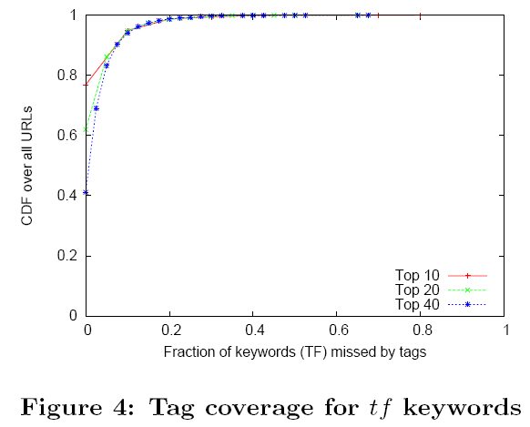
The Vocabulary of Tags (2)
Cover ration

Slide 26
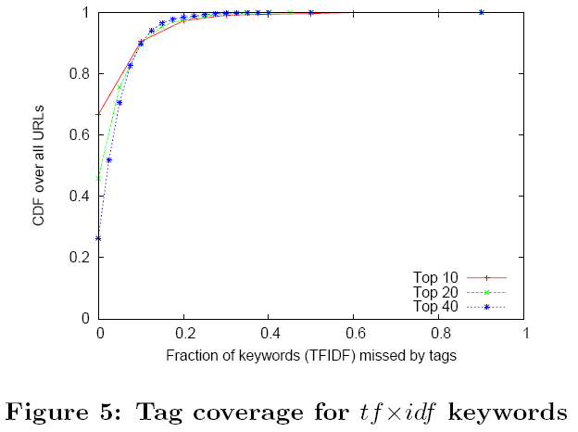
The Vocabulary of Tags (3)
Cover ration
Unpopular keyword’s boost

Slide 27
The Vocabulary of Tags (4)
Test result
  The vocabulary of user-generated tags can cover the main concepts of the URLs they bookmarked.

Slide 28
The Convergence of User’s Tag Selections (1)
Our question
  May the number of distinct tags used for a given web document increase as the document is bookmarked by more users ?
Answer
  No
  Golder et al., [8]
    the relative proportions of tags in the bookmarks are quite stable for popular URLs.

Slide 29
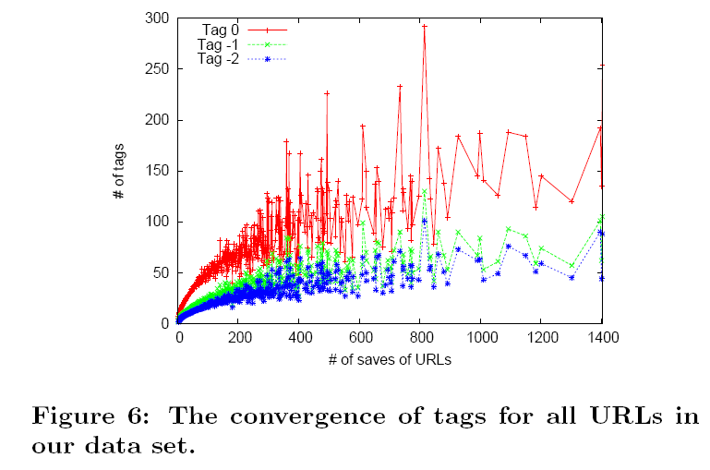
The Convergence of User’s Tag Selections (2)

Slide 30

Tag Matched by Documents (1)
The most important question?
  How well do tags capture the main concepts of documents, or how well tags of a URL are matched by the content of the URL?
Answer
  Yes
Our statistical analysis about correlation of tags and contents.

Slide 31
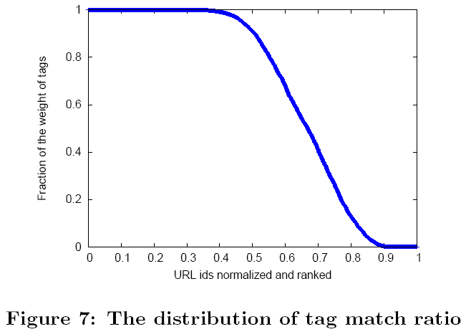
Tag Matched by Documents (2)

Slide 32
Discovering Social Interest with Tags (1)
Bookmark system
  Social Interest - the web pages that a user has bookmarked
    User-generated tags
      Capturing the content of a web page.
      More concise and closer to the users understanding.
      For reasons
        We believe that tags can be used to represent the content of URLs and hence the interest of users.
        Multiple tags are frequently used together, they define an topic of interest.

Slide 33
Discovering Social Interest with Tags (2)
Bookmark system
  Social Interest - the web pages that a user has bookmarked
    The sets of tags that are shared – Community of interest
    Task of discovering social interest for users
      Extracting frequently used tags
      Clustering the URLs and users under the identified tags
      Similar to association rules [aggrawal]

Slide 34
Content
Introduction
Related Work
Data Set
  Data Collection and Pre-Processing
  Users, URLs, and Tags
ANALYSIS OF TAGS
  An Example of Tags vs. Keywords
  The Vocabulary of Tags
  The Convergence of User’s Tag Selections
  Tags Matched by Documents
  Discovering Social Interest with Tags
ARCHITECTURE FOR SOCIAL INTEREST DISCOVERY
  Data Source
  Topic Discovery
  Clustering
  Indexing
  Online Version
EVALUATION RESULT
  The URL Similarity of Intra- and Inter- Topics
  User Interest Coverage
  Human Reviews
  Cluster Properties
Conclusions

Slide 35
Architecture For Social Interest Discovery
The software architecture of ISID
Find topics of interests
Clustering for each topic of interests.
Indexing
Posts
Data Source
Topic Discovery
Topics
Topics
Clusters
Indexing
Clustering

Slide 36
Data Source
A stream of posts
  P=(user, URL, tags)
Unique ID
Tag set

Slide 37
Topic Discovery
Frequent tag patterns for a given set of posts
  Association rule algorithm (aggrawal)
  Transaction: post p=(user, URL, tags)
    Key: (user, URL)
    Item: (tags)
    Example
      100 posts (“food”, “recipes”), support: 30
      Hot topics {food, recipes}, {food}, {recipes}
  Redundancy removal
    {food, recipes}, {food}, {recipes}

Slide 38
Clustering
for all topic T ⋲ T do
T.user ← ∅ ;
T.url ← ∅ ;
end for
for all post P ⋲ P do
for all topic T of P do
T.user←T.user⊔{P.user}
T.url←T.url⊔{P.url}
end for
end for
W(t1) > W(t2)
W(t1)
W(t2)

Slide 39
Indexing
Goal: Providing the basic query services
  For a given topic, list all URLs that contain this topic,
    have been tagged with all tags of the topic.
  For a given topic, list all users that are interested in this topic
    have used all tags of the topic.
  For given tags, list all topics containing the tags.
  For a given URL, list all topics the URL belong to.
  For a given URL and a topic, list all users that are interested in the topic and have saved the URL.
indexing on topics
for the topic-centric user and URL clusters
indexing on the URLs for the URL-centric topic and user clusters

Slide 40
Content
Introduction
Related Work
Data Set
  Data Collection and Pre-Processing
  Users, URLs, and Tags
ANALYSIS OF TAGS
  An Example of Tags vs. Keywords
  The Vocabulary of Tags
  The Convergence of User’s Tag Selections
  Tags Matched by Documents
  Discovering Social Interest with Tags
ARCHITECTURE FOR SOCIAL INTEREST DISCOVERY
  Data Source
  Topic Discovery
  Clustering
  Indexing
  Online Version
EVALUATION RESULT
  The URL Similarity of Intra- and Inter- Topics
  User Interest Coverage
  Human Reviews
  Cluster Properties
Conclusions

Slide 41
Evaluation Results
Selected 500 interest topics
  more than 30 bookmarked URLs
  5–6 co-occurring user tags . For each interest
For each interest topic
  Intra-topic similarity (500 interest topics)
    The average cosine similarity of all URL pairs in the cluster
  Inter-topic similarity
    Randomly select 10,000 topic-pairs among these 500 interest topics
    the average pairwise document similarity between every two topics,

Slide 42
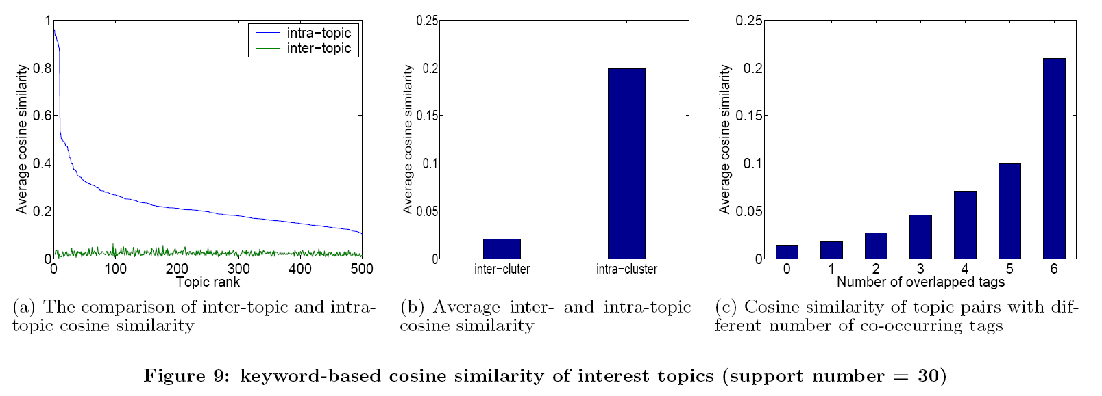
The URL Similarity of Intra- and Inter-Topics

Slide 43
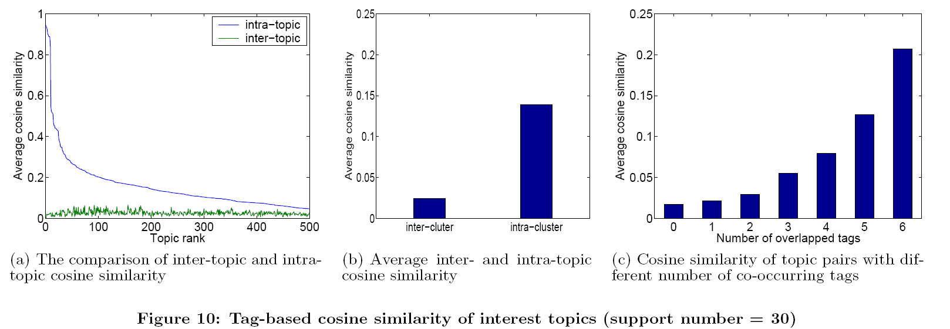
The URL Similarity of Intra- and Inter-Topics

Slide 44
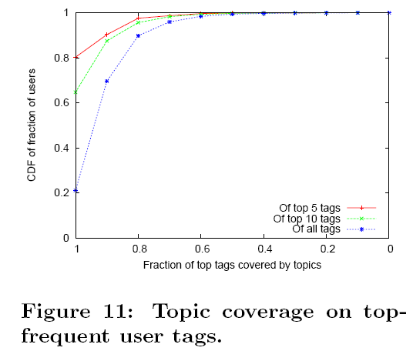
User Interest Coverage (1)
Have the topics generated by ISID have indeed captured the user?
  How many of the top-used tags of each user have been captured by the topics ISID discovered?

Slide 45
User Interest Coverage (2)
Have the topics generated by ISID have indeed captured the user?
  How many of the top-used tags of each user have been captured by the topics ISID discovered?

Slide 46
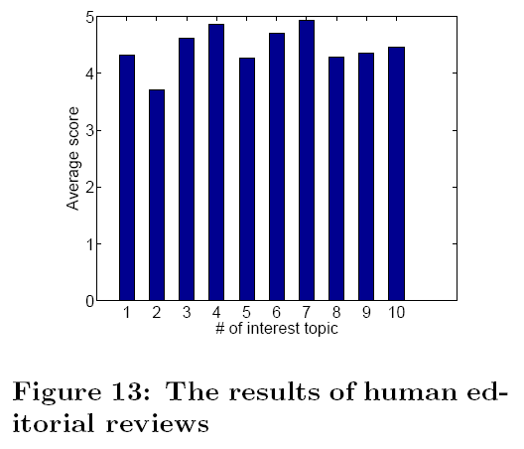
Human Reviews
4 human editors
10 multi-tag topics
Scores
  1, 2, 3, 4, 5

Slide 47
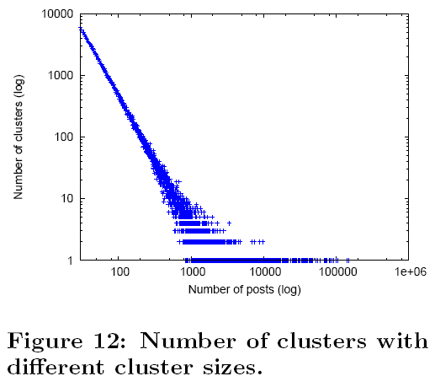
Cluster Properties (1)
With the support threshold 30, 163 K clusters

Slide 48
Cluster Properties (2)
Power-law distribution
The maximal cluster - 148 K with topic tag “design”.
Conclusion
  The interests of the users also follow the power-law distribution
  Existence of hot topics on the Internet which capture a large amount of users

Slide 49
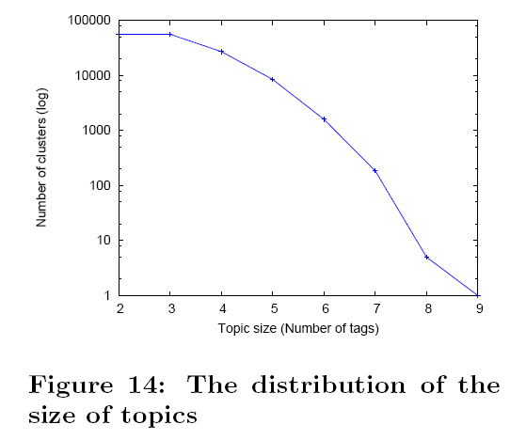
Cluster Properties (3)
Another related question to answer
  How many tags each of the topics contains? Figure 14 plots the number of

Slide 50
Cluster Properties (4)
Answer
  Most of the topics have no more than 5 tags
  Usage of a small number of words to summarize the contents
    Beyond 6 tags, the number of clusters reduces quickly
    Users are unlikely to reach consensus about the terms for describing a given content

Slide 51
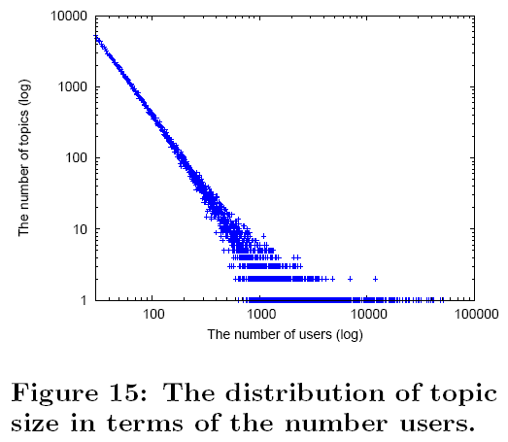
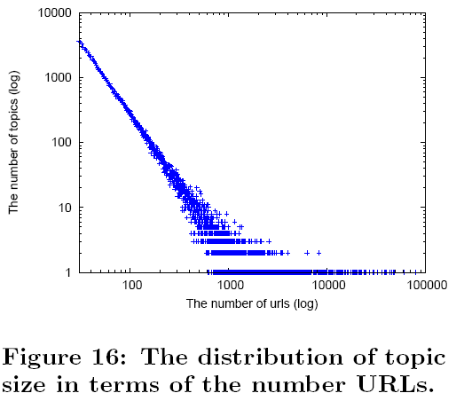
Cluster Properties (5)
Our result report
  Finally, we show the distribution of the number of topics as F(the number of users), F(the number of URLs)

Slide 52
Content
Introduction
Related Work
Data Set
  Data Collection and Pre-Processing
  Users, URLs, and Tags
ANALYSIS OF TAGS
  An Example of Tags vs. Keywords
  The Vocabulary of Tags
  The Convergence of User’s Tag Selections
  Tags Matched by Documents
  Discovering Social Interest with Tags
ARCHITECTURE FOR SOCIAL INTEREST DISCOVERY
  Data Source
  Topic Discovery
  Clustering
  Indexing
  Online Version
EVALUATION RESULT
  The URL Similarity of Intra- and Inter- Topics
  User Interest Coverage
  Human Reviews
  Cluster Properties
Conclusions

Slide 53
Conclusions
Tag-based social interest discovery approach
Justification our approach
System to discover common interest topics in social networks - del.icio.us

