Slide 1
Expectation Maximization
Heymo Kou
Jan 9th, 2017

Slide 2
Contents
Maximum Likelihood
EM Algorithm
Coin Toss
What is EM Algorithm?
Example using Scikit-learn

Slide 3
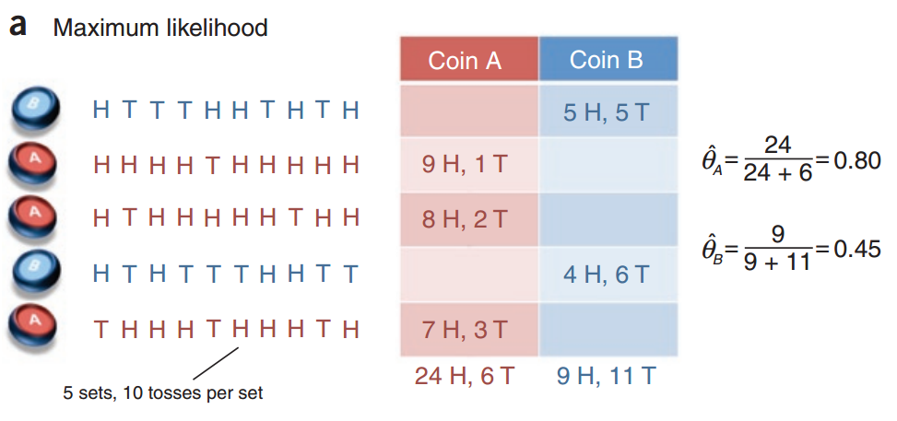

Maximum likelihood [Ronald Fisher, 1912]
Estimate population from a given sample
Find probability of head for each coin
$\hat{θ}$ = $\frac{H}{H+T}$
Are you sure it’s the best estimation?

Slide 4
EM Algorithm [Dempster et. al., 1997]
Repeat guessing and calculating
Until local optima has found
2 Steps
Expectation Step
Guess unknown parameters
Maximization Step
Observe result of guessed parameters
Reuse the new result in Expectation Step

Slide 5
EM Algorithm in nutshell
initial guess
E step
Guess of
unknown
parameters
(probabilities)
Guess of unknown
hidden structure
(tags, parses, weather)
Observed structure (words, ice cream)
M step

Slide 6
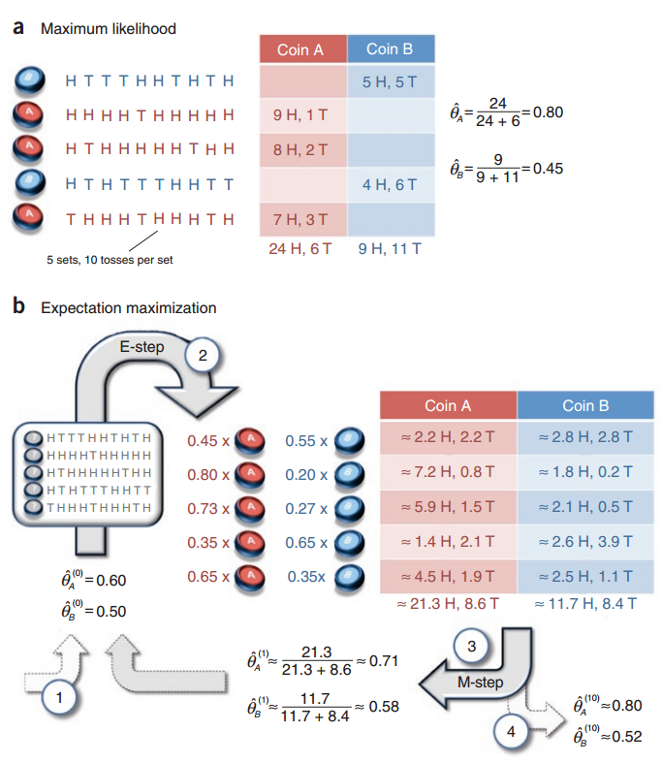
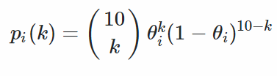
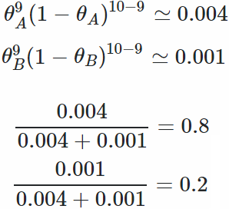
Coin toss [Chuong B Do & Serafim Batzoglou, 2008]
Published in Nature
What is the EM algorithm?
Probability of k heads

Slide 7
EM Clustering
Using Old Faithful geyser data
https://en.wikipedia.org/wiki/Expectation%E2%80%93maximization_algorithm

Slide 8
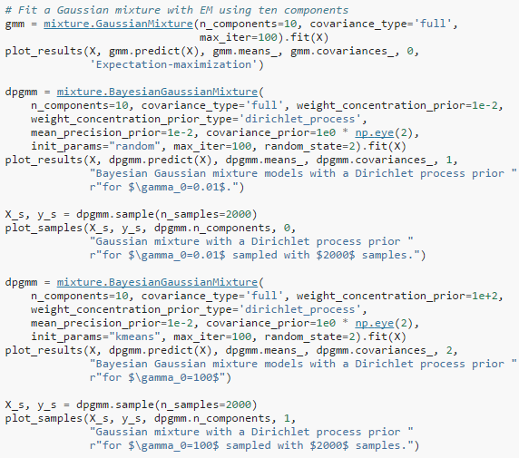
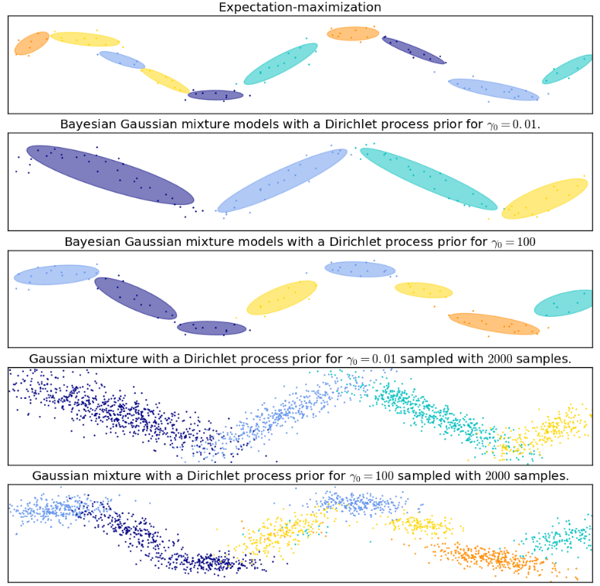
Sample Code
Clustering using EM Algorithm
http://scikit-learn.org/stable/auto_examples/mixture/plot_gmm_sin.html

Slide 9
Summary
Maximize expectation by repeating
Expectation step
Maximization step
Guaranteed to find local optima
Cons
Iteration may greatly slow
If dataset gets big
Cf) Monte Carlo method (Randomized)
Used in Alpha Go

Slide 10
Reference
http://ai.stanford.edu/~chuongdo/papers/em_tutorial.pdf
JHU CS 600.465 - Intro to NLP - J. Eisner

