Slide 1
YAGO: A Large Ontology from Wikipedia and WordNet
Fabian M. Suchanek, Gjergji Kasneci, Gerhard Weikum
Max-Planck-Institute for Computer Science, Saarbruecken, Germany
Journal of Web Semantics 2008
3 August 2011
Presentation @ IDB Lab Seminar
Presented by Jee-bum Park

Slide 2
Outline
Introduction
The YAGO model
Sources for YAGO
Information extraction
Evaluation
Conclusion

Slide 3
Introduction
Many applications in modern information technology utilize ontological background knowledge
Exploit lexical knowledge
Uses taxonomies
Combined with ontologies
Rely on background knowledge
Ontological knowledge structures play an important role in
Data cleaning
Record linkage
Information integration
Entity- and fact-oriented Web search
Community management
But the existing applications typically use only a single source of background knowledge

Slide 4


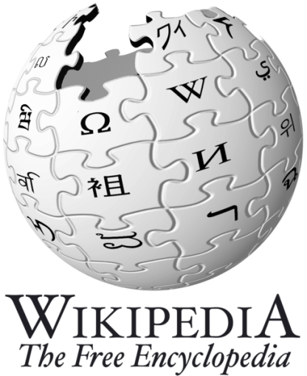
Introduction
If a huge ontology with knowledge from several sources were available, applications could boost their performance

Slide 5
Introduction
YAGO
Based on a data model that slightly extends RDFS
Combines high coverage with high quality
YAGO sources
From the vast amount of individuals known to Wikipedia
From WordNet for the clean taxonomy of concepts

Slide 6
Outline
Introduction
The YAGO model
Sources for YAGO
Information extraction
Evaluation
Conclusion

Slide 7
The YAGO model
The state-of-the-art formalism in knowledge representation is the Web Ontology Language (OWL)
However, it cannot express relations between facts
RDFS, the basis of OWL,
provides only very primitive semantics
For example, it does not know transitivity
This is why we introduce an extension of RDFS, the YAGO model

Slide 8
The YAGO model - Informal description
The YAGO model uses the same knowledge representation as RDFS
All objects are represented as entities in the YAGO model
Two entities can stand in a relation
For example, to state that Elvis won a Grammy Award,
Entities
ElvisPresley hasWonPrize GrammyAward
Relation

Slide 9
The YAGO model - Informal description
A certain word refers to a certain entity
This allows us to deal with synonymy and ambiguity
We use quotes to distinguish words from other entities
”Elvis” means ElvisPresley
Words
”Elvis” means ElvisConstello

Slide 10
The YAGO model - Informal description
Similar entities are grouped into classes
Each entity is an instance of at least one class
Classes are arranged in a taxonomic hierarchy, expressed by the subClassOf relation
Class
ElvisPresley type singer
singer subClassOf person

Slide 11
The YAGO model - Informal description
The triple of an entity, a relation and an entity is called a fact
The Two entities are called the arguments of the fact
Arguments
Fact
ElvisPresley hasWonPrize GrammyAward

Slide 12
The YAGO model - Informal description
In YAGO, we will store with each fact where it was found
For this purpose, facts are given a fact identifier
Each fact has a fact identifier
Suppose that the below fact had the fact identifier #1
Then the following line says that this fact was found in Wikipedia:
ElvisPresley bornInYear 1935
#1 foundIn Wikipedia
Fact identifier

Slide 13
The YAGO model - Reification graphs
We write down a YAGO ontology by listing the elements of the function in the form id₁ : arg1₁ rel₁ arg2₁ id₂ : arg1₂ rel₂ arg2₂ …
We allow the following shorthand notation id₂ : (arg1₁ rel₁ arg2₁) rel₂ arg2₂ to mean id₁ : arg1₁ rel₁ arg2₁ id₂ : id₁ rel₂ arg2₂

Slide 14
The YAGO model - Reification graphs
For example, to state that Elvis’ birth date was found in Wikipedia, we can simply write this fragment of the reification graph as
Elvis bornInYear 1935 foundIn Wikipedia

Slide 15
The YAGO model - n-Ary relations
Some facts require more than two arguments
RDFS and OWL do not allow n-ary relations
Therefore, the standard way to deal with this problem is:
GrammyAward prize elvisGetsGrammy
Elvis winner elvisGetsGrammy
1921 year elvisGetsGrammy

Slide 16
The YAGO model - n-Ary relations
The YAGO model offers a more natural solution to this problem:
Elvis hasWonPrize GrammyAward inYear 1967

Slide 17
The YAGO model - Query language
“When did Elvis win the Grammy Award?”
Usually, each entity that appears in the query also has to appear in the ontology
If that is not the case, there is no match
However “Which singers were born after 1930?”
Hence, we introduce filter relations ?x type singer ?x bornInYear ?y ?y after 1930
Elvis hasWonPrize GrammyAward inYear ?x

Slide 18
Outline
Introduction
The YAGO model
Sources for YAGO
Information extraction
Evaluation
Conclusion

Slide 19
Sources for YAGO - WordNet
WordNet is a semantic lexicon for the English language
WordNet distinguishes between words as literally appearing in texts and the actual senses of the words
A set of words that share one sense is called a synset

Slide 20
Sources for YAGO - Wikipedia
Wikipedia is a multilingual, Web-based encyclopedia
The majority of Wikipedia pages have been manually assigned to one or multiple categories
Furthermore, a Wikipedia page may have an infobox

Slide 21
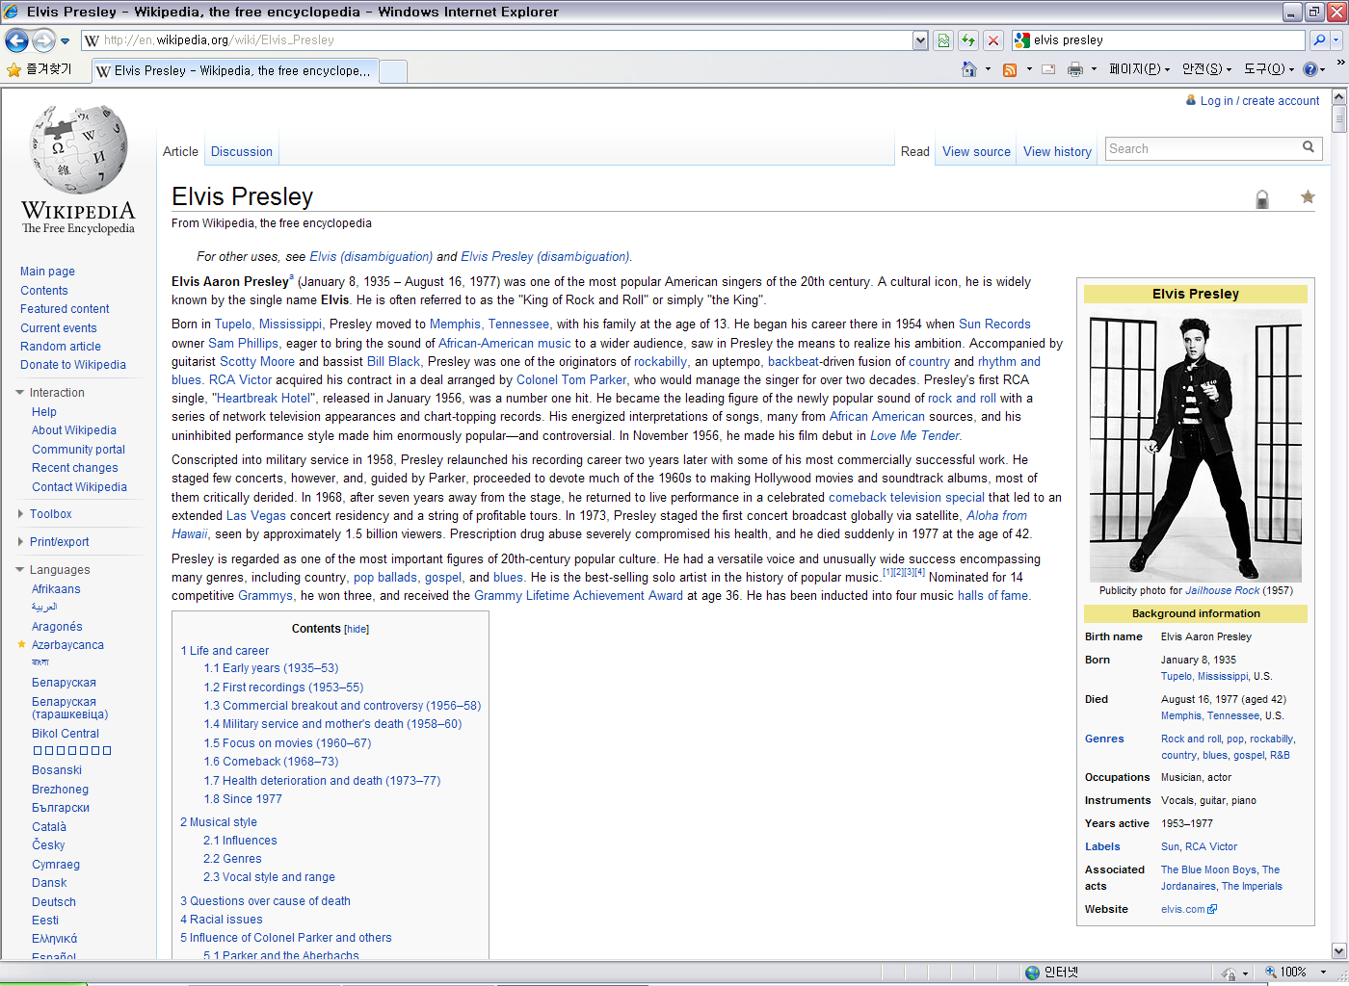
Sources for YAGO - Wikipedia

Slide 22
Outline
Introduction
The YAGO model
Sources for YAGO
Information extraction
Evaluation
Conclusion

Slide 23
Information extraction - Wikipedia heuristics
The individuals for YAGO are taken from Wikipedia
Each Wikipedia page title is a candidate to become an individual in YAGO
The page titles in Wikipedia are unique

Slide 24
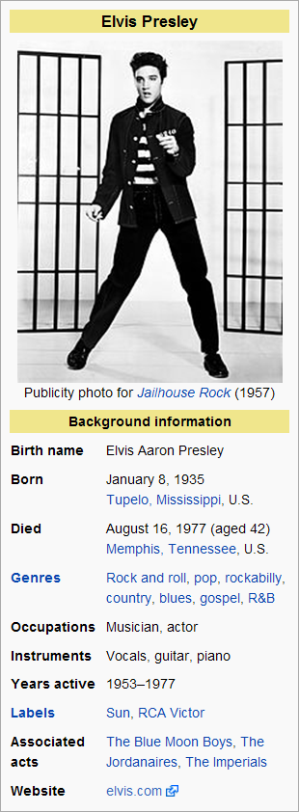
Information extraction - Wikipedia heuristics
Infobox heuristics

Slide 25
Information extraction - Wikipedia heuristics
To establish for each individual its class, we exploit the category system of Wikipedia
The Wikipedia categories are organized in a directed acyclic graph
The hierarchy is of little use from an ontological point of view
Hence we take only the leaf categories of Wikipedia and ignore all higher categories
Then we use WordNet to establish the hierarchy of classes, because WordNet offers an ontologically well-defined taxonomy of synsets

Slide 26
Information extraction - Wikipedia heuristics
Each synset of WordNet becomes a class of YAGO
For example, the Wikipedia class “American people in Korea”
Has to be made a subclass of the WordNet class “person”
We stem the head compound of the category name to its singular form: “American person in Korea”
We determine the pre-modifier and the post-modifier: “Amercian person”, “in Korea”
Then we check whether there is a WordNet synset for the modifier: “Amercian person” is a hyponym of “person”
The head compound “person” has to be mapped to a corresponding WordNet synset

Slide 27
Information extraction - Storage
We store for each individual the URL of the corresponding Wikipedia page with the describes relation
This will allow future applications to provide the user with detailed information on the entities
To produce minimal overhead, we decided to use simple text files as an internal format
We maintain a folder for each relation, each folder contains files that list the entity pairs

Slide 28
Information extraction - Query engine
Since entities can have several names in YAGO, we have to deal with ambiguity
We replace each non-literal, non-variable argument in the query by a fresh variable and add a means fact for it
We call this process word resolution

Slide 29
Information extraction - Query engine
“Who was born after Elvis?” ?i1: Elvis bornOnDate ?e ?i2: ?x bornOnDate ?y ?i3: ?y after ?e This query becomes ?i0: “Elvis” means ?Elvis ?i1: ?Elvis bornOnDate ?e ?i2: ?x bornOnDate ?y ?i3: ?y after ?e

Slide 30
Information extraction - Query engine
In the example, the SQL query is: SELECT f0.arg2, f1.arg2, f2.arg1, f2.arg2 FROM facts f0, facts f1, facts f2 WHERE f0.arg1=‘”Elvis”’ AND f0.relation=‘means’ AND f1.arg1=f0.arg2 AND f1.relation=‘bornOnDate’ AND f2.relation=‘bornOnDate’
Then, the query engine evaluates the after relation on the result

Slide 31
Information extraction - Query engine
This implementation leaves much room for improvement, especially concerning efficiency
It takes several seconds to return 10 answers to the previous query
Queries with more joins can take even longer
In this article, we use the engine only to showcase the contents of YAGO

Slide 32
Outline
Introduction
The YAGO model
Sources for YAGO
Information extraction
Evaluation
Conclusion

Slide 33
Evaluation - Precision
To evaluate the precision of an ontology, its facts have to be compared to some ground truth
We had to rely on manual evaluation
We presented randomly selected facts of the ontology to human judges and asked them to assess whether the facts were correct
13 judges participated in the evaluation
Evaluated a total number of 5200 facts

Slide 34
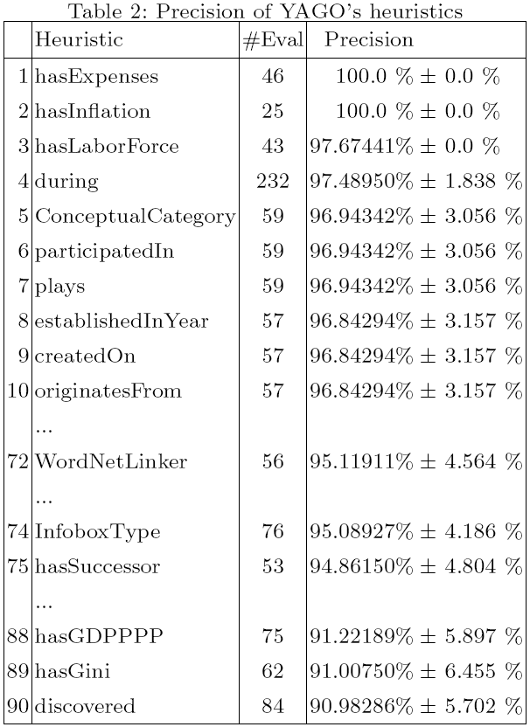
Evaluation - Precision

Slide 35
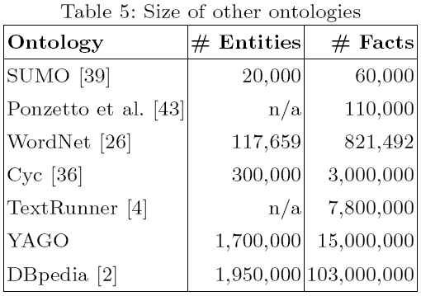
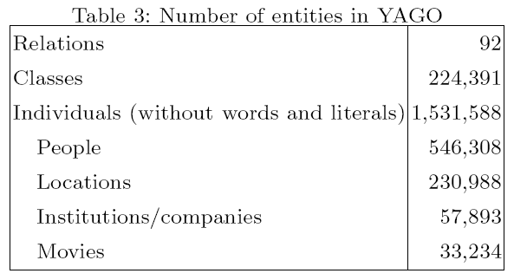
Evaluation - Size
Half of YAGO’s individuals are people and locations
The overall number of entities is 1.7 million

Slide 36
Outline
Introduction
The YAGO model
Sources for YAGO
Information extraction
Evaluation
Conclusion

Slide 37
Conclusion
We presented our ontology YAGO and the methodology
We showed how the category system and the infoboxes of Wikipedia can be exploited for knowledge extraction
Our evaluation showed not only that YAGO is one of the largest knowledge bases available today, but also that it has an unprecedented quality in the league of automatically generated ontologies

Slide 38
Thank You!
Any Questions or Comments?

